Slide 1
JavaScript
Lecture. Object, Array, Context.

Slide 2
Lesson Plan
Object
Methods
Array
Self Pointer ‘this’
Context
.call
.apply
.bind

Slide 3
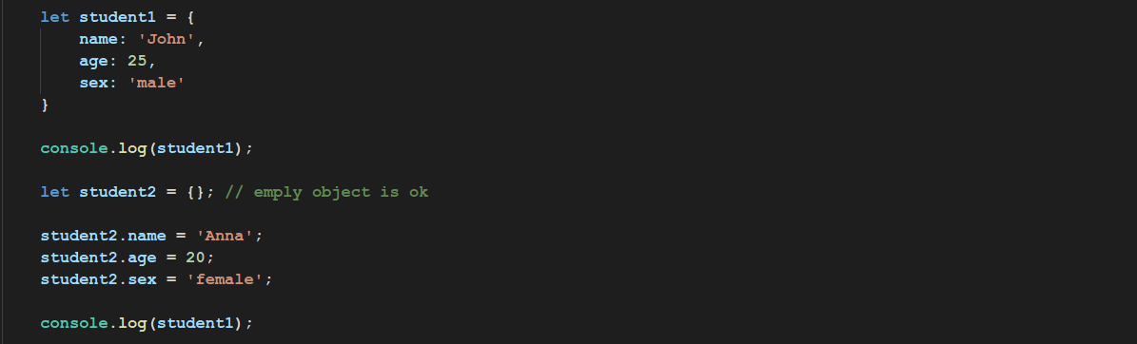
Object
Associative array - is an abstract data type composed of a collection of
(key, value) pairs, such that each possible key appears at most once
in the collection.

Slide 4
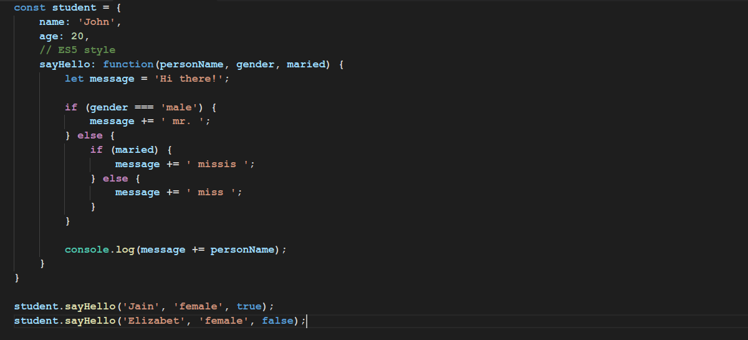

Object Methods

Slide 5
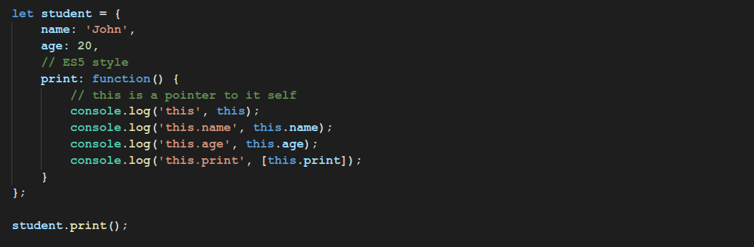

Self Pointer ‘this’
All functions have a local variable ‘this’ (context)

Slide 6
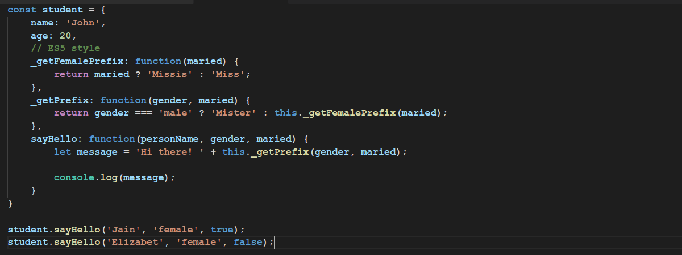
Private Methods
JavaScript doesn’t has access modifiers.
All private methods should have _underscore prefix.

Slide 7
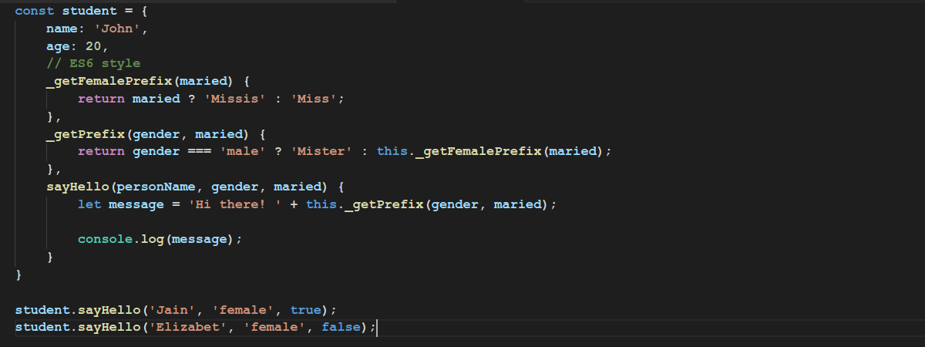
Methods in ES6
ES6 brought us concise notation of methods

Slide 8
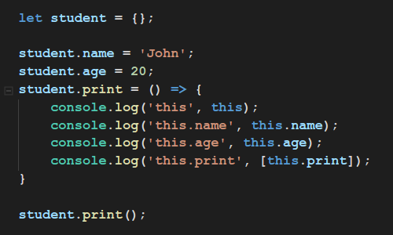
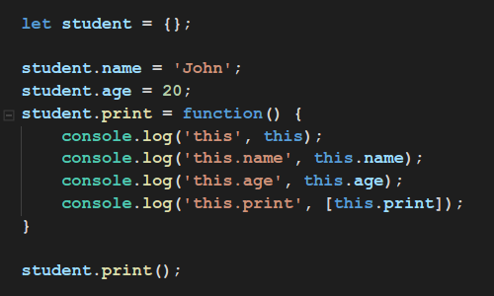
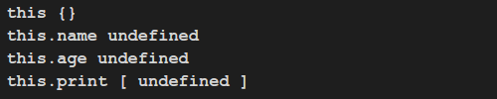
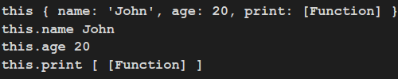
Methods
Be aware!

Slide 9
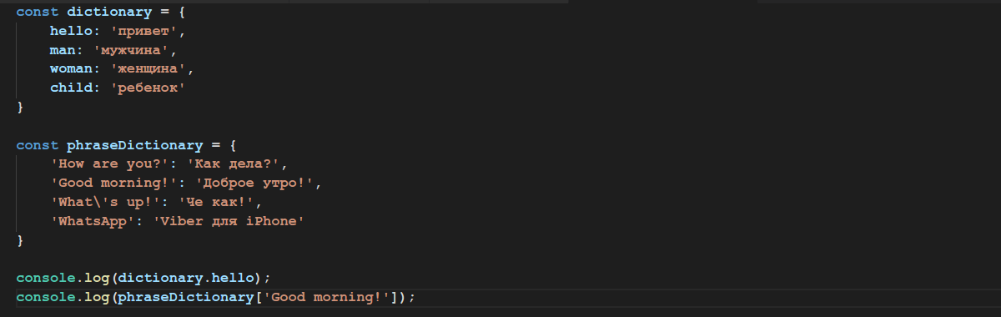

Property Accessors
Property accessors provide access to an object's properties by using the dot notation or the bracket notation.

Slide 10
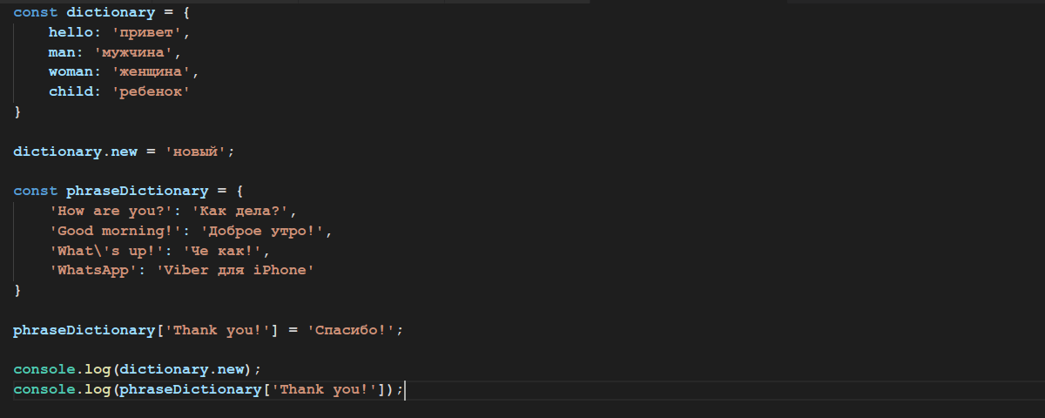

Property Accessors
Bracket and Dot notations

Slide 11
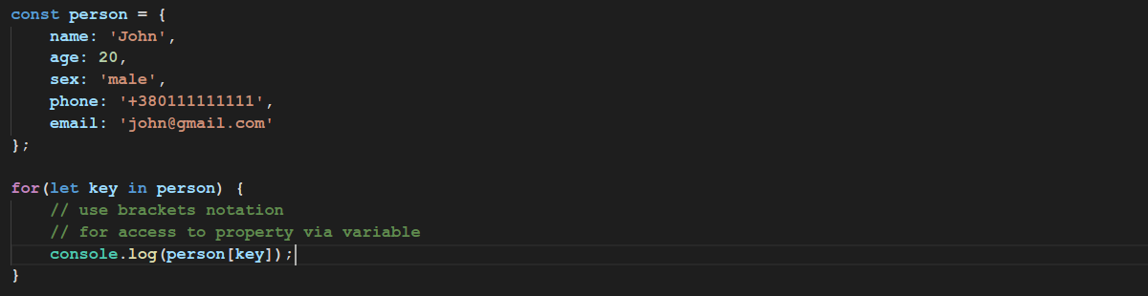
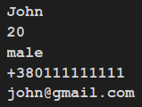
for… in
The for...in statement iterates over the enumerable properties of an object, in original insertion order.

Slide 12
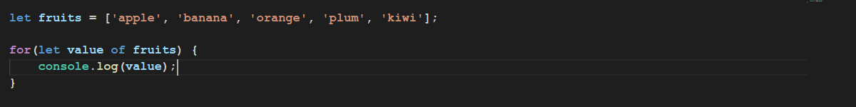

for… of
The for… of statement creates a loop iterating over iterable objects
(including Array, String, arguments object and so on)

Slide 13
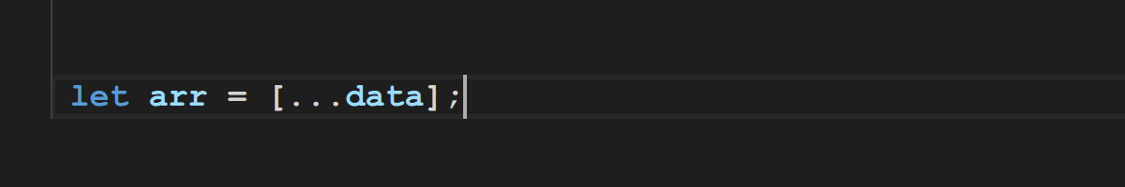
Array
Let’s see some useful methods

Slide 14
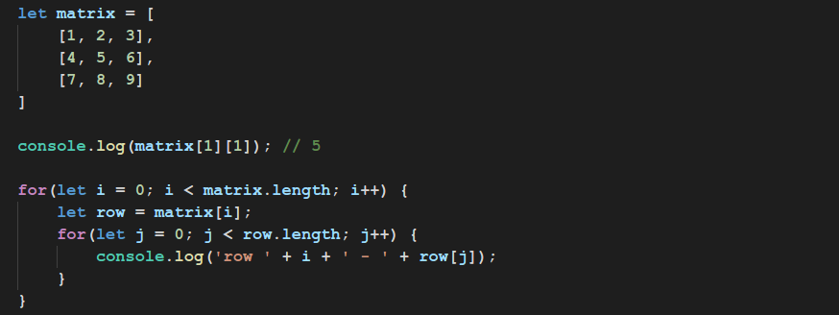
Multidimensional Arrays

Slide 15
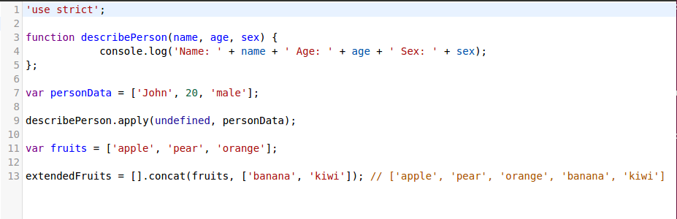
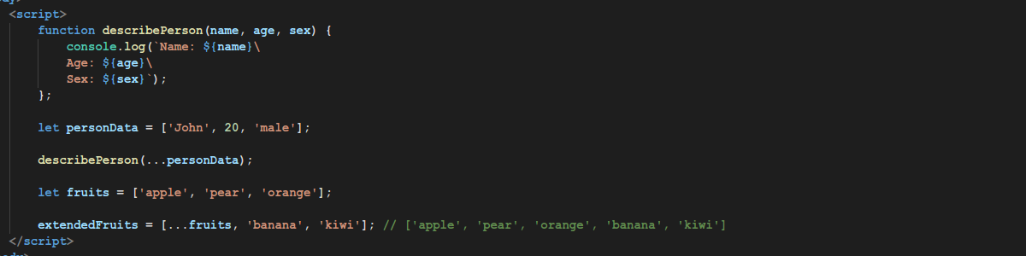
Array
Spread operator

Slide 16
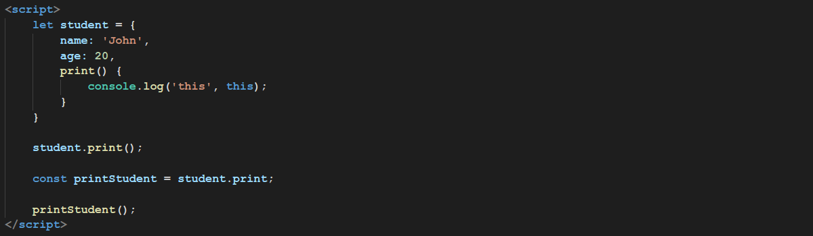
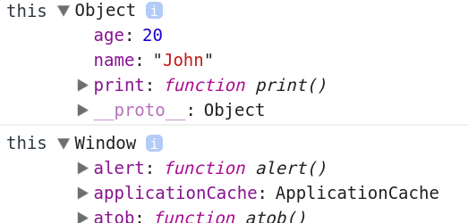
Context
What happened? How can we fix this?

Slide 17
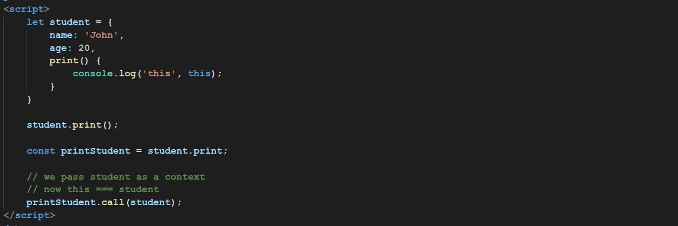
.call

Slide 18
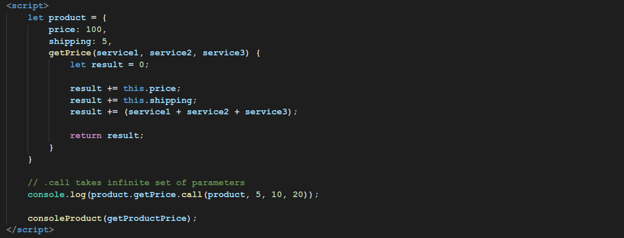
.call

Slide 19
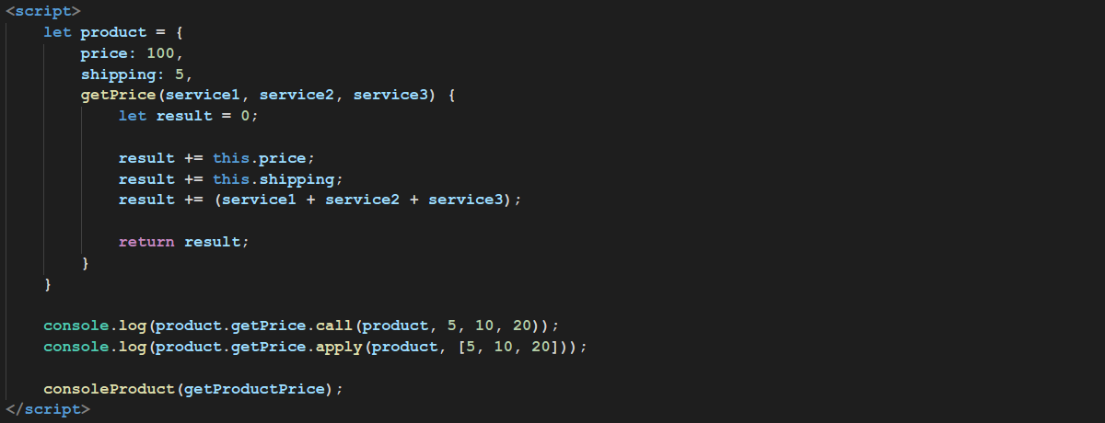
.apply
.call takes infinite set of parameters
.apply takes array with parameters as second parameter

Slide 20
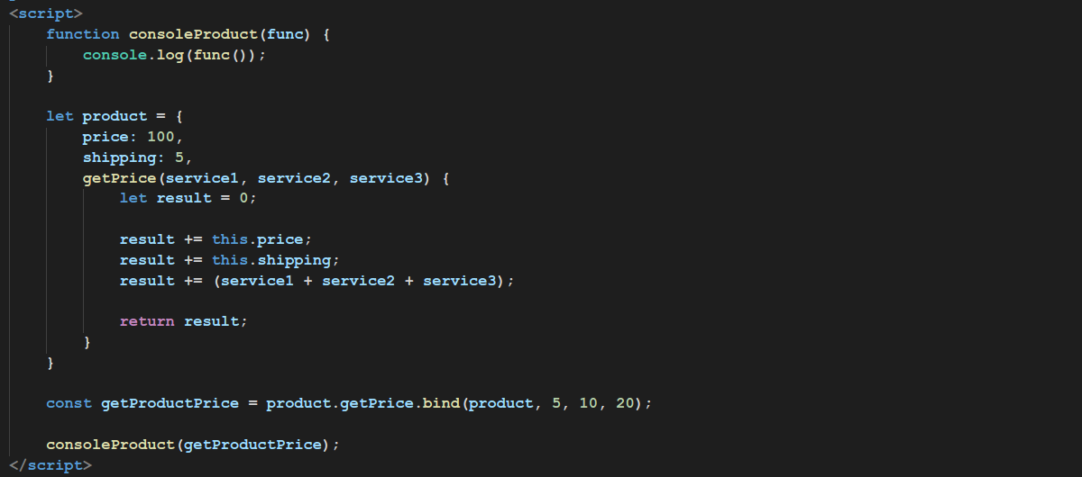
.bind

Slide 21
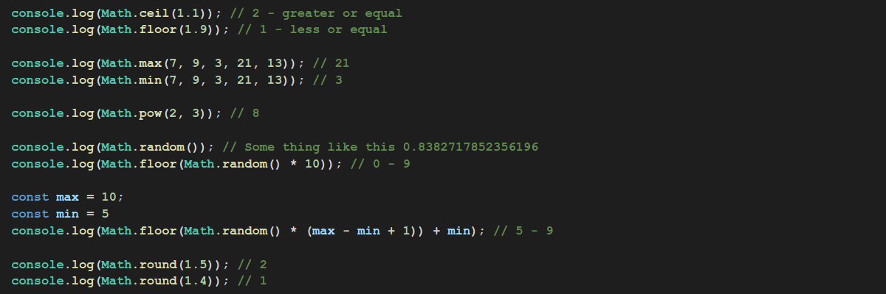
Math
Some useful methods

Slide 22
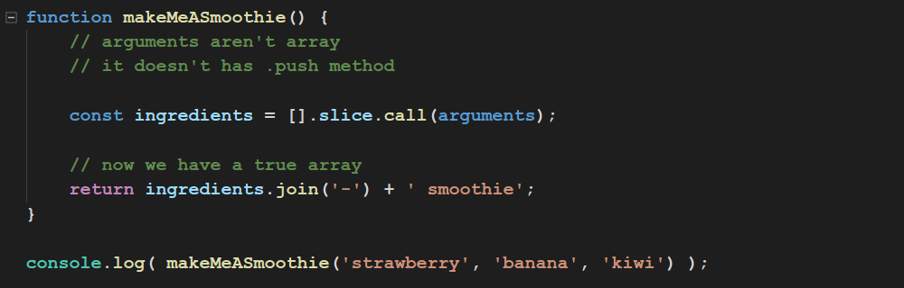
Methods Borrowing

Slide 23
Task 1
Please write a function that retrieve an array of digits and
returns the bigger one.

Slide 24
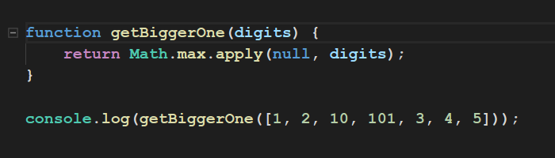
Task 1

Slide 25
Task 2
Please write a function that retrieve number of string arguments and
return joined string from that arguments.

Slide 26
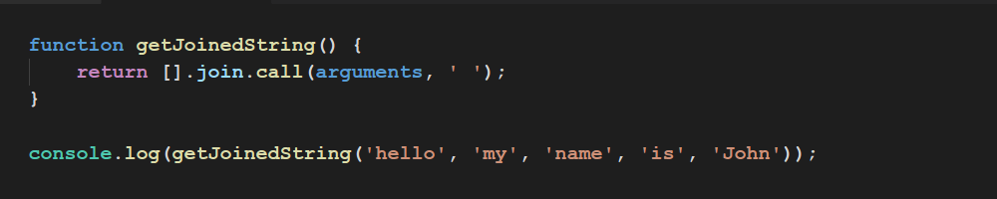
Task 2

Slide 27
Thanks for your attention

