Slide 1
SYPHONIX x AI ENGINE · QUANTHACK
Model to Market
An AI-native, self-adapting quantitative trading system
$1,000,000 paper
30x max leverage
10 FX + metals
Market-neutral
Entrant: alex@ladimex.com
Notes:
Open with the honest thesis: thin edge, but a complete, self-adapting, governed system. The pitch is engineering and discipline, not a magic signal.

Slide 2
An honest thesis
I make no claim to a magic alpha. The edge is thin and regime-dependent, and I prove that with data rather than hide it. I compete on engineering, live self-adaptation, and risk discipline.
0
forced liquidations across every round
Engineering
Self-adaptation
Risk discipline
A complete stack - research, a multi-layer risk engine, native MT5 execution, cloud deploy - all built and runnable.
It measures the live market and re-tunes its own strategy, leverage and cadence, autonomously.
Layered caps, a drawdown ladder and a profit-lock ratchet - the AI can only ever reduce risk.

Slide 3
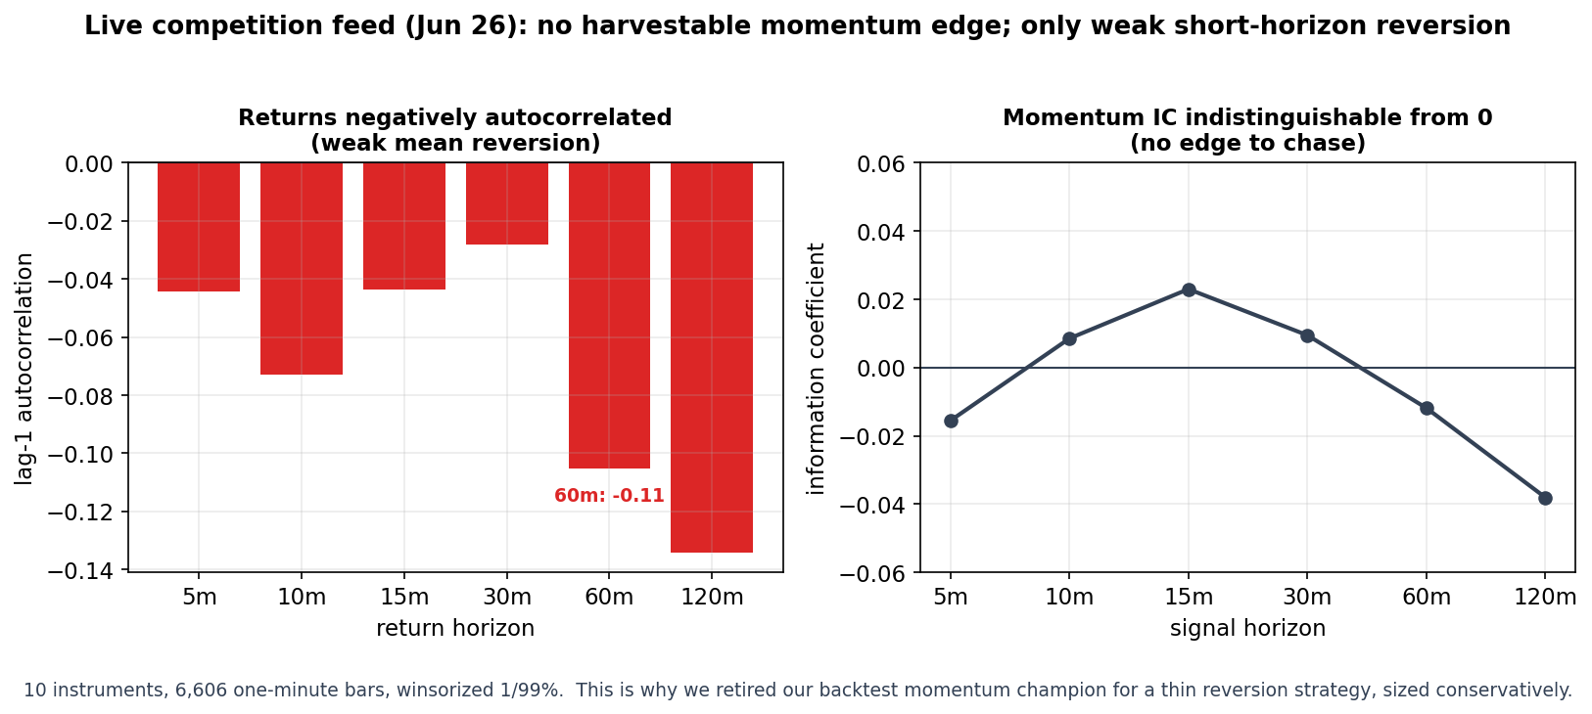
I let the data overturn my own thesis
My backtest champion was 8-hour momentum.
Live on the competition feed, an information-coefficient and autocorrelation study showed momentum was the wrong sign - returns mean-revert at every short horizon.
So I retired momentum and wired a conservative reversion strategy.
Retire your own champion the moment the live data disagrees.
Live feed, 26 Jun: 10 instruments, 6,606 one-minute bars.

Slide 4
Autopilot: a governed AI desk
AI proposes, a deterministic governor disposes - and Logfire traces every decision.
>
>
>
>
NVIDIA Nemotron
Anthropic Claude
Pydantic
Governor
Execution
Analyst - reads the live regime
Strategist - proposes strategy / gross / cadence
Validates every output - cannot be out of bounds
Clamps to competition-safe limits
Reduce-only only
In practice: a reckless gross=9 proposal is clamped to 3.0; an aggressive ask in a no-edge regime becomes 1.0. The AI advises - it can never breach a risk limit.

Slide 5
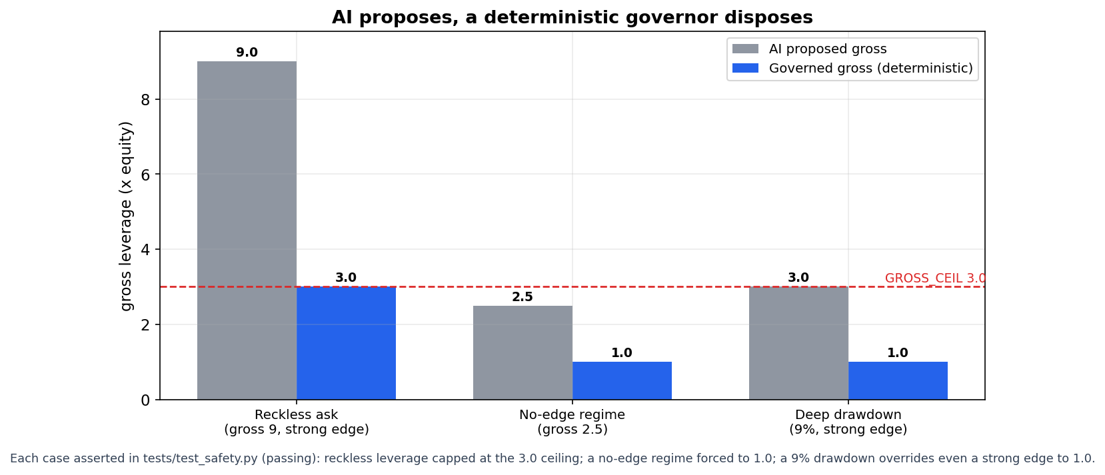
The governor can only ever reduce risk
Every AI-proposed leverage is clamped before it can act. These exact mappings are asserted in a runnable test suite - tests/test_safety.py, 6/6 passing.

Slide 6
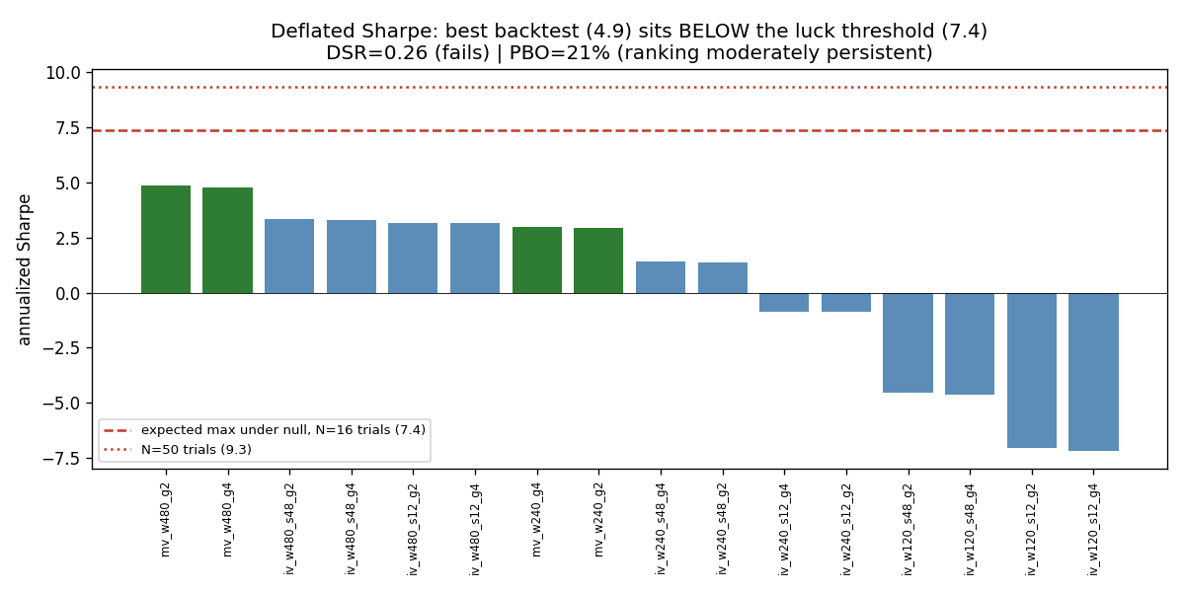
Honesty as a feature
Deflated Sharpe = 0.26 - my best backtest sits below the luck threshold for the number of trials run.
Probability of Backtest Overfitting about 21%.
Negative results I kept and published: momentum, crypto, order-flow and scalping - all tested live and rejected.
Trust the direction of the findings, not the magnitude.

Slide 7
Every sponsor used for something real
NVIDIA Nemotron
Anthropic Claude
Pydantic + Logfire
Live regime Analyst in Autopilot, a reduce-only news/event-risk gate, and a catalog auto-resolver immune to model drift.
Strategist in Autopilot, plus desk rationale and post-round red-team memos.
Typed, hard-bounded AI outputs and end-to-end tracing of every cycle and agent call.
Doubleword
MetaTrader 5
Northflank
Opt-in private-inference provider wired into the multi-provider gateway.
Native copy_rates feed and a notional-to-lots execution bridge, dry-run safe.
Containerised cloud mission control: dashboard, AI desk and Logfire.

Slide 8
Layered, provable risk
Concentration caps: <=30% of gross and <=75% of equity per name; metals sector <=35%.
Drawdown ladder auto-cuts gross: 5% to x0.7, 8% to x0.4, 12% to x0.2.
Profit-lock ratchet: once ahead, de-risks as gains are surrendered - locks profit without a stop's whipsaw.
Preflight circuit breaker halts a cycle on a stale feed or an insane book.
Paper-only throughout; every AI overlay is reduce-only and can never override the risk engine.
0
forced liquidations
3 min
risk monitor cadence (reduce-only)

Slide 9
The system, end to end
MT5 feed
live_runner
Risk engine
Autopilot
Preflight
MT5 bridge
live 1-min panel
target book (rev)
caps + ladder
Nemotron + Claude to Governor
halt if insane
paper orders
Parallel: fast_monitor every 3 minutes (drawdown ladder + profit-lock, reduce-only). Logfire tracing throughout. Northflank cloud mission control.

Slide 10
A system that re-tunes itself - observably and safely
No magic alpha. The most competition-relevant thing I built is a system that measures the live market, tests its own ideas, kills the ones that don't survive contact with the data, and re-tunes itself - within hard risk limits it can never breach.
github.com/Alex-Lahdiri/Quanthack-Model-to-Market
Past simulated performance is not indicative of live results.

