Slide 1


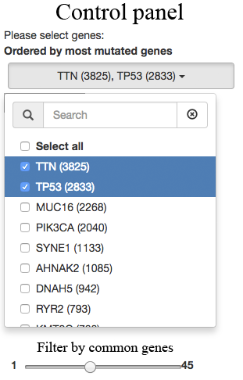
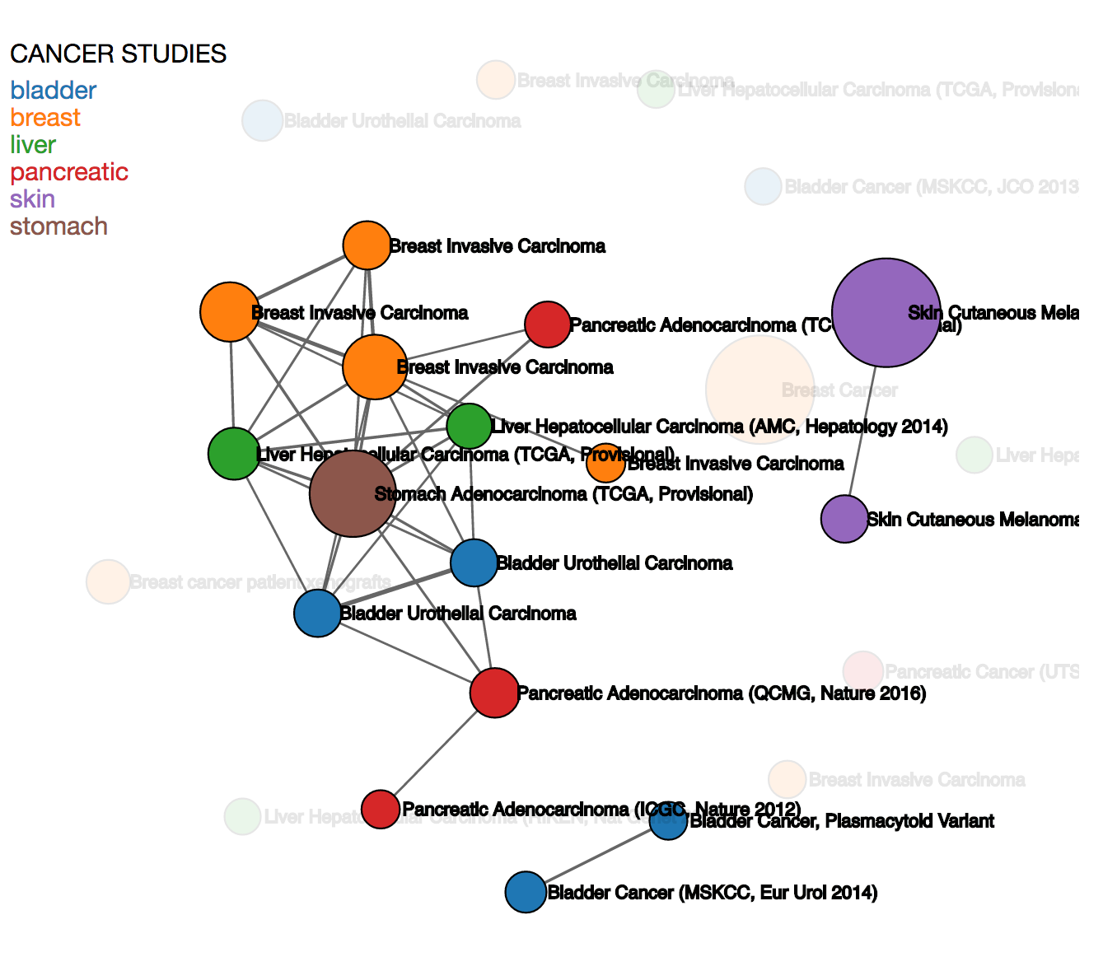
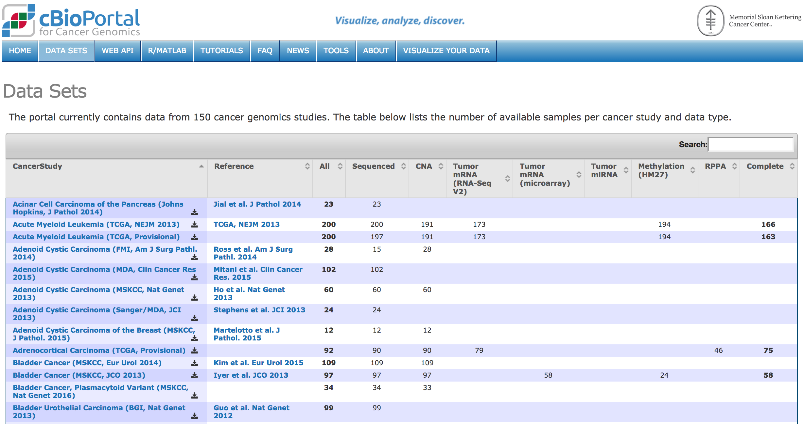
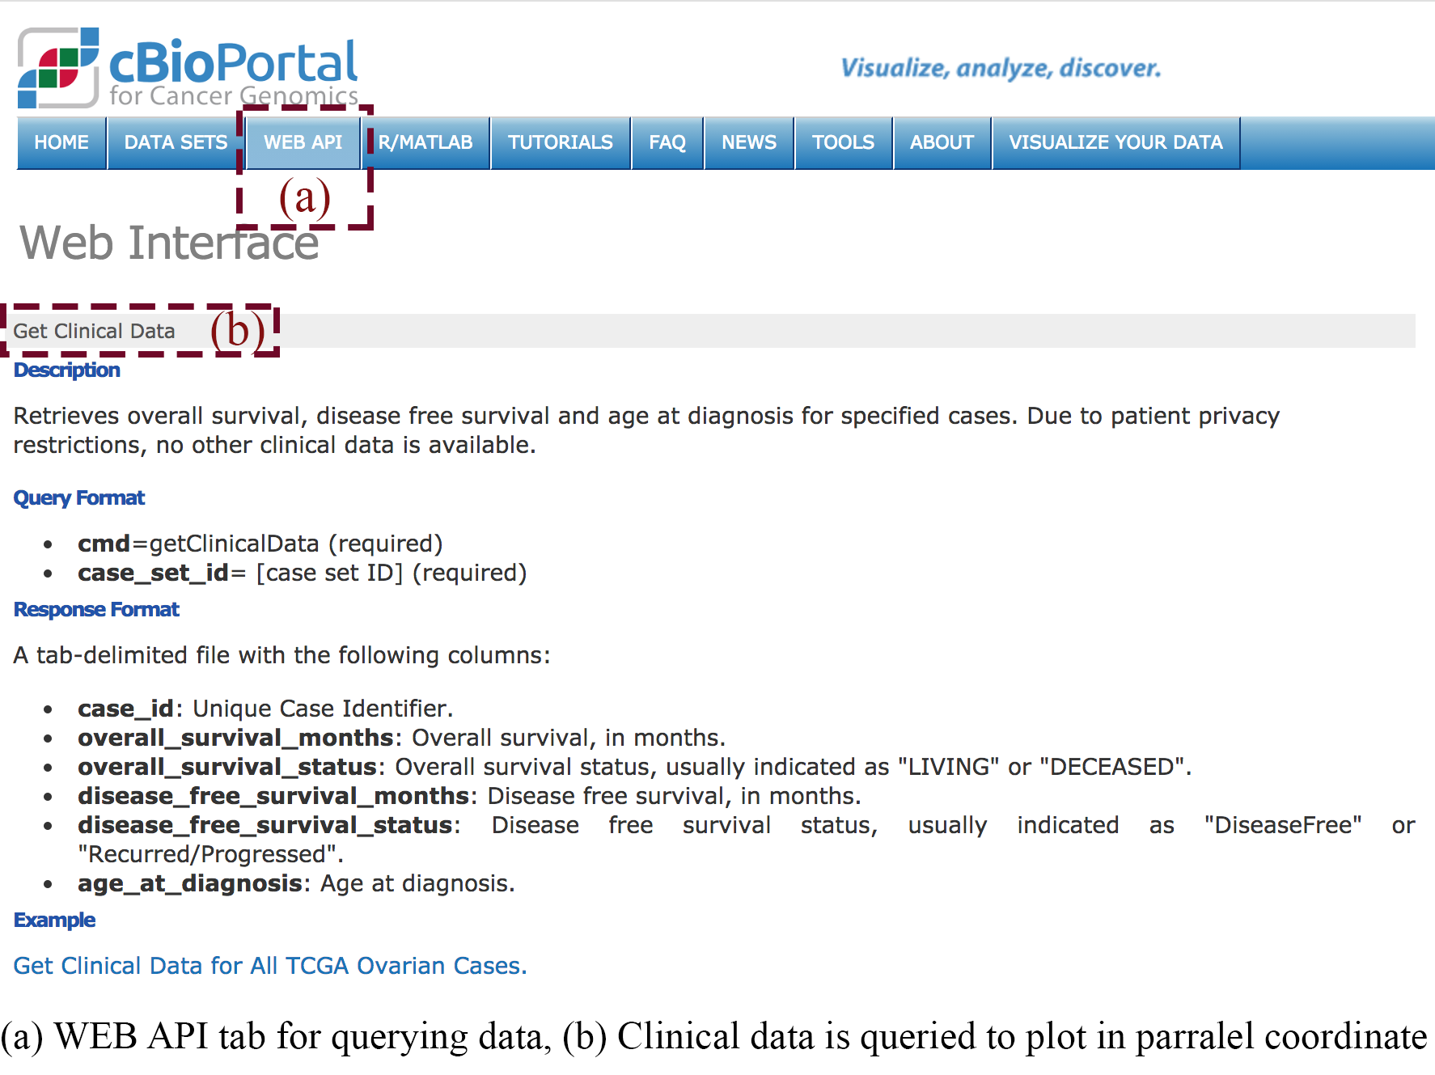
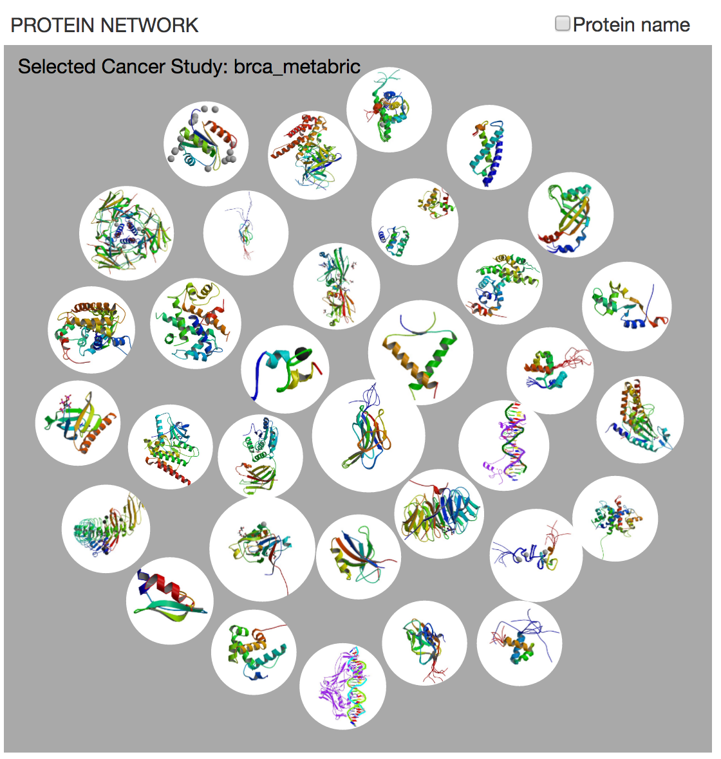
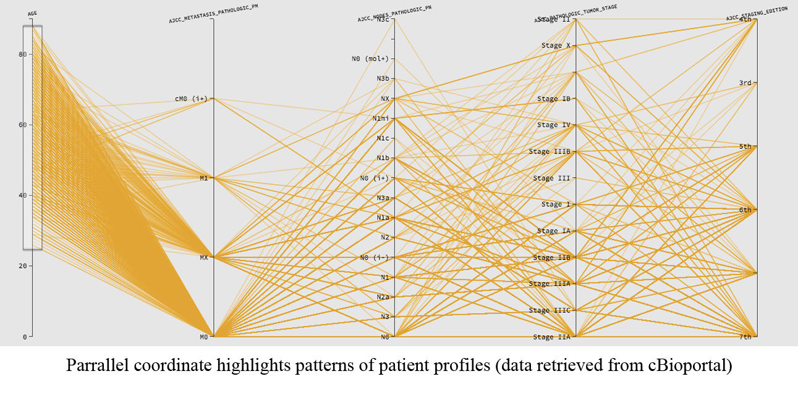

CancerMapper: A bottom-up exploration of protein network
Vinh The Nguyen (vinh.nguyen@ttu.edu), Tommy Dang (tommy.dang@ttu.edu) – Computer Science Dept., Texas Tech University
Abstract
Understanding the complicated many-to-many relationships between cancers and mutated genes is challenging. For example, what common proteins are highly mutated in both prostate cancer and breast cancer or what cancers are driven by a selected subset of proteins. In this paper, we present CancerMapper, a novel exploration tool, that allows users to uncover the correlations among cancer studies as well as cancer studies and genes. CancerMapper also helps biologists to filter the cancer network based on the common mutated proteins and their frequencies. Bubble graph is constructed to visualize common protein based on its frequency and biological assemblies. Parallel coordinates highlight patterns of patient profiles (obtained from cBioportal by WebAPI services) on different attributes for a specified cancer study. Data retrieved from cBioportal.org as a Comma Separated Value file including protein name, frequency, cancer study and study type fields as well as Tab Separated Value through WebAPI service provided by cBioPortal. Protein’s images pulled from Protein Data Bank (http://www.rcsb.org/)
Introduction
Network visualization is a powerful representation of relationships between data and is considered to be an important task in scientific research. It is widely used in many different application domains such as social networks, communication networks, protein networks and so on. Despite such available tools and techniques, understanding protein-protein interactions is still ongoing challenges for biologists and researchers for years, even with small question of how to better understand complicated many-to-many relationships between cancers and mutated genes. Therefore, having a graphical tool that help biologists can analyze and gain insight interactions of protein-protein network is highly desirable. The main objectives of this paper are:
to allows users to uncover the correlations among cancer studies as well as cancer studies and genes.
to helps biologists to filter the cancer network based on the common mutated proteins and their frequencies
to visualizes common protein based on its frequency and biological assemblies
to highlights patterns of patient profiles (obtained from cBioportal by WebAPI services) on different attributes for a specified cancer study
Methods
Input dataset:
Cancer studies/proteins/attributes: from cBioportal.org
Protein biological assemblies: Protein Data Bank (http://www.rcsb.org/pdb/home/home.do)
The client side contains four components
Control panel (A) : This panel provides two options that allow user to filter cancer studies by genes and by the number of common genes between cancer studies
Main view (B): Within this view user can interactively display connection between cancer studies
Biological Assemblies view (C): User can either display protein assembly or protein name by checking protein name at the top right corner of this window
Parallel coordinate view (D): this graph highlight patterns of patient profiles (obtained from cBioportal by WebAPI services) on different attributes for a specified cancer study.
A
B
Main view:
Cancer study and protein datasets
Conclusion
In this paper, we introduced Cancermapper to visualize interactive protein network comprising of different cancer study id’s which are related based on their common genes by using HTML, CSS, and D3js. Protein frequency and its biological assembly is shown in bubble graph. The correlation between cancer study attributes is plotted on the parallel graph.
Future work
In the future, we will integrate protein-protein relationship to the Protein network (C) by extracting data from PubMed central database. Automatic feature detection across different cancer studies to compare and cluster proteins/genes is also included.
References:
http://www.texastech.edu/identityguidelines/idguidelines/ttu
http://www.tltc.ttu.edu/posters
Saraiya, P., North, C., & Duca, K. (2005). Visualizing biological pathways: requirements analysis, systems evaluation and research agenda. Information Visualization, 4(3), 191-205.
Dang, T. N., Murray, P., & Forbes, A. G. (2015, August). PathwayMatrix: visualizing binary relationships between proteins in biological pathways. In BMC proceedings (Vol. 9, No. 6, p. S3). BioMed CentralYet another reference goes here.
C
D

