Slide 1


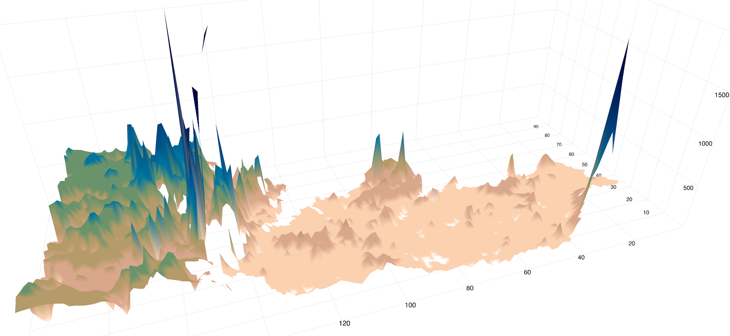
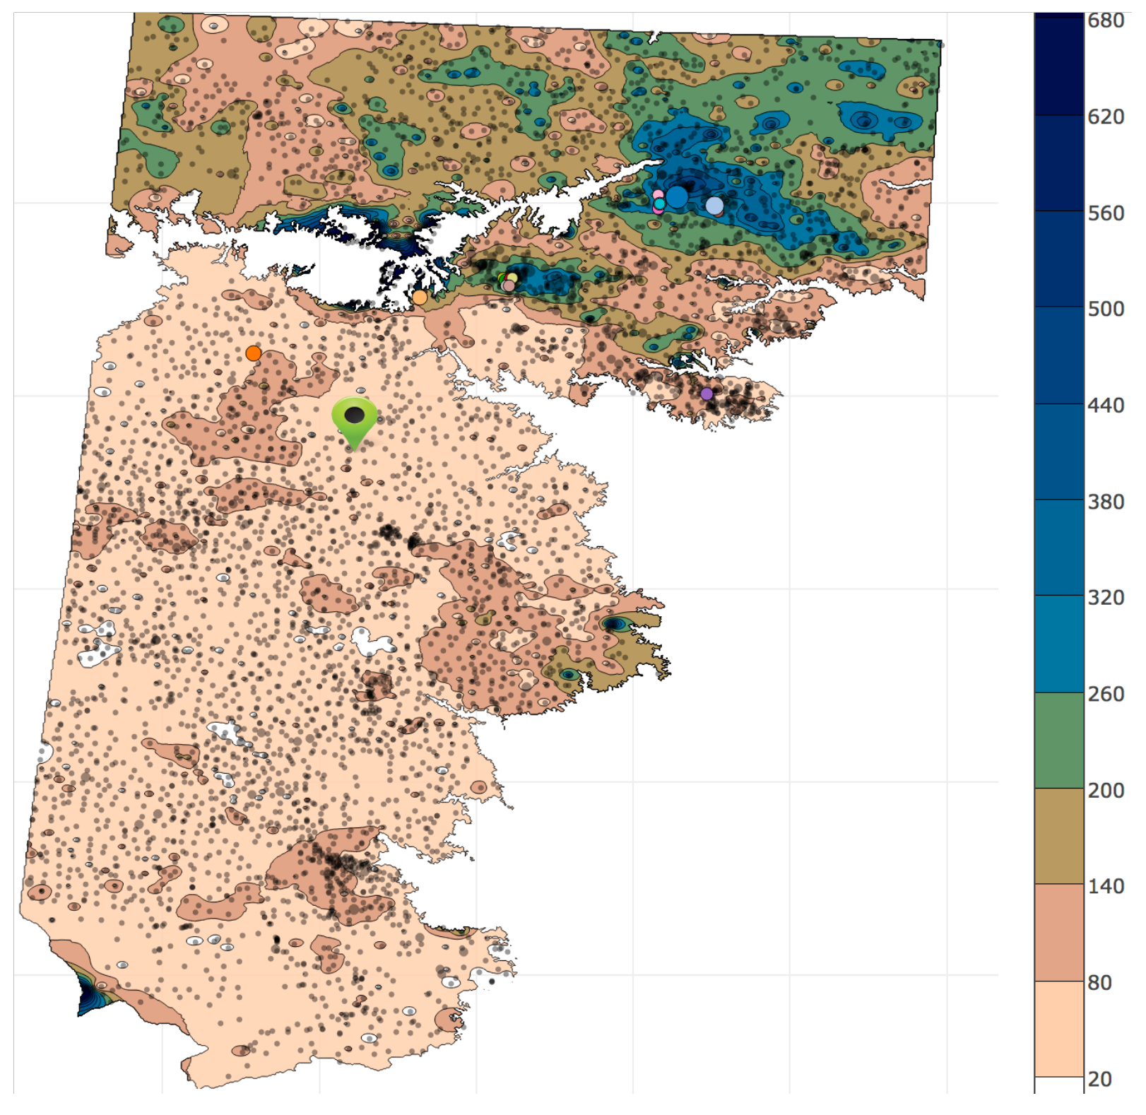
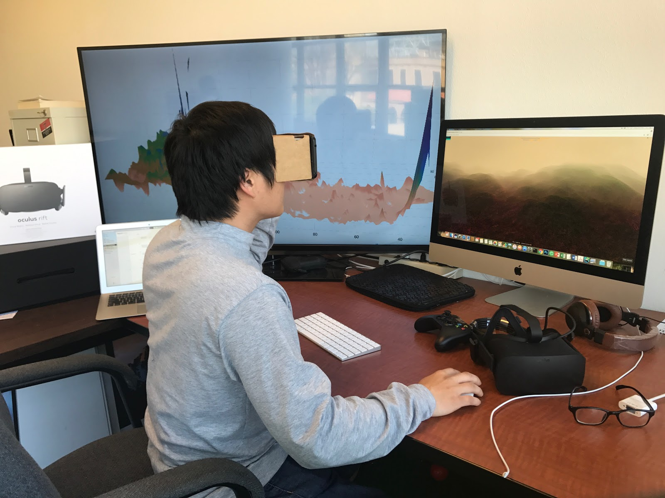
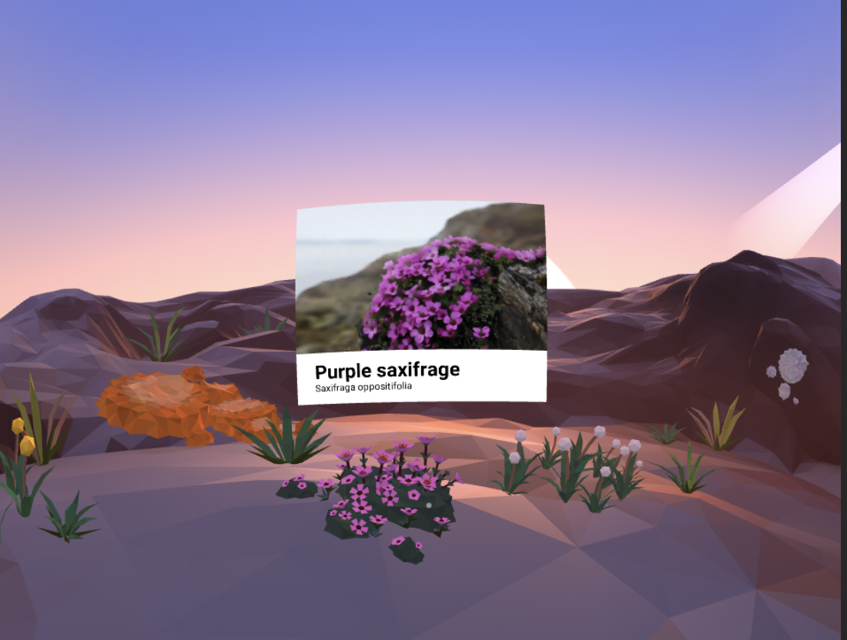
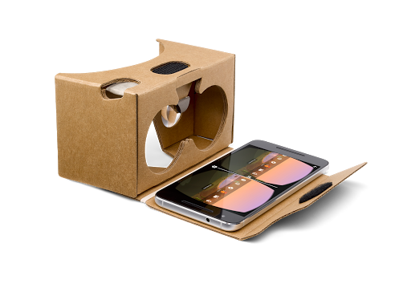
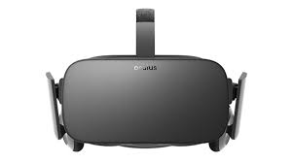
Virtual Water Management Model (VWMM): Monitoring and analyzing Southern High Plains water in Virtual Reality environment Vinh Nguyen, Long Nguyen, Tommy Dang, Abdullahn Karim, and Venki Uddameri Computer Science and Civil, Environmental, and Construction Department, Texas Tech University, Texas, USA
Abstract
We introduce Virtual Water Management Model (VWMM), a virtual reality model for visualizing and monitoring Southern High Plains Aquifer of Texas. The water systems are monitored by sensors integrated on wells distributed on a vast geographic area. Our web-based application captures data collected by integrated well sensors. This data can be transcribed into the virtual environment by using three.js. Google cardboard is used to help users interact with water system. Our VWMM aims to allow users/policy makers exploring the complicated dynamic structure of underground water and performing their own analysis, such as making periodic rainfall or conditional usage of water on sunny days, chart out how temperatures (climate change), and land affect stream water quality.
Water has a strong connection with agriculture and energy which has been stressing due to the increasing regional and social pressures and governance issues as result of land use change, climate variability, and heterogeneous resource distribution. Our VWMM targets the interdependencies of this nexus. All wells, factories, energy towers, and windmills are interconnected in a smart networks based on their sensing (real-time) information.
Introduction
Water is the basic element that human relies on for all living and manufacturing activities. According to the National Ground Water Association report in 2016, we extract around 982km3 of water per year from the ground [2]. This number serves as a good indicator of the need of water in daily life. Therefore, monitoring ground water, sustaining aquifer capability, and analyzing its changes are highly desirable by decision makers. Venki etal. [3] discussed two types of errors in well management improper removal of wells and redundancy of insensitive wells. Moreover, as the number of wells increases, it becomes more and more challenging for specialists to visualize and analyze such large amount of well monitoring data which comes in real time.
We propose Virtual Water Management Model which allows users to analyze, monitor, and interconnect a large number of wells, along with other energy distributed on a vast geographic area. Our proposal includes:
An algorithm to interconnect thousands of wells into a smart network which allows to perform advanced analysis such as in case of a well failure at a specific location, the neighboring wells can supply enough of water for our production activities. This algorithm uses the results in [3] to access the role of a particular well in the network in monitoring and managing water usages at a given city.
Virtual Water Management Model which allows users to explore wells and watershed in an immersive environment. Causal analysis and simulation of the smart network will help us understand between the connections between human activities, climate change, and underground water.
We also propose to extend this idea to an AR + VR game, a multiplayer game modeled after the classic Monopoly® and SimCity®. Students are provided a fixed amount of coins and a distinct parcel of land on which they can either build or expand urban areas, grow crops, engage in industrial activities, and manage energy usages.
Methods
VWMM will entirely be un on web-based application by using Web API, Google cardboard and Three.js [4]. Currently there are many available VR devices on the market such as Oculus Rift, Gear VR, HTC Vive, View-Master, so on. Out of these devices, Google cardboard is chosen due to its low-cost VR headset and simple design.
The process of create virtual model involves in several steps: data is retrieved through Web API services and then transcribed into the scene by using Three.js a cross-browser JavaScript library/API used to create and display animated 3D computer graphic in a web browser (basically a simpler WebGL).
Google cardboard, which as a pair of lenses that a create a 3D effect when held up to user’s eyes, is utilize to interact with user phone in a seemingly real-world experience [5].
Figures:
A: 2D model of wells in our recent publication
B: 3D model of wells in our ongoing project
C: Google cardboard and Oculus Rift are used to interact with water system in virtual environment
D: a PhD student in iDVL lab experiencing virtual models on Google cardboard and Oculus
E: Complimentary information pop up when user selects an object.
2D model of saturated thickness in our recent publication [1]
B
A
Acknowledgements:
This work is in collaborations with Water Resources Center at Texas Tech university.
References:
[1] Tommy Dang, Long Hoang Nguyen, Abdullahn Karim, and Venki Uddameri. STOAViz: Visualizing Saturated Thickness of Ogallala Aquifer. The Visualization in Environmental Sciences 2017 (EnvirVis 2017)
[2] NGWA: Facts about global groundwater usage. Westerville,Ohio 43081-8978 USA
[3] VENKI UDDAMERI ABDULLAH KARIM E. U., SRIVASTAVAP.: Sensitivity of wells in a large groundwater monitoring network andits evaluation using grace satellite derived information. In SensitivityAnalysis in Earth Observation (2017), Elsevier, pp. 235–256
[4] Danchilla, B. (2012). Three. js framework. In Beginning WebGL for HTML5 (pp. 173-203). Apress. .
[5] LaValle, S. M. (2016). Virtual reality. Champaign (IL): University of Illinois.
D
E
Google cardboard and Oculus for VR environments
C

