Slide 1
We rate dogs
Twitter channel analysis

Slide 2
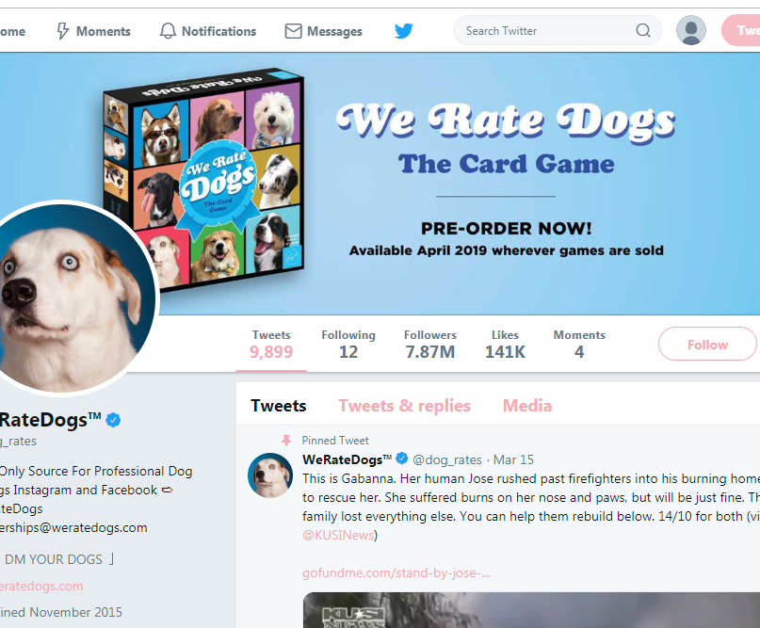

Questions:
What are the top three breeds holding most favorites?
What are the top three breeds holding most retweets?
Are the breeds mentioned above and those holding most audience engagement (the sum of retweets and favorites) the same?
How often is the top breed holding most engagement (in the following mention just "top breed") mentioned in tweets?
What is the set of words for tweets with the top breed?
How often do the words from the top-breed-set appear in tweets?
Are there any words that are more specific for the top breed?
We have a huge amount of other questions and are going to find their answers in other projects))

Slide 3
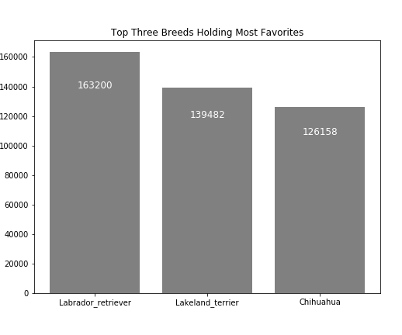
top three breeds holding most favorite
Labrador retriever – 163,200 favorites
Lakeland terrier – 139,482 favorites
Chihuahua – 126,158 favorites
An interesting detail is that the author mentioned the stage DOGGO in the tweet that accumulated most favorites. The second place has the stage PUPPO. The tweet that took third place contains no data about the stage, but the dog is good anyway.

Slide 4
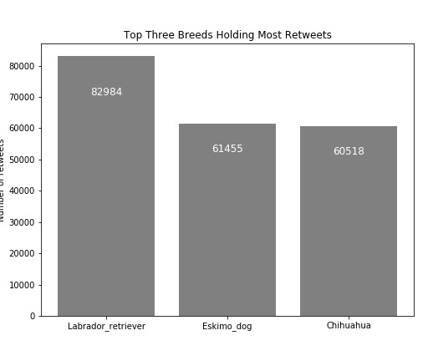
top three breeds holding most retweets
Labrador retriever – 82,984 retweets
Eskimo dog – 61,455 retweets
Chihuahua – 60,518 retweets

Slide 5
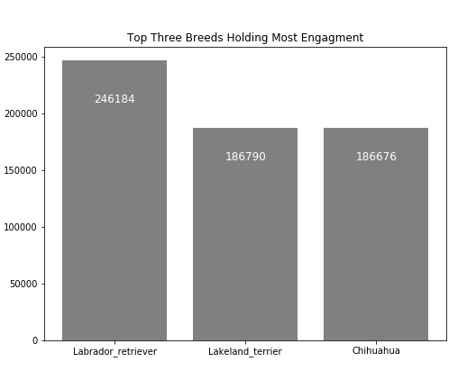
Top breeds with most engagement
Labrador retriever – 246,184 engages
Lakeland terrier – 186,790 engages
Chihuahua – 186,676 engages

Slide 6
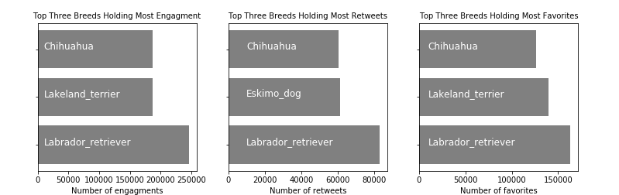

Are the breeds holding most engagement and the breeds holding most favorites and retweets the same?

Slide 7
The winner is Labrador Retriever
We found the top breeds are not the same, though the first places are in the same hands.
It may be a common situation where the same tweet holds the biggest numbers of retweets, favorites and total engagements. However, this is not a fact for all, and we have to check. The checking is done and we found a winner. Let"s look at them closer.

Slide 8
How often is the winner mentioned in tweets?
So our winner is Labrador Retriever. We built a list of following synonyms:
“Labrador retriever”
“labrador retriever”
“Labrador”
“lab”
“labs”
“labra”
We checked how many times each word appears in our data set with tweets.

Slide 9
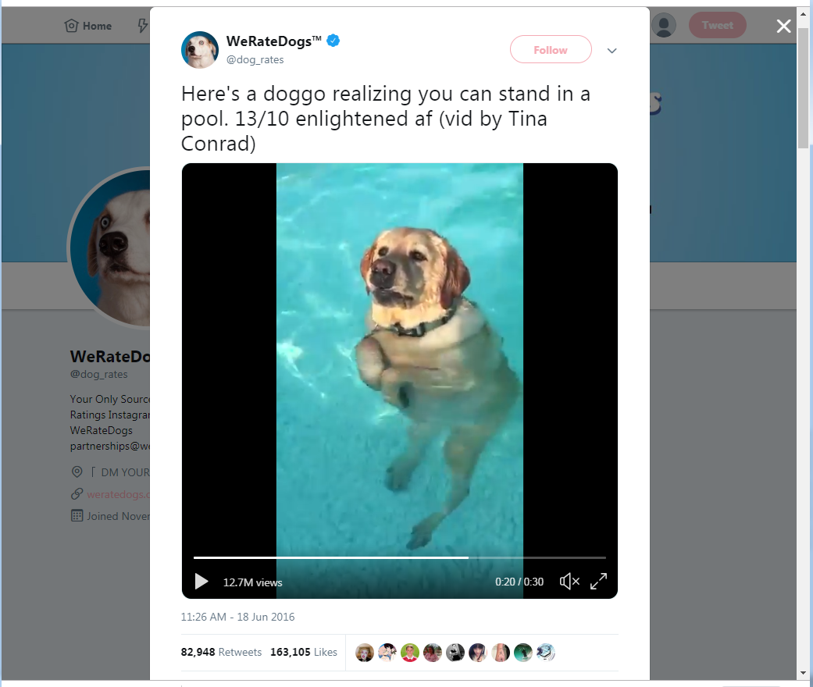
Unbelievable!
We have ZERO mentions of Labrador breed in 2,298 tweets.
Definitely, this Twitter-channel is not about Labradors.
Our winner won just with a funny video, not by breed.

Slide 10
Conclusion
Now, there is no point to keep track of our questions, but there is one case...
We tried to see the tweets containing pictures, where the prediction algorithm found Labrador Retriever breed, but came up with the following conclusion:
The data set is too small and not "labradory" and "breedy" enough to make any decision about specific words for the top breed, or for any breed
We are done with the analysis of our winner, despite the fact that our Labrador is a good dog.

Slide 11
Conclusion
After getting a look at the tweets, we can decide that we failed to make a statement about the popularity of particular breeds among the visitors of WeRateDogs.
All we can do is just state that funny videos of dogs have bigger popularity than photos. On the other hand, this is good proof that dogs are very good, since their behavior may attract more attention from people.

