Slide 1

Learning with large datasets
Large scale machine learning
Machine Learning

Slide 2
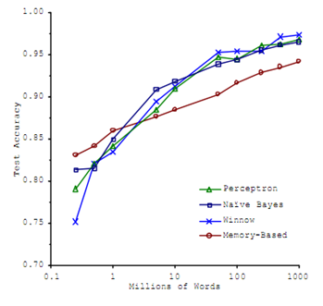
Machine learning and data
Classify between confusable words.
E.g., {to, two, too}, {then, than}.
For breakfast I ate _____ eggs.
Accuracy
Training set size (millions)
“It’s not who has the best algorithm that wins.
It’s who has the most data.”
[Figure from Banko and Brill, 2001]

Slide 3
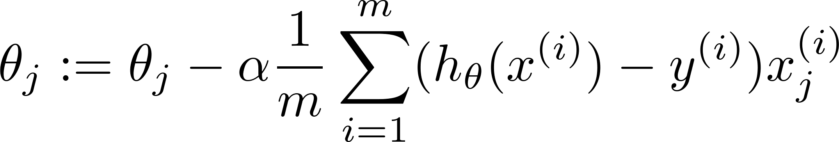
Learning with large datasets
error
error
(training set size)
(training set size)

Slide 4
Stochastic gradient descent
Large scale machine learning
Machine Learning

Slide 5
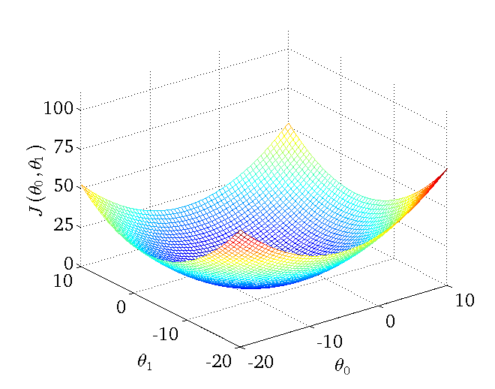
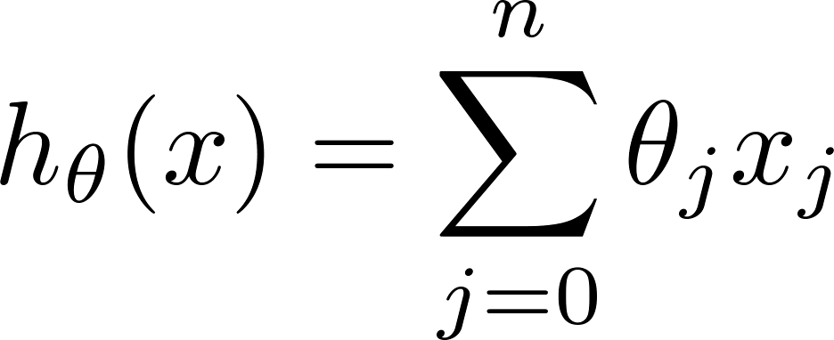
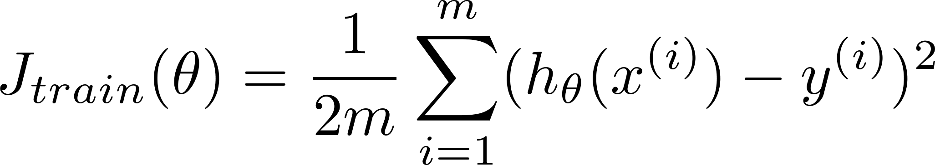
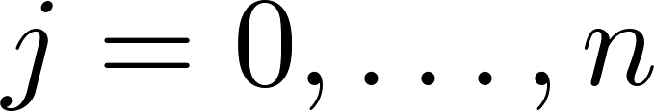
Linear regression with gradient descent
Repeat {
(for every )
}
Notes:
Add dots

Slide 6
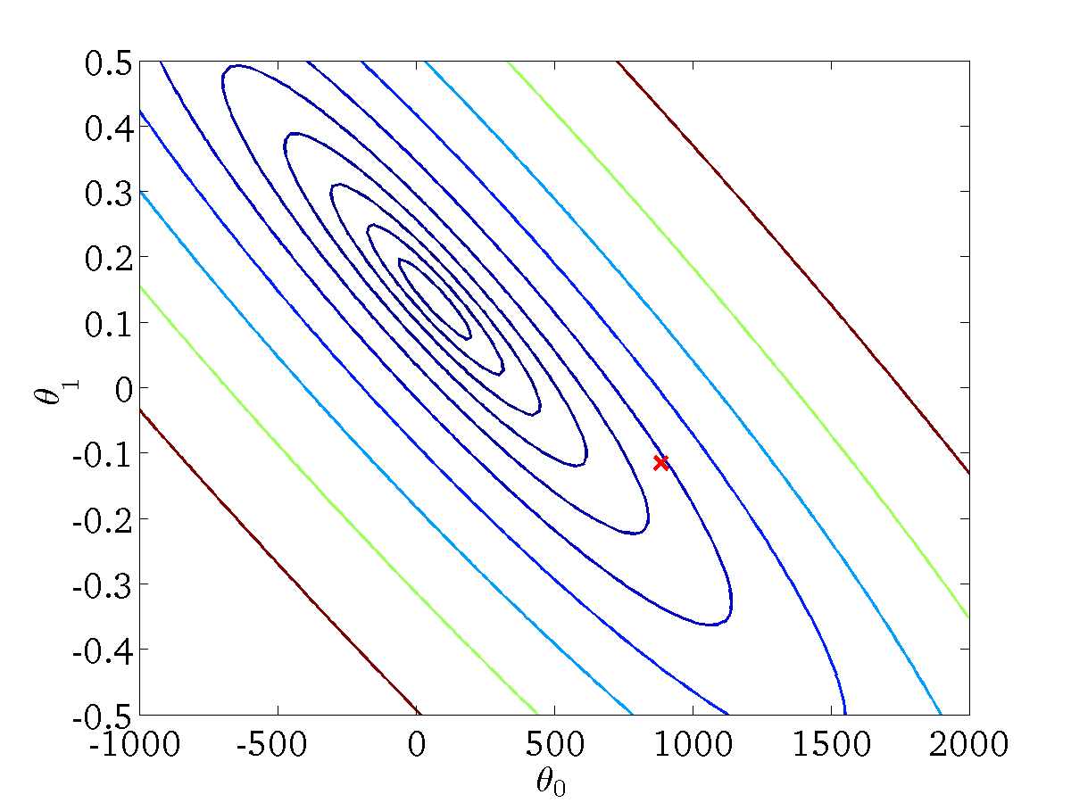

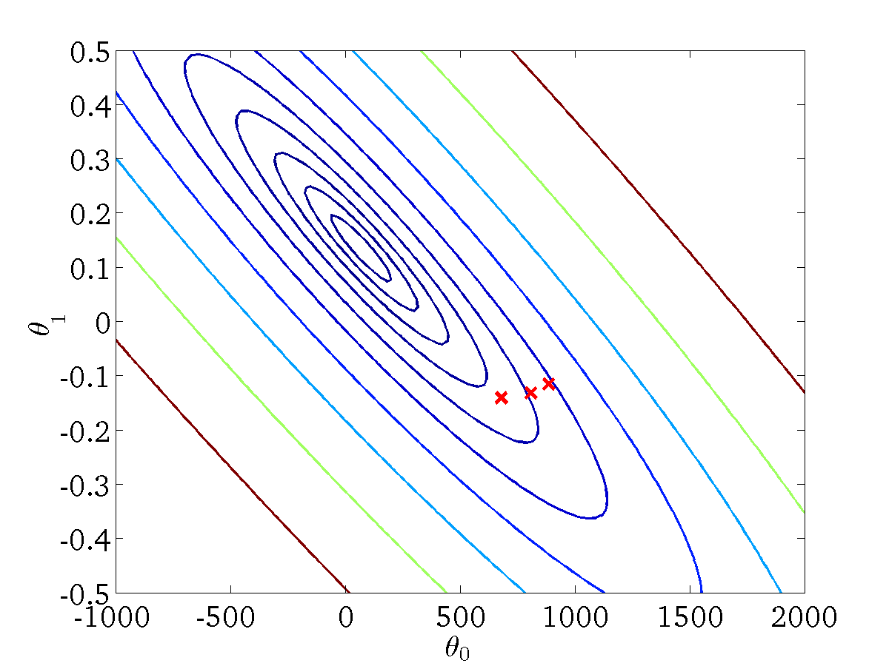

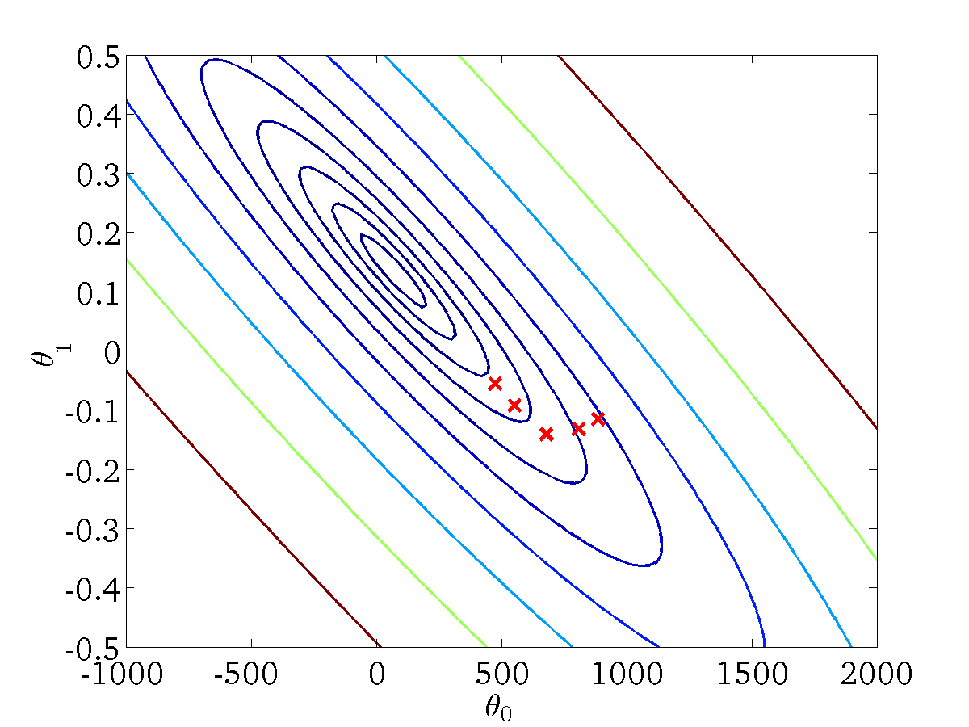


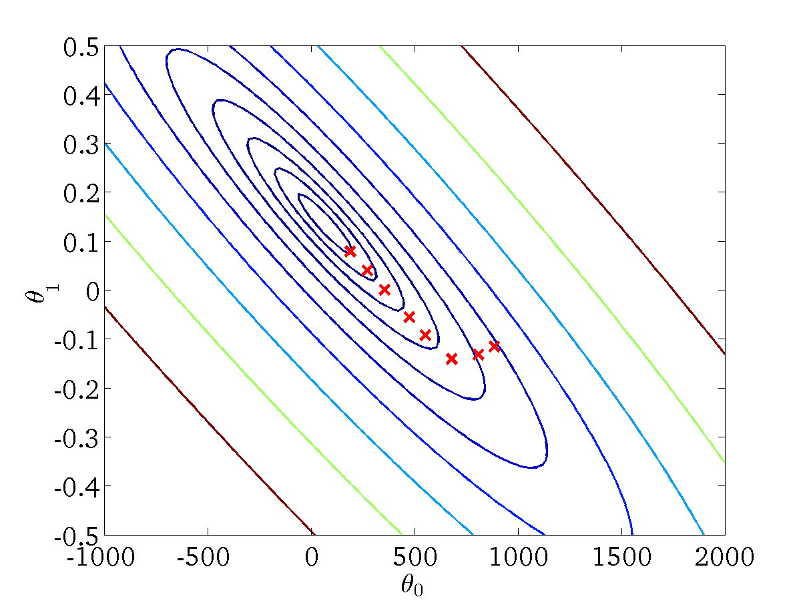

Linear regression with gradient descent
Repeat {
(for every )
}

Slide 7
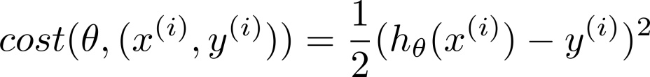
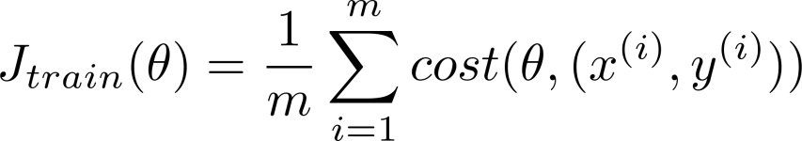
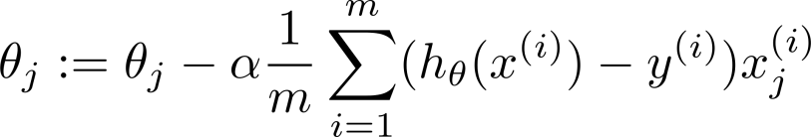

Batch gradient descent
Stochastic gradient descent
Repeat {
(for every )
}

Slide 8
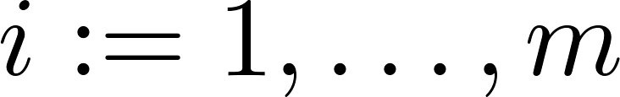
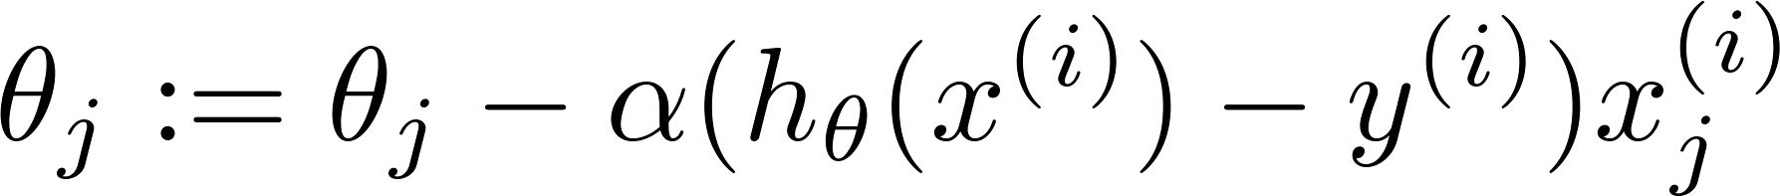
Stochastic gradient descent
Randomly shuffle (reorder) training examples
Repeat {
for {
(for every )
}
}

Slide 9
Mini-batch gradient descent
Large scale machine learning
Machine Learning

Slide 10
Mini-batch gradient descent
Batch gradient descent: Use all examples in each iteration
Stochastic gradient descent: Use 1 example in each iteration
Mini-batch gradient descent: Use examples in each iteration
Notes:
Change numbers to LATEX as well

Slide 11
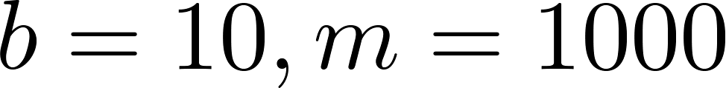
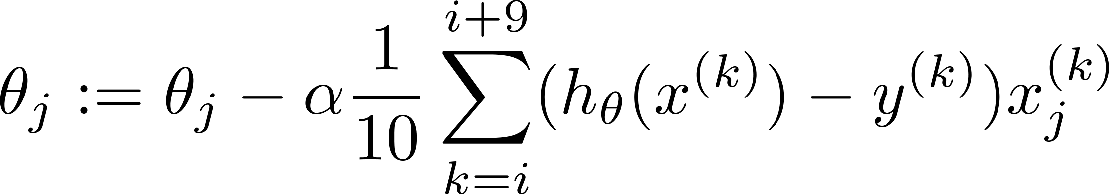
Mini-batch gradient descent
Say .
Repeat {
for {
(for every )
}
}
Notes:
Change numbers to LATEX as well

Slide 12
Stochastic gradient descent convergence
Large scale machine learning
Machine Learning

Slide 13
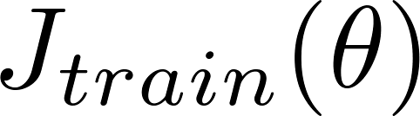
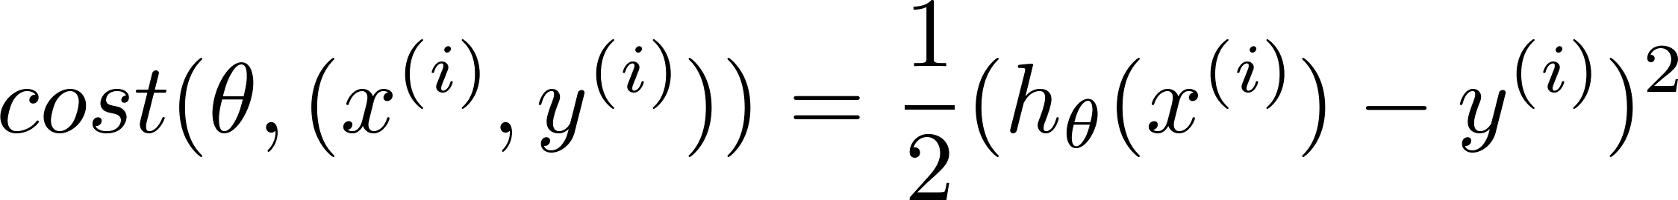
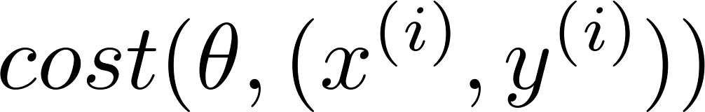
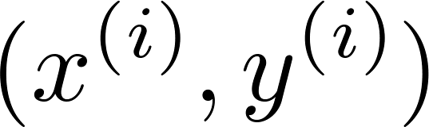
Checking for convergence
Batch gradient descent:
Plot as a function of the number of iterations of gradient descent.
Stochastic gradient descent:
During learning, compute before updating
using .
Every 1000 iterations (say), plot averaged over the last 1000 examples processed by algorithm.

Slide 14
Checking for convergence
Plot , averaged over the last 1000 (say) examples
No. of iterations
No. of iterations
No. of iterations
No. of iterations

Slide 15
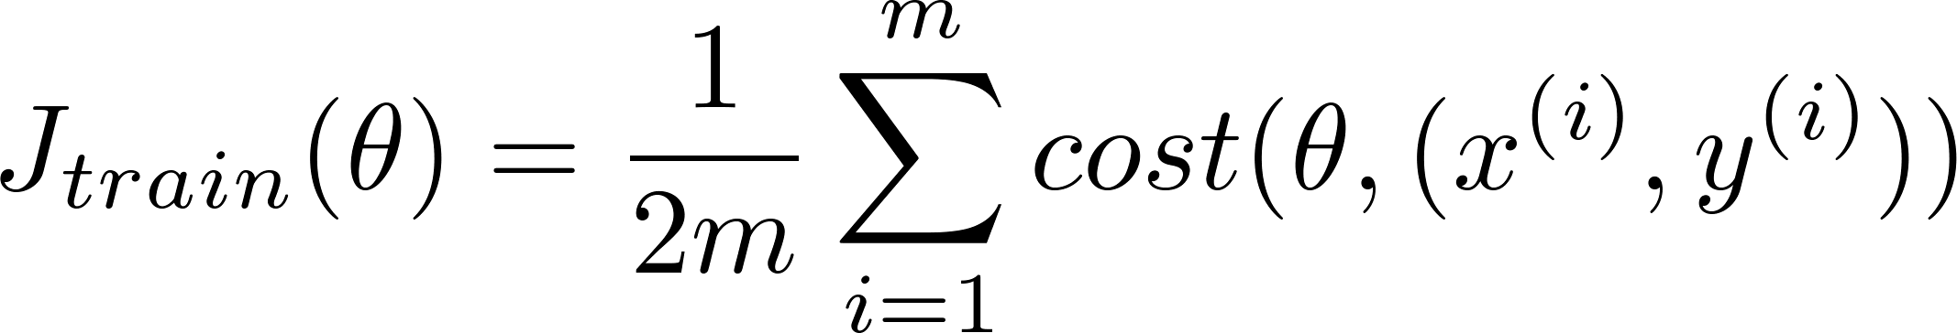



Stochastic gradient descent
Randomly shuffle dataset.
Repeat {
for {
(for )
}
}
Learning rate is typically held constant. Can slowly decrease
over time if we want to converge. (E.g. )
const1
iterationNumber + const2

Slide 16
Stochastic gradient descent
Randomly shuffle dataset.
Repeat {
for {
(for )
}
}
Learning rate is typically held constant. Can slowly decrease
over time if we want to converge. (E.g. )
const1
iterationNumber + const2

Slide 17
Online learning
Large scale machine learning
Machine Learning

Slide 18



Online learning
Shipping service website where user comes, specifies origin and destination, you offer to ship their package for some asking price, and users sometimes choose to use your shipping service ( ), sometimes not ( ).
Features capture properties of user, of origin/destination and asking price. We want to learn to optimize price.
Notes:
Make points have 0 mean on x1 and x2

Slide 19
Other online learning example:
Product search (learning to search)
User searches for “Android phone 1080p camera”
Have 100 phones in store. Will return 10 results.
features of phone, how many words in user query match name of phone, how many words in query match description of phone, etc.
if user clicks on link. otherwise.
Learn .
Use to show user the 10 phones they’re most likely to click on.
Other examples: Choosing special offers to show user; customized selection of news articles; product recommendation; …
Notes:
Make points have 0 mean on x1 and x2

Slide 20
Map-reduce and data parallelism
Large scale machine learning
Machine Learning

Slide 21
Map-reduce
Batch gradient descent:
Machine 1: Use
Machine 2: Use
Machine 3: Use
Machine 4: Use
[ Jeffrey Dean and Sanjay Ghemawat]

Slide 22
Map-reduce
Computer 1
Training set
Computer 2
Combine results
Computer 3
Computer 4
[http://openclipart.org/detail/17924/computer-by-aj]

Slide 23
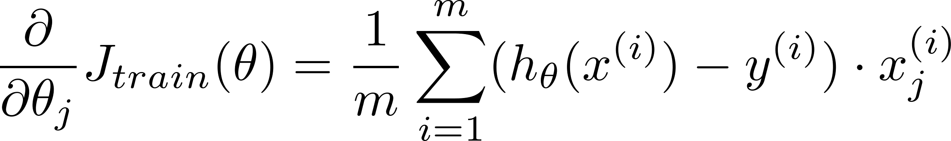
Map-reduce and summation over the training set
Many learning algorithms can be expressed as computing sums of functions over the training set.
E.g. for advanced optimization, with logistic regression, need:

Slide 24
Multi-core machines
Core 1
Training set
Core 2
Combine results
Core 3
[http://openclipart.org/detail/100267/cpu-(central-processing-unit)-by-ivak-100267]
Core 4

