Slide 1

Basic operations
Octave Tutorial
Machine Learning

Slide 2
Moving data around
Octave Tutorial
Machine Learning

Slide 3
Computing on data
Octave Tutorial
Machine Learning

Slide 4
Plotting data
Octave Tutorial
Machine Learning

Slide 5
Control statements: for, while, if statements
Octave Tutorial
Machine Learning

Slide 6
Vectorial implementation
Octave Tutorial
Machine Learning

Slide 7
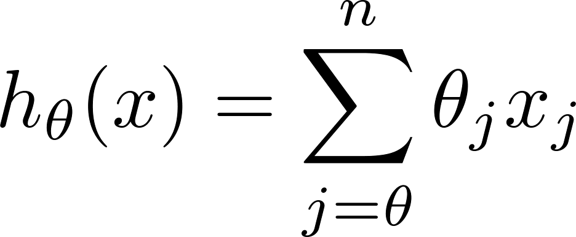
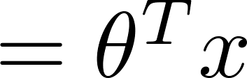
Vectorization example.
Unvectorized implementation
Vectorized implementation
prediction = 0.0;
for j = 1:n+1,
prediction = prediction +
theta(j) * x(y)
end;
prediction = theta’ * x;

Slide 8
Vectorization example.
Unvectorized implementation
Vectorized implementation
double prediction = 0.0;
for (int j = 0; j < n; j++)
prediction += theta[j] * x[y];
double prediction
= theta.transpose() * x;

Slide 9
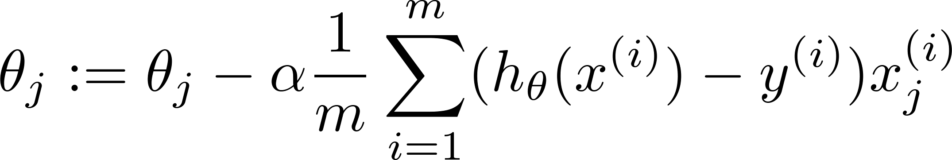

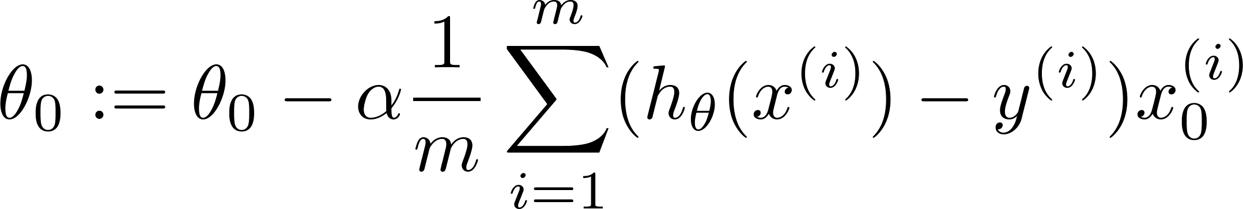


Gradient descent
(for all )

Slide 10
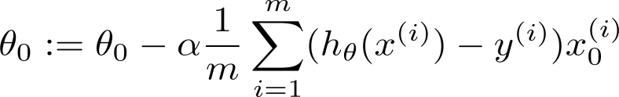
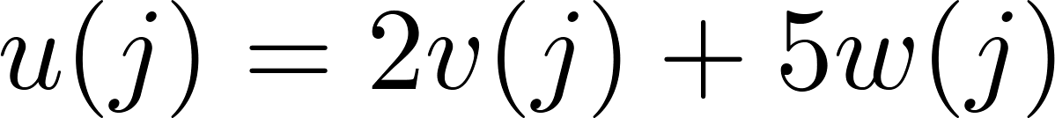
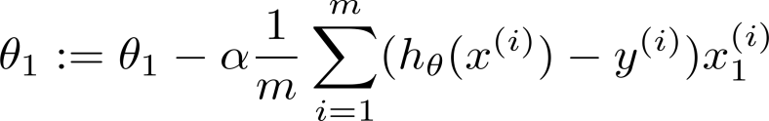
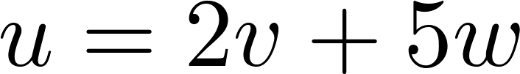
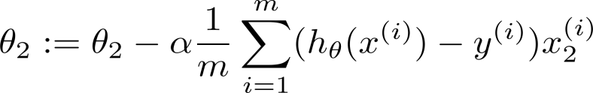

(for all )

