Slide 1
Lab 2 of COMP 319
Data and File in Matlab
Lab 2: 2021

Slide 2
Outline of Lab 2
Review of Lab 1
Matlab vectors and arrays
Matlab file (.m) building and saving
User defined function (if time is enough)

Slide 3
Outline of Lab 2
Review of Lab 1
(The path of Matlab: http://www1.szu.edu.cn/nc/view.asp?id=64)
2. Matlab vectors and arrays
3. Matlab file (.m) building and saving
4. User defined function

Slide 4
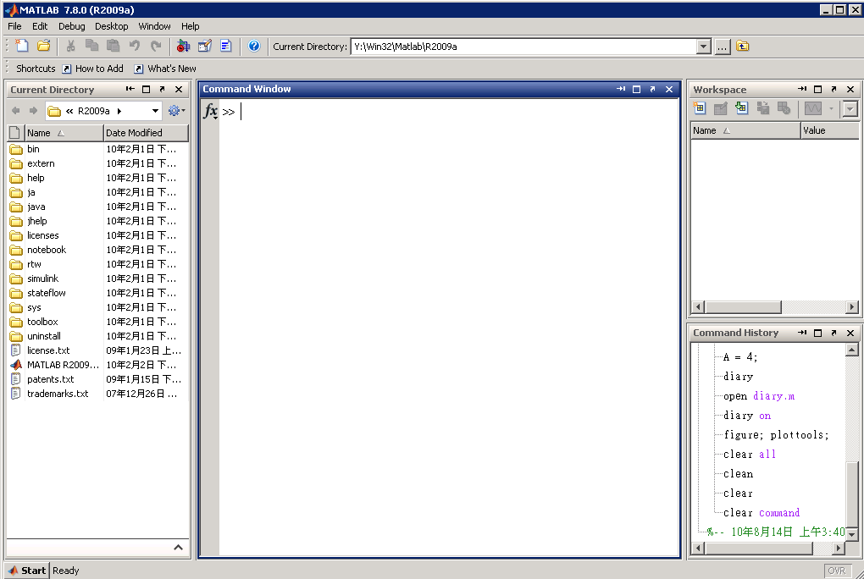
Matlab Desktop
Launch Pad
Workspace
Current Directory
Command Window
History

Slide 5
Matlab Help
Different ways to find information
  help
  help general, help mean, sqrt...
  helpdesk - an html document with links to further information

Slide 6
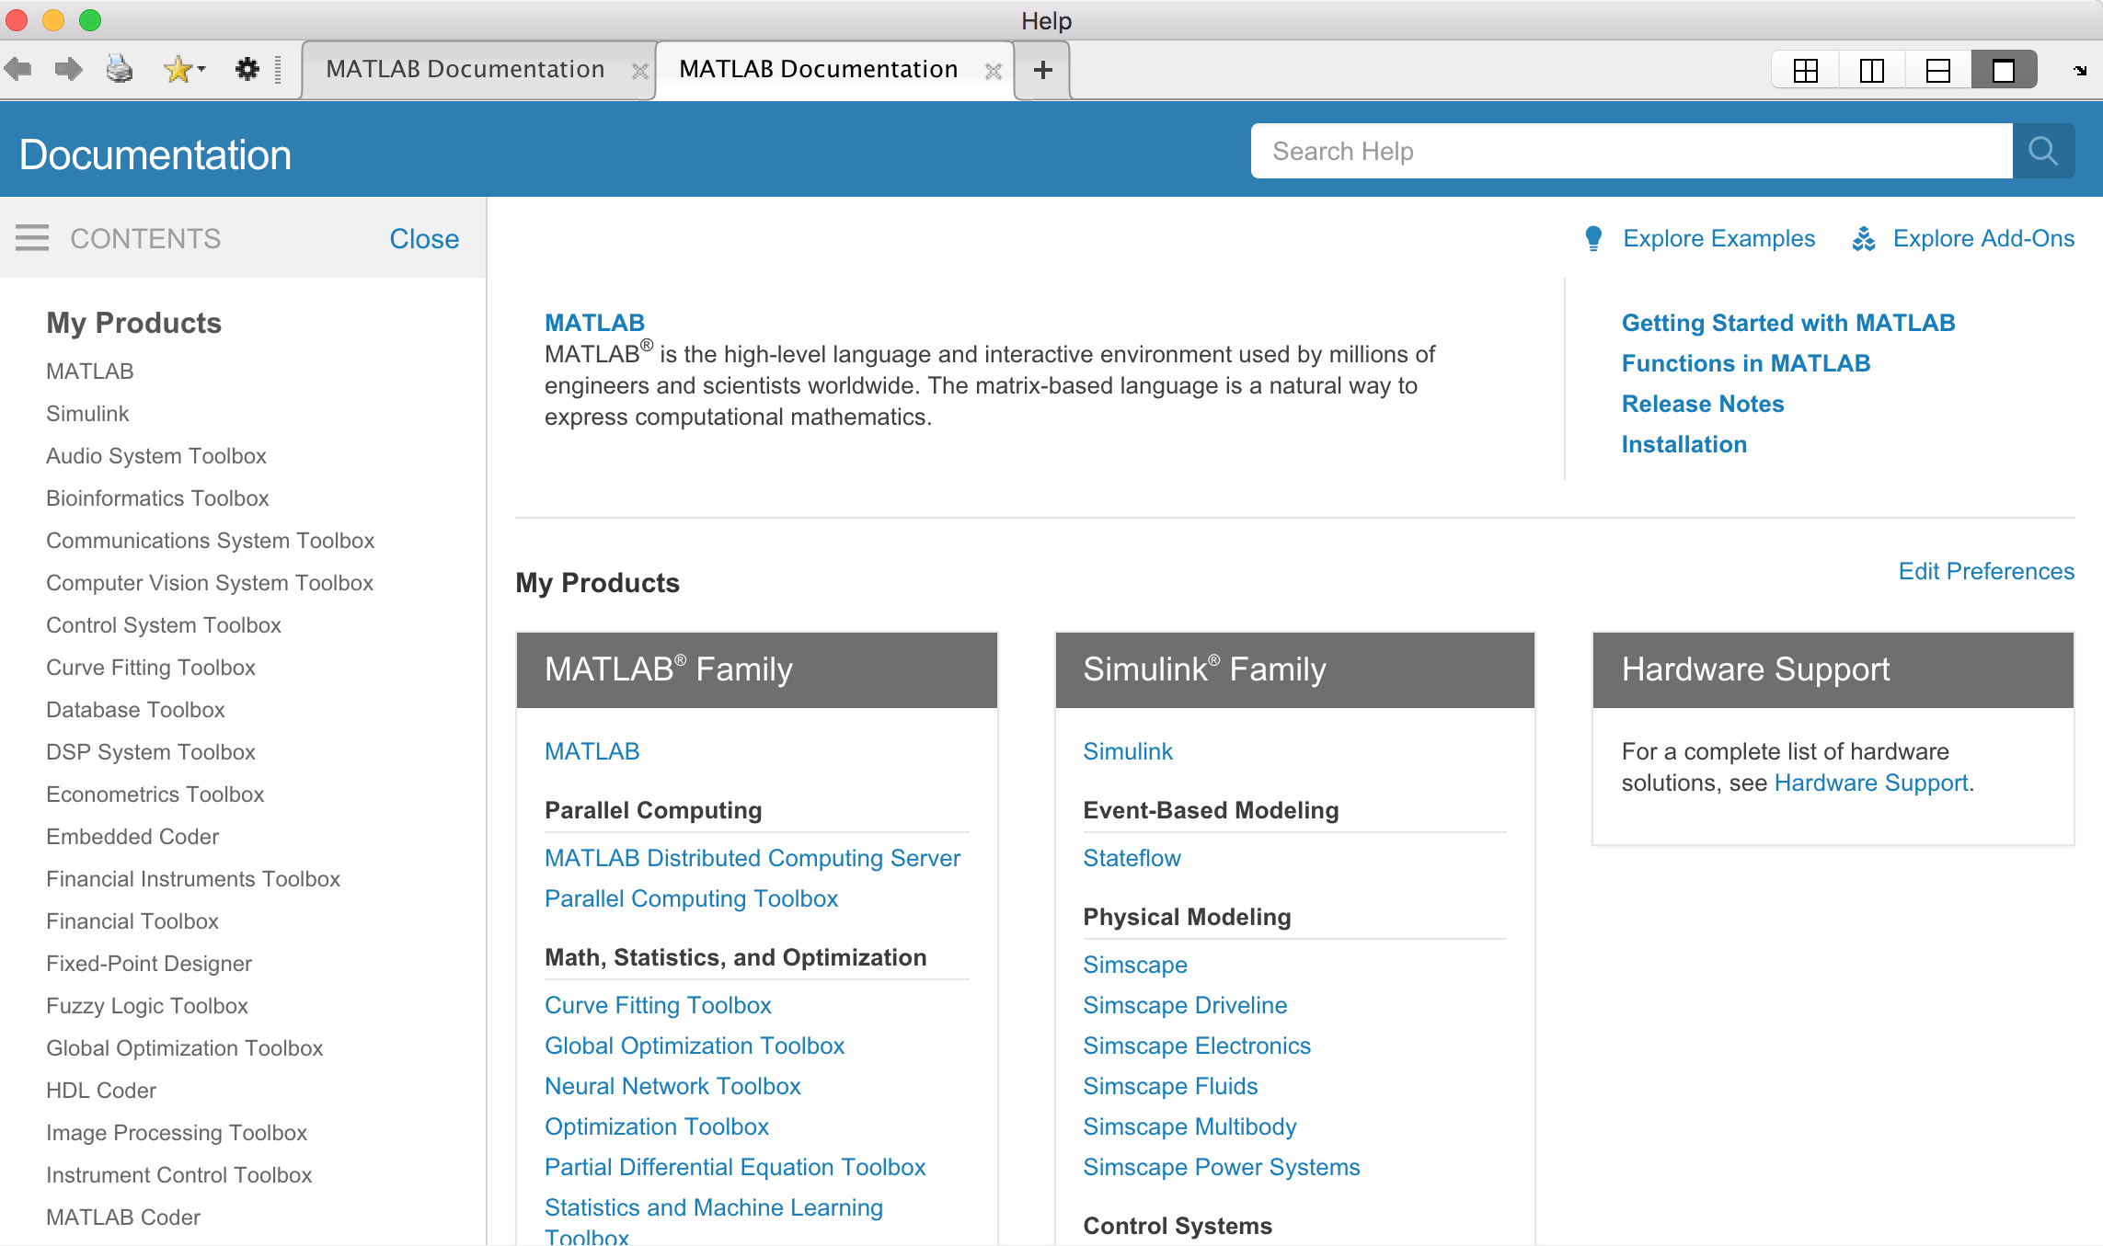
Matlab Help
Notes:
Let’s bring the memory discussion to MATLAB.
Examine the upper left pane on the MATLAB window. Several pieces of memory have been “allocated”, “named” and assigned variables.
We used an “assignment statement” (i= 10;) to assign a “value” to a “variable”.
On some computers (and in some languages) the memory must first be “allocated” before any values can be assigned.
KEY ITEMS TO DISCUSS:
A variable is piece of memory that has been given a name.
A value is the contents with the variable.
THE SCREEN SHOWS:
The screen shows the name of the variable,
The size of the variable (in elements and bytes),
The “class” - what kind of data is stored in the piece of memory

Slide 7
MATLAB Matrices
MATLAB treats all variables as matrices. For our purposes a matrix can be thought of as an array, in fact, that is how it is stored.
Vectors are special forms of matrices and contain only one row OR one column.
Scalars （标量）are matrices with only one row AND one column

Slide 8
Extracting a Sub-Matrix
A portion of a matrix can be extracted and stored in a smaller matrix by specifying the names of both matrices, the rows and columns. The syntax is:
sub_matrix = matrix ( r1 : r2 , c1 : c2 ) ;
where r1 and r2 specify the beginning and ending rows and c1 and c2 specify the beginning and ending columns to be extracted to make the new matrix.

Slide 9
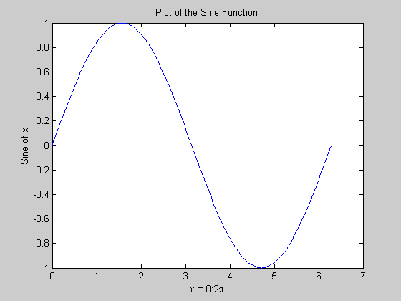
Matlab Graphics
x = 0:pi/100:2*pi;
y = sin(x);
plot(x,y)
xlabel('x = 0:2\pi')
ylabel('Sine of x')
title('Plot of the Sine Function')
Notes:
連續函數和離散函數 continuous, discrete function

Slide 10
Outline of Lab 2
Review of Lab 1
Matlab vectors and arrays
Matlab file (.m) building and saving
User defined function

Slide 11
Vectors and Arrays in MATLAB
Matrix is the basic data structure of MATLAB
Vectors are special forms of matrices which contain only one row OR one column.
Array is another name of Matrix

Slide 12
Objectives of Introduction
This lab will discuss the basic calculations in the form of vectors and arrays.
For each of these collections, you will learn how to :
  Create them
  Manipulate them
  Access their elements
  Perform mathematical and logical operations on them

Slide 13
Vectors in Matlab
A vector is the simplest means of grouping a collection of same data items.
Vector elements have two separate and distinct attributes that make them unique in a specific vector: their numerical value and their position in that vector.
  For example, the number 66 is in the third position in the vector. Its value is 66 and its index is 3.
  There may be other items in the vector with the value of 66, but no other item will be located in this vector at position 3.
Value:
Index:
45 | 57 | 66 | 48 | 39 | ... | 71 | 68
1 2 3 4 5 n-1 n

Slide 14
Create a Vector
There are two ways to create vectors that are directly analogous to the techniques for creating individual data items.
  Creating vectors as a series of constant values
  Producing new vectors by operating on existing vectors

Slide 15
Create Vectors of Constant Values
Enter the values directly
In the command window, enter the following:
>> A = [2, 5, 7, 1, 3]
A =
2 5 7 1 3

Slide 16
Create Vectors of Constant Values
Enter the values as a range of numbers using the colon operator. The first number is the starting value, the second number is the increment, and the third number is the ending value.
In the command window, enter the following:
>> B = 1:3:20
B =
1 4 7 10 13 16 19

Slide 17
Create Vectors of Constant Values
Using the linspace() function to create a fixed number of values between two limits. The first parameter is the lower limit, the second parameter is the upper limit, and the third parameter is the number of values in the vector.
First step: Help linspace;
LINSPACE(X1, X2, N) generates N points between X1 and X2.
  Second step: write the function by yourself
    In the command window, enter the following:
    >> C = linspace(0, 20, 11)
    C =
    0 2 4 6 8 10 12 14 16 18 20

Slide 18
Create Vectors of Constant Values
Using the functions zeros(1,n), ones(1,n), rand(1,n) (random numbers with uniform distribution), and rand(1,n) (random numbers with normal distribution) to create vectors filled with 0, 1, or random values between 0 and 1.
In the command window, enter the following:
>> E = zeros(1, 4)
E =
0 0 0 0
>> F = ones(1, 4)
E =
1 1 1 1
Do it yourself about how to use rand function

Slide 19
Contents in Workspace Window
The workspace window gives you several pieces of information about each of the variables/vectors you created: name, value, size, bytes, class, min, and max.
Notice that if the size of the vector is small enough, the value field shows its actual contents; otherwise, you see a description of its attributes, like <1 * 11 double>.

Slide 20
Index A Vector
As mentioned before, each element in a vector has two attributes: its value and its position in the vector.
You can access the elements in a vector in either of two ways: by indexing with a numerical vector or indexing with a logical vector.

Slide 21
Numerical Indexing
The elements of a vector can be accessed individually or in groups by enclosing the index of the one or more required elements in parentheses.
Do it yourself (A = [2, 5, 7, 1, 3])
Change elements of a vector using the former exercise:
>> A(5) = 42
A =
2 5 7 1 42

Slide 22
Numerical Indexing
A unique feature of Matlab is its behavior when attempting to write beyond the bound of a vector. Matlab will automatically extend the vector if you write beyond its current end.
Do it yourself(A = [2, 5, 7, 1, 42])
Extend a vector using the former exercise:
>> A(8) = 3
A =
2 5 7 1 42 0 0 3
Note: Matlab extended the length to 8 and stored the value 0 in the unassigned elements.

Slide 23
Logical Indexing
So far, the only type of data we have used has been numerical values of type double. The logical operation is a different type of data, with values either true or false. Like numbers, logical values can be assembled into arrays by specifying true or false values. Below is an example, we can specify the variable mask as follows:
>> mask = [true, false, false, true]
mask =
1 0 0 1
Note: the command window echoes the values of logical variables as if 1 represented true and 0 represented false.

Slide 24
Logical Indexing
We can index any vector with a logical vector as follows:
>> A = [2, 4, 6, 8, 10];
>> A(mask)
ans =
2 8
Note 1: When indexing with a logical vector the result will contain the elements of the original vector corresponding in position to the true values in the logical index vector.
Note 2: The logical index vector can be shorter than the source vector, but it cannot be longer.

Slide 25
Operating on Vectors
The essential core of the Matlab language is a rich collection of tools for manipulating vectors and arrays. First we show how these tools operate on vectors, and then generalizes to how they apply to arrays.
  Arithmetic operations
  Logical operations
  Applying library functions
  Concatenation
  Slicing (generalized indexing)

Slide 26
Arithmetic Operations
Arithmetic operations can be performed collectively on the individual components of two vectors as long as both vectors are the same length, or one vector is a scalar.
  Addition + a + b
  Subtraction - a - b
  Multiplication * or.* a*b or a.*b
  Division / or ./ a/b or a./b

Slide 27
Arithmetic Operations
Do it yourself
In the command window, enter the following:
>> A = [2, 5, 7, 1, 3];
>> A + 5
ans =
7 10 12 6 8
>> A*2
ans =
4 10 14 2 6

Slide 28
Arithmetic Operations
Do it yourself (A = [2, 5, 7, 1, 3])
In the command window, enter the following:
>> B = -1:1:3
B =
-1 0 1 2 3
>> A .* B
ans =
-2 0 7 2 9
Note: the sign .* means element-by-element multiplication.

Slide 29
Arithmetic Operations
Do it yourself (A = [2, 5, 7, 1, 3])
In the command window, enter the following:
>> A * B
??? Error using ==> mtimes
Inner matrix dimensions must agree. (the column size of A must be equal to the row size of B)
>> C = [1, 2, 3];
>> A .* C
??? Error using ==> times
Matrix dimensions must agree.

Slide 30
Exercise 1
A is a row vector. The first element in A is 0, and the value vary from 0 to 10 with increment of 2
B is row vector with six elements, and every variable in B is 2.5
Calculate the value of C, which is equal to the sum of A and B
Calculate the value of D, which is equal to the element-by element multiplication between A and B
Change A(1,3) to 8.
Calculate E = A./B

Slide 31
Logical Operations
Logical operations can be performed element-by-element on two vectors as long as both vectors are the same length, or one vector is a scalar. The result will be a vector of logical values with the same length as the original vectors.
Do it yourself
>> A = [2, 5, 7, 1, 3];
>> B = [0, 6, 5, 3, 2];
>> A >= 5
ans =
0 1 1 0 0

Slide 32
Logical Operations
Do it yourself (A = [2, 5, 7, 1, 3]; B = [0, 6, 5, 3, 2];)
>> A >= B
ans =
1 0 1 0 1
>> C = [1, 2, 3];
>> A > C
??? Error using ==> gt
Matrix dimensions must agree.

Slide 33
Applying Library Functions
Matlab supplies the usual rich collection of mathematical functions that cover mathematical, and statistics capabilities. The following functions provide specific capabilities that are frequently useful:
  sum(v) and mean(v) consume a vector and return the sum and mean of all the elements of the vector respectively.
  min(v) and max(v) return two quantities: the minimum or maximum value in a vector, as well as the position in that vector where that value occurred.
>> [value, where] = max([2, 7, 42, 9, -4])
value = 42
where = 3

Slide 34
Applying Library Functions
  round(v), ceil(v), floor(v), and fix(v) remove the fractional part of the numbers in a vector by conventional rounding, rounding up, rounding down, and rounding toward zero, respectively.
Do it yourself
>> A = [1.1, 2.6, 3.7, -5.9, -6.4];
>> round(A)
ans =
1 3 4 -6 -6
>> fix(A)
ans =
1 2 3 -5 -6

Slide 35
Concatenation
Matlab lets us construct a new vector by concatenating other vectors, even an empty vector:
A = [B C D … X Y Z]
where the individual items in the brackets may be any vector.
>> A = [2, 5, 7];
>> B = [1, 3];
>> [A B]
ans =
2 5 7 1 3

Slide 36
Slicing (Generalized Indexing)
>> A = [2, 5, 7, 1, 3, 4];
>> odds = 1:2:length(A);
>> A(odds)
ans =
2 7 3
Line 1: create a vector A with 6 elements.
Line 2: define another vector odds. The function length() is used to refer to the size of a vector.
Line 3: Using vector odds to access elements in vector A. Since no assignment is made, the default variable ans takes on the value of a three-element vector containing the odd-numbered elements of A.
Note: these are the odd-numbered elements, not the elements with odd values.

Slide 37
Exercise 2
A=[1, 2.7, 8.9, -8, 4, 3.5]
B>0;
Return the sum and mean value of all the elements in A.
Return the max value of all elements in A.
fix(A)

Slide 38
Arrays in Matlab
Properties of an array
Create an array
Access and remove elements
Operating on arrays

Slide 39
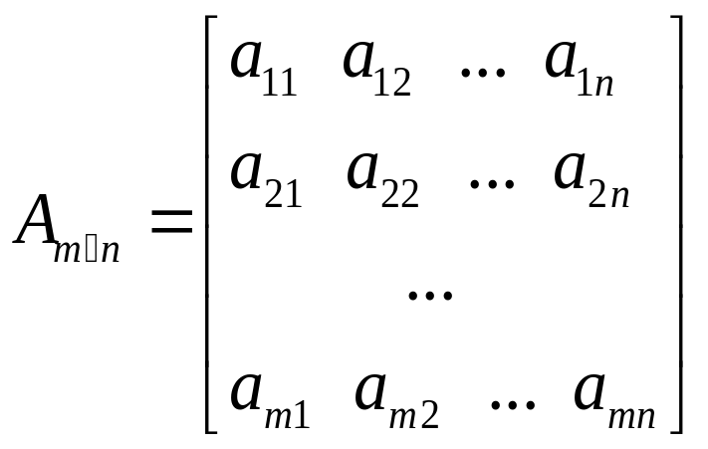
Properties of An Array
A vector is the simplest way to group a collection of data items. This idea can be extended to arrays of multiple dimensions.
Our discussion will focus on two dimensional arrays. Properties and manipulations of arrays with higher dimensions are similar.

Slide 40
Properties of An Array
When a 2-D array has the same number of rows and columns, it is called square.
When the only nonzero values in a square occur when the row and column indices are the same, the array is called diagonal.
When there is only one row, the array is a row vector, or just a vector as you saw earlier.
When there is only one column, the array is a column vector, the transpose of a row vector.

Slide 41
Create An Array
Arrays can be created either by entering values directly, or by using built-in functions that create specific arrays.
Do it yourself
entering values directly.
>> A = [2, 5, 7; 1, 3, 42]
A =
2 5 7
1 3 42

Slide 42
Create An Array
Do it yourself
>> z = zeros(2,3) >> rand(2,3)
z = ans =
0 0 0 0.9501 0.6068 0.8913
0 0 0 0.2311 0.4860 0.7621
>> [z ones(2,4)] % concatenating arrays
ans =
0 0 0 1 1 1 1
0 0 0 1 1 1 1

Slide 43
Access Elements of An Array
The elements of an array may be addressed by enclosing the indices of the required element in parentheses. The first index is the row index and the second index is the column index. Using the array A in the former example,
Do it yourself (A = [2, 5, 7; 1, 3, 42])
>> A(2,3) >> A(2,3) = 0
ans = A =
42 2 5 7
1 3 0

Slide 44
Remove Elements From An Array
(A = [2, 5, 7; 1, 3, 0])
>> A(:, 3)= []
A =
2 5
1 3
This command removes all elements from the third column in array A.
>> A(2, :)= []
A =
2 5
This command removes all elements from the second row in array A.

Slide 45
Operating on Arrays
Operating on arrays is very similar to the operating on vectors.
  Arithmetic operations
  Logical operations
  Applying library functions
  Concatenation
  Slicing (generalized indexing)
  Reshaping arrays

Slide 46
Arithmetic Operations
Do it yourself
>> A = [2, 5, 7; 1, 3, 2];
>> A+5
ans =
7 10 12
6 8 7
>> B = ones(2, 3)
B =
1 1 1
1 1 1
>> B = B * 2
B =
2 2 2
2 2 2

Slide 47
Logical Operations
Do it yourself
>> A = [2, 5; 1, 3];
>> B = [0, 6; 3, 2];
>> A > 4
ans =
0 1
0 0
>> A >= B
ans =
1 0
0 1
>> C = [1, 2, 3, 4];
>> A > C
??? Error using ==> gt
Matrix dimensions must agree.

Slide 48
Applying Library Functions
Below are some useful functions for array operation.
  sum(v) or mean(v) when applied to a 2-D array return a row vector containing the sum or mean of each column of the array, respectively. If you want the sum of the whole array, use sum(sum(v)).
  min(v) or max(v) return two row vectors: the minimum or maximum value in each column and also the row in that column where that value occurred.
  max(max(y)) or min(min(y)) return the minimum or maximum of the whole array.
>> [values rows] = max([2, 7, 42; 9, 14, 8; 10, 12, -6])
values = 10 14 42
rows = 3 2 1

Slide 49
Exercise 3
A=[1, 2.7, 8.9, -8, 4, 3.5; 6.5, 8.9, 5, -0.9, 3, 19] ;
Set every element in six column to be 0.7.
Remove the second column in A;
Return the mean value of every column in A;
Return the mean value of whole A;

Slide 50
Concatenation
Do it yourself
>> A = [2, 5; 1, 7];
>> B = [1, 3]’; % transpose B and make a column vector
>> [A B]
ans =
2 5 1
1 7 3

Slide 51
Slicing (Generalized Indexing)
Do it yourself
>> A = [2, 5, 7, 1, 3, 4;
1, 4, 8, 9, 6, 2;
7, 3, 2, 5, 4, 6;
8, 9, 3, 6, 1, 5];
>> odds = 1:2:6;
>> evens = 2:2:4;
>> A(evens, odds)
ans =
1 8 6
8 3 1

Slide 52
Reshaping Arrays
The function reshape(A, m, n) reforms the array A into an m-by-n array.
>> A = 1:10
A =
1 2 3 4 5 6 7 8 9 10
>> reshape(A, 2, 6)
??? Error using ==> reshape
To RESHAPE the number of elements must not change.
>> reshape([A, 0, 0], 2, 6)
ans =
1 3 5 7 9 0
2 4 6 8 10 0

Slide 53
Outline of Lab 2
Review of Lab 1
Matlab vectors and arrays
Matlab file (.m) building and saving
User defined function

Slide 54
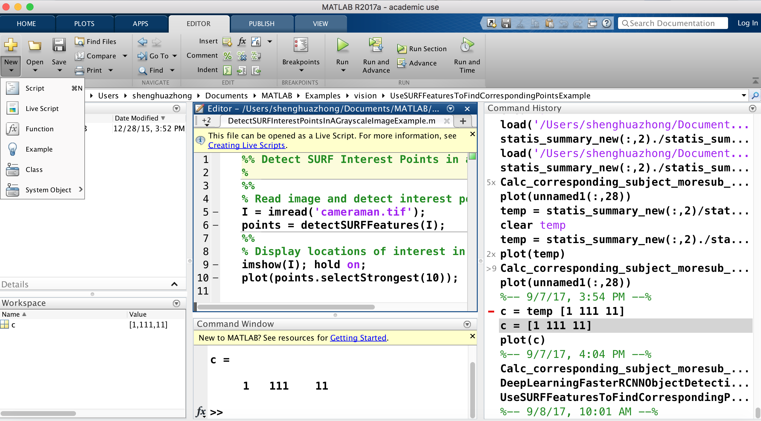
M-file Building (Step 1)
“File” - “New” - “One of three kinds of M-File”

Slide 55
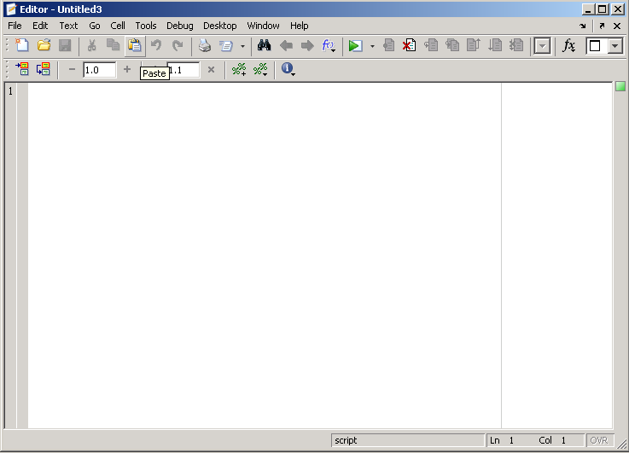
M-file Building (Step 2)

Slide 56
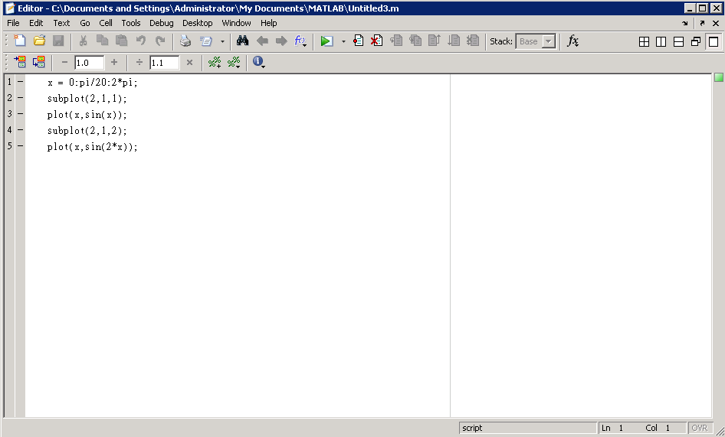
M-file Building (Step 3)
Use the subplot exercise as an example:

Slide 57
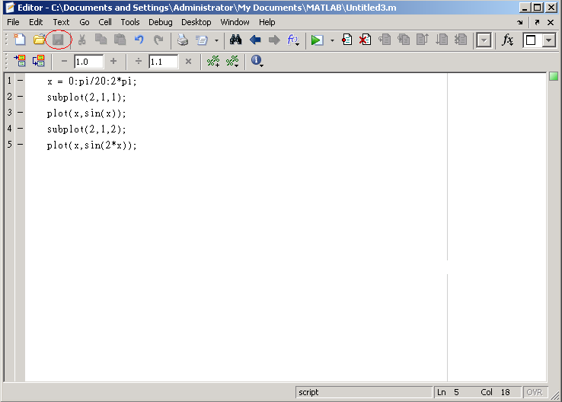
M-file Saving (Step 1)
“File” - “Save” or save it in the current directory

Slide 58
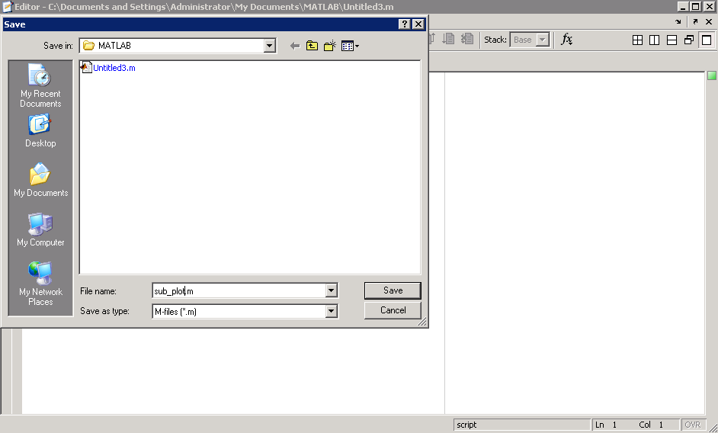
M-file Saving (Step 2)
Type “sub_plot” as the file name, then click “Save”

Slide 59
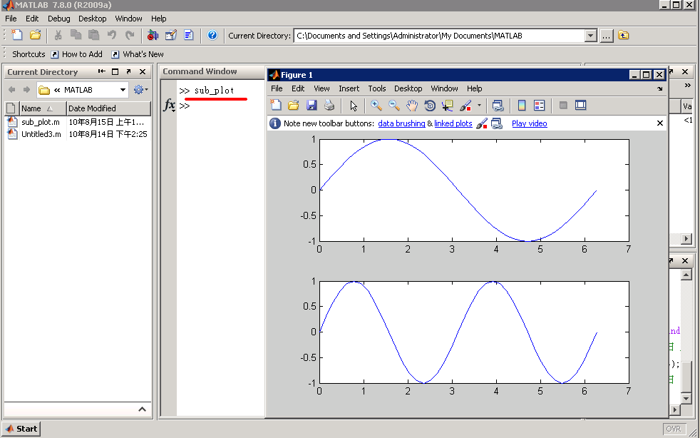
Run M-file (Method 1)
Type the M-file’s name: “sub_plot” into command window and then press the “enter” key.

Slide 60
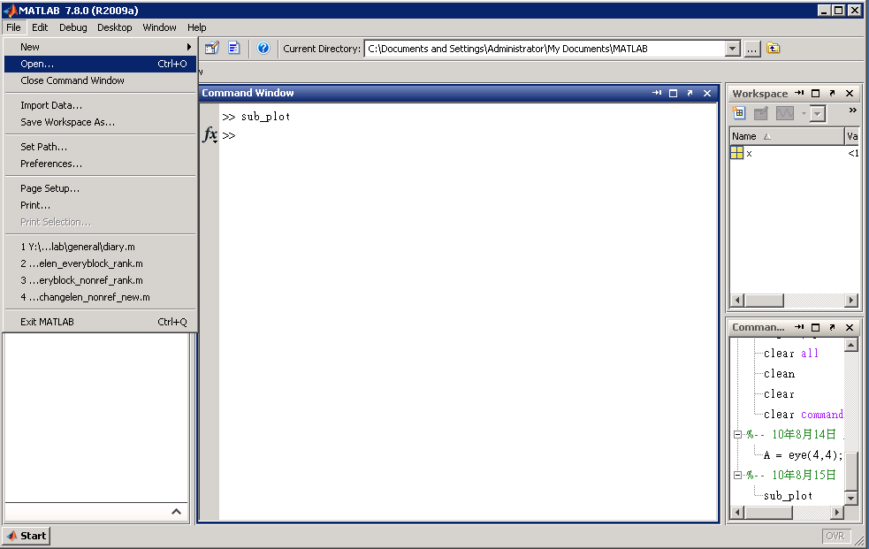
Run M-file (Method 2: Step 1)

Slide 61
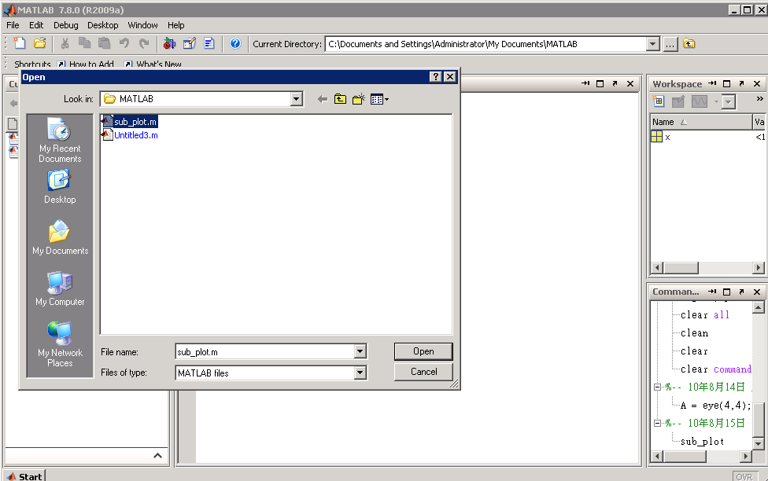
Run M-file (Method 2: Step 2)
Double click the file “sub_plot”;
Or single click the file “sub_plot” and single click “open”

Slide 62
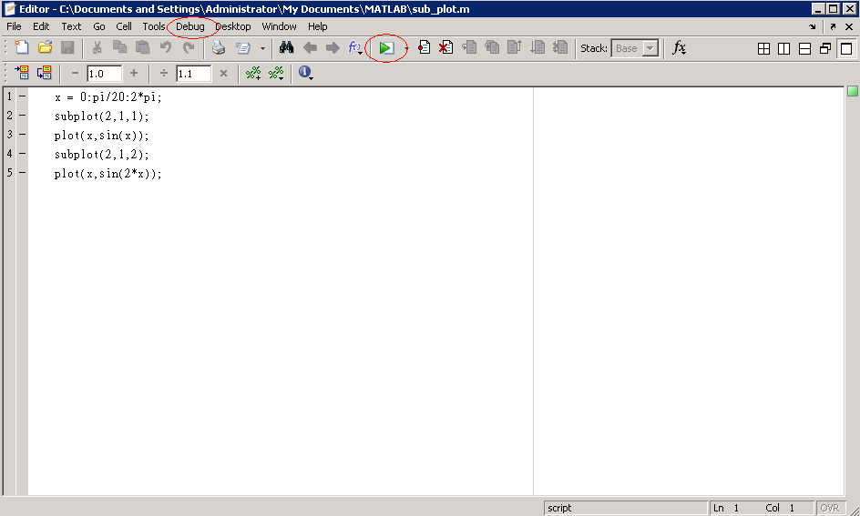
Run M-file (Method 2: Step 3)
Single click “Debug” and single click the button “Run”:

Slide 63
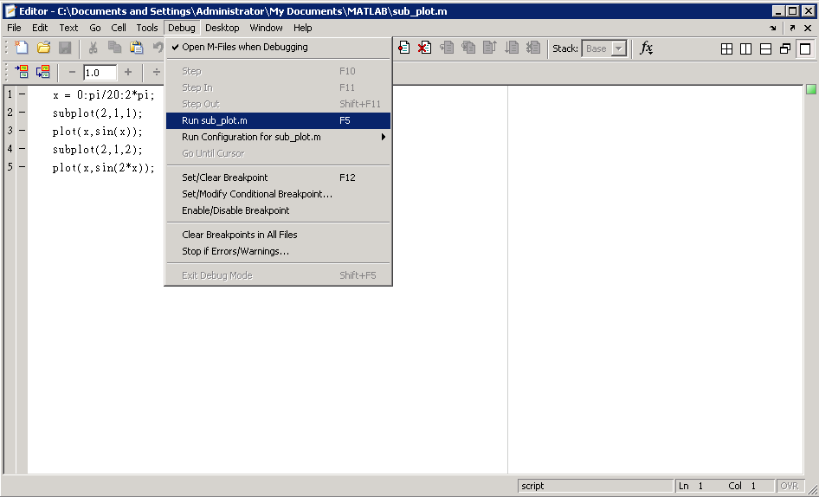
Run M-file (Method 2: Step 4)
Or choose to run the m file in this way

Slide 64
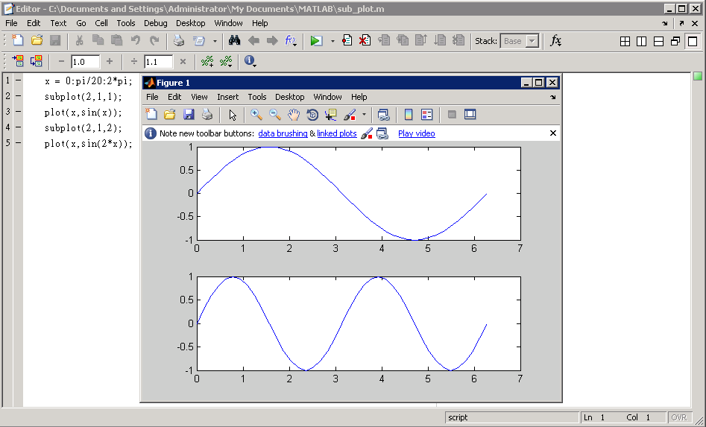
Run M-file (Method 2: Step 5)

Slide 65
Exercise 4
Write the command of exercise 3 into a M-file
  A=[1, 2.7, 8.9, -8, 4, 3.5; 6.5, 8.9, 5, -0.9, 3, 19] ;
  Set every element in six column to be 0.7.
  Remove the second column in A;
  Return the mean value of every column in A;
  Return the mean value of whole A;
Add this command: Return the mean value of the every row in A;

Slide 66
Outline of Lab 2
Review of Lab 1
Matlab vectors and arrays
Matlab file (.m) building and saving
User defined function

Slide 67
User-Defined Function
A function is a piece of computer code that accepts an input argument from the user and provides output to the program. We have already explored some of Matlab’s built-in functions, such as sin(x), cos(x).
But you may wish to define your own functions-those which are used commonly in your programming. User-defined functions are stored as M-files and can be accessed by Matlab if they are in the current directory.

Slide 68
User-Defined Function
Each function consists of a name, user-provided input, and calculated output. For example, the function: my_function(x)
  is named my_function,
  takes user input inside the parentheses (in this case, x), and
  calculate a result.
The user does not see the calculations performed, but just accepts the answer. The function could be regarded as a black box.
input
output
function

Slide 69
User-Defined Function
User-defined functions are stored as M-files. Each must start with a function definition line that contains
  the word “function”,
  one or several variables that defines the function output,
  a function name, and
  one or several variables used for the input argument.
  Save the function as M-file using the same name in your function
Some examples:
  function output = my_function(x)
  function [output1, output2] = my_function(x1,x2,x3)
Hints: The function name and the names of the input and output variables are arbitrary and selected by the programmer, but the word “function” can not be changed.

Slide 70
User-Defined Function
function output = myfunction_poly(x)
% This function calculates the value of a third-order
% polynomial
output = 3*x.^3+5*x.^2-2*x+1
comments
Save above commands into an M-file and then type the below commands in command window to observe the results:
>> a=4;
>> myfunction_poly (a)
>> b=1:5;
>> myfunction_poly (b)

Slide 71
Summary of Lab 2
Introduction the vectors and arrays in Matlab
  The basic data structure in Matlab
Matlab file (.m) building and saving
  The basic component helps us to build a complete project
User defined function
  It is another kind of Matlab file works likes a black box

Slide 72
Next class
Execution control
Plots and graphs using Matlab
Basic manipulation in image processing

