Slide 1
Lab of Multimedia System
Image Processing with MATLAB

Slide 2
Outline of Lab 3
Review of Lab 2
Execution control
Plots and graphs using Matlab
Basic manipulation in image processing

Slide 3
Outline of Lab 3
Review of Lab 2
Execution control
Plots and graphs using Matlab
Basic manipulation in image processing

Slide 4
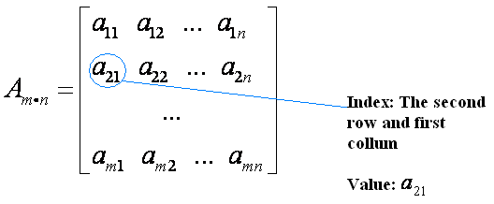
Review of Lab 2 about Data Structure
Introduction the basic data structure in Matlab
  Vector and Array
The distinct attributes of these data structures
  Numerical Value
  Index

Slide 5
Review of Lab 2 about Data Structure
3. What we have learnt
  How to create them
    For example: A = [3, 4, 5; 6, 5.5, 0]
  How to manipulate them
    For example: A(1,1:2) = A(1,1:2) + 2
  How to access their elements
    For example: B = A(1,1:2)
  How to perform mathematical and logical operations on them
    For example: C = A./2.5; D = sum(sum(A))
    For example: E = A > 0.5

Slide 6
Review of Lab 2
Matlab file (.m) building and saving
  The basic component helps us to build a complete project
User defined function
  It is another kind of Matlab file works likes a black box

Slide 7
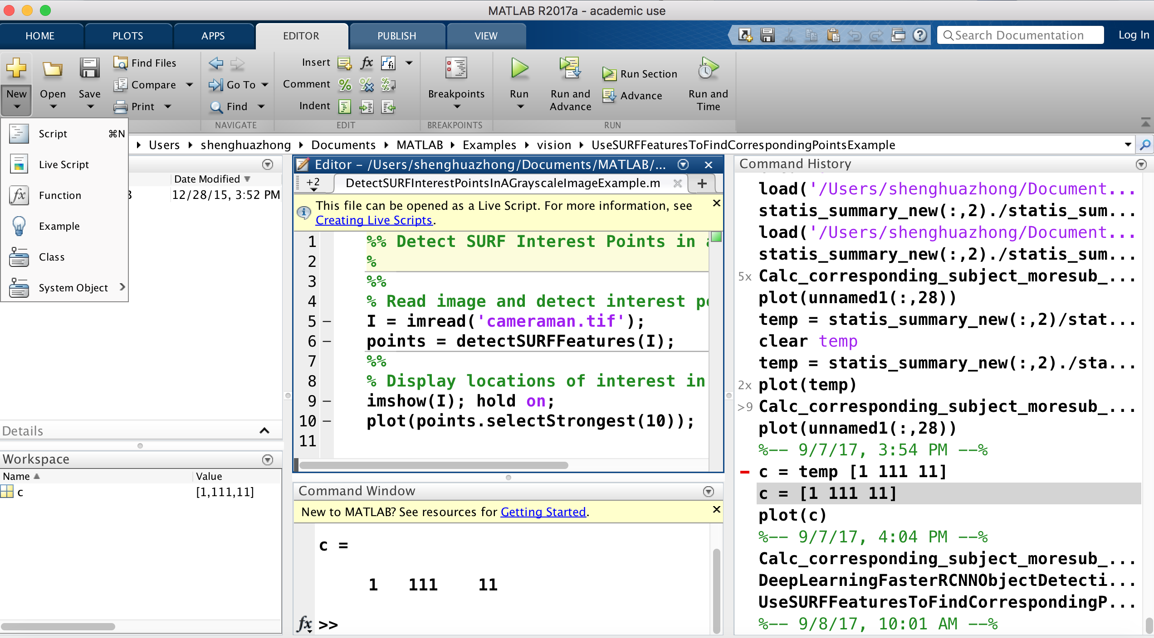
Review of Lab 2 about M file
“File” - “New” - “One of three kinds of M-File”

Slide 8
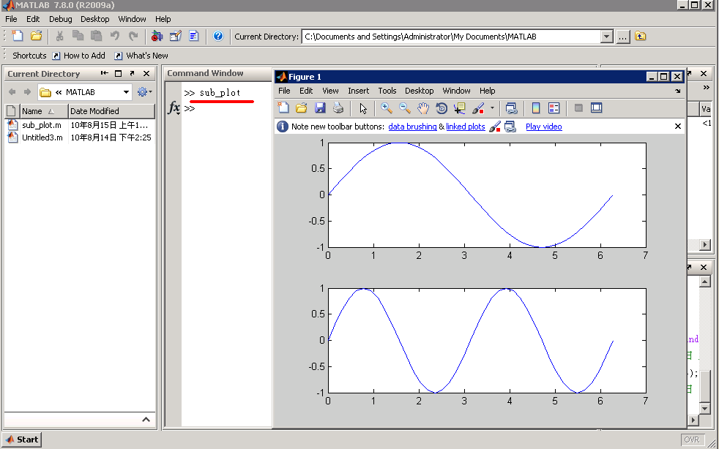
Review of Lab 2 about M file
Type the M-file’s name: “sub_plot” into command window and then press the “enter” key.

Slide 9
Review of Lab 2 about User-Defined Function
User-defined functions are stored as M-files. Each must start with a function definition line that contains
  the word “function”,
  one or several variables that defines the function output,
  a function name, and
  one or several variables used for the input argument.
  Save the function as M-file using the same name in your function
Some examples:
  function output = my_function(x)
  function [output1, output2] = my_function(x1,x2,x3)
Hints: The function name and the names of the input and output variables are arbitrary and selected by the programmer, but the word “function” can not be changed.

Slide 10
Review of Lab 2 about User-Defined Function
function output = myfunction_poly(x)
% This function calculates the value of a third-order
% polynomial
output = 3*x.^3+5*x.^2-2*x+1
comments
Save above commands into an M-file and then type the below commands in command window to observe the results:
>> a=4;
>> myfunction_poly (a)
>> b=1:5;
>> myfunction_poly (b)

Slide 11
Outline of Lab 3
Review of Lab 2
Execution control
Plots and graphs using Matlab
Basic manipulation in image processing

Slide 12
Objectives of Execution control
Why need execution control
  You may want to execute some parts of the code under certain circumstances only;
  You may want to repeat a section of code a certain number of times.

Slide 13
Conditional execution
General concepts
if statements

Slide 14
General concepts
Generally speaking, the statements written in our scripts have been executed in sequence from the top (the first line) to the bottom (the last line).
However, it is frequently necessary to make choices about how to process a set of data based on some characteristic of that data.

Slide 15
if statements
A set of statements (the code block to be executed) is shown as a rectangle, a decision point is shown as a diamond, and the flow of program control is indicated by arrows.
The execution of a code block is based on some conditional test. If the result of the test is true, the code block is executed. Otherwise, the code block is omitted and the instructions after the end of that code block are executed.
if
condition
false
true
statements
A simple if statement

Slide 16
if statements
Examples:
Suppose Test =[2 0 0 0 ; 3 0 0 0; 4 0 0 0; 0 0 0 1]
Type
if Test(4,4)>0
display(‘Condition is true’)
end
Matlab displays
ans =
Condition is true
Type
if Test(1,1)>0 | Test(2,4)==0
display(‘TRUE’)
else
display(‘FALSE’)
end
Matlab displays
ans =
TRUE

Slide 17
if statements
if
condition
false
elseif
condition
false
…
elseif
condition
false
else
true
true
true
statements(1)
statements(2)
statements(n)
statements(n+1)
A compound if statement (more than one conditional test)
In the compound if statement, if the first logical test returns false, a second test is performed to determine whether the second code block should be executed. If that test returns false, as many further tests as necessary may be performed, each with the appropriate code block to be implemented when the result is true. Finally, if none of these tests returns true, the last code block (with the keyword else) is executed.

Slide 18
if statements
if
condition
false
elseif
condition
false
…
elseif
condition
false
else
true
true
true
statements(1)
statements(2)
statements(n)
statements(n+1)
A compound if statement (more than one conditional test)
If one of the code blocks is executed, the next instruction to execute is the one that follows the conditional code after the end statement.
In particular, if there is no else clause, it is possible that no code at all is executed in this conditional statement.

Slide 19
General templete of if statements
if <logical expression 1>
<code block 1>
elseif <logical expression 2>
<code block 2>
elseif <logical expression n>
<code block n>
else
<default code block>
end
…

Slide 20
Important notes of if statements
The only essential ingredients are the first if statement, one code block, and the end statement. All other features may be added as the logical requires.
The code blocks may contain any sequence of legal Matlab statements, including other if statements (nested ifs).
Nested if statements with a code block are an alternative implementation of a logical and statement.
clear all;
a = 5;
if a>3
if a-4 == 1
b=6
end
end
clear all;
a = 5;
if a>3 & a-4==1
b=6
end
Notes:
clear all;
a = 5;
if a>3
if a-4 == 1
b=6
end
end
%
clear all;
a = 5;
if a>3 & a-4==1
b=6
end

Slide 21
Iteration
General concepts
for loops

Slide 22
General concepts
Iteration allow controlled repetition of a code block. Control statements at the beginning of the code block specify the manner and extent of the repetition.
  The for loop is designed to repeat its code block a fixed number of times and largely automates the process of managing the iteration.

Slide 23
for loops
The repeated execution of the code block is performed under the control of a loop-control variable. It is first set to an initial value that is tested against a terminating condition. If the terminating test succeeds, the program leaves the for loop. Otherwise, the computations in the code block are performed using the current value of that variable. When one pass through the code block is finished, the variable is updated to its next value, and control returns to the termination test.
for <loop>
Done
computations
Structure of a for loop

Slide 24
General template of for loops
for <variable specification>
<code block>
end
All of the mechanics of iteration control are handled automatically in the variable specification section.

Slide 25
Important notes of for loops
The core concept in the Matlab for loop implementation is in the style of the variable specification, which is accomplished as follows:
<variable specification>: <variable> = <vector>
where <variable> is the name of the loop control variable and <vector> is any vector that can be created by the techniques discussed in this lab.

Slide 26
for statements
Example:
Type for k = 1:10 Remember - the colon operator
k indicates every integer between
end the start and end OR
Matlab displays start : increment : end
k =
1
k =
2 and so on, through k = 10.
Type for counter = 2:2:10
counter notice that counter increments
end by 2 with each time thru the loop

Slide 27
Exercise 1 (control structure)
Create a M-file and write these codes down.
% use the percent sign to
Mymatrix = [1:5; 14:2:22; 50:-7:22]; % indicate comments
for i = 1:3
for j = 1:5
if Mymatrix(i,j)< 5 | Mymatrix(i,j) > 20
newmatrix(i,j) = Mymatrix(i,j);
elseif Mymatrix(i,j) == 20
newmatrix(i,j) = 100;
else
newmatrix(i,j) = 0; %semicolon means
end %Matlab won’t display
end
end

Slide 28
Outline of Lab 3
Review of Lab 2
Execution control
Plots and graphs using Matlab
Basic manipulation in image processing

Slide 29
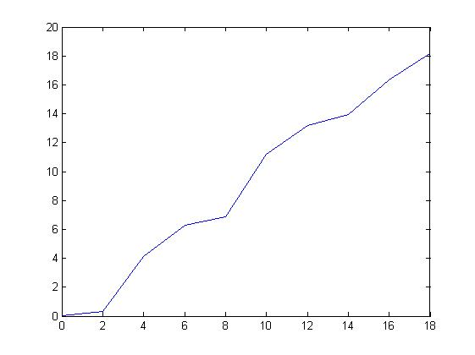
Basic Plotting
Simple x-y plots:
>> x=[0:2:18];
>> y=[0,0.33,4.13,6.29,6.85,11.19,13.19,13.96,16.33,18.17];
>> plot(x,y)
Hint: The number of elements in vector x must be equal to the number of elements in vector y, otherwise it will make an error.

Slide 30
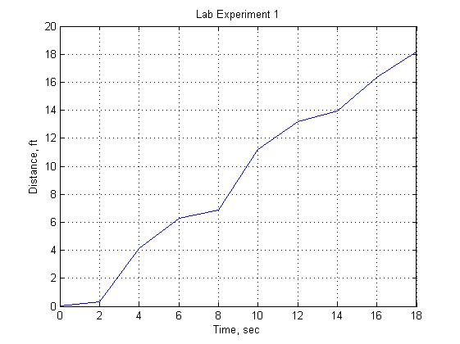
Basic Plotting
Titles, Labels, and Grids:
>> x=[0:2:18];
>> y=[0,0.33,4.13,6.29,6.85,11.19,13.19,13.96,16.33,18.17];
>> plot(x,y), title('Lab Experiment 1'), xlabel('Time'), ylabel('Distance'), grid on
Hint: You must create a graph before you add the title and labels. If you specify the title and labels first, they are erased when the plot command executes.

Slide 31
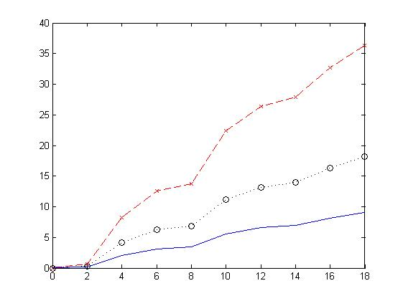
Basic Plotting
Line, Color, and Mark style:
>> x=[0:2:18];
>> y=[0,0.33,4.13,6.29,6.85,11.19,13.19,13.96,16.33,18.17];
>> plot(x,y,':ok',x,y*2,'--xr',x,y/2,'-b')
Hint: You plot three different x-y plots in one image, using different line type, point type and color.

Slide 32
Basic Plotting
Line, Color, and Mark style:
Line Type | Indicator | Point Type | Indicator | Color | Indicator
solid | - | point | . | blue | b
dotted | : | circle | o | green | g
dash-dot | -. | x-mark | x | red | r
dashed | -- | plus | + | cyan | c
 |  | star | * | magenta | m
 |  | square | s | yellow | y
 |  | diamond | d | black | k

Slide 33
Exercise 2 (Basic plotting)
Plot x versus y for y=sin(x). Let x vary from 0 to 2pi in increments of 0.1pi.
Add a title and labels to your plot.
Plot x versus y1 and y2 for y1=sin(x) and y2=cos(x). Let x vary from 0 to 2pi in increments of 0.1pi. Add a title and labels to your plot.
Re-create the plot from step 3, but make the sin(x) line dashed and red. Make the cos(x) line green and dotted.
Use the M file to write and run it.

Slide 34
Subplots
The subplot command allows you to subdivide the graphing window into a grid of m rows and n columns.
The function:
subplot(m,n,p)
split the figure into m*n matrix. The variable p identifies the portion of the window where the current plot will be drawn.

Slide 35
Subplots
For example, if the command subplot(2,2,1) is used, the window is divided into two rows and two columns, and the plot is drawn in the upper left-hand window. The windows are numbered from left to right, top to bottom.
p=1 | p=2
p=3 | p=4

Slide 36
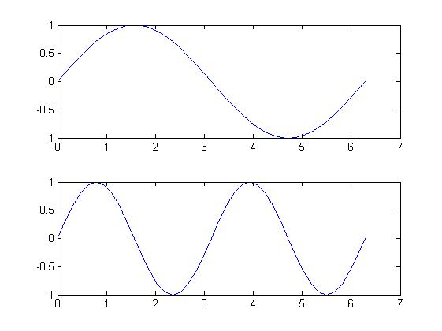
Subplots
>> x=0:pi/20:2*pi;
>> subplot(2,1,1)
>> plot(x,sin(x))
>> subplot(2,1,2)
>> plot(x,sin(2*x))
Simple x-y plots, in the first part of figure, y = sin(x).
And in the second part of figure, y= sin(2*x).

Slide 37
Exercise 3 (Subplots)
Subdivided a figure window into one row and two columns.
In the left window, plot y=tan(x) Let x vary from -1.5 to 1.5 in increment of 0.1.
Add a title and axis labels to your graph.
In the right window, plot y=sinh(x) for the same x range. (Hyperbolic sine function)
Add a title and axis labels to this graph.
Use the M file to write and run it.

Slide 38
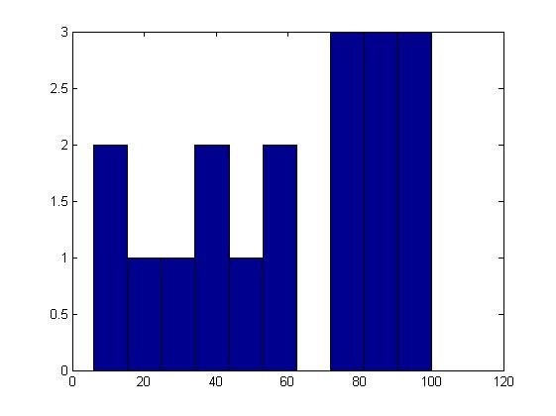
Histograms
A histogram is a special type of graph that is particularly useful for the statistical analysis of data. A histogram is a plot showing the distribution of a set of values. In Matlab, the histogram compute the number of values falling into 10 bins (categories) that are equally spaced between the minimum and maximum values.
>> x=[100,96,74,87,75,22,56,78,34,35,93,88,86,42,55,48,9,6];
>> hist(x)

Slide 39
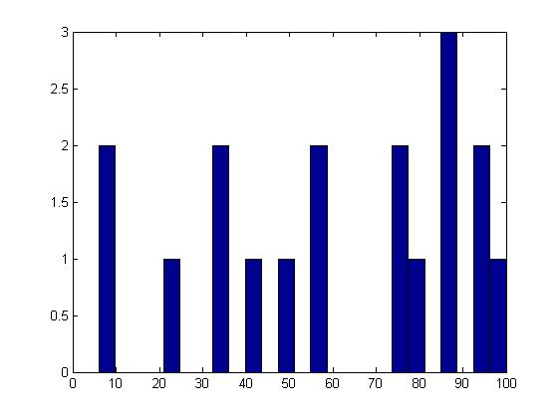
Histograms
The default number of bins is 10, but if we have a large data set, we may want to divide the data up into more bins. For example, to create a histogram with 25 bins, the command would be hist(x, 25) .

Slide 40
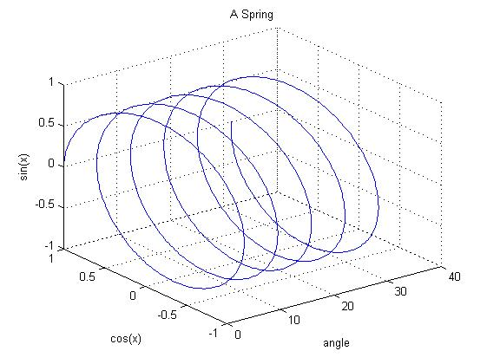
Three Dimensional Plotting
>>x = linspace (0, 10*pi, 1000);
>> y = cos(x);
>> z = sin(x);
>> plot3(x,y,z)
>> grid on, xlabel('angle'), ylabel('cos(x)'), zlabel('sin(x)'), title('A Spring')

Slide 41
Exercise 4 (Histogram)
Suppose that x = [1, 2, 3, 4, 6, 7, 8, 9, 10, 12, 14, 17, 19, 23, 29, 30, 31, 32, 35, 40, 57,66,67,68,80,90,91,100]
Subdivided a figure window into two rows and one column.
In the top window, plot the histogram of x with the default number of bins.
Add a title to your graph.
In the bottom window, plot the histogram of x with 20 bins.
Add a title to this graph.
Use the M file to write and run it.

Slide 42
Outline of Lab 3
Review of Lab 2
Execution control
Plots and graphs using Matlab
Basic manipulation in image processing

Slide 43
The MATLAB Image Processing Toolbox
The Image Processing Toolbox is a collection of MATLAB functions (called M-functions or M-files) that extend the capability of the MATLAB environment for the solution of digital image processing problems.

Slide 44
The MATLAB Image Processing Toolbox
Including:
  Spatial image transformations
  Neighborhood and block operations
  Linear filtering and filter design
  Transforms
  Image analysis and enhancement

Slide 45
How to find suitable M-function?
Find it in Matlab Help.
-by category
-by alphabetical list
Find it on the textbook.
Find in the sub-folder in Matlab

Slide 46
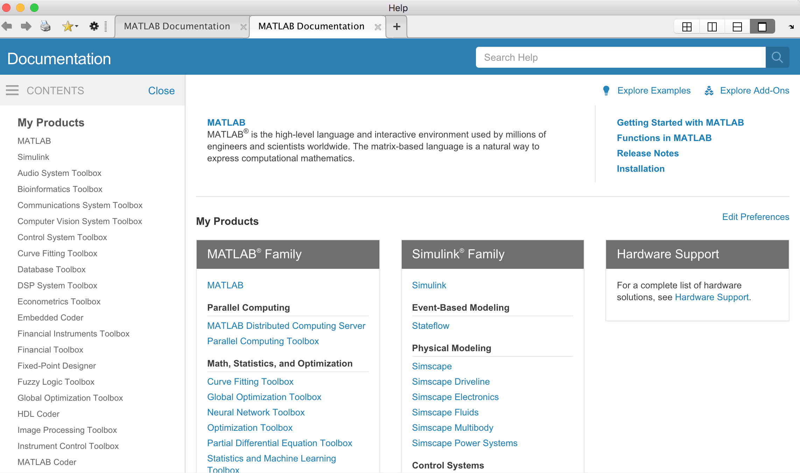
Where is Image Processing Toolbox

Slide 47
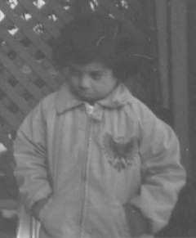

Reading an image
Function:
  imread()
Goal:
  Load the image and save it as the array format.
Method:
  I = imread(filename);
  [I,map] = imread(filename);
Examples:
I = imread('pout.tif');
I = imread('rice.png');
pout
rice

Slide 48
Displaying an image
Function:
  imshow()
Goal:
  Open a window to show the image
Method:
  imshow(I)
Goal:
  Open a new window to show the image
Method:
  figure,imshow(I)

Slide 49
Displaying an image(cont.)
Function:
  colorbar
Goal:
  To display an image with a colorbar that indicates the range of intensity values.
Method:
  imshow(I), colorbar
Example:
  I = imread('pout.tif');
  imshow(I) , colorbar

Slide 50
Writing an image
Function:
  imwrite()
Goal:
  Function: write the image out as a file
Method:
  imwrite(I,filename,format)
Example:
  imwrite(I, ‘pout.jpg’, ‘JPEG’);

Slide 51
Image information
Function:
  size()
Goal:
  Returns the number of rows and columns of an matrix/image
Method:
  [M,N] = size(I) for matrix/image I, returns the number of rows and columns in X as separate output variables.
Example:
  I= imread('saturn.png'); % I is a gray image
[I_x,I_y] = size(I) % I_x= height of the image, I_y= width of the image
Method:
  M = SIZE(X,DIM) returns the length of the dimension specified

Slide 52
Image information
Function:
  whos
Goal:
  Display information about a variable .
Example:
  whos I
Function:
  imfinfo()
Goal:
  display information about image file .
Example:
  info = imfinfo('saturn.png')

Slide 53
Digital Image processing
Function:
  im2bw()
Goal:
  Convert intensity image I to binary image g using threshold T, where T must be in range [0, 1].
Method:
  g = im2bw(I, T);
Example:
  I= imread('pout.tif');
g = im2bw(I, 0.4);
imshow(g) ,colorbar

Slide 54
Digital Image processing (cont.)
Function:
  rgb2gray()
Goal:
  Transform RGB color model image into gray-level image.
Example:
  I= imread ('saturn.png');
imshow(I);
  g = rgb2gray(I);
  figure,
  imshow(g), colorbar

Slide 55
Digital Image processing (cont.)
Function:
  imresize()
Goal:
  Change the size of an image.
Method:
  imresize(A, SCALE, METHOD)
Example:
  I = imread('circuit.tif');
  J = imresize(I,1.25);
  imshow(I)
  figure, imshow(J)
Method:
  imresize(A, [NUMROWS NUMCOLS], METHOD)
Example:
  I = imread('circuit.tif');
J = imresize(I,[100 150], 'bilinear');
imshow(I)
figure, imshow(J)
Notes:
Interpolation method

Slide 56
Digital Image processing (cont.)
Function:
  imrotate();
Goal:
  Rotate image A by ANGLE degrees in a counterclockwise direction around its center point.
Method:
  imrotate(I, angle);
Example:
  I = imread('pout.tif');
J = imrotate(I,35);
imshow(J)

Slide 57
More Example (cont.)
How to use this function ?
  imfilter()
Find instructions about it by help
  Help imfilter
Write this code and see what will happen?
  I = imread('coins.png');
  h = ones(5,5) / 25;
  I2 = imfilter(I,h);
  imshow(I), title('Original Image');
  figure, imshow(I2), title('Filtered Image')

Slide 58
More Example (cont.)
Write this code and see what will happen?
  I = imread('cameraman.tif');
  h = fspecial('unsharp');
  I2 = imfilter(I,h);
  imshow(I), title('Original Image')
  figure, imshow(I2), title('Filtered Image')

