Slide 1
Learning Outputs of Lecture 07 回顾
Introduction to Compression （压缩）
The need for data compression
Lossless vs lossy compression
Compression ratio
Basics of Information Theory （信息论基础）
Variable-Length Coding (VLC) （变长编码）
Shannon-Fano Algorithm
Huffman Coding
Dictionary-based Coding （基于字典的编码）
Arithmetic Coding （算术编码）

Slide 2
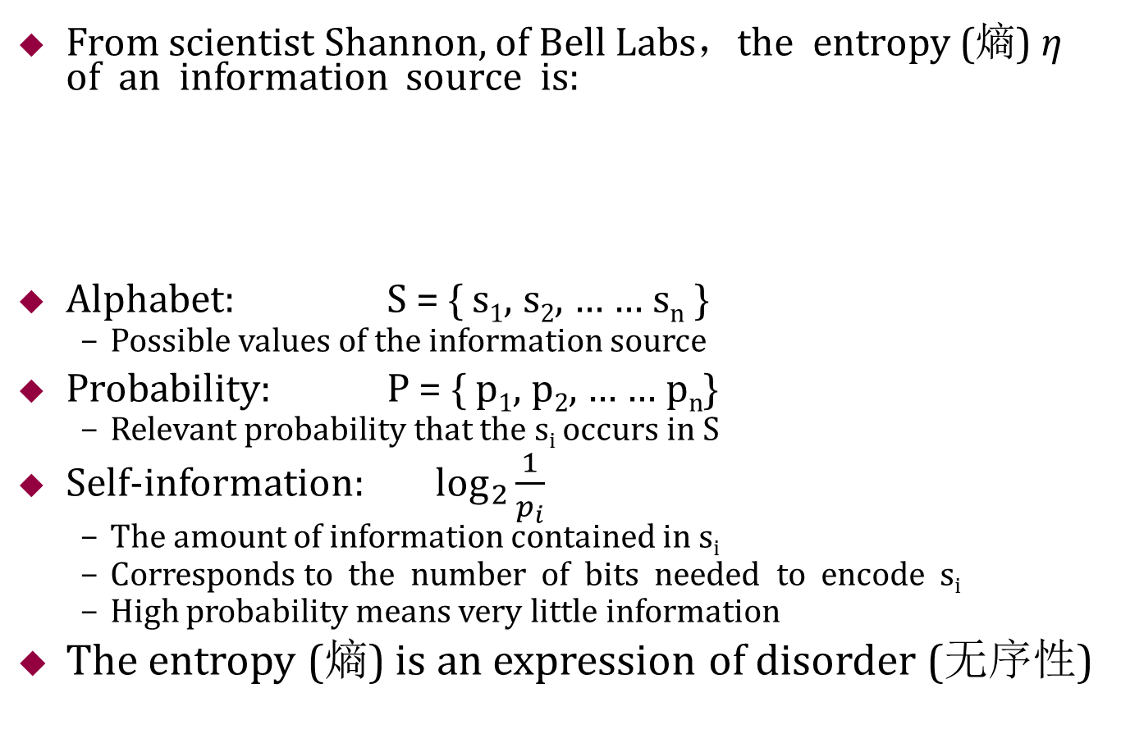
Basics of Information Theory
From scientist Shannon, of Bell Labs，the entropy (熵) η of an information source is:
Alphabet: S = { s₁, s₂, … … s_{n} }
Possible values of the information source
Probability: P = { p₁, p₂, … … p_{n}}
Relevant probability that the s_{i} occurs in S
Self-information: $\log_{2}{\frac{1}{p_{i}}}$
The amount of information contained in s_{i}
Corresponds to the number of bits needed to encode s_{i}
High probability means very little information
The entropy (熵) is an expression of disorder (无序性)

Slide 3
Shannon-Fano Algorithm
Coding tree for “hello” by Shannon-Fano algorithm
Symbol | L | H | E | O
Count | 2 | 1 | 1 | 1
(5)
0
1
(3)
(5)
L:(2)
0
1
0
1
H:(1)
E,O:(2)
L:(2)
H,E,O:(3)
(b)
(a)
(5)
0
1
(3)
L:(2)
0
1
(2)
H:(1)
0
1
E:(1)
O:(1)
(c)

Slide 4
Huffman Coding
Example:
Consider a symbol stream:
ACABADADEAABBAAAEDCACDEAAABCDBBEDCBACAE
Give the Huffman coding!
Average number of bits needed for each symbol is: (1*15+3*7+3*6+3*6+3*5)/(15+7+6+6+5) = 2.23
Ideal entropy = (15*1.38 + 7*2.48 + 6*2.7+6*2.7 + 5*2.96)/39=2.19
P4:(39)
Symbol | Code | Count | Log(1/p)
A | 0 | 15 | 1.38
B | 111 | 7 | 2.48
C | 110 | 6 | 2.70
D | 101 | 6 | 2.70
E | 100 | 5 | 2.96
0
1
A:(15)
P3:(24)
0
1
P1:(11)
P2:(13)
0
1
0
1
E:(5)
D:(6)
C:(6)
B:(7)

Slide 5
Dictionary-based Coding
“ABABBABCABABBA”
The output codes are: 1 2 4 5 2 3 4 6 1
Compression ratio = 14/9 = 1.56
Notes:
LZW算法又叫“串表压缩算法”就是通过建立一个字符串表，用较短的代码来表示较长的字符串来实现压缩。 LZW压缩算
ZW码能有效利用字符出现频率冗余度进行压缩，且字典是自适应生成的，但通常不能有效地利用位置冗余度。
LZW压缩技术对于可预测性不大的数据具有较好的处理效果，常用于TIF格式的图像压缩，其平均压缩比在2：1以上，最高压缩比可达到3：1。
主题内容是一个if判断语句，如果s+c不存在，输出s，把s+c添加到字典， 如果s+c存在，判断更长词是否存在

Slide 6
Dictionary-based Coding
The LZW decompression algorithm then works as follows:
BEGIN
s = NIL;
while not EOF
{
k = next input code;
entry = dictionary entry for k;
output entry;
if (s != NIL)
add string s + entry[0] to
dictionary with a new code;
s = entry;
} END
Output “ABABBABCABABBA”
Notes:
基于k 输出词， 然后添加词典

Slide 7
Arithmetic Coding
Arithmetic Coding Encoder
BEGIN
low = 0.0;
high = 1.0;
range = 1.0;
while (symbol != terminator)
{
get (symbol);
low = low + range * Range_low(symbol); high = low + range * Range_high(symbol); range = high - low;
}
output a code so that low <= code < high; END
Notes:
主题是更新 low， hight 和range，

Slide 8
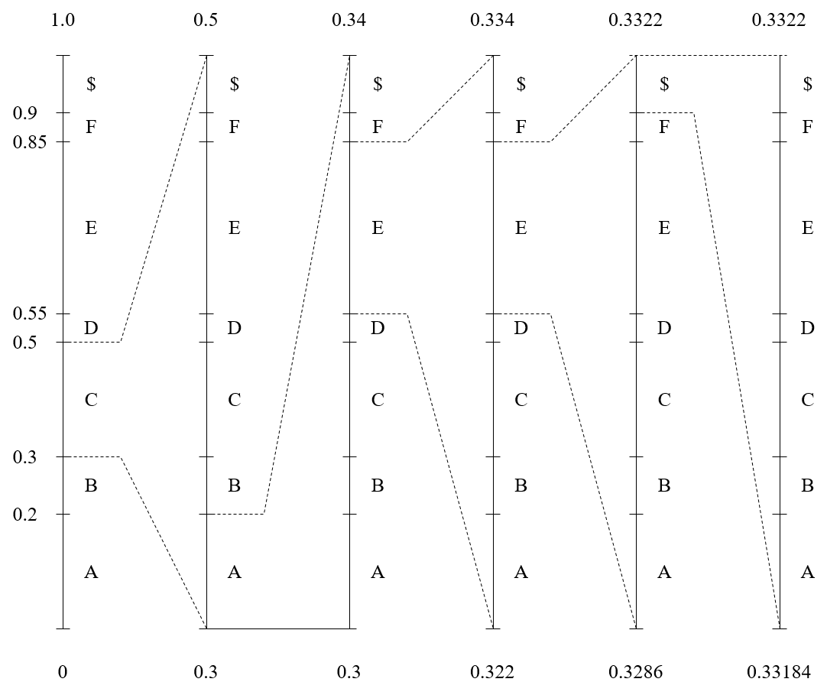
Dictionary-based Coding

Slide 9
Arithmetic Coding
Encode Symbols “CAEE$”.
Generate the codeword
0.33184 < codeword < 0.33220
The shortest binary codeword 0.01010101
The message becomes longer，the length of the interval shortens
Symbol | low | high | range
 | 0 | 1.0 | 1.0
C | 0.3 | 0.5 | 0.2
A | 0.30 | 0.34 | 0.04
E | 0.322 | 0.334 | 0.012
E | 0.3286 | 0.3322 | 0.0036
$ | 0.33184 | 0.33220 | 0.00036
Notes:
区间中取最短二进制码，算法见参考书，是个尝试判断方法

Slide 10
Arithmetic Coding
Generate the codeword
0.33184 < codeword < 0.33220
The shortest binary codeword 0.01010101
Generating Codeword for Encoder
BEGIN
code = 0;
k = 1;
while (value(code) < low)
{ assign 1 to the kth binary fraction bit if (value(code)>high)
replace the kth bit by 0
k = k + 1;
} END
Notes:
区间中取最短二进制码，算法见参考书，是个尝试判断方法

Slide 11
Arithmetic Coding
Arithmetic Coding Decoder
BEGIN
get binary code and convert to decimal value = value(code);
Do
{ find a symbol s so that
Range_low(s) <= value < Range_high(s); output s;
low = Rang_low(s); high = Range_high(s); range = high - low;
value = [value - low] / range;
}
Until symbol s is a terminator END
①
②
③
④
Notes:
二进制码转成十进制码①， 查看落在那个字符区间，更新low hight range， 更新value

Slide 12
Arithmetic Coding
Decode symbols “CAEE$”
0.01010101→ 0.33203125
value = [value - low] / range;
value | Output Symbol | low | high | range
0.33203125 0.16015625 0.80078125 0.8359375 0.953125 | C A E E $ | 0.3 0.0 0.55 0.55 0.9 | 0.5 0.2 0.85 0.85 1.0 | 0.2 0.2 0.3 0.3 0.1

Slide 13

有损压缩算法 Lossy Compression Algorithms
授课教师：张小燕
邮箱：xyzhang15@szu.edu.cn
2021年春季课程

Slide 14
Outline
Introduction to Lossy Compression （有损压缩）
Distortion Measures （失真度量）
Quantization （量化）
Transform Coding （变换编码）

Slide 15
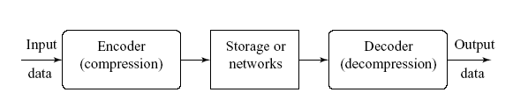
Introduction to Lossy Compression
What is lossy compression ?
The compressed data is not the same as the original data, but a close approximation of it.
Yields a much higher compression ratio than that of lossless compression.
Notes:
有损是手段，目的是获取高压缩率，哪些应用需要有损，哪些应用需要无损？

Slide 16
Outline
Introduction to Lossy Compression （有损压缩）
Distortion Measures （失真度量）
Quantization （量化）
Transform Coding （变换编码）

Slide 17

Distortion Measures
Distortion Measures
– mean square error (MSE,均方差 ) σ ²,
where xn, yn, and N are the input data sequence, reconstructed data sequence, and length of the data sequence respectively.
– signal to noise ratio (SNR,信号噪声比 ), in decibel units (dB),
_{σ}2
SN R = 10 log₁₀
x
_{σ}2
d
σ² is the MSE.
均方
d
σ² is the average square value of the original data sequence
x
– peak signal to noise ratio (PSNR，峰值信噪比),
_{x}2
P SN R = 10 log₁₀
peak
_{σ}2
d

Slide 18
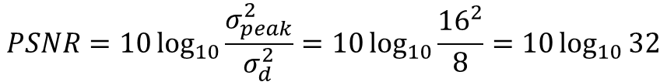
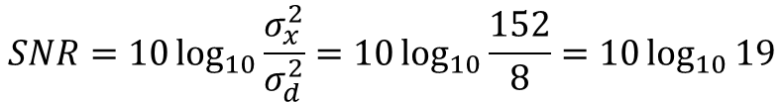
Distortion Measures
Example
A set of codes before compression are: 12, 16, 16, 12, 12, 8, 8, 12
After compression: 8, 12, 12, 12, 12, 8, 12, 12
Please give the MSE, SNR, PSNR
MSE
$σ_{d}^{2}=\frac{{(12−8)}^{2}+{(16−12)}^{2}+{(16−12)}^{2}+{(12−12)}^{2}+{(12−12)}^{2}+{(8−8)}^{2}+{(8−12)}^{2}+{(12−12)}^{2}}{8}$ =8
SNR
$σ_{x}^{2}=\frac{{(12)}^{2}+{(16)}^{2}+{(16)}^{2}+{(12)}^{2}+{(12)}^{2}+{(8)}^{2}+{(8)}^{2}+{(12)}^{2}}{8}$ =152
$$SNR=10\log_{10}{\frac{σ_{x}^{2}}{σ_{d}^{2}}=10\log_{10}{\frac{152}{8}}=10\log_{10}{19}}$$
$$PSNR=10\log_{10}{\frac{σ_{peak}^{2}}{σ_{d}^{2}}=10\log_{10}{\frac{{16}^{2}}{8}=10\log_{10}{32}}}$$
PSNR

Slide 19
Outline
Introduction to Lossy Compression （有损压缩）
Distortion Measures （失真度量）
Quantization （量化）
Transform Coding （变换编码）

Slide 20
Quantization
Quantization is the main source of the “loss” in lossy compression scheme
Reduce the number of distinct output values to a much smaller set
Original: { 0,1,2, … 64 … 128 … 192 … 255 }
Smaller set: {16,48, 80, 112,144,176,208,240}
Two different forms of quantization
Uniform scalar quantization : equally spaced intervals
Nonuniform scalar quantization: unequally spaced intervals
Notes:
为什么要把量化单独讲呢？ 因为量化是实现有损的主要手段， 有损的目的是减少数据量， 量化的目的也是减少数据个数
{0,32, 64, 96,128,160,192,224}

Slide 21
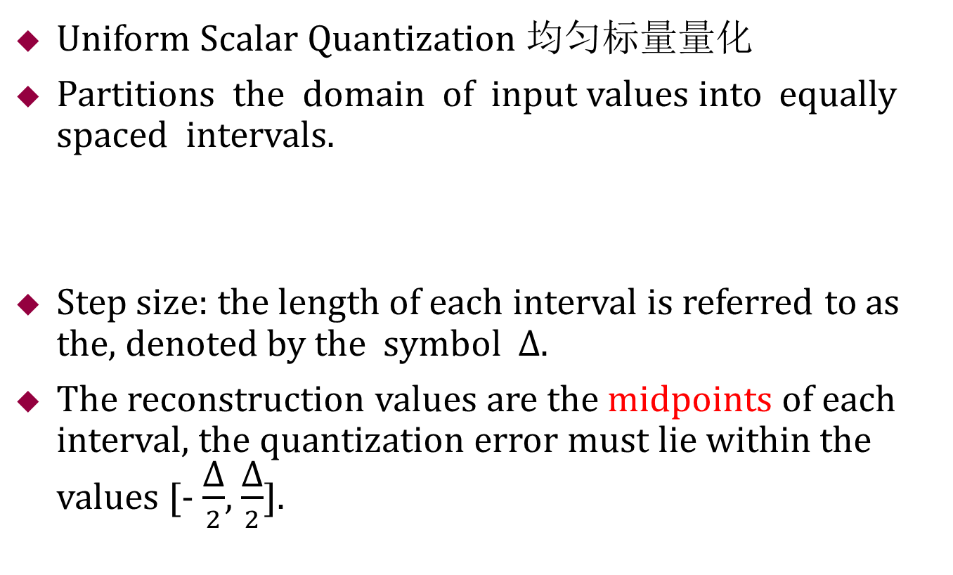
Quantization
Uniform Scalar Quantization 均匀标量量化
Partitions the domain of input values into equally spaced intervals.
Step size: the length of each interval is referred to as the, denoted by the symbol ∆.
The reconstruction values are the midpoints of each interval, the quantization error must lie within the values [- $\frac{\text{∆}}{2}$, $\frac{\text{∆}}{2}$].
∆
0 32 64 96 128 160 192 224 256

Slide 22
Quantization
Nonuniform Scalar Quantization非均匀标量量化
Partition the domain of input values into unequally spaced intervals.
Concentrate the bits to where is most need.
Lloyd-Max quantization and companded quantization.
^
X
Uniform quantizer
X
G
_{G} −1
Companded quantization.
压缩扩展量化

Slide 23
Outline
Introduction to Lossy Compression （有损压缩）
Distortion Measures （失真度量）
Quantization （量化）
Transform Coding （变换编码）

Slide 24
Transform Coding
Example of transform coding
Original data X: {100 101 100 99 100 100 100 100}
Transform coding T: di-di-1 and d1 = 100;
Transformed vector Y: {100 1 -1 -1 1 0 0 0}
Y is the result of a linear transform T of the input vector X , the components of Y are much less correlated.
If most information is accurately described by the first few components of a transformed vector, then the remaining components can be coarsely quantized.
Y’: {100}

Slide 25
Transform Coding
Frequency domains can be obtained through the transformation from one (time or spatial) domain to the other (frequency) via
Fourier Transform (FT，傅里叶变换), MPEG Audio .
Discrete Cosine Transform (DCT，离散余弦变换) ——Heart of JPEG and MPEG Video, MPEG Audio.
Fourier transform
Sine transform
Cosine transform
Notes:
把一个信号分解成在不同频率余弦函数的叠加，统计每个频率余弦基函数的组成成分，举例颜色模型

Slide 26



1D DCT and IDCT with 8 numbers
Given an input function f(i) over an integer variables i, the 1D DCT transforms it into a new function F(u), with integer u running over the same range as i .
Consider a data sequence with 8 numbers
1D DCT
1D IDCT
The constants C(u) are determined by
Notes:
局部信息统计手段，每8个信息计算一次dct
Fi 在cos 函数的投影， cos的频率有u决定

Slide 27
1D DCT and IDCT with 8 numbers
1D DCT basis function

Slide 28
1D DCT and IDCT with 8 numbers
1D DCT basis function
The 4th basis function (u = 4)
The 5th basis function (u = 5)
1.0
0.5
0
−0.5
−1.0
1.0
0.5
0
−0.5
−1.0
0 1 2 3 4 5 6 7
0 1 2 3 4 5 6 7
i
i
The 6th basis function (u = 6)
The 7th basis function (u = 7)
1.0
0.5
0
−0.5
−1.0
1.0
0.5
0
−0.5
−1.0
0 1 2 3 4 5 6 7
0 1 2 3 4 5 6 7
i
i

Slide 29
Example of Compression Scheme for 1D DCT
Matlab code of 1D DCT (see DCT1D.m)
Original data X: { 60 36 21 21 17 12 21 38 }
Transformed vector Y: 80 20 32 2 16 1 0 0

Slide 30
2D DCT and 2D IDCT
Consider an image block with 8 ×8 numbers
2D DCT
2D IDCT
The constants C(u) are determined by

Slide 31
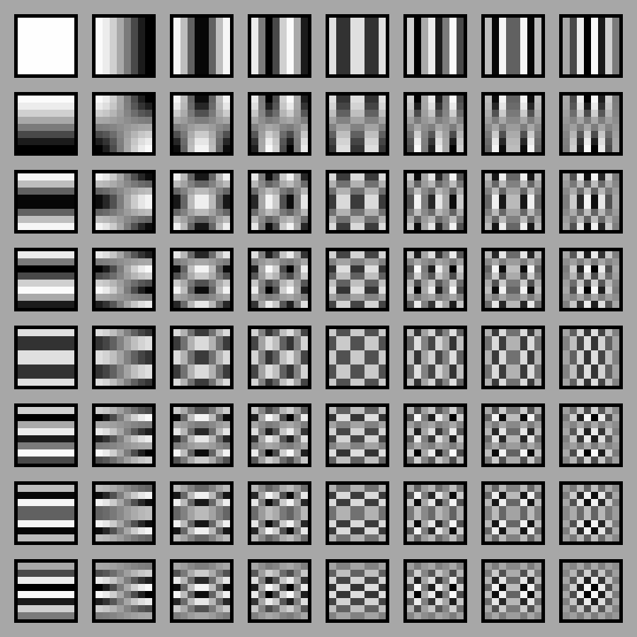
2D DCT and 2D IDCT
DCT 2D Basis Functions
Matlab code of 2D DCT (see DCT2Dbasis.m):

Slide 32
2D DCT and 2D IDCT Matlab
See demoDCT2.m
I = imread('Lena.jpg');
I=imresize(I,[400 400]);
I = rgb2gray(I);
I = im2double(I);
T = dctmtx(8);
dct = @(block_struct) T* block_struct.data*T';
B = blockproc(I,[8 8],dct);
mask = [1 1 1 0 0 0 0 0
1 1 1 0 0 0 0 0
1 1 1 0 0 0 0 0
0 0 0 0 0 0 0 0
0 0 0 0 0 0 0 0
0 0 0 0 0 0 0 0
0 0 0 0 0 0 0 0
0 0 0 0 0 0 0 0];

Slide 33
2D DCT and 2D IDCT Matlab
B2 = blockproc(B,[8 8],@(block_struct) mask .* block_struct.data);
invdct = @(block_struct) T' * block_struct.data * T;
I2 = blockproc(B2,[8 8],invdct);
figure
subplot(2,2,1);
imshow(I)
title('Original Grayscale Image ');
subplot(2,2,2);
imshow(I2)
title('Recovered from F(0,0) ~ F(2,2) ');
subplot(2,2,3);
imshow(B)
title('2D DCT result');

Slide 34
2D DCT and 2D IDCT Matlab

