Slide 1

无损压缩算法 Lossless Compression Algorithms
授课教师：张小燕
邮箱：xyzhang15@szu.edu.cn
2021年春季课程

Slide 2
Outline
Introduction to Compression （压缩）
The need for data compression
Lossless vs lossy compression
Compression ratio
Basics of Information Theory （信息论基础）
Variable-Length Coding (VLC) （变长编码）
Shannon-Fano Algorithm
Huffman Coding
Dictionary-based Coding （基于字典的编码）
Arithmetic Coding （算术编码）

Slide 3
The Need for Compression
Raw video, image, and audio can be very large.
Example: Uncompressed images.
Image Type | File Size
512 x 512 8-bit colour image | 0.25 MB
512 x 512 24-bit colour image | 0.75 MB
4032 x 3024 24-bit colour image (约1200万像素) | 34MB
Example: Videos (involves a stream of audio plus video imagery).
Raw Video —uncompressed image frames 512×512, true Colour at 25 FPS = 1125 MB/min.
HDTV (1920×1080) —true Colour at 25 FPS = 8.7 GB/min.
Compression HAS TO BE part of the representation of audio, image, and video。
CM3106 Chapter 9: Basic Compression Compression Overview 3
Notes:
5G, 1。超大带宽2。超低时延3。海量连接 5G比4G的速度快100倍,比4G的时延低了1/10, 5G网络的理论下行速度为10Gb/s，4G网络的下行速率能达到100Mbps～150Mbps。 为什么要学习压缩？互联网中的数据都要经过压缩，作为计算机学院的大学生应该知道你接触的数据经过了什么处理。比如，在另存图像时有不同的图像格式，如 bmp tif jpg，为什么存出来质量不同 大小不同。视频 存成 avi， mpg4 为什么大小可以不同。

Slide 4
Compression in Multimedia Data
The objective of compression is to reduce the redundancy of the data and to store or transmit data in an efficient form.
Compression basically employs redundancy （冗余）in the data:
Temporal in 1D data, 1D signals, audio, between video frames etc.
Spatial correlation between neighboring pixels or data items.
Spectral, e.g. correlation between color or luminescence components. This uses the frequency domain to exploit relationships between frequency of change in data.
Psycho-visual (心理视觉) exploit perceptual properties of the human visual system.

Slide 5
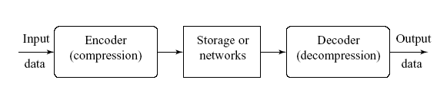
Lossless vs Lossy Compression
Compression can be categorized in two broad ways:
Lossless Compression（无损）: after decompression gives an exact copy of the original data.
There is no information loss .
Example：Entropy encoding schemes (Shannon-Fano, Human coding), arithmetic coding, LZW algorithm
Lossy Compression（有损）: after decompression gives ideally a “close” approximation of the original data.
There is information loss .
Example: JPEG/MPEG
Notes:
无损压缩一般压缩率比较小，有损压缩可以实现大压缩率。

Slide 6
Compression Ratio
Compression ratio
Compression ratio = B₀/B₁
B₀: number of bits before compression
B₁: number of bits after compression
有一个字符串，压缩前每个字符长度为8bit，压缩后每个字符的平均长度为3bit，压缩率为多少？
压缩率为8/3
Notes:
衡量数据压缩的程度

Slide 7
Outline
Introduction to Compression （压缩）
The need for data compression
Lossless vs lossy compression
Compression ratio
Basics of Information Theory （信息论基础）
Variable-Length Coding (VLC) （变长编码）
Shannon-Fano Algorithm
Huffman Coding
Dictionary-based Coding （基于字典的编码）
Arithmetic Coding （算术编码）

Slide 8
Basics of Information Theory
8 | 8
6 | 6
9 | 9
7 | 7
4 | 4
5 | 5
2 | 2
3 | 3
0 | 1
2 | 9
6 | 3
1 | 1
1 | 0
9 | 5
0 | 0
4 | 2
7 | 9
两位数字相同
有几种取值？？
两位数字随机
有几种取值？？
每个取值的概率：1/10
每个取值的概率：1/100
用二进制编码需要几位？
Log2（10）=3.3
用二进制编码需要几位？
Log2（100）=6.6
Notes:
信息论是运用概率论与数理统计的方法研究信息、信息熵、通信系统、数据传输、密码学、数据压缩等问题的应用数学学科。信息论将信息的传递作为一种统计现象来考虑，给出了估算通信信道容量的方法。我们的压缩方法、信息传递，信道等都是有系列对应的理论的。

Slide 9
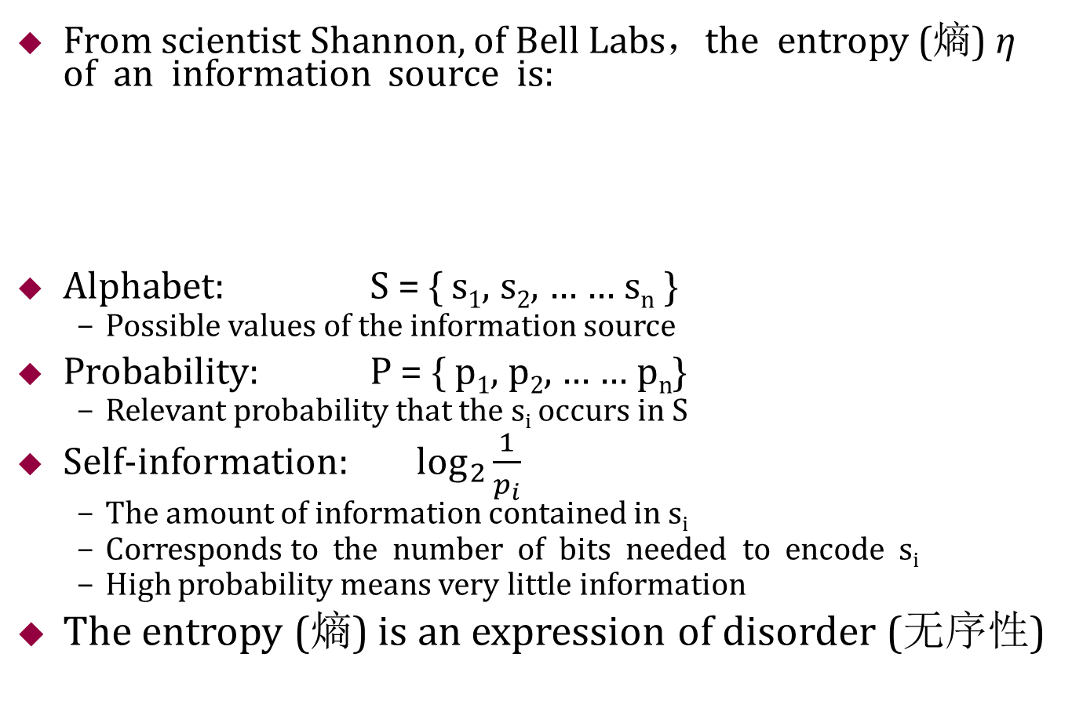
Basics of Information Theory
From scientist Shannon, of Bell Labs，the entropy (熵) η of an information source is:
Alphabet: S = { s₁, s₂, … … s_{n} }
Possible values of the information source
Probability: P = { p₁, p₂, … … p_{n}}
Relevant probability that the s_{i} occurs in S
Self-information: $\log_{2}{\frac{1}{p_{i}}}$
The amount of information contained in s_{i}
Corresponds to the number of bits needed to encode s_{i}
High probability means very little information
The entropy (熵) is an expression of disorder (无序性)
Notes:
信息论是运用概率论与数理统计的方法研究信息、信息熵、通信系统、数据传输、密码学、数据压缩等问题的应用数学学科。信息论将信息的传递作为一种统计现象来考虑，给出了估算通信信道容量的方法。我们的压缩方法、信息传递，信道等都是有系列对应的理论的。

Slide 10
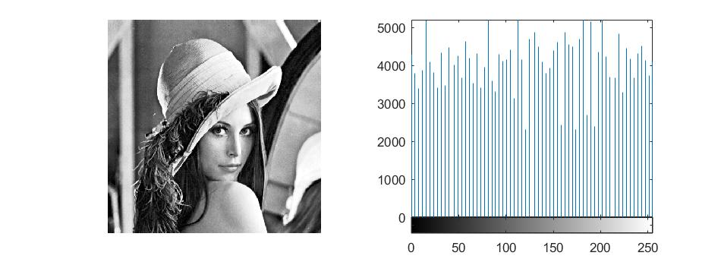
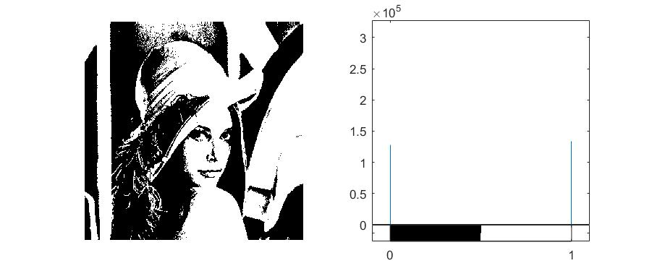
Example of Entropy Calculation
For image (b), p_{i} = {1/3, 2/3}, the entropy is
Notes:
bits should be used to represent each symbol. Which contains more information?

Slide 11

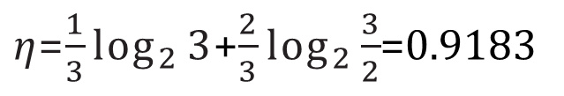
Example of Entropy Calculation
p_{i} p_{i}
1
1/256
2/3
For image (a), p_{i} = 1/256, the entropy is:
$\text{η}$=$\sum_{i=0}^{255}{\frac{1}{256}}$ log₂ 256 = 8
For image (b), p_{i} = {1/3, 2/3}, the entropy is
1/3
0
255
i
0
255
i
(a) (b)
Histograms for Two Gray-level Images.
$\text{η}$=$\frac{1}{3}\log_{2}{3}$+$\frac{2}{3}\log_{2}{\frac{3}{2}}$=0.9183
Notes:
bits should be used to represent each symbol

Slide 12
Example of Entropy Calculation
Example
Alphabet: S = {0, 1, 2, 3}
Probability: P = {1/4, 1/4, 1/4, 1/4}
Self-information: - log₂p_{i} = { 2, 2, 2, 2}
Entropy: E = 2
On average, 2 bits should be used to represent each symbol
Example
Alphabet: S = {0, 1, 2, 3}
Probability: P = {0, 1/2, 0, 1/2}
Self-information: - log₂p_{i} = {---, 1, ---, 1}
Entropy: E = 1
On average, 1 bit should be used to represent each symbol
Entropy corresponds to the average number of bits needed to encode a character
Notes:
bits should be used to represent each symbol

Slide 13
Basics of Information Theory
The entropy (熵) η represents the average amount of information contained per symbol in the source S.
The entropy η specifies the lower bound for the average number of bits to code each symbol in S, i.e.,
¯l is the average length (measured in bits) of the codewords produced by the encoder.
Entropy coding is a lossless data compression scheme.
Two most common: Shannon–Fano algorithm, Huffman coding.
Demo entropyRGB_Ycbcr.m
η ≤ ¯l
Notes:
熵编码即编码过程中按熵原理不丢失任何信息的编码。常见的熵编码有：香农(Shannon)编码、哈夫曼(Huffman)编码和算术编码(arithmetic coding)。
图像数据通过matlab内置函数rgb2ycbcr 进行转换，再重新计算各通道的信息熵。不难发现，Y亮度通道的信息熵和RGB颜色模型中的信息熵接近。但是Cb和Cr两个色差通道的信
息熵显著下降。即无损压缩难度降低。

Slide 14

Basics of Information Theory
练习
灰度 | 0 | 20 | 50 | 99
次数 | 32 | 8 | 16 | 8
概率 | 1/2 | 1/8 | 1/4 | 1/8
$η=\frac{1}{2}\log_{2}{2}+\frac{1}{8}\log_{2}{8}+\frac{1}{4}\log_{2}{4}+\frac{1}{8}\log_{2}{8}=$1.75

Slide 15
Outline
Introduction to Compression （压缩）
The need for data compression
Lossless vs lossy compression
Compression ratio
Basics of Information Theory （信息论基础）
Variable-Length Coding (VLC) （变长编码）
Shannon-Fano Algorithm
Huffman Coding
Dictionary-based Coding （基于字典的编码）
Arithmetic Coding （算术编码）

Slide 16
Variable-Length Coding (VLC)
The code lengths for different symbols should vary according to the information carried by the symbols
Symbols that occur more frequently will have shorter codes than symbols that occur less frequently
Main VLC algorithms
Shannon-Fano Algorithm(top-down approach)
Huffman Coding (bottom-up approach)
Notes:
每个字符的编码长度不一样，根据信息量，信息量小 用短码，信息量大用长码。

Slide 17
Shannon-Fano Algorithm
Developed by Shannon at Bell Labs and Robert Fano at MIT
Example
“HELLO”
Algorithm
Sort the symbols according to the frequency count of their occurrences.
Recursively divide the symbols into two parts, each with approximately the same number of counts, until all parts contain only one symbol.
Frequency count of the symbols
Symbol | L | H | E | O
Count | 2 | 1 | 1 | 1
Notes:
麻省理工学院（Massachusetts Institute of Technology）。2019-20年度，麻省理工学院位列QS世界大学排名第一 、U.S. News世界大学排名第二。

Slide 18
Shannon-Fano Algorithm
Coding tree for “hello” by Shannon-Fano algorithm
Symbol | L | H | E | O
Count | 2 | 1 | 1 | 1
(5)
0
1
(3)
(5)
L:(2)
0
1
0
1
H:(1)
E,O:(2)
L:(2)
H,E,O:(3)
(b)
(a)
(5)
0
1
(3)
L:(2)
0
1
(2)
H:(1)
0
1
E:(1)
O:(1)
(c)

Slide 19
Shannon-Fano Algorithm
Another coding tree for “hello” by Shannon-Fano algorithm
Symbol | L | H | E | O
Count | 2 | 1 | 1 | 1

Slide 20
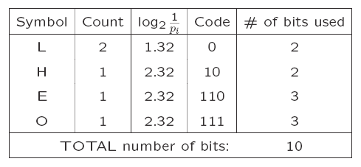
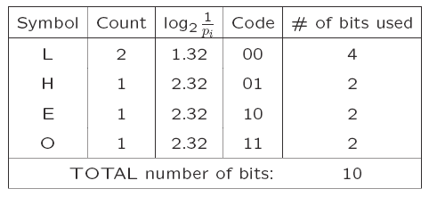
Shannon-Fano Algorithm
Result of Performing Shannon-Fano on HELLO
Discussion:
The Shannon–Fano algorithm delivers satisfactory coding results for data compression,
but it was soon outperformed and overtaken by the Huffman coding method.

Slide 21
Huffman Coding
First presented by Huffman in a 1952, has been adopted in fax machines, JPEG, and MPEG.
A bottom-up approach
Initialization: Put all symbols on a list sorted according to their frequency counts.
Repeat until the list has only one symbol left:
From the list pick two symbols with the lowest frequency counts. Form a Huffman subtree that has these two symbols as child nodes and create a parent node.
Assign the sum of the children’s frequency counts to the parent and insert it into the list such that the order is maintained.
Assign code 0/1 to the two branches of the tree, delete the children from the list.
Assign a codeword for each leaf based on the path from the root.
Notes:
First presented by Huffman in a 1952 paper, this method attracted an overwhelming
amount of research and has been adopted in many important and/or commercial
applications, such as fax machines, JPEG, and MPEG.
1951年，霍夫曼在麻省理工学院（MIT）攻读博士学位，他和修读信息论课程的同学得选择是完成学期报告还是期末考试。导师罗伯特·法诺（Robert Fano）出的学期报告题目是：查找最有效的二进制编码。由于无法证明哪个已有编码是最有效的，霍夫曼放弃对已有编码的研究，转向新的探索，最终发现了基于有序频率二叉树编码的想法，并很快证明了这个方法是最有效的。霍夫曼使用自底向上的方法构建二叉树，避免了次优算法香农-范诺编码（Shannon–Fano coding）的最大弊端──自顶向下构建树。

Slide 22
Huffman Coding
Symbol | L | H | E | O
Count | 2 | 1 | 1 | 1
P2:(3)
P1:(2)
0
1
0
1
P1:(2)
H:(1)
0
1
E:(1)
O:(1)
E:(1)
O:(1)
(b)
(a)
After initialization: L H E O
After iteration (a): L P1 H
After iteration (b): P2 L
After iteration (c): P3
P3:(5)
0
1
P2:(3)
L:(2)
0
1
P1:(2)
1
Symbol | Code
L | 0
H | 10
E | 110
O | 111
H:(1)
0
E:(1)
O:(1)
(c)

Slide 23
Huffman Coding
Example:
Consider a symbol stream:
ACABADADEAABBAAAEDCACDEAAABCDBBEDCBACAE
Give the Huffman coding!
P4:(39)
0
1
A:(15)
P3:(24)
0
1
P1:(11)
P2:(13)
0
1
0
1
E:(5)
D:(6)
C:(6)
B:(7)

Slide 24
Huffman Coding
Example:
Consider a symbol stream:
ACABADADEAABBAAAEDCACDEAAABCDBBEDCBACAE
Give the Huffman coding!
Average number of bits needed for each symbol is: (1*15+3*7+3*6+3*6+3*5)/(15+7+6+6+5) = 2.23
Ideal entropy = (15*1.38 + 7*2.48 + 6*2.7+6*2.7 + 5*2.96)/39=2.19
P4:(39)
Symbol | Code | Count | Log(1/p)
A | 0 | 15 | 1.38
B | 111 | 7 | 2.48
C | 110 | 6 | 2.70
D | 101 | 6 | 2.70
E | 100 | 5 | 2.96
0
1
A:(15)
P3:(24)
0
1
P1:(11)
P2:(13)
0
1
0
1
E:(5)
D:(6)
C:(6)
B:(7)

Slide 25
Huffman Coding
Properties of Huffman Coding
Unique Prefix Property（唯一前缀）: No Huffman code is a prefix of any other Huffman code - precludes any ambiguity in decoding.
Optimality(最优性): minimum redundancy code - proved optimal for a given data model :
Symbols that occur more frequently will have shorter Huffman codes than symbols that occur less frequently.
The average code length for an information source S is strictly less than η + 1. We have:
η ≤
¯l < η +1

Slide 26
Huffman Coding
Discussion
The following points are worth noting :
Decoding for the above two algorithms is trivial as long as the coding table/book is sent before the data. There is a bit of an overhead for sending this. But negligible if the data is big.
If prior statistics are available and accurate, then Human coding is very good.
Notes:
思考题：为什么Huffman Coding 比 Shannon-Fano Algorithm 压缩表现好？

Slide 27

Huffman Coding
练习
灰度 | 0 | 20 | 50 | 99
次数 | 32 | 8 | 16 | 8
概率 | 1/2 | 1/8 | 1/4 | 1/8
$η=$1.75
P3:(64)
0
1
每个像素的平均位数: (1*32+2*16+3*8+3*8)/(32+16+8+8) = 1.75
P2:(32)
0:(32)
0
1
P1:(16)
1
50:(16)
0
20:(8)
99:(8)

Slide 28
Huffman Coding
Learn 7.4.3 Adaptive Huffman Coding.
自学自适应哈夫曼编码方法，准备PPT进行方法介绍。
有同学报名？

Slide 29
Outline
Introduction to Compression （压缩）
The need for data compression
Lossless vs lossy compression
Compression ratio
Basics of Information Theory （信息论基础）
Variable-Length Coding (VLC) （变长编码）
Shannon-Fano Algorithm
Huffman Coding
Dictionary-based Coding （基于字典的编码）
Arithmetic Coding （算术编码）

Slide 30
Dictionary-based Coding
LZW （Lempel-Ziv-Welch）uses fixed-length codewords
LZW places longer and longer repeated entries into a dictionary, and then emits the code for an string （like English word）.
The Compression ratio 14/9
Encoder and decoder build up
the same dictionary dynamically.
Dictionary
1
4
2
4
1
ABABBABCABABBA
2
5
3
6
Notes:
LZW算法又叫“串表压缩算法”就是通过建立一个字符串表，用较短的代码来表示较长的字符串来实现压缩。LZW压缩技术对于可预测性不大的数据具有较好的处理效果，常用于TIF格式的图像压缩
is a universal lossless data compression algorithm created by Abraham Lempel, Jacob Ziv, and Terry Welch. It was published by Welch in 1984 as an improved implementation of the LZ78 algorithm published by Lempel and Ziv in 1978
LZW became very widely used when it became part of the GIF image format in 1987. It may also (optionally) be used in TIFF and PDF files.

Slide 31
Dictionary-based Coding
Example
String is “ABABBABCABABBA”
Dictionary (also referred to as a “string table”), initially containing only 3 characters, with codes as follows:
code string
---------------
1
2
3
A B C

Slide 32
Dictionary-based Coding
“ABABBABCABABBA”
The output codes are: 1 2 4 5 2 3 4 6 1
Compression ratio = 14/9 = 1.56
Notes:
LZW算法又叫“串表压缩算法”就是通过建立一个字符串表，用较短的代码来表示较长的字符串来实现压缩。 LZW压缩算
ZW码能有效利用字符出现频率冗余度进行压缩，且字典是自适应生成的，但通常不能有效地利用位置冗余度。
LZW压缩技术对于可预测性不大的数据具有较好的处理效果，常用于TIF格式的图像压缩，其平均压缩比在2：1以上，最高压缩比可达到3：1。

Slide 33
Dictionary-based Coding
The LZW decompression algorithm then works as follows:
BEGIN
s = NIL;
while not EOF
{
k = next input code;
entry = dictionary entry for k;
output entry;
if (s != NIL)
add string s + entry[0] to
dictionary with a new code;
s = entry;
} END
Output “ABABBABCABABBA”

Slide 34
Dictionary-based Coding
In real applications, the code length l is kept in the range of [l₀, lmax].
The dictionary initially has a size of 2^{l0}.
For Gif format, the dictionary size is 4096
When lmax is reached and the dictionary is filled up, it needs to be flushed (as in Unix compress, or to have the LRU (least recently used) entries removed.

Slide 35
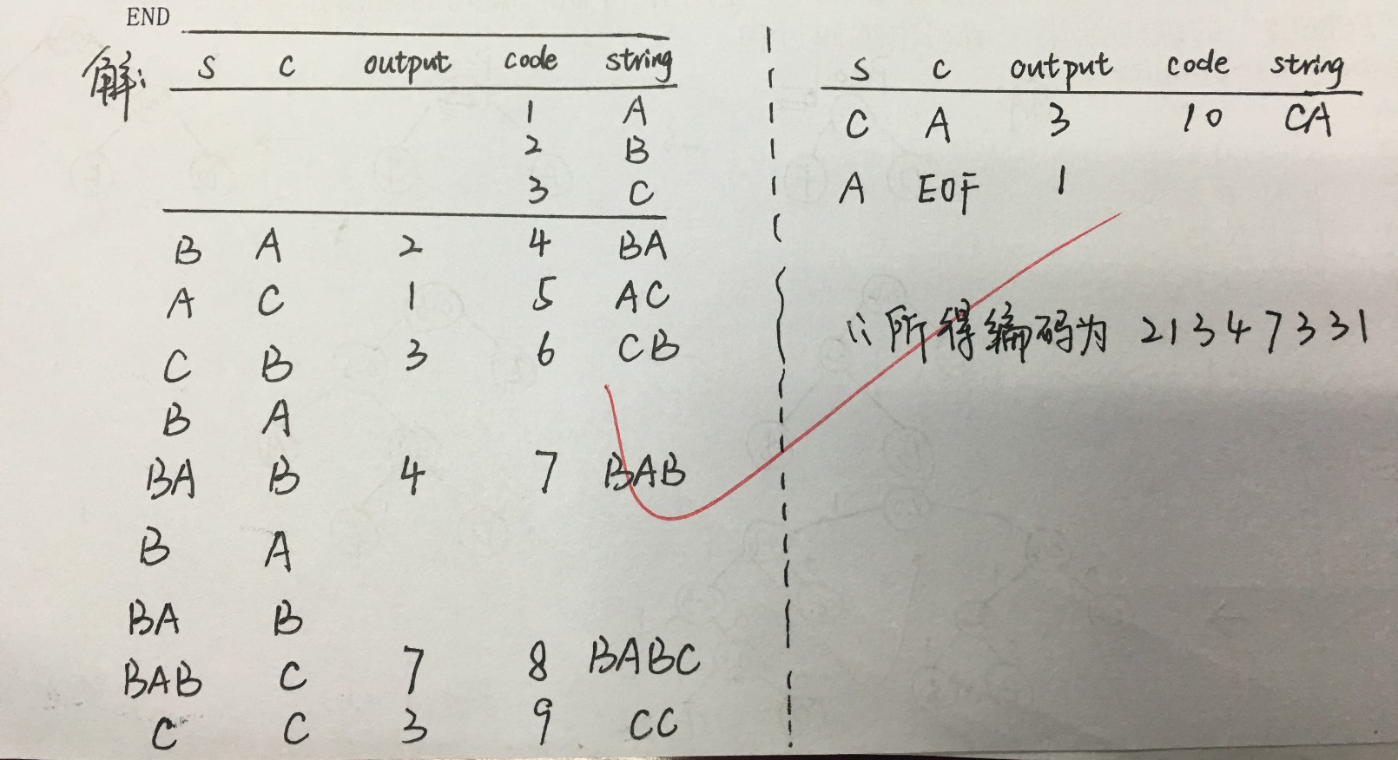
Dictionary-based Coding
练习
当输入数据为BACBABABCCA 时，请使用LZW压缩方法进行编码，写出编码过程。

Slide 36
Outline
Introduction to Compression （压缩）
The need for data compression
Lossless vs lossy compression
Compression ratio
Basics of Information Theory （信息论基础）
Variable-Length Coding (VLC) （变长编码）
Shannon-Fano Algorithm
Huffman Coding
Dictionary-based Coding （基于字典的编码）
Arithmetic Coding （算术编码）

Slide 37
Arithmetic Coding
It was initially developed in the late 1970s and 1980s.
A form of entropy encoding used in lossless data compression.
Characters of arithmetic coding (算术编码）
Arithmetic coding is a more modern coding method that usually out-performs Huffman coding
Arithmetic coding can treat the whole message as one unit
A message is represented by a half-open interval [a, b) where a and b are real numbers between 0 and 1.
Notes:
It was initially developed in the late 1970s and 1980s。Various modern versions of arithmetic coding have been developed for newer multimedia
standards: for example, Fast Binary Arithmetic Coding in JBIG, JBIG2 and JPEG-2000, and Context-Adaptive Binary Arithmetic Coding (CABAC) in H.264and H.265。Arithmetic coding can treat the whole message as one unit and achieve fractional number of bits for each input symbol。

Slide 38
Arithmetic Coding
Encode Symbols “CAEE$”.
Probability distribution of symbols.
Symbol | Probability | Range
A | 0.2 | [0, 0.2)
B | 0.1 | [0.2, 0.3)
C | 0.2 | [0.3, 0.5)
D | 0.05 | [0.5, 0.55)
E | 0.3 | [0.55, 0.85)
F | 0.05 | [0.85, 0.9)
$ | 0.1 | [0.9, 1.0)

Slide 39
Arithmetic Coding
Arithmetic Coding Encoder
BEGIN
low = 0.0;
high = 1.0;
range = 1.0;
while (symbol != terminator)
{
get (symbol);
low = low + range * Range_low(symbol); high = low + range * Range_high(symbol); range = high - low;
}
output a code so that low <= code < high; END

Slide 40
Dictionary-based Coding
Graphical display of shrinking ranges.
1.0
0.5
0.34
0.334
0.3322
0.3322
$
$
$
$
$
$
0.9
0.85
F
F
F
F
F
F
E
E
E
E
E
E
0.55
0.5
D
D
D
D
D
D
C
C
C
C
C
C
0.3
B
B
B
B
B
B
0.2
A
A
A
A
A
A
0
0.3 0.3 0.322 0.3286 0.33184

Slide 41
Arithmetic Coding
Encode Symbols “CAEE$”.
Generate the codeword
0.33184 < codeword < 0.33220
The shortest binary codeword 0.01010101
The message becomes longer，the length of the interval shortens
Symbol | low | high | range
 | 0 | 1.0 | 1.0
C | 0.3 | 0.5 | 0.2
A | 0.30 | 0.34 | 0.04
E | 0.322 | 0.334 | 0.012
E | 0.3286 | 0.3322 | 0.0036
$ | 0.33184 | 0.33220 | 0.00036

Slide 42
Arithmetic Coding
Arithmetic Coding Decoder
BEGIN
get binary code and convert to decimal value = value(code);
Do
{ find a symbol s so that
Range_low(s) <= value < Range_high(s); output s;
low = Rang_low(s); high = Range_high(s); range = high - low;
value = [value - low] / range;
}
Until symbol s is a terminator END

Slide 43
Arithmetic Coding
Decode symbols “CAEE$”
0.01010101→ 0.33203125
value | Output Symbol | low | high | range
0.33203125 0.16015625 0.80078125 0.8359375 0.953125 | C A E E $ | 0.3 0.0 0.55 0.55 0.9 | 0.5 0.2 0.85 0.85 1.0 | 0.2 0.2 0.3 0.3 0.1

Slide 44
Arithmetic Coding
请使用算术编码对字符串games进行编码。假设各字符的概率和初始编码间隔如表1所示。请写出编码过程，编码后字符串所在的区间为多少？
表1
字符 | s | e | m | a | g
概率 | 0.1 | 0.1 | 0.2 | 0.2 | 0.4
初始编码间隔 | [0 , 0.1) | [0.1, 0.2) | [0.2 , 0.4) | [0.4 , 0.6) | [0.6 , 1)

Slide 45
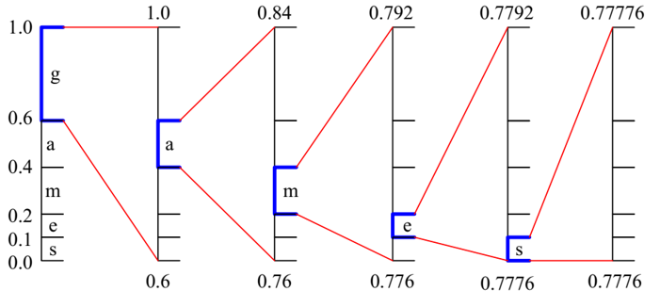
Arithmetic Coding
games
字符 | s | e | m | a | g
概率 | 0.1 | 0.1 | 0.2 | 0.2 | 0.4
初始编码间隔 | [0 , 0.1) | [0.1, 0.2) | [0.2 , 0.4) | [0.4 , 0.6) | [0.6 , 1)

Slide 46
思考题
文件夹压缩是什么原理？比如压缩成 ‘.rar’,’.zip’格式？ 是否有信息丢失？

