Slide 1
Introduction to Computational Thinking
Rui Mao
Shenzhen University
Shenzhen Institute of Computing Sciences

Slide 2
Three questions for freshmen
1. WWH
① What do you think is a computer?
② Why do you study computer?
③ How to study computer?
2. Clean up ambiguous idea
① “Computer is just a tool discipline”
② Change computer education from tool/operation-oriented to ability/thinking-oriented
3. Expectant goals
① Advocate computer science
② Love computer science
③ Study computer science
4. Construction of Computational Thinking Curriculum
① Computational Fundamentals
② Computer Science Unplugged
③ Foundation of computer hardware/software

Slide 3
Chapter 1 Introduction
1.1 Basic Concepts
1.2 Three pillars of scientific discoveries & technological innovations
1.3 Computational Science, Computer Science and Computing Discipline
1.4 Computational Thinking
1.5 “Warm-up” problems in the discipline

Slide 4
1.1 Basic Concepts
1. What is science?
① Darwin’s Definition：
Science consists in grouping facts so that general laws or conclusions may be drawn from them.
② On general, science includes nature science, social science and thinking science.
2. What is discipline?
A discipline refers to a certain scientific area or a branch of science (such as physics and biology). That is, a discipline means a finely divided branch of science.

Slide 5
3. What is thinking?
Thinking is a form of advanced psychological activity. Essentially, it is about the deployment of language. Human brain processes information in the forms of analysis, abstract, synthesis and summary.
①Analysis：The separation of a complex whole into its constituent individuals .
②Synthesis：The combination of individuals into a complex whole .
③Abstract：To find the common things among individuals.
④Summary：To compare the same and the difference among individuals and make conclusions about the whole.

Slide 6
1.2 Three pillars of scientific discoveries (SD) & technological innovations (TI)
1. Three pillars (Three sciences, three means)
Computational science now constitutes what many call the third pillar of the scientific enterprise, a peer alongside theoretical science and experimental science.
2. Authority of statement
Computational science as the third pillar of SD &TI has been widely cited in scientific literature and acknowledged in Congressional testimony and Federal and private-sector reports

Slide 7
3. The role of computational science
① Computational Science: Ensuring America‘s Competitiveness (President’s Information Technology Advisory Committee （ PITAC）. June 2005)
While it is itself a discipline, computational science serves to advance all of science. The most scientifically important and economically promising research frontiers in the 21st century will be conquered by those most skilled with advanced computing technologies and computational science applications.

Slide 8
② Famous Sayings (Sir Humphrey Davy, a famous chemist )
Nothing tends so much to the advancement of knowledge as the application of a new instrument. The native intellectual powers of men in different times are not so much the causes of the different success of their labors, as the peculiar nature of the means and artificial resources in their possession.

Slide 9
4. Science & Thinking
① In general speaking, the three sciences corresponds to three thinking
• Theoretical science ←→ Theoretical thinking
• Experimental science ←→ Experimental thinking
• Computational science ←→ Computational thinking
② Three types of thinking for human to know the world and reform the world
• Theoretical thinking: characterized by reasoning and induction, represented by mathematics.
• Experimental thinking: characterized by observing and summarizing the order of nature, represented by Physics.
• Computational thinking: characterized by design and construction, represented by computing discipline.

Slide 10
5. Scientific Thinking
“Scientific thinking is not only the origin of scientific research and technology development, but also running through their whole processes. It is the spirit of innovation.”
------“Advices on the innovative methods”, Official document of P. R. China government, GuoKeFaCai (2008) No. 197.
① Theoretical thinking (TT):
Theory is rooted in Mathematics. Theoretical thinking is the base of all the disciplines. Karl Marx held that only a discipline that successfully uses mathematics can be called a mature discipline. Definition is the soul of theoretical thinking, while theorem and proof are its essence. Axiomatic method is the most important approach of theoretical thinking.

Slide 11
② Experimental thinking (ET):
The pioneer of experimental thinking is the Italian scientist Galileo, the father of modern science. Different from theoretical thinking, experimental thinking usually makes use of some specific equipments, utilizing them to get the data for further analysis.
③ Computational thinking (CT):
Computational thinking refers to a variety of conceptual work, which covers the wide range of computer science, utilizing fundamental concepts from computer science to resolve problems, to design systems, or to understand human behavior.

Slide 12
1.3 Computational Science, Computer Science and Computing Discipline
1. Definition of Computational Science
Computational science fuses three distinct elements (PITAC 2005):
① Algorithms, modeling and simulation software developed to solve science, engineering, and humanities problems.
② Computer and information science that develops and optimizes advanced system hardware, software, networking, and data management components needed to solve computationally demanding problems.
③ The computing infrastructure that supports both the science and engineering problem solving and the developmental computer and information science.

Slide 13
2.Definition of Computer science
Computer science spans a wide range, from its theoretical and algorithmic foundations to cutting-edge developments in robotics, computer vision, intelligent systems, bioinformatics, and other exciting areas. (Computing Curricula 2005 )
① They design and implement software.
Computer scientists take on challenging programming jobs. They also supervise other programmers, keeping them aware of new approaches.

Slide 14
② They devise new ways to use computers.
Progress in the CS areas of networking, database, and human-computer-interface enabled the development of the WWW. Now CS researchers are working with scientists from other fields to make robots become practical and intelligent aides, to use databases to create new knowledge, and to use computers to help decipher the secrets of our DNA.
③ They develop effective ways to solve computing problems.
For example, computer scientists develop the best possible ways to store information in databases, send data over networks, and display complex images. Their theoretical background allows them to determine the best performance possible, and their study of algorithms helps them develop new approaches that provide better performance.

Slide 15
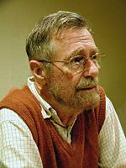
④ Famous sayings
E. Dijkstra (May 11, 1930 – August 6, 2002) is a Dutch computer scientist and received the Turing Award for fundamental contributions to developing programming languages in 1972 .
Computer science is not the study of computers.
Computers are to computer science what telescopes are to astronomy.
Alan Jay Perlis (April 1, 1922 – February 7, 1990) was an American computer scientist known for his pioneering work in programming languages and the first recipient of the Turing Award (1966).
Computer Science is the study of process, automated execution of process changes everything, Including how we think about things we already know.

Slide 16
3.Definition of Computing discipline (Denning P J, et al. Computing as a discipline. Communications of the ACM,1989)
① The discipline of computing is the systematic study of algorithmic processes that describe and transform information, their theory, analysis, design, efficiency, implementation, and application.
② The fundamental question underlying all of computing is, “What can be (efficiently) automated?”

Slide 17
4.Structure of the Computing Curricula Series
CC2005
Overview
CC2001
(CS2001)
Computer Science
IS2002
Information System
SE2004
Software Engineering
CE2005
Computer Engineering
IT2005
Information Technology
Other
curriculum
volumes as
needed for
emerging
disciplines

Slide 18
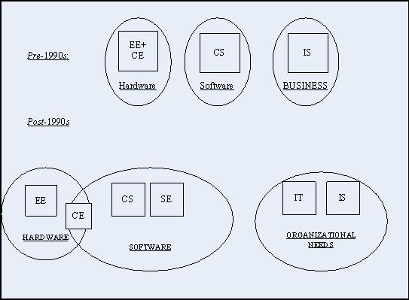
5. The landscape of computing disciplines
Computing is not just a single discipline, but is a family of disciplines. During the 1990s, important changes in computing and communications technology, and in the impact of that technology on society, led to important changes in this family of disciplines.

Slide 19
① Before the 1990s
Undergraduate degree programs in the computing-related disciplines began to emerge in the 1960s.Originally, there were only three kinds of computing-related degree programs in North America: computer science (CS), electrical engineering (EE), and information systems (IS).
Before the 1990s, the only major change in this landscape in the U.S. was the development of computer engineering (CE). Prior to the invention of chip-based microprocessors, computer engineering was one of several areas of specialization within electrical engineering.

Slide 20
② Significant developments of the 1990s
Computer engineering (CE) solidified its emergence from electrical engineering .
• Computer science grew rapidly and became accepted into the family of academic disciplines.
• Software engineering had emerged as an area within computer science, began to develop as a discipline unto itself.
• Information systems had to address a growing sphere of challenges.
• Information technology programs began to emerge in the late 1990s.

Slide 21
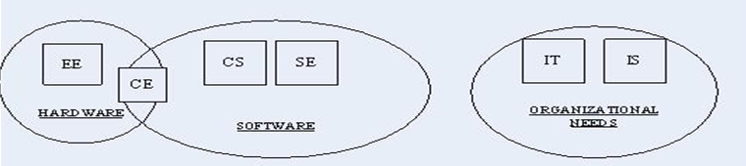
③ After the 1990s.

Slide 22
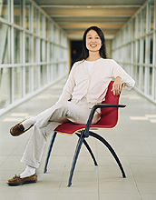
1.4 Computational Thinking
1. definition of the computational thinking
Computational thinking involves solving problems, designing systems, and understanding human behavior, by drawing on the concepts fundamental to computer science. Computational thinking includes a range of mental tools that reflect the breadth of the field of computer science.
——Jeannette M. Wing
Wing is President's Professor of Computer Science and Department Head, Computer Science Department, Carnegie Mellon University

Slide 23
2. Examples of Computational Thinking
① CT is thinking recursively.
② CT is parallel processing.
③ CT is interpreting code as data and data as code.
④ CT is type checking as the generalization of dimensional analysis.
⑤ CT is recognizing both the virtues and the dangers of aliasing, or giving someone or something more than one name.
⑥ CT is recognizing both the cost and power of indirect addressing and procedure call.
⑦ CT is judging a program not just for correctness and efficiency but for aesthetics, and a system’s design for simplicity and elegance.

Slide 24
⑧ CT is using abstraction and decomposition when attacking a large complex task or designing a large complex system.
⑨ CT is separation of concerns. It is choosing an appropriate representation for a problem or modeling the relevant aspects of a problem to make it tractable.
⑩ CT is using invariants to describe a system’s behavior succinctly and declaratively.
⑪ CT is having the confidence we can safely use, modify, and influence a large complex system without understanding its every detail.
⑫ CT is modularizing something in anticipation of multiple users or prefetching and caching in anticipation of future use.

Slide 25
⑬ CT is thinking in terms of prevention, protection, and recovery from worst-case scenarios through redundancy, damage containment, and error correction.
⑭ CT is calling gridlock deadlock and contracts interfaces.
⑮ CT is learning to avoid race conditions when synchronizing meetings with one another.
⑯ CT is using heuristic reasoning to discover a solution.
⑰ CT is planning, learning, and scheduling in the presence of uncertainty.
⑱ CT is search, search, and more search, resulting in a list of vocabulary; when non-determinism and garbage collection take on the meanings used by computer scientists; and when trees are drawn upside down.

Slide 26
3. What it is, and isn’t?
Computational thinking thus has the following characteristics:
① Conceptualizing, not programming
② Fundamental, not rote skill
③ A way that humans, not computers, think
④ Complements and combines mathematical and engineering thinking
⑤ It’s for everyone, everywhere
⑥ Ideas, not artifacts

Slide 27
3. What it is, and isn’t?
① Conceptualizing, not programming
Computer science is not computer programming. Thinking like a computer scientist means more than being able to program a computer. It requires thinking at multiple levels of abstraction;
② Fundamental, not rote skill
A fundamental skill is something every human being must know to function in modern society. Rote means a mechanical routine. Ironically, not until computer science solves the AI Grand Challenge of making computers think like humans will thinking be rote;

Slide 28
3. What it is, and isn’t?
③ A way that humans, not computers, think
Computational thinking is a way humans solve problems; it is not trying to get humans to think like computers. Computers are dull and boring; humans are clever and imaginative. We humans make computers exciting. Equipped with computing devices, we use our cleverness to tackle problems we would not dare take on before the age of computing and build systems with functionality limited only by our imaginations;

Slide 29
3. What it is, and isn’t?
④ Complements and combines mathematical and engineering thinking
Computer science inherently draws on mathematical thinking, given that, like all sciences, its formal foundations rest on mathematics. Computer science inherently draws on engineering thinking, given that we build systems that interact with the real world. The constraints of the underlying computing device force computer scientists to think computationally, not just mathematically. Being free to build virtual worlds enables us to engineer systems beyond the physical world;

Slide 30
3. What it is, and isn’t?
⑤ Ideas, not artifacts
It’s not just the software and hardware artifacts we produce that will be physically present everywhere and touch our lives all the time, it will be the computational concepts we use to approach and solve problems, manage our daily lives, and communicate and interact with other people;
⑥ It’s for everyone, everywhere
Computational thinking will be a reality when it is so integral to human endeavors it disappears as an explicit philosophy.

Slide 31
4.Computational thinking in other disciplines (From Wing)
① Biology
Shotgun algorithm expedites sequencing of human genome
DNA sequences are strings in a language
Protein structures can be modeled as knots
Protein kinetics can be modeled as computational processes
Cells as a self-regulatory system are like electronic circuits
Notes:
It is named by analogy with the rapidly-expanding, quasi-random firing pattern of a shotgun.
Language with alphabet
Protein secondary structure

Slide 32
4.Computational thinking in other disciplines (From Wing)
② Brain Science
Modeling the brain as a computer
Vision as a feedback loop
Analyzing fMRI data with machine learning
Notes:
功能磁共振成像(fMRI)就是大脑成像技术。fMRI在“观察活动中的大脑”时，不仅时间分辨率更高，就连空间分辨率也可达到毫米水平。借助fMRI，对大脑的研究便可扩展至记忆、注意力、决定……在某些情况下，fMRI技术甚至能够识别研究对象所见到的图像或者阅读的词语。对个人内心世界的这些揭示不禁让人期待在大脑中鉴别谎言这种复杂状态的可能性。

Slide 33
4.Computational thinking in other disciplines (From Wing)
③ Chemistry (Madden, Fellow of Royal Society of Edinburgh)
Atomistic calculations are used to explore chemical phenomena
Optimization and searching algorithms identify best chemicals for improving reaction conditions to improve yields

Slide 34
4.Computational thinking in other disciplines (From Wing)
④ Geology
“The Earth is an analogue computer” (Boulton, Edinburgh)
Abstraction boundaries and hierarchies of complexity model the earth and our atmosphere.

Slide 35
4.Computational thinking in other disciplines (From Wing)
⑤ Mathematics
Discovering E8 Lie Group: 18 mathematicians, 4 years and 77 hours of supercomputer time (200 billion numbers). Profound implications for physics (string theory)
Four-color theorem proof

Slide 36
4.Computational thinking in other disciplines (From Wing)
⑥ Engineering (electrical, civil, mechanical, aero & astro, …)
Calculating higher order terms implies more precision, which implies reducing weight, waste, costs in fabrication
Boeing 777 tested via computer simulation alone, not in a wind tunnel
Notes:
大气核试验
淮河
天气预报
地震

Slide 37
4.Computational thinking in other disciplines (From Wing)
⑦ Economics
Automated mechanism design underlies electronic commerce, e.g., ad placement, on-line auctions, kidney exchange
MIT PhDs in CS are quants on Wall Street

Slide 38
4.Computational thinking in other disciplines (From Wing)
⑧ Social Sciences
Social networks explain phenomena such as MySpace, YouTube
Statistical machine learning is used for recommendation and reputation services, e.g. Netflix, affinity card
Notes:
Connect friend

Slide 39
4.Computational thinking in other disciplines (From Wing)
⑨ Medicine
Robotic surgery
Electronic health records require privacy technologies
Scientific visualization enables virtual colonoscopy
Notes:
针灸

Slide 40
4.Computational thinking in other disciplines (From Wing)
⑩ Law
Stanford Computational Law approaches include AI, temporal logic, state machines, process algebras, Petri nets
FF POIROT Project on fraud investigation is creating a detailed Ontology of European law
Sherlock Project on crime scene investigation
Notes:
Model Checking cpu

Slide 41
4.Computational thinking in other disciplines (From Wing)
⑪ Entertainment
Games
Movies
Dreamworks uses HP data center to render Shrek and Madagascar
Lucas Films uses 2000-node data center to produce Pirates of the Caribbean.
Notes:
阿凡达

Slide 42
4.Computational thinking in other disciplines (From Wing)
⑫ Arts
Art (e.g., Robotticelli)
Drama
Music
Photography

Slide 43
4.Computational thinking in other disciplines (From Wing)
⑬ Sports
Lance Armstrong’s cycling computer tracks man and machine statistics
Synergy Sports analyzes digital videos NBA games
Notes:
Houston rocket

Slide 44
4.Computational thinking in other disciplines (From Wing)
⑭ Educational Implications
Universities should start with their freshmen-level intro courses. --Teach “Ways to Think Like a Computer Scientist” not just “Intro to <programming language>”
Engage national and international organizations to reform curricula, in particular K-12. --ACM, CSTA, CRA, etc.
It needs to be a collective effort.
Notes:
Kindergarten to grade 12,
Computer Science Teachers Association
Computing Research Association

Slide 45
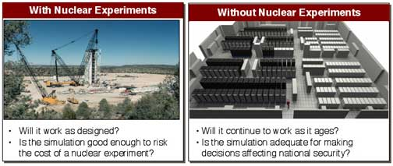
4.Computational thinking in other disciplines (From Wing)
⑮ Simulation

Slide 46
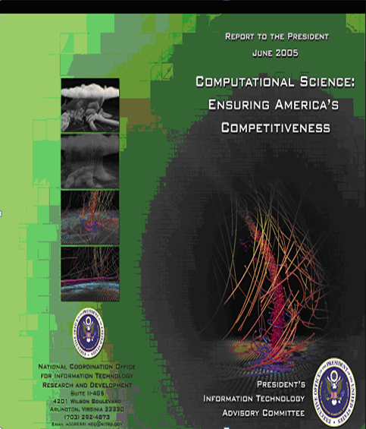
4.Computational thinking in other disciplines (From Wing)
⑯ Cover Imagery
Computational science enabled by high-end computing power now makes it possible for researchers to look inside tornadic storms
National Center for Supercomputing Applications (NCSA) . The simulation was based on data collected from a 2003 F4 tornado that ripped through Manchester, South Dakota.

Slide 47
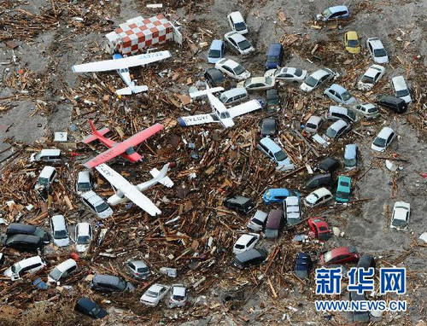
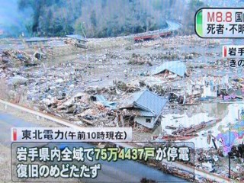
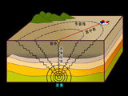
4.Computational thinking in other disciplines (From Wing)
⑰ Earthquake can be efficiently simulated?
M8.8 to M9.0 Earthquake in Japan

Slide 48
1.5 “Warm-up” problems in the discipline
Twenty guesses
The Seven Bridges of Königsberg
The King’s marriage
The Towers of Hanoi

Slide 49
1. Twenty guesses --from Computer Science Unplugged
Secretly determine a number, x, in a range, say [1, 1,000,000]
Each time, the audience can ask a question with possible answers “yes” or “no” only. And the audience always get the true answer based on x.
To find out x, how many times the audience need to ask questions?
Decision tree, binary search

Slide 50
2. The Seven Bridges of Königsberg --from Wikipedia
The Seven Bridges of Königsberg is a notable historical problem in mathematics. Its negative resolution by Leonhard Euler in 1735 laid the foundations of graph theory and prefigured the idea of topology.
The city of Königsberg in Prussia (now Kaliningrad, Russia) was set on both sides of the Pregel River, and included two large islands which were connected to each other and the mainland by seven bridges.
Notes:
当时东普鲁士柯尼斯堡（今日俄罗斯加里宁格勒）市区跨普列戈利亚河两岸，河中心有两个小岛。小岛与河的两岸有七条桥连接。在所有桥都只能走一遍的前提下，如何才能把这个地方所有的桥都走遍？

Slide 51
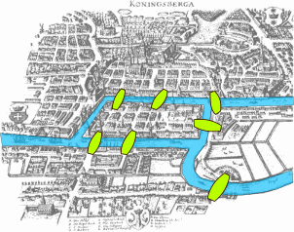
The problem was to find a walk through the city that would cross each bridge once and only once.

Slide 52
Abstraction:
Ignore: The length and width of the bridge; the area of Land and Island.

Slide 53
Definition 1 An Euler path in a graph G is a path which visits every edge of G exactly once
Definition 2 An Euler circuit in a graph G is an Euler path which starts and ends on the same vertex
Definition 3 An Euler graph is a graph containing an Euler circuit
THEOREM 1 A connected multigraph with at least two vertices has an Euler circuit if and only if each of its vertices has even degree.
THEOREM 2 A connected multigraph has an Euler path but not an Euler circuit if and only if it has exactly two vertices of odd degree.

Slide 54
3. The King’s marriage -- From Hongjiawei(洪加威)
Once upon a time, a young king loving mathematics proposed to a beautiful smart princess. She gave him a problem: finding a proper factor for 48 770 428 433 377 171. If the king can find the answer in a day, she will marry with him.
The king went back home and checked the integers one by one to find the proper factor. In a whole day, from morning to evening, he only checked about 30000 numbers, still can’t find the answer.
He pled to the princess. She gave the answer 223 092 827. The king easily verified it is a proper factor.
Princess said: “I will give you another chance. If you still fail, you will only be a guest on my wedding.”

Slide 55
The king then went back to his castle immediately, and asked help from his prime minister, a mathematician. The prime minister thought very carefully, and claimed that for a number with 17 digits, its smallest proper factor will not bigger than 9 digits.
He came up with the idea: giving a NO. to every civilians in his kingdom according to the order of natural number. Once the princess gave the big prime, broadcast this prime and let the civilians divide this prime with their own NO. If some civilian’s NO can divide this prime exactly, he should report to the king and will be rewarded with a good fortune.
Now, the princess gave the new 17-digits prime.
The king adopted the new method and found the right proper factor.

Slide 56
warm-up problem 5 The King’s marriage
The king uses the serial algorithm first.
And then the prime minister proposed the parallel algorithm.
Questions：
Can the questions be solved by some parallel algorithm if they can’t be solved by any serial method?
Suppose a question can be handled by some parallel method, and the speed of a parallel computer will increase with the number of CPU. Is it possible to handle the intractable problem?
When we divide a task into multiple CPUs, because there exits some inevitable serial operations in the algorithm, the speedup capability of the computer is significantly limited.

Slide 57

warm-up problem 6 Amdahl’s law
f：the ratio of inevitable serial operation in the algorithm, when solving a problem;
p：number of CPUs；
S_{p}：the speedup capability of a parallel computer，and
Suppose f =1%， p →∞；we have S_{p} =100。
I.e., even the portion of serial operation is only 1%, no matter how many
CPUs we have, the speed to solve the problem can only be accelerated on 100 times.
So the conclusion is：for the intractable problem, it is not enough to only increase the speed of computer; the key is to reduce the order of magnitude for the algorithm complexity.

Slide 58
4. The Towers of Hanoi
The Tower of Hanoi or Towers of Hanoi, also called the Tower of Brahma or Towers of Brahma, is a mathematical game or puzzle.

Slide 59
The objective of the puzzle is to move the entire stack to another rod, obeying the following rules:
1. Only one disk may be moved at a time.
2. Each move consists of taking the upper disk from one of the rods and sliding it onto another rod, on top of the other disks that may already be present on that rod.
3. No disk may be placed on top of a smaller disk.

Slide 60

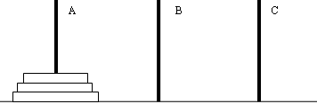
汉诺塔问题
印度古老传说：在世界中心贝拿勒斯的圣庙里，一块黄铜板上插着三根宝石针A、B和C。印度教的主神梵天在创造世界时，在其中一根针上从下到上地穿好了由大到小的64片金片，这就是所谓的汉诺塔问题。
不论白天黑夜，总有一个僧侣在按下面的法则移动这些金片：一次只移动一片，不管在哪根针上，小片必须在大片上面。僧侣们预言，当所有金片移到另外一根针上时，世界将在一声霹雳中消灭，而梵塔、庙宇和众生也都将同归于尽。

Slide 61
h(1)=? h(2)=? h(3)=?
Recursive solution
hanoi(#disk, source, buffer, target):
hanoi(n, left, middle, right);
hanoi(n-1, left, right, middle);
move(1, left, _, right);
hanoi(n-1, middle, left, right);
h(n) = 2h(n-1)+1 = ?
= 2^{n}-1
??
move(n, left, _, middle);
hanoi(n-1, left, middle, right);
move(n, middle, _, right);

Slide 62
不管这个传说的可信度有多大，如果仅考虑把64片金片，由一根针上移到另一根针上，并且始终保持上小下大的顺序。这需要多少次移动呢？这里需要使用递归算法。
假设有n片，移动次数是f(n)
显然f(1)=1，f(2)=3，f(3)=7，且f(k+1)=2*f(k)+1
不难证明f(n)=2^n-1
当n=64时，f(64)=2^64-1=18446744073709551615次
如果每秒钟移动一次，共需多长时间呢？
一年有31536000秒，则
18446744073709551615/31536000=5849亿年

Slide 63
有n层塔位于最左边的柱子上，把初始状态的盘子从上往下依次标记为0、1、2…n-1，采用二进制从sum=0开始计数，当2^{n}位由“0”变成“1”时，循环移动一次n号盘到它右边邻近的柱子上，若违反盘子的大小规则，就跳到下一根柱子，最终能得到最优解法，并且最优解的步数恰好是sum。
https://www.youtube.com/watch?v=2SUvWfNJSsM&feature=youtu.be

Slide 64
warm-up problem 8: Traveling Salesman Problem (TSP,旅行商问题)
Given a list of cities and their pairwise distances, a traveling salesman will start from one city, visit every city exactly once, and then go back to the starting city. The question is how to find a shortest possible tour for the salesman?

Slide 65
warm-up problem 8 Traveling Salesman Problem (TSP)
List all possible path combinations and pick up the shortest.
Path ABCDA，overall distance 13； Path ABDCA， overall distance 14；
Path ACBDA， overall distance 19； Path ACDBA， overall distance 14；
Path ADCBA， overall distance 13； Path ADBCA， overall distance 19。

Slide 66
warm-up problem 8 Traveling Salesman Problem (TSP)
If we have 4 cities, we need to consider 6 path combinations in the worst case.
If we have n cities, we need to consider (n–1)! path combinations in the worst case.
But with the growing of city list, the number of path combination will increase dramatically, so that the most powerful computer can’t compute it, resulting in “combination explosion”.
For example, suppose the city number is 20, the path combination will be (20–1)! ≈ 1.216 × 10¹⁷ . If a supercomputer can compare 10 million paths per second, it will take 386 years to find the shortest path.
The intractability of NP problem

Slide 67
warm-up problem 8 Traveling Salesman Problem (TSP)
Heuristic（启发式） algorithm ：Following some heuristic rule, we can find the best solution in acceptable (time/space) cost, but not guaranteeing this solution is the optimal one.
Some classical algorithms:
Greedy algorithm
branch and bound method, A* algorithm
Genetic algorithm, ant algorithm, evolutionary algorithm
In 1998, the scientists successfully resolved the TSP of 13509 USA cities, by combining the cutting-plane method with branch & bound method in combinatorial optimization.
In 2001, with the help of the inter-connected 110 computers in Rice Univ. and Princeton Univ. , the TSP of 15112 German cities is resolved.

Slide 68
warm-up problem 8 Traveling Salesman Problem (TSP)
The scheduling problem of drilling the circuit board.
The time to drill a hole is fixed，the overall time of drill moving is variable.
The holes to be drilled can be considered as the “cities” in the TSP.
The cost of drill moving from one hole to another can be seen as the “distance” in the TSP.
Some other fileds：
Transportation
Logistics and services

Slide 69
warm-up problem 7 Algorithm Complexity
Algorithm complexity
Space complexity & Time complexity
Hanoi Tower reveals the time complexity of algorithm
When we have n dishes，the steps is h(n) = 2^{n}-1
So the algorithm’s time complexity is O(2^{n})
It’s exponential complexity, and now the computer can’t handle it.
Suppose h(n) = n²+64n+128, the time complexity will be O(n²), we say it’s polynomial complexity.
The computer can handle it.
Suppose h(n) = 64n+128, the time complexity will be O(n)
Suppose h(n) = 128, the time complexity is O(1)
A piece of cake for the computer

Slide 70
warm-up problem 10 the power and limitation of human and the related concepts on difficulty and complexity
Manual work & brainwork
physical strength & brains (memory, understanding, etc )
Limitations of physical strength:
The world record of high jump is 2.45 meters (1993, Cuban Sotomayor);
100-metre race, 9 .58 seconds（August 16, 2009, Bolt);
Marathon, 2 hours , 3 minutes and 59 seconds（ 2008, Gebrselassie, the length is prescribed is 42.195 km).
The power when using tools
For example, by means of aircraft, people can fly very high.

Slide 71
warm-up problem 10 the power and limitation of human and the related concepts on difficulty and complexity
Limitations of human brain:
1+2 +3 + ... ... +20
The rule is that we must add the numbers one by one, which means, we first calculate 1 +2 = 3, then 3 +3 = 6, etc., and counting the time when calculating.
For the fastest student and the normal students, no much difference on the calculation time, roughly in an order of magnitude.
From this angle, the power of human brains are in the same order of magnitude.
How about Newton?
The power when using tools
For example, with the help of mathematical tools

Slide 72
warm-up problem 10 （1）The Power When Using Tools
Newton was a genius!
His talent does not stand on the prominent computing power of his brain, but on knowing how to properly simplify and idealize a complex problem, transforming it into a problem which our brain can handle.
Einstein did the same thing!

