Slide 1
Introduction to Computational Thinking Chapter 10: P, NP, NP-hard and NP-complete A brief and NOT SO accurate introduction
Rui Mao
Shenzhen University
Shenzhen Institute of Computing Sciences

Slide 2
计算复杂性
通俗说来，就是用计算机求解问题的难易程度。其度量标准一般是算法的时间复杂度。
可计算问题
可计算性指的是理论上的可计算性，以及其实践上的可计算性。即，其算法是否可以在可接受的时间或空间内完成。
一般来说，如果算法的时间复杂度不超过一个多项式，则其是可以在计算机上处理的(实践可计算）；
如果算法的时间复杂度大于多项式,例如O(2^{n})，则认为是无法在计算机上处理的（实践不可计算，理论可计算）。
大数据可计算：O(n)
*以上资料来源wikipedia

Slide 3
Outline
Decision and Optimization Problems
Deterministic & Non-deterministic algorithms
P and NP
NP-Hardness and NP-Completeness
Examples
Relation of P and NP

Slide 4
Decision and Optimization Problems
Decision Problem: computational problem with intended output of “yes” or “no”, 1 or 0
Optimization Problem: computational problem where we try to maximize or minimize some value
Turn optimization into decision:
Introduce parameter k and ask if the optimal value for the problem is a most or at least k.
判断题
填空题

Slide 5
Deterministic & Non-deterministic algorithms
Deterministic algorithm
Given a particular input, it will always produce the same correct output
Non-deterministic algorithm:
with one or more choice points where multiple different continuations are possible, without any specification of which one will be taken

Slide 6
Complexity Class P
Deterministic in nature
Solved by conventional computers in polynomial time
O(1) Constant
O(log n) Sub-linear
O(n) Linear
O(n log n) Nearly Linear
O(n²) Quadratic
Polynomial upper and lower bounds

Slide 7
Complexity Class NP
Non-deterministic part as well
If someone tells us the solution to a problem, we can verify it in polynomial time
Two steps: non-deterministic method to generate possible solutions, deterministic method to verify in polynomial time that the solution is correct.

Slide 8
P 问题
在计算复杂性理论种，时间复杂度不超过多项式的问题称为P(polynomial)问题
NP 问题
将可以在多项式时间内验证的问题称为NP (non-deterministic polynomial)问题。其也作为多项式时间可验证解的算法问题的集合。
*以上资料来源wikipedia

Slide 9
NP-complete
在计算复杂度理论的世界中，NPC问题，又称NP完全问题或NP完备问题，是NP中最难的决定性问题。因此NP完备问题应该是最不可能被化简为P的决定性问题的集合。
NP-hard
NP困难问题是指这样的一类问题, 它们本身的复杂度是多少无所谓(但由后面的论述可知至少是NP), 但是只要这个问题找到确定的多项式时间的解, 那么我们可以证明出所有的NP问题都一定存在确定的多项式时间的解. (简单叙述一下就是, 只要有一个NP困难问题找到P解, 那么所有NP问题都是P问题.)
*以上资料来源wikipedia

Slide 10
NP-complete
A decision problem C is NP-complete if it is complete for NP, meaning that:
it is in NP and
every other problem in NP is reducible to it.
“Reducible” (归约)a polynomial-time many-one reduction

Slide 11
History of NP-complete
Stephen Cook,'The complexity of theorem-proving procedures‘, in the Proceedings of the 3rd Annual ACM Symposium on Theory of Computing(STOC), pages 151-158, 1971
Cook-Levin theorem (independently by Leonid Levin) states that the Boolean satisfiability problem is NP-complete
In 1972 Richard Karp proved that several other problems were also NP-complete (see Karp's 21 NP-complete problems)
Thousands of other problems have been shown to be NP-complete by reductions from other problems previously shown to be NP-complete;
Garey and Johnson's 1979 : Computers and Intractability: A Guide to NP-Completeness.

Slide 12
NP-hard
A problem satisfying condition 2 but not necessarily condition 1 is said to be NP-hard.
Informally, an NP-hard problem is "at least as hard as" any NP-complete problem, and perhaps harder.
For example, choosing the perfect move in certain board games on an arbitrarily large board is NP-hard or even strictly harder than the NP-complete problems.

Slide 13
NP-complete Example: subset sum problem
given a finite set of integers, determine whether exist a non-empty subset of them sums to zero.
A supposed answer is very easy to verify for correctness
but no one knows a significantly faster way to solve the problem than to try every single possible subset, which is very slow.

Slide 14
例子
我们不知道81785036517是否为素数，但是要确定277877是否为81785036517因子，我们可以直接拿去除。针对277877来验证8178503651是否为质数的动作可在多项式时间内完成，故针对某可能解来验证某数是否为质数的问题是一个NP问题。
*以上资料来源wikipedia

Slide 15
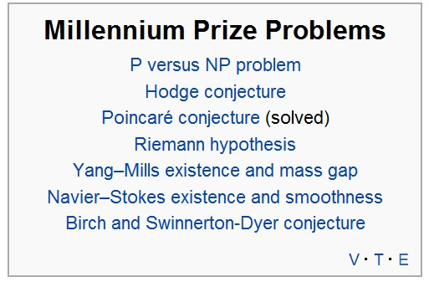
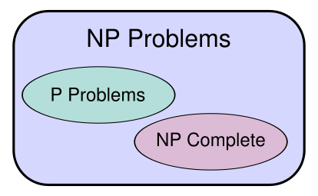
Relation of P and NP
P is a subset of NP
“P = NP”? 计算机科学中最大的问题之一
The Clay Mathematics Institute is offering a $1 million reward.千禧年大奖难题

