Slide 1
Introduction to Computational Thinking(2)
Guoliang Chen, Rongsheng Dong
Rui Mao
Shenzhen University
Shenzhen Institute of Computing Sciences

Slide 2
Chapter 2 Computational Theory & Computational Models
2.1 Understanding of computational essence for human beings
2.2 Theory of Computation

Slide 3
2.1 Understanding of computational essence for human beings
0. Definition of computation and calculation
1. Computational approach should be implemented by computational machinery
2. Computational process should be expressed by formalization (形式化)
3. Computational program should be executed by automation

Slide 4
2.1 0
0. Definition of computation and calculation
① Definition of computation : Computation is a general term for any type of process, algorithm or measurement; this often includes but is not limited to digital data. This includes phenomena ranging from human thinking to calculations with a more narrow meaning. Computation is a process following a well-defined model that is understood and can be expressed in an algorithm, protocol, network topology, etc. Computation is also a major subject matter of computer science: it investigates what can or cannot be done in a computational manner.
② Definition of calculation A calculation is a deliberate process for transforming one or more inputs into one or more results, with variable change. The term is used in a variety of senses, from the very definite arithmetical calculation of using an algorithm to the vague heuristics of calculating a strategy in a competition or calculating the chance of a successful relationship between two people.

Slide 5
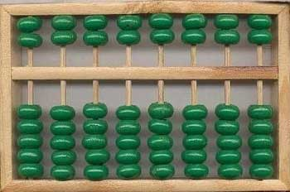
2.1 1
1. Computational approach should be implemented by the computational machinery
(1) Chinese counting board – abacus (bead abacus, Suanpan):
① Prototype of abacus:
A rectangular wooden frame with thin rods across it, that is divided into two unequal parts by a strip of wood . On each rod are placed 7 wooden beads: 5 below the strip and 2 above it.
② Chinese “Algorithmization Thinking”:
Chinese ancient scholars thought that a mathematical problem was solvable only if some rules exist for calculating it with abacus. This idea is called the Chinese "algorithmization" thinking ("enablement").

Slide 6
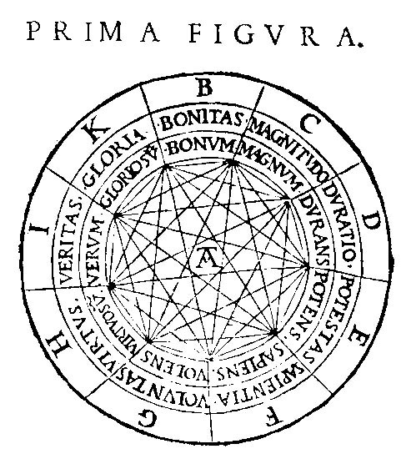
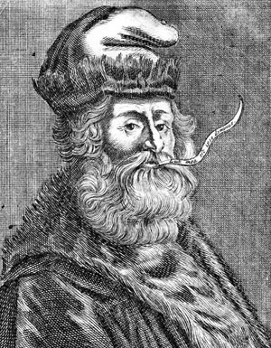
2.1 1
(2) Llull 's Thinking Machine (Turning toys, or Learning toys):
From http://history-computer.com/
① R. Llull (1232–1315) was born and died in the island of Mallorca, one of the most prominent European writers, philosophers and scientists of 13th and 14th centuries.
② Hardware of Llull's machine
Llull 's thinking machine marked the beginning of the formalization revolution.

Slide 7
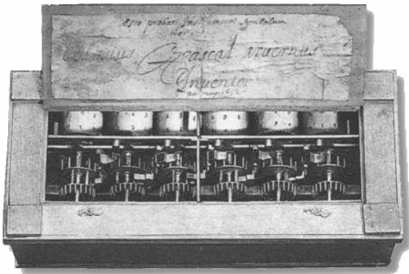
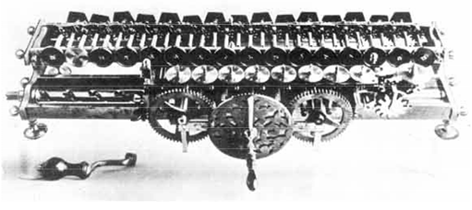
2.1 1
(3) Other computational Machinery
① Blaise Pascal’s 1641 “Pascaline” machine (Paris)
② Gottfried Wilhelm von Leibniz’s calculating wheel (1671)
Notes:
Pascal (programming language) Pascal (unit) (Pa), the SI unit of pressure (equivalent to one newton per square meter)
Leibniz occupies a prominent place in the history of mathematics and the history of philosophy. He developed the infinitesimal calculus independently of Isaac Newton, and Leibniz's mathematical notation has been widely used ever since it was published.

Slide 8
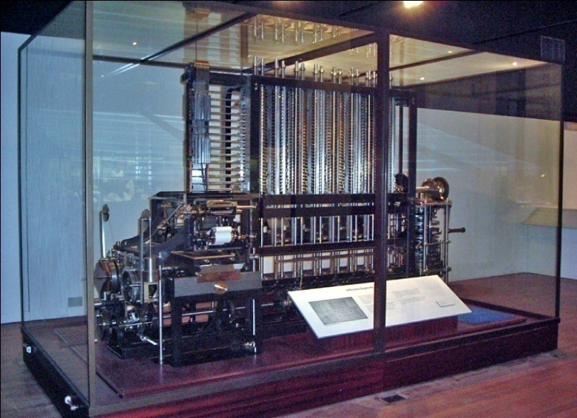
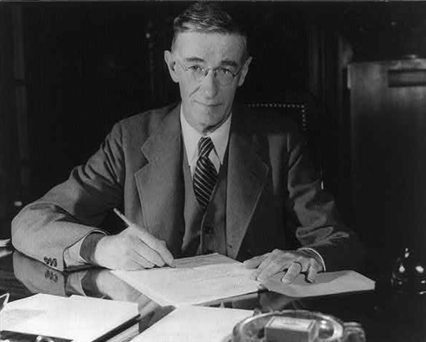
2.1 1
(3) Other computational Machinery
③ C. Bobbage’s Difference Engine #2
④ Vannevar Bush’s analog computer

Slide 9
2.1 1
(4) Conclusions:
① In history, the computation method adopted by an analog computer was different from what we known as “four arithmetic operations”. A classical analog computer called differential analyzer by a means of a differential wheel and “integration” which are usually more effective than a computation method based on the four arithmetic operations.
② The history of computing presented above reflected the efforts of human beings for exploring the essence and the fundamental problems of computing process. During the long procedure, more and more experiences for the development of modern computers was also accumulated.

Slide 10
2.1 2
2. Computational process should be expressed by formalization
① In fact, the real understanding of the essences of computing depends on the progress of the research with formalization. The whirligigs ( 旋转木马) is just a product of formalization; it also marks the beginning of the revolution of formalization.
② The study of formal methods and theories originated from fundamental studies of mathematics. The fundamental studies of mathematics focus on the general principles of the mathematical objects and properties, as well as on the occurrence and development of these objects and properties.

Slide 11
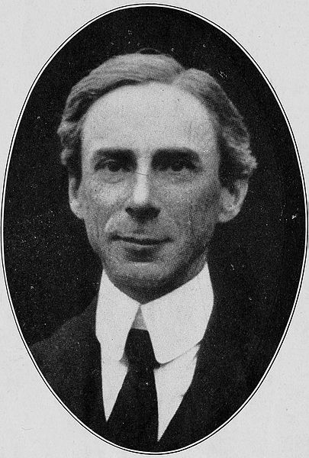
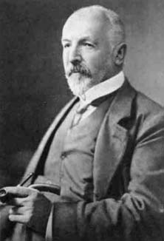
2.1 2
(1) Cantor’s set theory and Russell’s paradox:
① G. F. L. P. Cantor (1845 – 1918) was a German mathematician, best known as the inventor of set theory, which has become a fundamental theory in mathematics.
② B. A. W. Russell(罗素)(1872 –1970), was a British philosopher, logician, mathematician, historian, and social critic.
Russell's paradox. Symbolically:
These logic contradiction led to the third crisis in the history of mathematics.

Slide 12
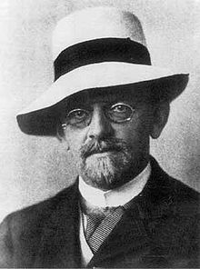
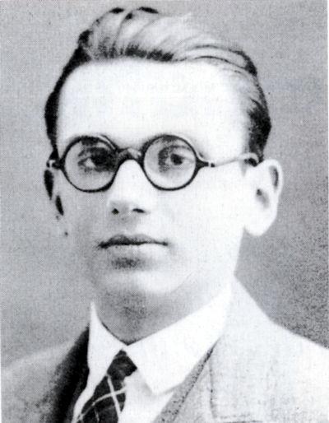
2.1 2
(2) Hilbert's program and Gödel’s incompleteness theorems:
① D. Hilbert(1862–1943) was a German mathematician.
② K. F. Gödel (1906-1978) was an Austrian logician, mathematician and philosopher.
Hilbert's program showing that:
All of mathematics follows from a correctly chosen finite system of axioms; and
that some such axiom system is provably consistent through some means such as the epsilon calculus.
Gödel is best known for his two incompleteness theorems:
If the system is consistent(相容性）, it cannot be complete（完备性）.
The consistency of the axioms cannot be proven within the system.

Slide 13
2.1 2
(2) Hilbert's program and Gödel’s incompleteness theorems:
③ Conclusions:
Although Hilbert’s program was failure, it was still a great achievement of the abstract thinking of human beings.
Gödel published (1931) a famous paper exposing the limitations of a computational systems, and a major research effort was being directed toward understanding these limitations.
For the discipline of computing, the most important significance is that persons should avoid spending lots of time to prove problems which are undecidable, and should concentrate on solving problems which are solvable.

Slide 14
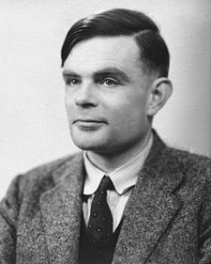
2.1 2
(3) Turing Machine and Church-Turing Thesis:
① A. M. Turing(1912 -1954), was an English mathematician, logician, cryptanalyst and computer scientist.
He provided a formalization of the concepts of "algorithm" and "computation" with the Turing machine, which played a significant role in the creation of the modern computer.
In fact, Turing’s vision was that of a human performing computations with pencil and paper. Turing’s goal was to provide a model by which the limits of “computational process” could be studied.

Slide 15
2.1 2
(3) Turing Machine and Church-Turing Thesis:
② Church-Turing Thesis: From the point of computing power, Turing machine is equal with other computation models designed for solving computational problems, such as the recursive function proposed by Gödel, the λ Calculus proposed by A. Church, and the POST specification system proposed by E. L. Post. These facts formed the basis of the famous Church-Turing Thesis.
③ Solvable problems: Turing machine as a computation models was designed for solvable problems. From a theoretical point of view, the solvability of a problem just requires the correctness of a computation model. However, from a practical point of view, both the time complexity and the space complexity should be considered for determining whether a problem is really solvable.

Slide 16
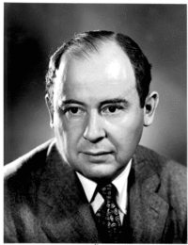
2.1 3
3. Computational program should be executed by automation
(1) V. Neumann (1903 –1957) was a Hungarian American mathematician.
Notes: One of the contributions for which popular history has chosen to credit him, the stored-program concept, was apparently developed by researchers led by J. P. Eckert at the Moore School of Electrical Engineering at the University of Pennsylvania. Von Neumann was merely the first to publish work reporting the idea and thus computing lore has selected him as the inventor.

Slide 17
2.1 3
(2) Concept of the stored program computer: He wrote a paper, which described a computer architecture in which both data and the program are stored in the computer's memory in the same address space. This is a great revolution in the concept. What reflected by it is just the essence of computing, i.e., the transformation of symbols.
(3) Notice: In early time, computers were designed, people thought that programs and data were two kinds of entities and therefore were handled independently; data were stored in the memory, while programs were treated as a part of the controller (program of outer setting type). For example, in the first computer ENIAC of the world, programs and data were divided. Even for a small program, since it was handled as parts of the controller, thousands of plugs would be used to insert in dozens of boards with several feet of length.

Slide 18
2.2 Theory of Computation
1. Functions and Their Computation
2. Turing Machines
3. A Non-computable Function
5. Complexity of Problems

Slide 19
2.2 1
1. Functions and Their Computation
① Function: A correspondence between a collection of possible input values and a collection of possible output values so that each possible input is assigned a single output
② Computing a function: Determining the output value associated with a given set of input values
③ Non-computable function: A function that cannot be computed by any algorithm
④ Study of computable functions is the study of the ultimate capabilities of machines.

Slide 20
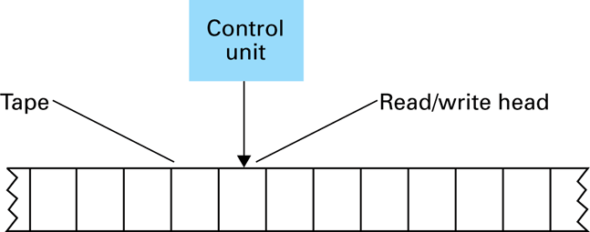
2.2 2
2. Turing Machines
① The components of a Turing machine:
② Turing Machine Operation
Inputs at each step
State
Value at current tape position
Actions at each step
Write a value at current tape position
Move read/write head
Change state

Slide 21
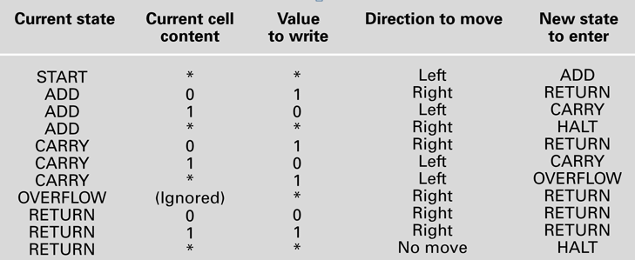
2.2 2
② Turing Machine Operation
Example: A Turing machine for incrementing a value
1
0
*
…
*
*
1
0
1
*
*
…
_{ADD}
_{RETURN}
_{HALT}
_{RETURN}
_{CARRY}
_{START}
Both “add” and “carry”, seriously?

Slide 22

图灵机与冯·诺依曼机
一、图灵机
1.直观描述
①图灵机的计算装置：一条两端可无限延长的带子，一个读写头，一组控制指令。
┄ b b 1 0 1 0 0 0 1 0 b b ┄
读写头
读写头可以沿带子方向左右移动，并可以在每个方格上进行读写。
状态
q₁
控制指令
Notes:
两个大牛
emerson

Slide 23
图灵机与冯·诺依曼机
②带子上的符号为一个有穷字母表：
{S₀,S₁,S₂,¨¨,S_{p}}
通常仅有S₀、S₁两个字符，其中：
S₀→0，S₁→1
这可加深对布尔值、二进制机器的理解。
③机器的控制状态：
{q₁,q₂,¨,q_{n}}
图灵机的初始状态设为q₁,结束状态设为q_{n}
Notes:
有多个稳定可转化状态就可以用作计算机

Slide 24
图灵机与冯·诺依曼机
④五元组指令集合：
(q_{i}S_{j}S_{k}R(LN)q_{n})
q_{i}表示机器目前所处的状态； S_{j}表示机器从方格中读入的符号； S_{k}表示机器用来代替S_{j}写入方格的符号； R,L,N表示右移一格,左移一格,不移动； q_{n}表示下一步机器的状态。
一个给定机器的程序是机器内的五元组形式的指令集，它定义了机器在特定状态下读入一个特定字符时所采取的动作。

Slide 25
图灵机与冯·诺依曼机
2.工作原理
机器从给定带子上的某起点出发，其动作完全由其初始状态值及机内五元组指令集来决定。计算结果是从机器停止时带子上的信息得到。
指令死循环：q₁S₂S₂Rq₃
q₃S₃S₃Lq₁
指令二义性：q₃S₂S₂Rq₄
q₃S₂S₄Lq₆

Slide 26
图灵机与冯·诺依曼机
3.应用实例
[例]假设：b表示空格
q₁表示机器的初始状态
q₄表示机器的结束状态
如果带子上的输入信息为10100010，读写头位对准最右边第一个为0的方格，且状态为q₁。
按照以下五元组指令集执行后，输出正确的计算结果是什么？

Slide 27

图灵机与冯·诺依曼机
指令集
q₁01Lq₂
q₁10Lq₃
q₁bbNq₄
q₂00Lq₂
q₂11Lq₂
q₂bbNq₄
q₃01Lq₂
q₃10Lq₃
q₃bbNq₄
b
1
0
1
0
0
0
1
1
…
b
b
1
0
1
0
0
0
1
0
b
b
…
q₂
q₂
q₂
q₂
q₂
q₂
q₂
q₂
q₁
q₄
计算函数是：S(x)=x+1
…
b
b
1
1
0
0
0
1
0
1
b
b
…
q₁

Slide 28
图灵机与冯·诺依曼机
[例]图灵机Mz：其中Q={q₁,q₂,q_{f}}
五元组指令集为：q₁10Rq₁
q₁00Lq₂
q₂01Nq_{f}
求Mz的作用是什么？
…
b
b
1
1
1
1
1
1
0
0
b
b
…
q₁
仅留下最后一个“1”

Slide 29
2.2 2
③ Church-Turing Thesis
The functions that are computable by a Turing machine are exactly the functions that can be computed by any algorithmic means. (Turing-computable functions = Computable functions)
Church-Turing Thesis establishes the capabilities of Turing machines as a standard to which the powers of other computational systems can be compared. If a computational system is capable of computing all the Turing-computable functions, it is considered to be as powerful as any computational system can be.
Notes:
门电路的完备性

Slide 30
2.2 4
3. A Non-computable Function
① Goal:
We now identify a function that is not Turing computable and so, by the Church-Turing thesis, is widely believed to be noncomputable in the general sense. Thus it is a function whose computation lies beyond the capabilities of computers.
② The Halting Problem:
Halting problem is the problem of trying to predict in advance whether a program will terminate (or halt) if started under certain conditions.
③ Self-reference:
Whether a program ultimately halts can depend on the initial values of its variables. Self-reference will be achieved by assigning the variables in a program an initial value that represents the program itself.

Slide 31
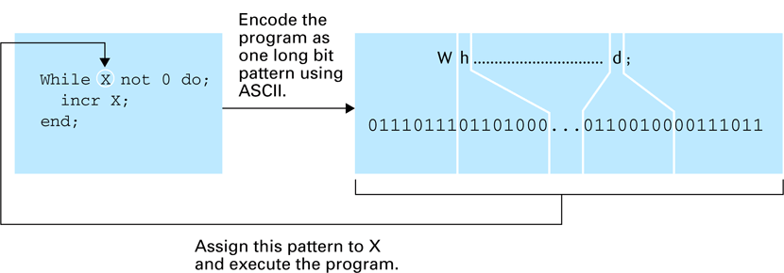
2.2 4
④ Testing a program for self-termination
⑤ Self-terminating:
A Bare Bones program is self-terminating if executing the program with all its variables initialized to the program’s own encoded representation leads to a terminating process. Informally, a program is self-terminating if its execution terminates when started with itself as its input.

Slide 32
1st Goal: Non-computable problem exists
Proof: Find an example P, P is non-computable
2nd Goal: P is non-computable
Assume P is computable, then F() exists to solve P
get contradiction,
=>F does not exist
P: determine whether a program terminates
Contradiction: find another program Q, terminate and non-terminate

Slide 33
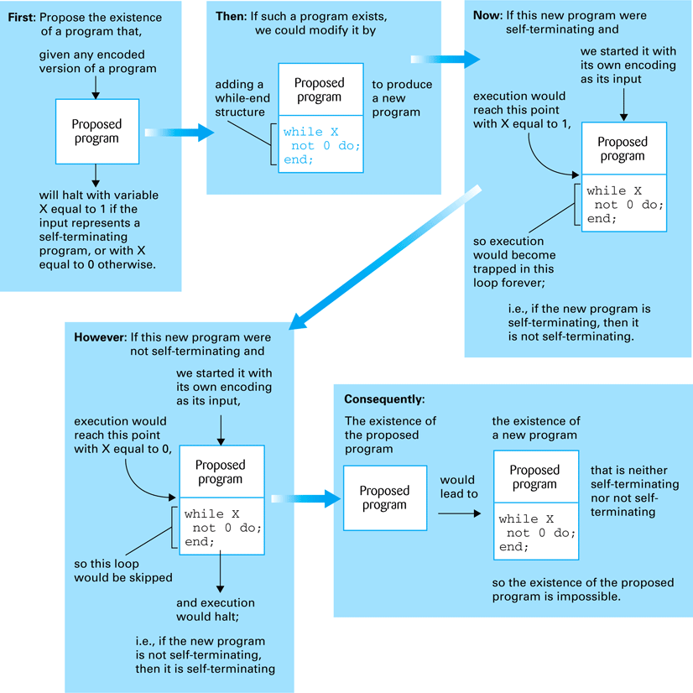
2.2 4
⑥ Proving the unsolvability of the halting program
P
Q
Contradiction:
is Q terminable?
Try Q(Q)

Slide 34
2.2 4
⑦ Conclusion:
We conclude that the halting function is not computable, and because the solution to the halting problem relies on the computation of that function we must conclude that solving the halting problem lies beyond the capabilities of any algorithmic system. Such problems are called unsolvable problems.

Slide 35
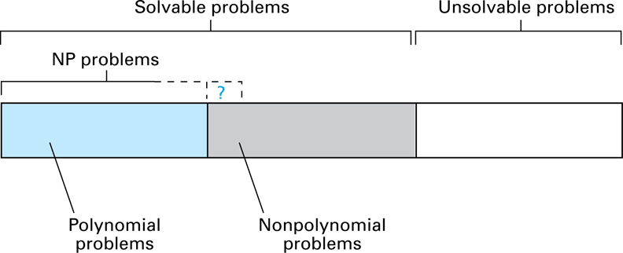
2.2 5
4. Complexity of Problems
① Measuring a problem’s complexity
Time complexity
Space Complexity

Slide 36
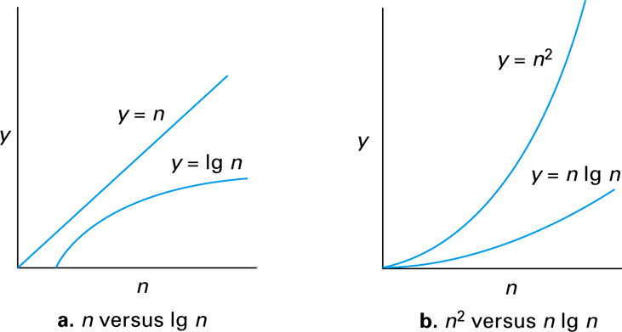
2.2 5
② Polynomial Versus Non-polynomial Problems
Class P: All problems in any class Q(f(n)), where f(n) is a polynomial
Class NP: All problems that can be solved by a nondeterministic algorithm in polynomial time
Nondeterministic algorithm = an “algorithm” whose steps may not be uniquely and completely determined by the process state
Class NPC: A decision problem is NP-complete if:
C is in NP, and
Every problem in NP is reducible to C in polynomial time.

