Slide 1
Introduction to Computational Thinking Chapter 3: Data Storage
Rui Mao
Shenzhen University
Shenzhen Institute of Computing Sciences

Slide 2
Chapter 3: Data Storage
3.1 Bits and Their Storage
3.2 Main Memory
3.3 Mass Storage
3.4 Representing Information as Bit Patterns
3.5 The Binary System

Slide 3
3.1 Bits and Bit Patterns
Bit(位): Binary Digit (0 or 1)
Bit Patterns are used to represent information.
Numbers
Text characters
Images
Sound
And others

Slide 4
3.1.1 Boolean Operations
Boolean (布尔) Operation: An operation that manipulates one or more true/false values
Specific operations：
AND (与)
OR (或)
XOR (exclusive or, 异或)
NOT (非)

Slide 5
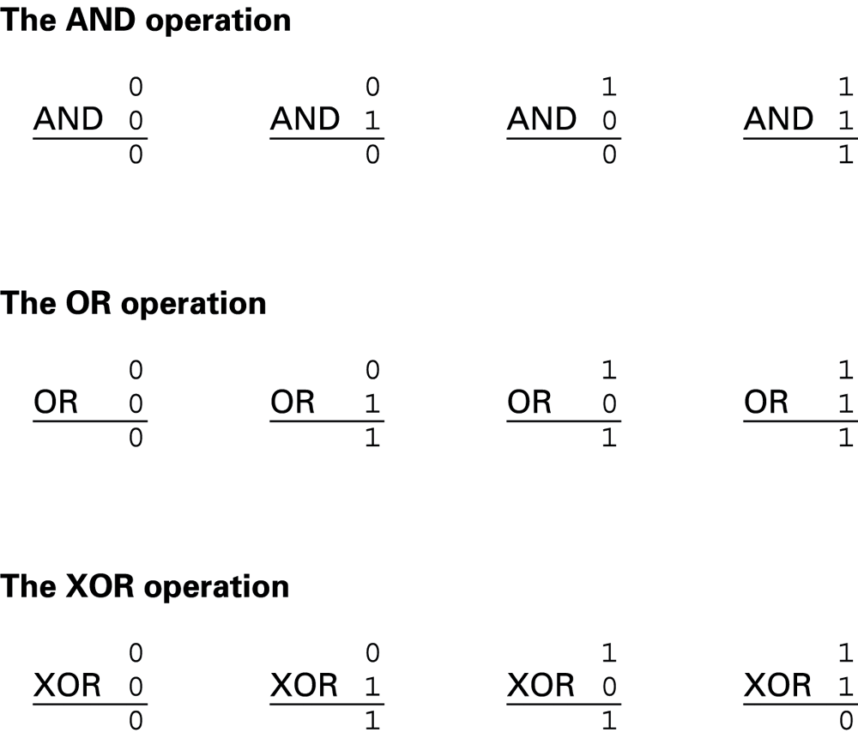
Figure 3.1 The Boolean operations AND, OR, and XOR (exclusive or)

Slide 6
3.1.2 Gates
Gate (门): A device that computes a Boolean operation
Often implemented as (small) electronic circuits
Provide the building blocks from which computers are constructed
VLSI (Very Large Scale Integration)

Slide 7
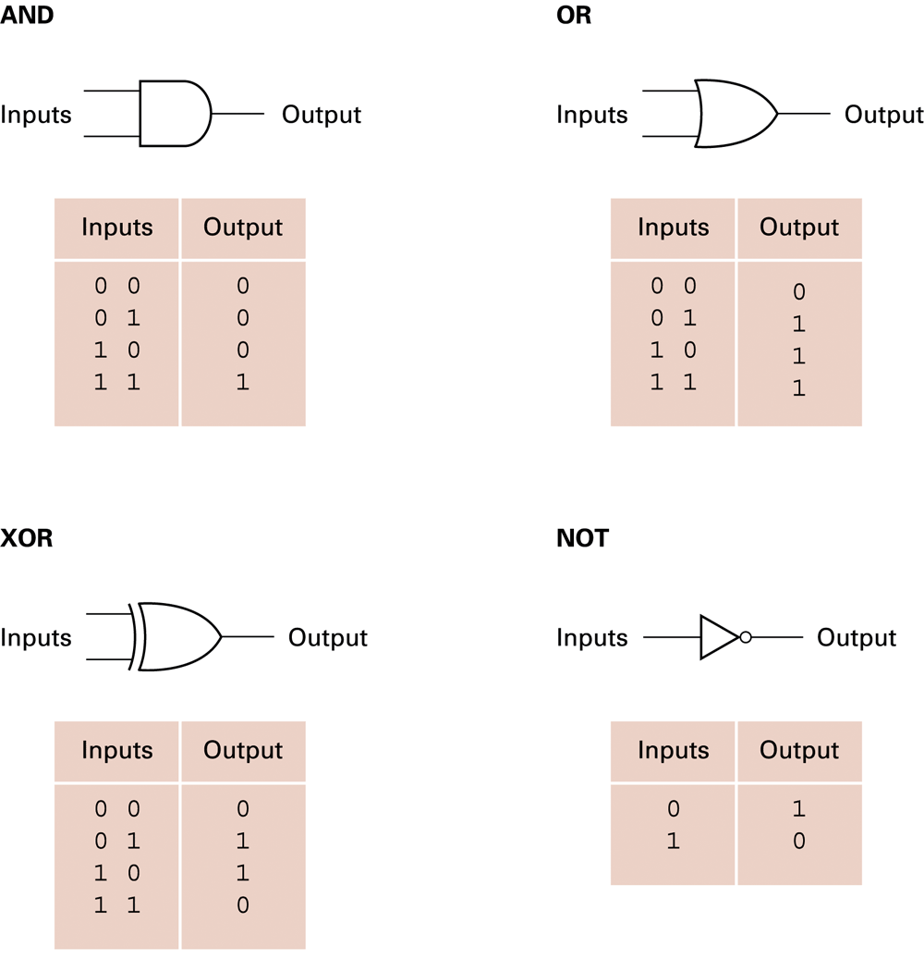
Figure 3.2 A pictorial representation of AND, OR, XOR, and NOT gates as well as their input and output values

Slide 8
3.1.3 Hexadecimal Notation
Hexadecimal notation (16进制表示): A shorthand notation for long bit patterns
Divides a pattern into groups of four bits each
Represents each group by a single symbol
Example: 10100011 becomes A3

Slide 9
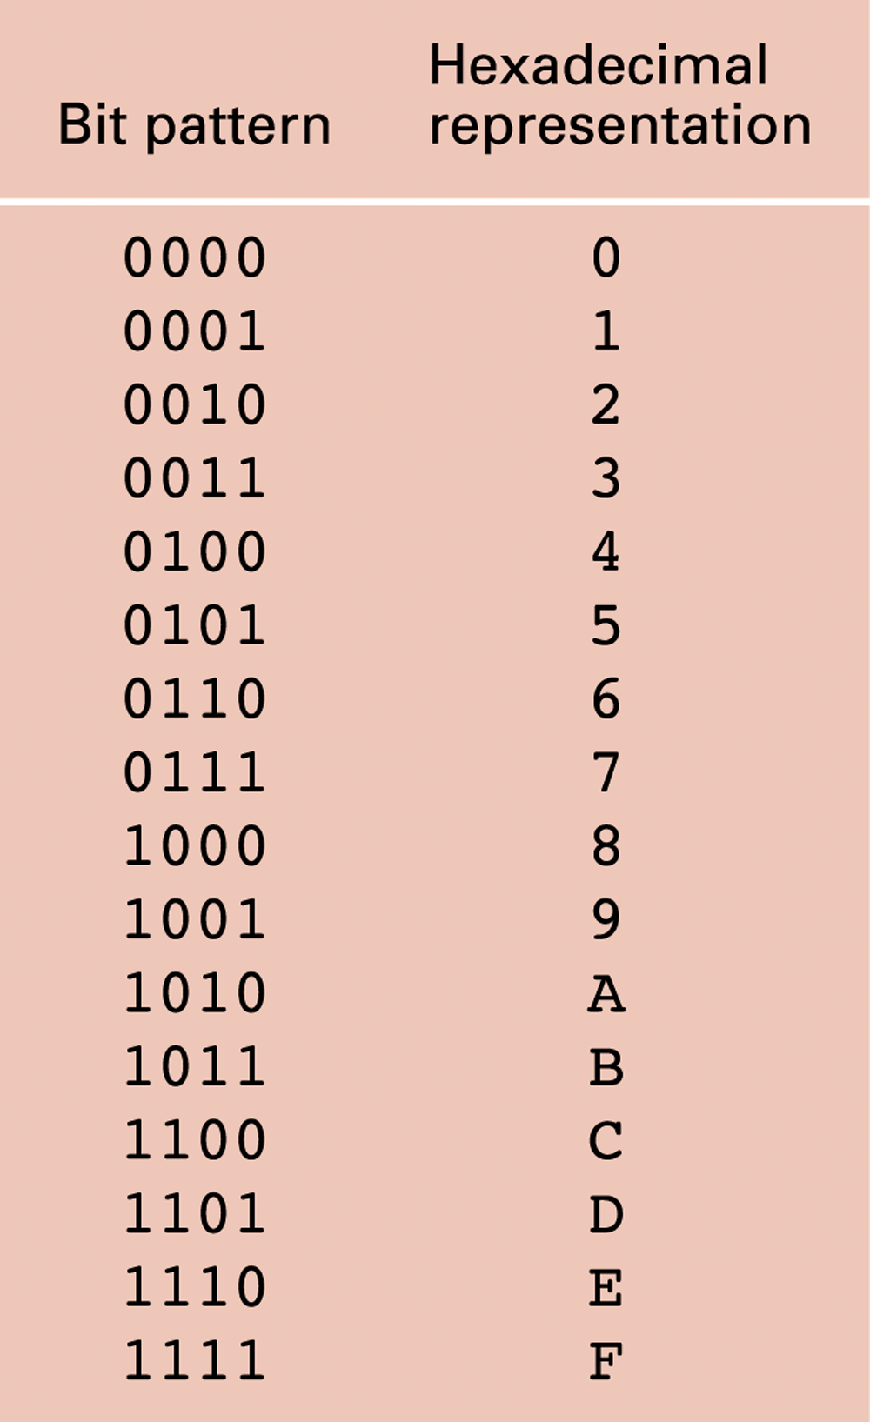
Figure 3.6 The hexadecimal coding system

Slide 10
3.2 Main Memory (主存、内存)
Cell: A unit of main memory (typically 8 bits which is one byte(字节))
Most significant bit: the bit at the left (high-order) end of the conceptual row of bits in a memory cell
Least significant bit: the bit at the right (low-order) end of the conceptual row of bits in a memory cell
Might be the other way for some machines

Slide 11
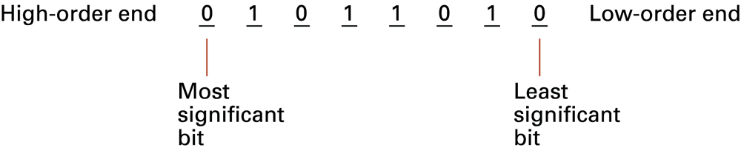
3.2.1 Memory organization Figure 3.7 The organization of a byte-size memory cell

Slide 12
Main Memory Addresses
Address: A “name” that uniquely identifies one cell in the computer’s main memory
The names are actually numbers.
These numbers are assigned consecutively starting at zero.
Numbering the cells in this manner associates an order with the memory cells.

Slide 13
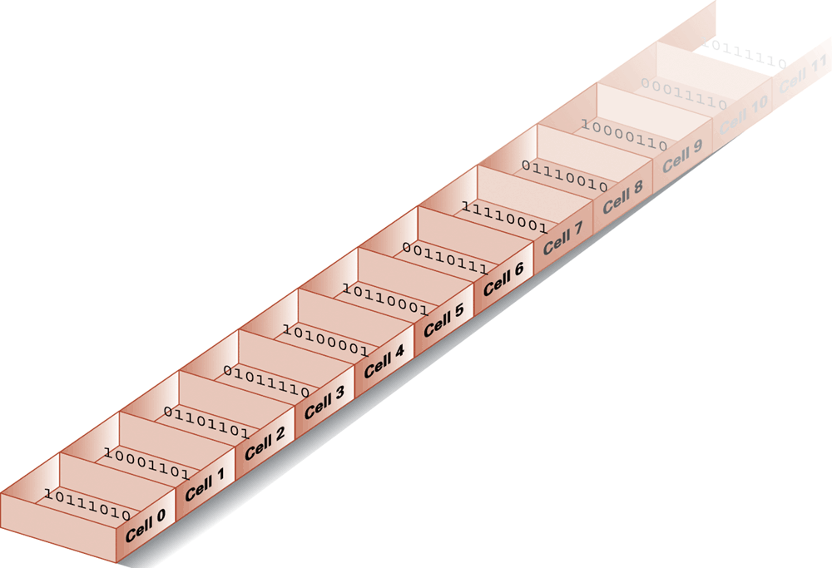
Figure 3.8 Memory cells arranged by address

Slide 14
Memory Terminology
Random Access Memory (RAM): Memory in which individual cells can be easily accessed in any order
Dynamic Memory (DRAM): RAM composed of volatile memory

Slide 15
3.2.2 Measuring Memory Capacity
Bit (位)
Byte (字节): 8 bits
Word(字): usually a few bytes, machine-dependent
Kilobyte: 2¹⁰ bytes = 1024 bytes≈10³, 千
Example: 3 KB = 3 times1024 bytes
Megabyte: 2²⁰ bytes = 1,048,576 bytes≈10⁶ ,百万
Gigabyte: 2³⁰ bytes = 1,073,741,824 bytes≈10⁹ ,十亿
Terabyte: 2⁴⁰ bytes ≈10¹² ,万亿
Petabyte: 2⁵⁰ bytes ≈10¹⁵ ,千万亿
E
Z
Y

Slide 16
3.3 Mass Storage (海量存储)
On-line versus off-line
Typically larger than main memory
Typically less volatile than main memory
Typically slower than main memory

Slide 17
Mass Storage Systems
Magnetic Systems
Disk
Tape
Optical Systems
CD
DVD
Flash Drives

Slide 18
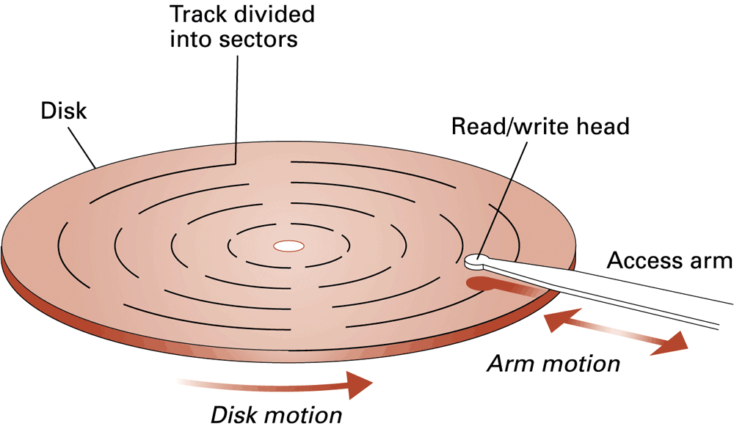
Figure 3.9 A magnetic disk storage system

Slide 19
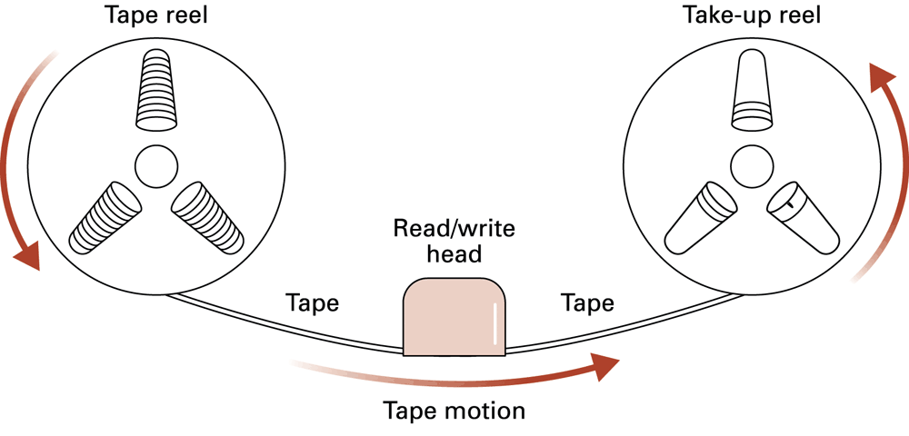
Figure 3.10 Magnetic tape storage

Slide 20
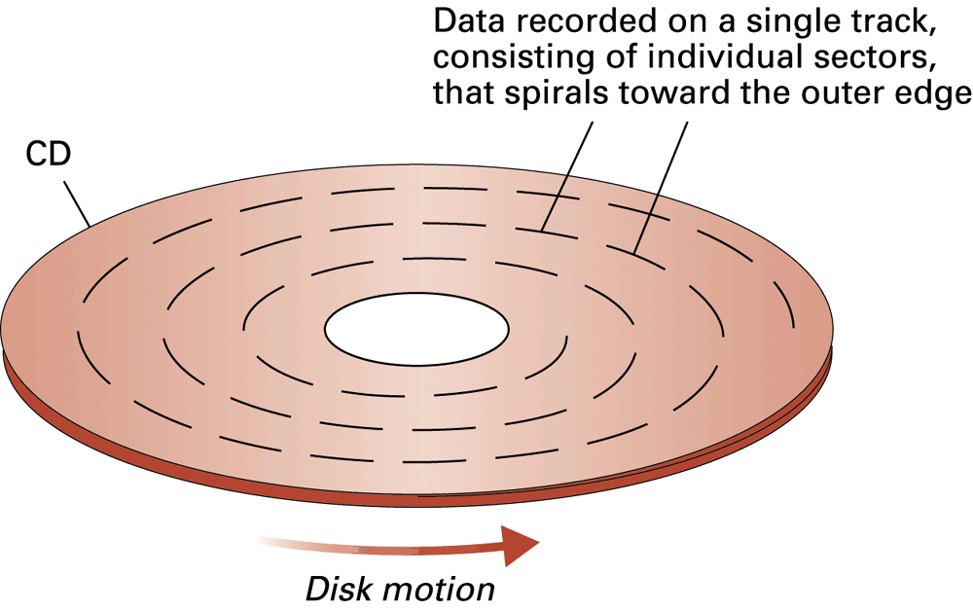
Figure 3.11 CD storage

Slide 21
3.4 Representing Information as Bit Patterns 3.4.1 Representing Text
Each character (letter, punctuation, etc.) is assigned a unique bit pattern.
ASCII(American Standard Code for Information Interchange ): Uses patterns of 7-bits to represent most symbols used in written English text
Unicode: Uses patterns of 16-bits to represent the major symbols used in languages world wide
ISO standard: Uses patterns of 32-bits to represent most symbols used in languages world wide

Slide 22
ASCII codes
upper
b₆b₅b₄
lower
b₃b₂b₁b₀

Slide 23
3.4.2 Representing Numeric Values
Binary notation: Uses bits to represent a number in base two
Limitations of computer representations of numeric values
Overflow – occurs when a value is too big to be represented
Truncation – occurs when a value cannot be represented accurately

Slide 24
3.4.3 Representing Images
Bit map (位图) techniques
Pixel (像素): short for “picture element”
RGB
Luminance and chrominance
Vector techniques
Scalable
TrueType and PostScript

Slide 25
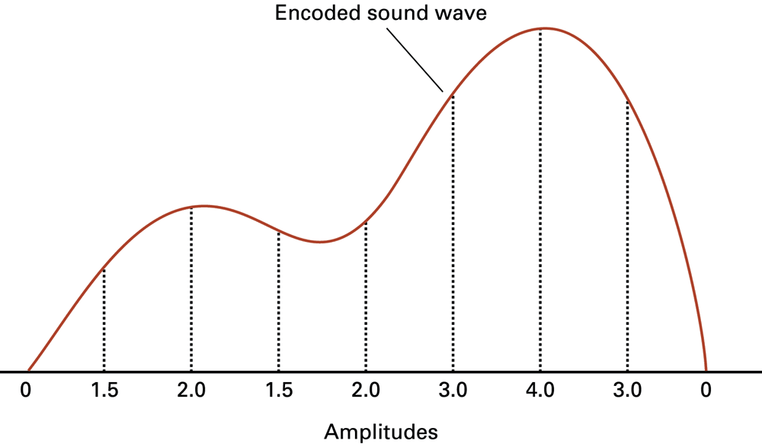
3.4.4 Representing Sound
Sampling techniques
Figure 3.14 The sound wave represented by the sequence 0, 1.5, 2.0, 1.5, 2.0, 3.0, 4.0, 3.0, 0

Slide 26
3.5 The Binary System
The traditional decimal system is based
on powers of ten.
The Binary system is based on powers
of two.

Slide 27
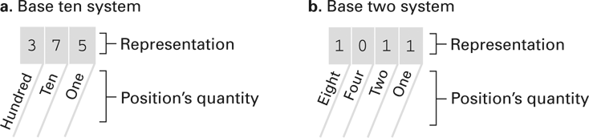
3.5.1 Binary notation Figure 3.15 The base ten and binary systems

Slide 28
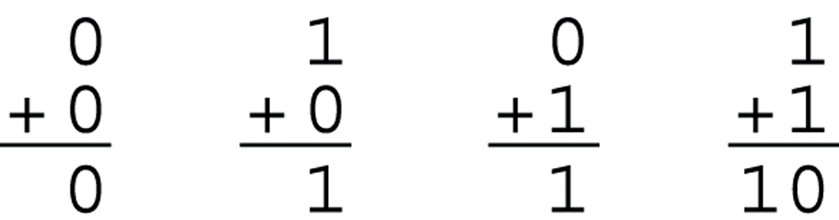
3.5.2 Binary addition Figure 3.19 The binary addition facts

Slide 29
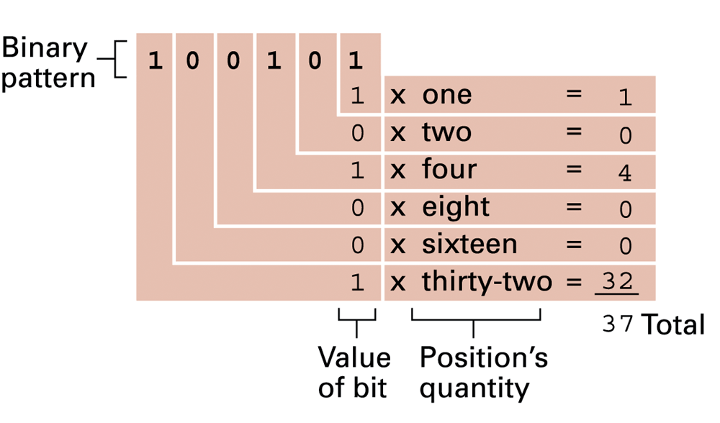
3.5.3 Binary vs. decimal Figure 3.16 Decoding the binary representation of 100101

Slide 30
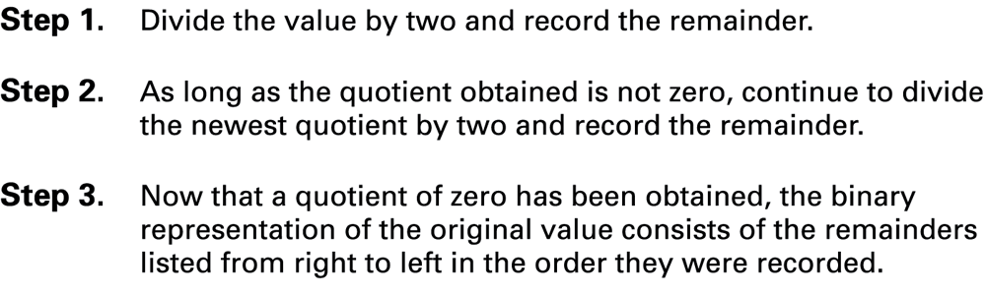
Figure 3.17 An algorithm for finding the binary representation of a positive integer

Slide 31
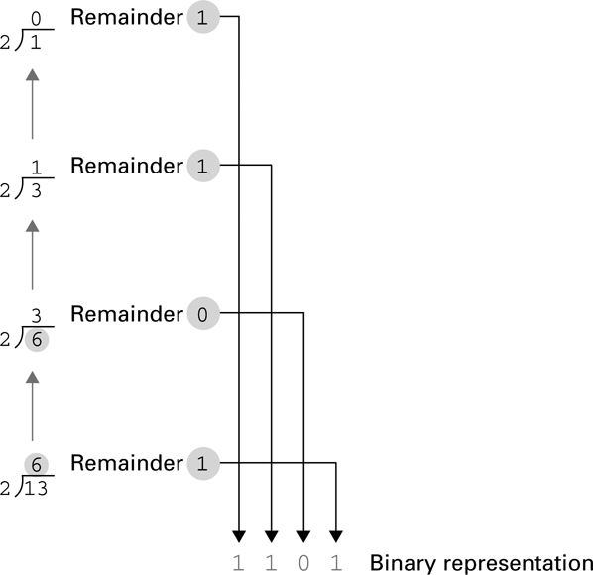
Figure 3.18 Applying the algorithm in Figure 3.15 to obtain the binary representation of thirteen

Slide 32
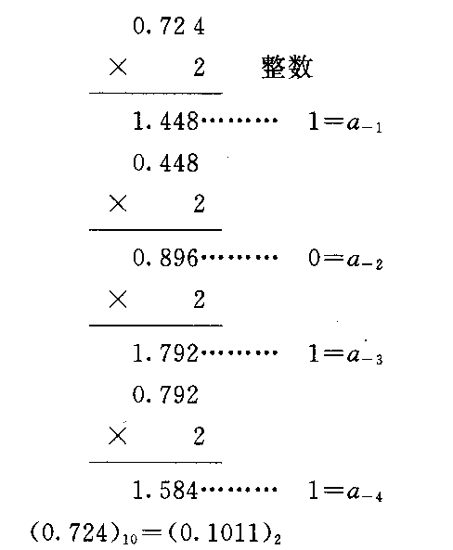
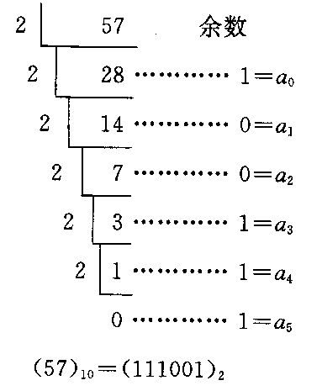
Decimal to binary
Integer: 除2取余(逆序)
Fraction: 乘2取整(顺序)

Slide 33
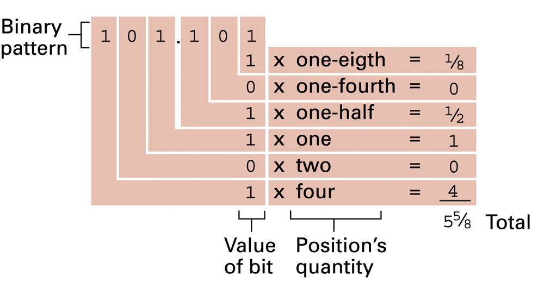
Figure 3.20 Decoding the binary representation 101.101

Slide 34
3.5.4 General forms
1. 进位记数制的要素：
①基数：指各种进位记数制中允许选用基本数码的个数。例如十进制的数码有：
0,1,2,3,4,5,6,7,8,9→基数是10
②位权：每个数码所表示的数值等于该数码乘以一个与数码所在位置相关的常数，这个常数叫做权值。例如：
123.4＝1×10²+2×10¹+3×10⁰ +4×10⁻¹
Notes:
其实就是基数

Slide 35
2.几种进位记数制
a_{n-1}a_{n-2}…a₁a_{0.}a₋₁…a_{-m}
Notes:
Windows calculator

Slide 36
几种进制数之间的对应关系
十进制 | 二进制 | 八进制 | 十六进制
0 1 2 3 4 5 6 7 8 9 10 11 12 13 14 15 | 0000 0001 0010 0011 0100 0101 0110 0111 1000 1001 1010 1011 1100 1101 1110 1111 | 0 1 2 3 4 5 6 7 10 11 12 13 14 15 16 17 | 0 1 2 3 4 5 6 7 8 9 A B C D E F
Notes:
注意16进制后几个数字

Slide 37
3.不同进制数的相互转换
⑴二进制数与十进制数的互换
人→十进制，计算机→二进制
二进制数转换成十进制数
按权展开，然后求和，就可把二进制数转换成十进制数。例如：
(101.1)₂＝1*2²+0*2¹+1*2⁰+1*2⁻¹
＝( ? )₁₀

Slide 38
十进制数转换成二进制数
十进制数有整数和小数两部分。
在转换时，整数部分采用除2取余法
小数部分采用乘2取整法
然后通过小数点将转换后的二进制数连接起来即可。例如：
(105.625)₁₀=(?)₂

Slide 39
⑵二进制数与八进制数的互换
二进制数转换成八进制数
三位并一位：以小数点为基准，整数部分从右到左，小数部分从左到右，每三位一组，不足三位添0补足,然后把每组的三位二进制数按权展开后相加，得到相应的一位八进制数码，再按权的顺序连接即得相应的八进制数。
例如：(1011100.00101011)₂=(?)₈
001,011,100.001,010,110)₂=(134.126)₈ 1 3 4 . 1 2 6

Slide 40
八进制数转换成二进制数
一位拆三位：将每一位八进制数写成对应的三位二进制数，然后按权连接即可。
例如： (123.67)₈=(?)₂
1 2 3 . 6 7 (八进制)
001,010,011.110111 (二进制)
(123.67)₈=(1010011.110111)₂

Slide 41
⑶二进制数与十六进制数的互换
二进制数转换成十六进制数
四位并一位：以小数点为基准，整数部分从右到左，小数部分从左到右，每四位一组，不足四位添0补足,然后把每组的四位二进制数按权展开后相加，得到相应的一位十六进制数码，再按权的顺序连接即得相应的十六进制数。 例如：(1011110.00011)₂=(?)₁₆ (0101,1110.0001,1000)₂=(5E.18)₁₆ 5 E . 1 8

Slide 42
十六进制数转换成二进制数
一位拆四位：把一位十六进制数写成对应的四位二进制数，然后按权连接即可。
例如：(123.EF)₁₆=(?)₂ 1 2 3 . E F (十六进制) 0001,0010,0011.1110,1111 (二进制)
(123.EF)₁₆=(100100011.11101111)
十进制数:512D或512 二进制数:1011B
八进制数:127Q 十六进制数:A8H

