Slide 1
Introduction to Computational Thinking Chapter 4: Data Manipulation
Rui Mao
Shenzhen University
Shenzhen Institute of Computing Sciences

Slide 2
Chapter 4: Data Manipulation
4.1 Computer Architecture
4.1.1 CPU basics
4.1.2 The stored program concept
4.2 Machine Language
4.2.1 Terminology
4.2.2 The instruction repertoire
4.2.3 An illustrative machine language
4.3 Program Execution
4.3.1 The machine circle
4.3.2 Decoding of an instruction
4.3.3 An example of program execution

Slide 3
4.1 Computer Architecture 4.1.1 CPU basics
Central Processing Unit (CPU, 中央处理器) or processor
Arithmetic/Logic unit(算术逻辑单元、运算器) versus Control unit(控制器)
Registers (寄存器)
General purpose
Special purpose
Bus (总线)
Motherboard (主板)

Slide 4
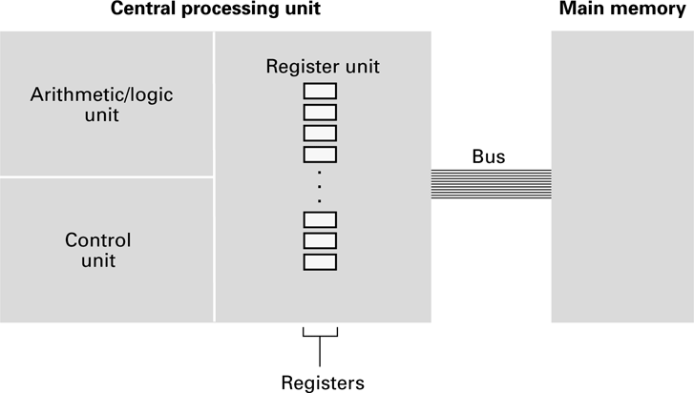
Figure 4.1 CPU and main memory connected via a bus

Slide 5
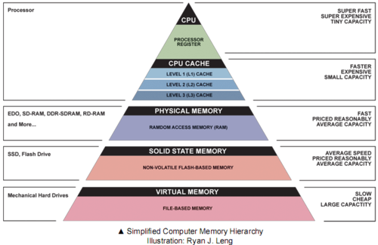
存储系统层次结构
存取速度更快
单位价格更高
存储容量更大
海量存储器
光盘和磁带

Slide 6
4.1.2 Stored Program Concept
A program can be encoded as bit patterns and stored in main memory. From there, the CPU can then extract the instructions and execute them. In turn, the program to be executed can be altered easily.

Slide 7
4.2 Machine Language 4.2.1 Terminology
Machine instruction(机器指令): An instruction (or command) encoded as a bit pattern recognizable by the CPU
Machine language(机器语言): The set of all instructions recognized by a machine

Slide 8
4.2.2 The instruction repertoire Machine Language Philosophies
Reduced Instruction Set Computer (RISC,精简指令集计算机)
Few, simple, efficient, and fast instructions
Examples: PowerPC from Apple/IBM/Motorola
and SPARC from Sun Microsystems
Complex Instruction Set Computing (CISC, 复杂指令集计算机)
Many, convenient, and powerful instructions
Example: Pentium from Intel

Slide 9
Machine Instruction Types
Data Transfer: copy data from one location to another
Arithmetic/Logic: use existing bit patterns to compute a new bit patterns
Control: direct the execution of the program

Slide 10
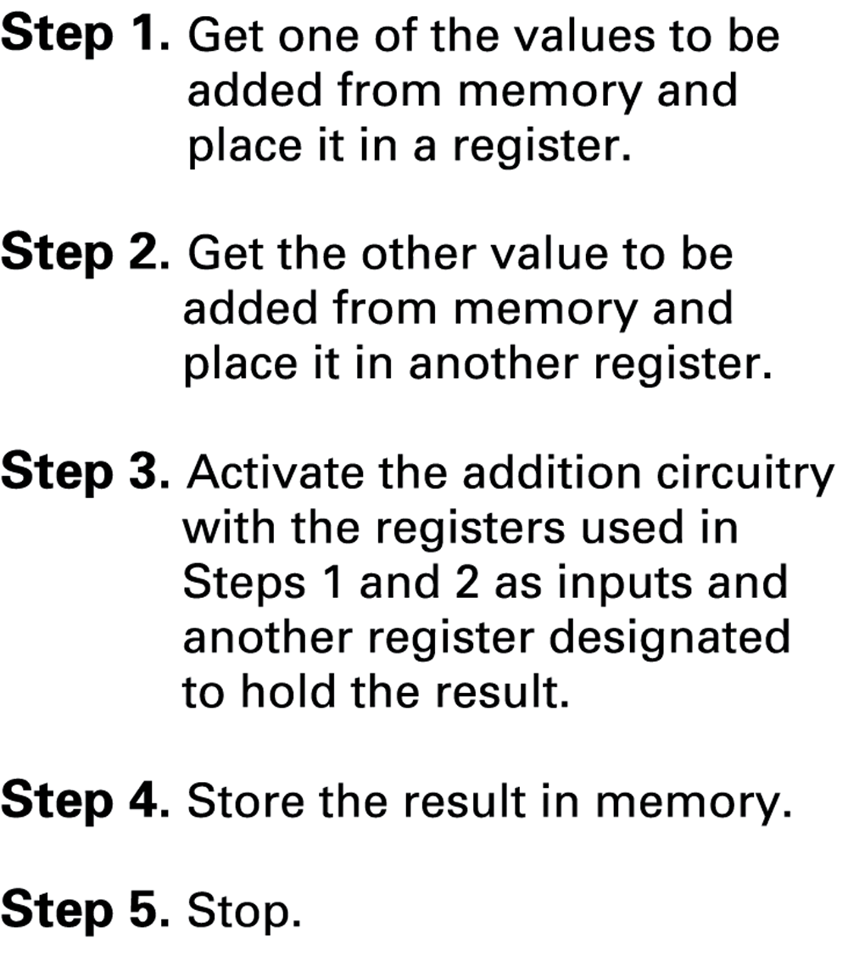
Figure 4.2 Adding values stored in memory

Slide 11
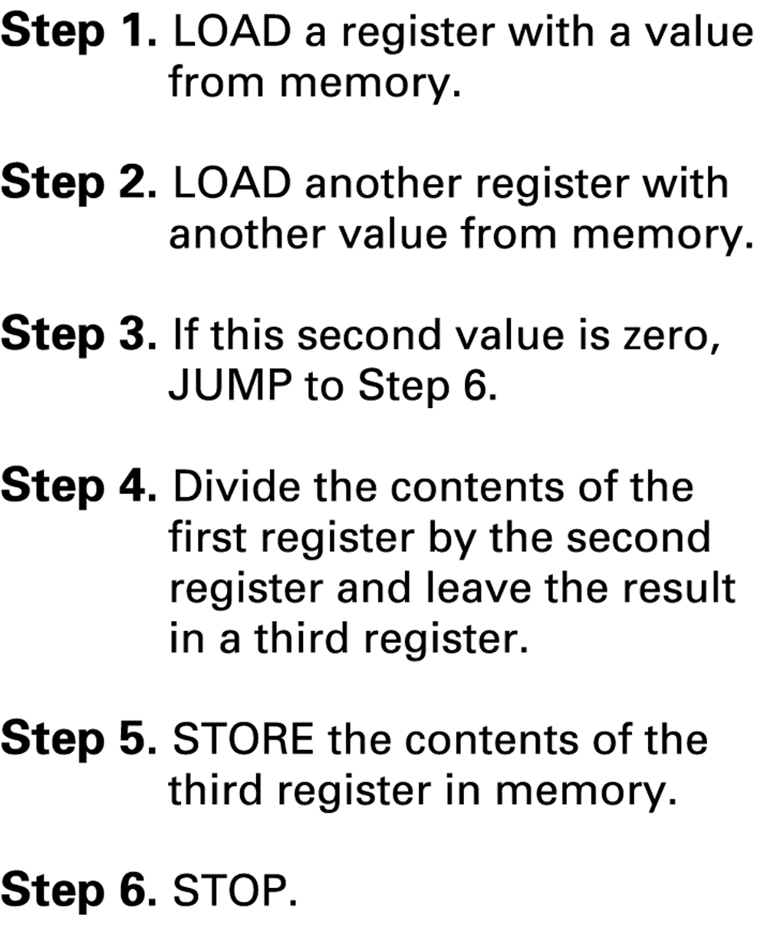
Figure 4.3 Dividing values stored in memory

Slide 12
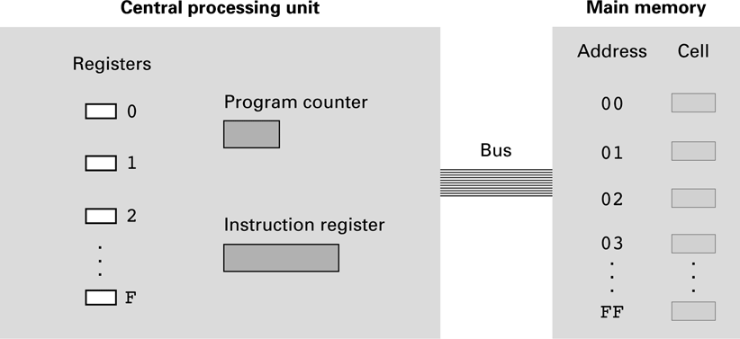
4.2.3 An illustrative machine language Figure 4.4 The architecture of the machine described in Appendix C

Slide 13
Parts of a Machine Instruction
Op-code: Specifies which operation to execute
Operand: Gives more detailed information about the operation
Interpretation of operand varies depending on op-code

Slide 14
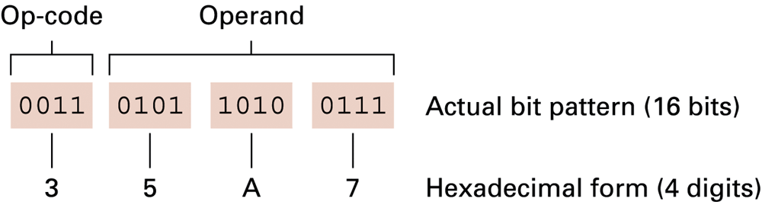
Figure 4.5 The composition of an instruction for the machine in Appendix C

Slide 15
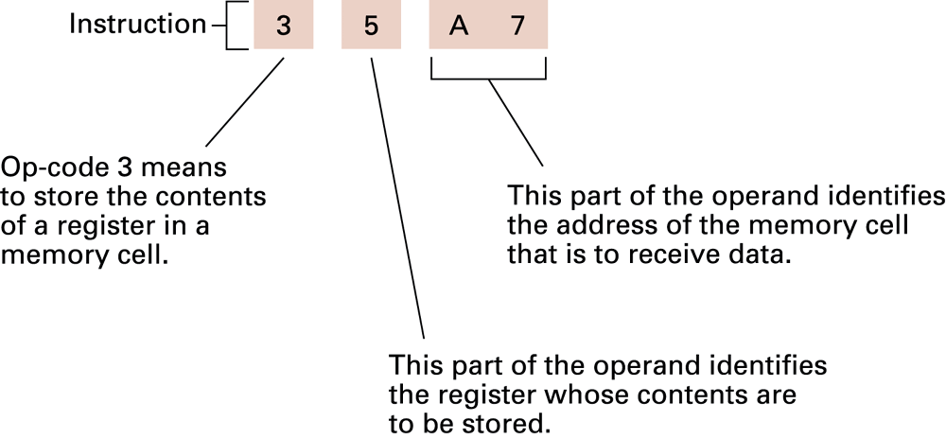
Figure 4.6 Decoding the instruction 35A7

Slide 16
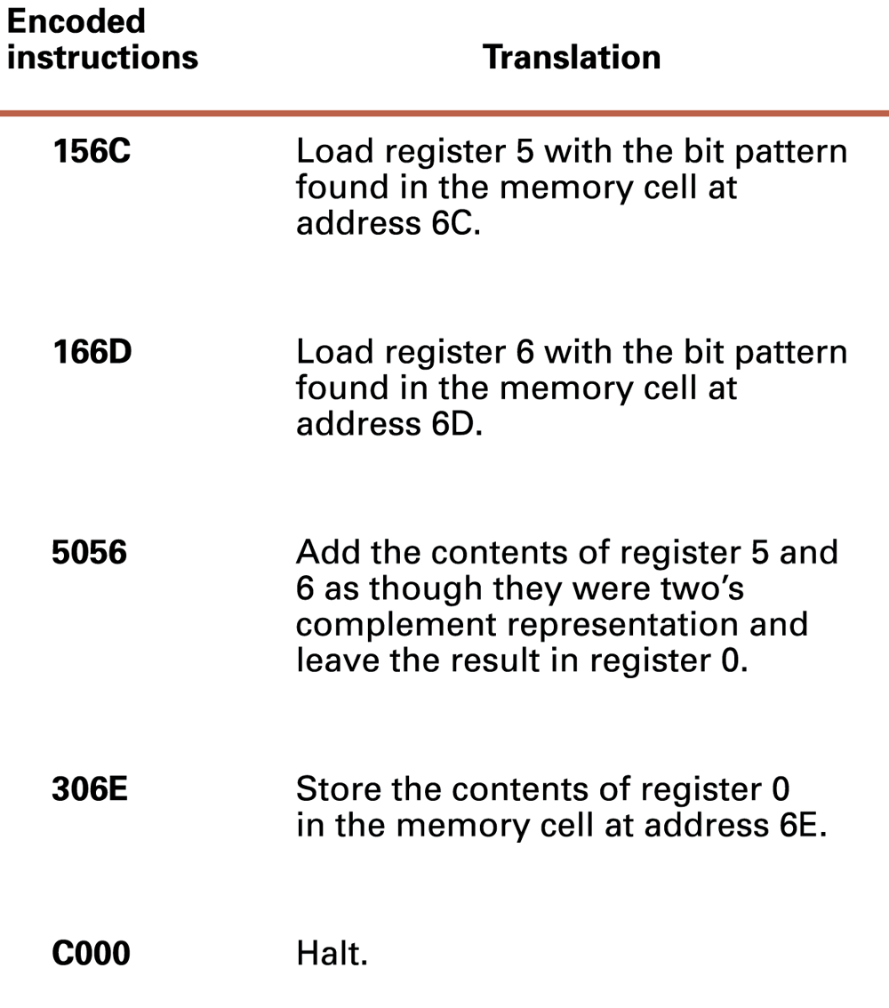
Figure 4.7 An encoded version of the instructions in Figure 4.2

Slide 17
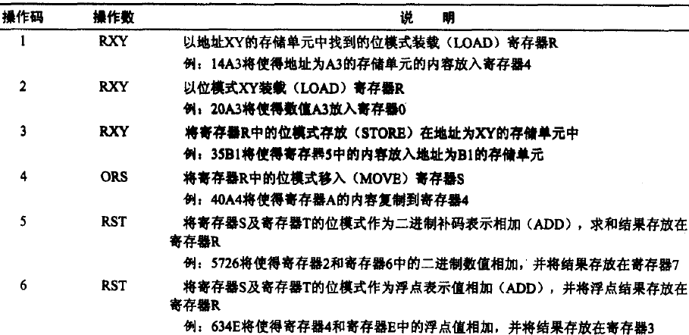

Slide 18
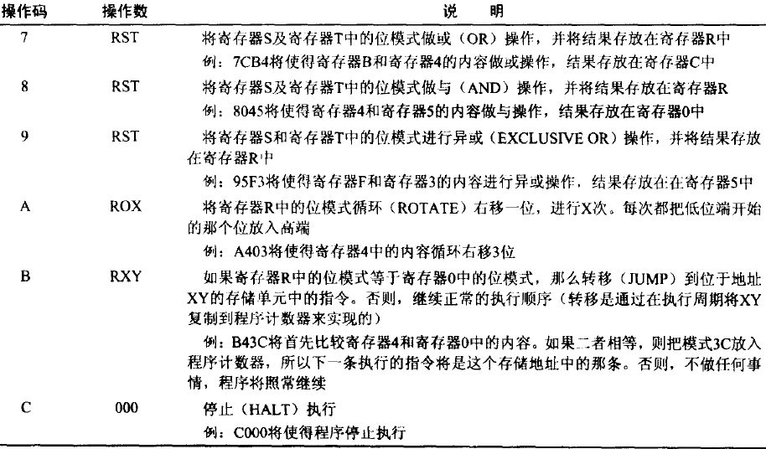

Slide 20
For循环的机器指令
内存地址
00:
…
存放数据：3C:
3D:
…
…
存放代码：55:
不是56->57:
59:
不是61->5B:
5D:
5F:
61:
63:
65:
67:
69:
…
…
FF:
内存内容
0
1
10 3C
21 05
12 3D
23 01
B1 65
52 02
50 30
B0 5D
30 3C
32 3D
C0 00
//i放在3C单元
//j放在3D单元
//i放到0号寄存器
//5放到1号寄存器
//j放到2号寄存器
//1放到3号寄存器
//如果i=5跳转
//j=j+i
//i=i+1
//无条件跳转goto
//i保存回内存
//j保存回内存
int j=1;
for(int i=0;i<5;i++)
{
j=j+i;
}
int i=0,j=1;
L: if (i<5)
{
j=j+i;
i=i+1;
goto L;
}

Slide 21
4.3 Program Execution
Controlled by two special-purpose registers
Program counter: address of next instruction
Instruction register: current instruction
Machine Cycle
Fetch
Decode
Execute

Slide 22
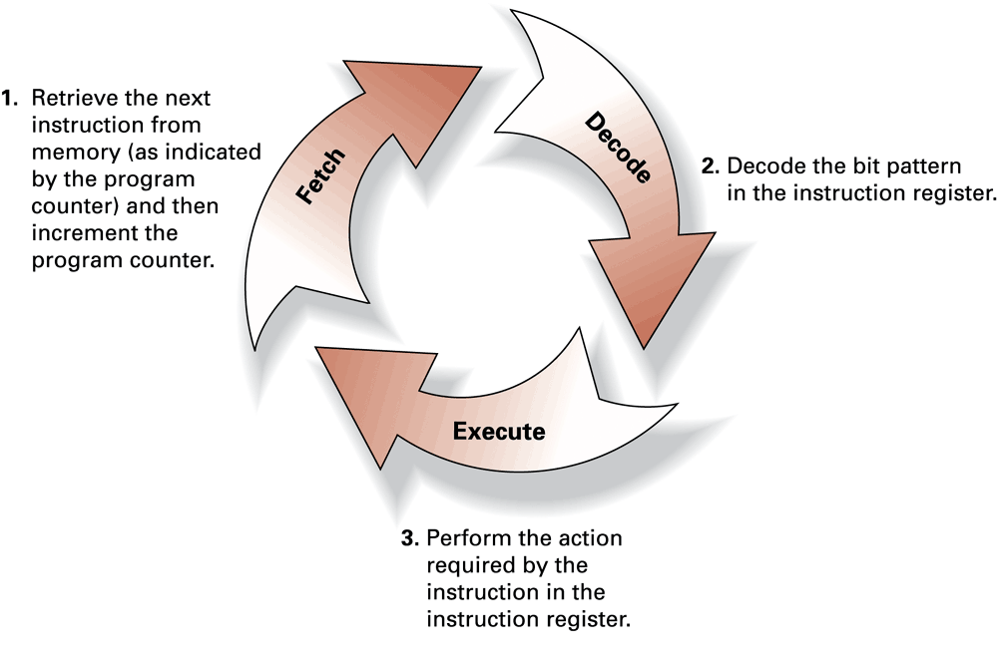
Figure 4.8 The machine cycle

Slide 23
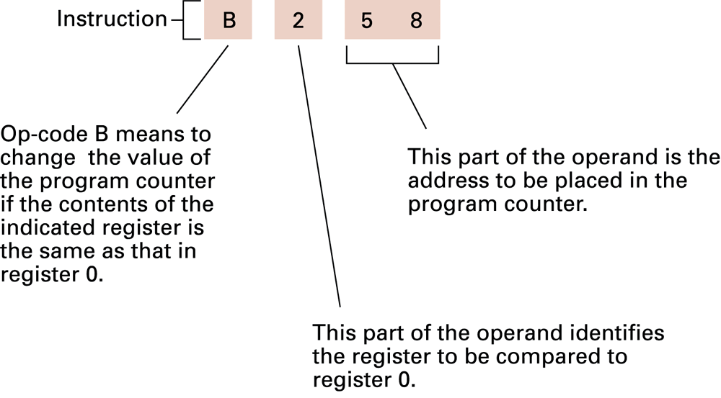
Figure 4.9 Decoding the instruction B258

Slide 24
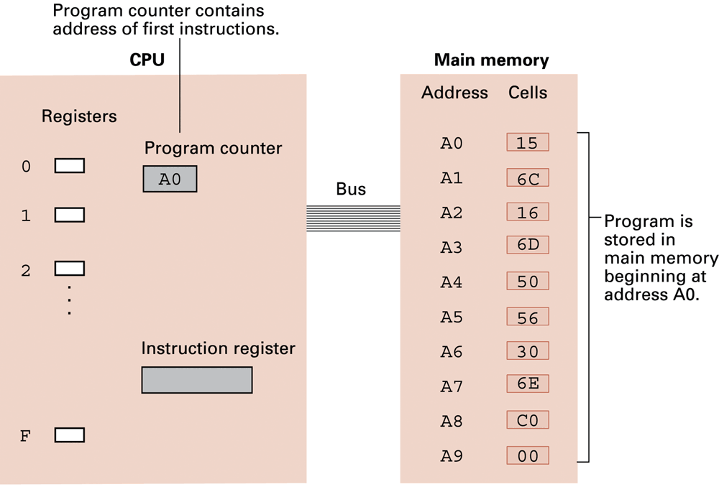
Figure 4.10 The program from Figure 4.7 stored in main memory ready for execution

Slide 25
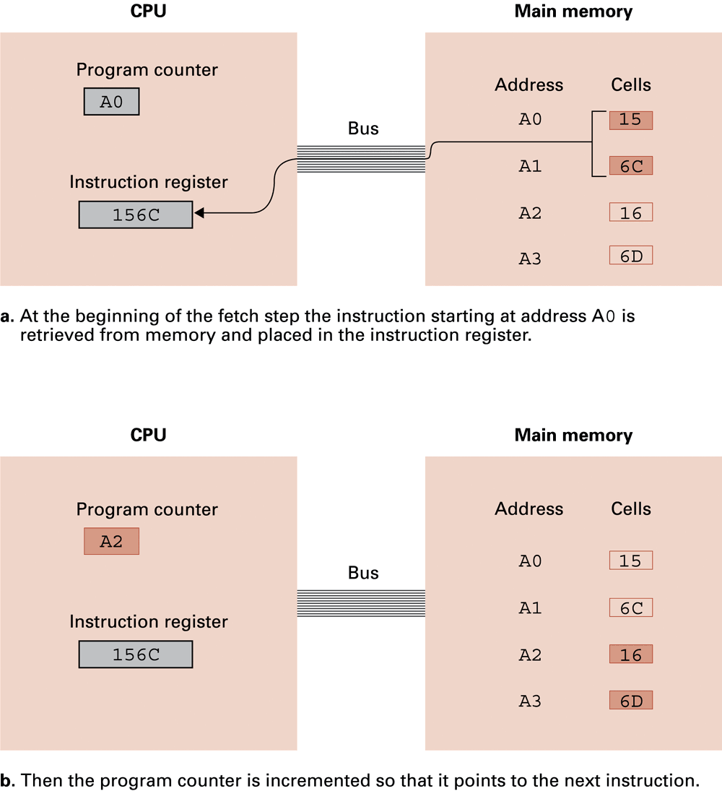
Figure 4.11 Performing the fetch step of the machine cycle

Slide 26
Figure 4.11 Performing the fetch step of the machine cycle (cont’d)

Slide 27
For循环的机器指令
内存地址
00:
…
3C:
3D:
…
…
55:
57:
59:
5B:
5D:
5F:
61:
63:
65:
67:
69:
…
…
FF:
内存内容
i=0
j=1
10 3C
21 02
12 3D
23 01
B1 65
52 02
50 30
B0 5D
30 3C
32 3D
C0 00
int j=1;
for(int i=0;i<2;i++)
{
j=j+i;
}
PC | IR | PC | IR | PC | IR
55
57 | 10 3C
59 | 21 02
5B | 12 3D
5D | 23 01 | 5D | B0 5D | 5D | B0 5D
5F | B1 65 | 5F | B1 65 | 5F->65 | B1 65
61(i=0) | 52 02 | 61(i=1) | 52 02
63(i=1) | 50 30 | 63(i=2) | 50 30
65->5D | B0 5D | 65->5D | B0 5D | 65 | B1 65
 |  |  |  | 67 | 30 3C
 |  |  |  | 69 | 32 3D
 |  |  |  | 6B | C0 00
int i=0,j=1;
L: if (i<2)
{
j=j+i;
i=i+1;
goto L;
}

Slide 28
For循环的机器指令
内存地址
00:
…
3C:
3D:
…
…
55:
57:
59:
5B:
5D:
5F:
61:
63:
65:
67:
69:
…
…
FF:
内存内容
i=0
j=1
10 3C
21 02
12 3D
23 01
B1 65
52 02
50 30
B0 5D
30 3C
32 3D
C0 00
int j=1;
for(int i=0;i<2;i++)
{
j=j+i;
}
IR
10 3C
21 05
12 3D
23 01
B1 65
52 02
50 30
B0 5D
IR
B0 5D
B1 65
52 02
50 30
B0 5D
B0 5D
IR
B1 65
B1 65
B1 65
30 3C
32 3D
C 0 00
PC |  | PC |  | PC
55
57
59
5B
5D |  | 5D |  | 5D
5F |  | 5F |  | 5F->65
61(i=0) |  | 61(i=1)
63(i=1) |  | 63(i=2)
65->5D |  | 65->5D |  | 65
 |  |  |  | 67
 |  |  |  | 69
 |  |  |  | 6B
int i=0,j=1;
L: if (i<2)
{
j=j+i;
i=i+1;
goto L;
}

