Slide 1
Introduction to Computational Thinking Chapter 5: Operating Systems
Rui Mao
Shenzhen University
Shenzhen Institute of Computing Sciences

Slide 2
Chapter 5: Operating Systems(操作系统)
5.1 The History of Operating Systems
5.1.1 Functions of operating systems
5.1.2 Evolution of shared computing
5.1.3 Common operating systems*
5.2 Operating System Architecture
5.3 Coordinating the Machine’s Activities
5.4 Handling Competition Among Processes

Slide 3
5.1.1 Functions of Operating Systems
Oversee operation of computer
Store and retrieve files
Schedule programs for execution
Coordinate the execution of programs
①管理各种软硬件资源； ②提供良好的用户界面。
1.处理机管理 2.存储管理 3.设备管理
4.文件管理 5.用户接口

Slide 4
5.1.2 Evolution of Shared Computing
Batch processing
Interactive processing
Requires real-time processing
Time-sharing/Multitasking
Implemented by Multiprogramming
Multiprocessor machines
1.单用户操作系统 2.批处理操作系统 3.分时操作系统
4.实时操作系统 5.网络操作系统 6.分布式操作系统
7.嵌入式操作系统 8.智能卡操作系统

Slide 5
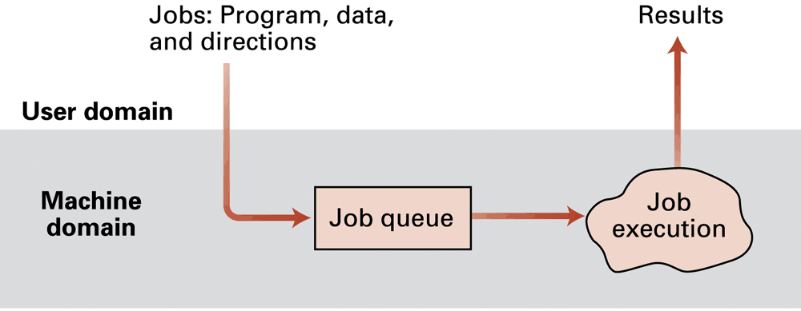
Figure 5.1 Batch processing

Slide 6
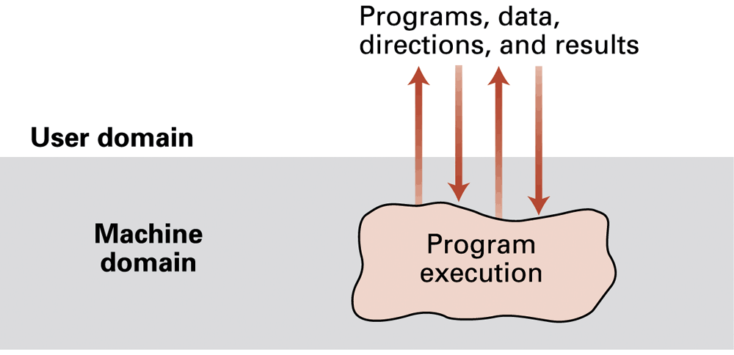
Figure 5.2 Interactive processing

Slide 7
5.1.3 Common operating systems
1.操作系统早期霸主--DOS
1981年IBM公司首次推出IBM PC,就采用了Microsoft公司开发的DOS操作系统。
（1）基本输入输出系统
（2）输入输出接口模块
（3）文件管理模块
（4）命令处理模块

Slide 8
2.操作系统当代大亨--Windows
1981年，微软公司内部制定了发展界面管理者的计划。到1983年5月,微软公司决定把这一计划命名为Microsoft Windows。
1983年11月，Bill Gates宣布推出Windows1.0版本，但不成功。直到1985年才正式发布。
1987年，微软公司推出Windows2.0。直到1990年，微软公司推出Windows3.0，才逐渐取代DOS成为主流操作系统。

Slide 9
Windows内核系列发布表
日期 版本 | 日期 版本
1983.11 Windows宣布诞生 1985.11 Windows 1.0 1987.4 Windows 2.0 1990.5 Windows 3.0 1992.4 Windows 3.1 1994.2 Windows 3.11 1995.8 Windows 95 1998.6 Windows 98 1999.5 Windows 98 SE 2000.9 Windows Me 2001.1 Win9x内核宣告停止 | 1993.8 Windows NT 3.1 1994.9 Windows NT 3.5 1995.6 Windows NT 3.51 1996.8 Windows NT 4.0 1997.9 Windows NT 5.0 Beta 1 1998.8 Windows NT 5.0 Beta 2 1999.4 Windows 2000 Beta 3 2000.2 Windows 2000 2000.7 Windows 2000 SP1 2001.10 Windows XP 2001.11 Windows XP 中文版

Slide 10
3.天皇巨星--UNIX
UNIX是使用比较广泛、影响比较大的主流操作系统之一。UNIX结构简练、功能强，可移植性和兼容性都比较好，因而它被认为是开放系统的代表。
UNIX是1969年贝尔实验室开发的多用户操作系统，最早用于PDP-7和PDP-11小型机,并很快得到普及。迄今已成为跨越从微型机到巨型机范围的唯一操作系统。

Slide 11
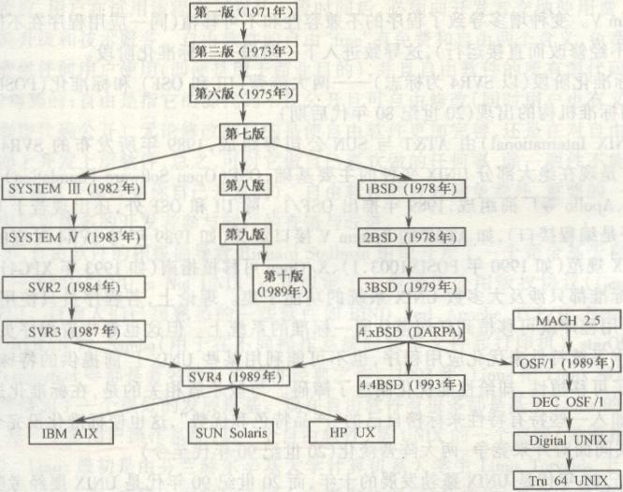
UNIX发展简图
Notes:
多分支发展

Slide 12


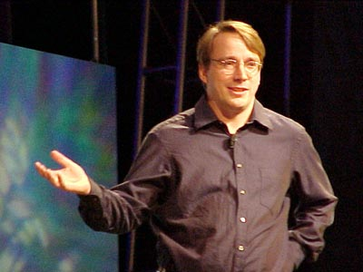
4.诱人的小企鹅--Linux
1991年，芬兰赫尔辛基大学的21岁学生Linus Torvolds在学习操作系统时，将自己开发的Linux系统源程序完整地上传到FTP服务器上，供大家下载测试。
Notes:
['li:nэks]
精简免费的unix

Slide 13
流行的Linux版本
Linux内核版本：测试版、稳定版
2.6.8
主版本号
当前版本错误修改次数
次版本号：奇数→测试版
偶数→稳定版
Red Hat Linux Mandrake Linux Turbo Linux 红旗Linux 中软Linux | www.redhat.com www.mandrake.org www.turbolinux.com.cn www.redflag-linux.com linux.cosix.com.cn

Slide 14
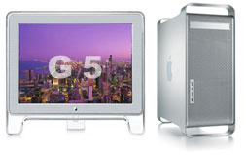
5.天使的化身--Mac OS X
Apple Ⅰ/Ⅱ→Lisa→Macintosh
1976
1983
1984
1984 1985 1987 1988 1991 1994 1997 1998.10 1999.5 1999.10 | System 1.0 System 2.0 System 5.0 System 6 System 7 System 7.5 System 7.6 MAC OS 8 MAC OS 8.5 MAC OS 8.6 MAC OS 9 | 2000.1 2001.3 2001.9 2002 2004 2005 | MAC OS X MAC OS X 10.0 MAC OS X 10.1 MAC OS X 10.2 MAC OS X 10.3 MAC OS X 10.4

Slide 15
5.1 The History of Operating Systems
5.2 Operating System Architecture
5.2.1 Types of software
5.2.2 Operating system components
5.2.3 The booting process
5.3 Coordinating the Machine’s Activities
5.4 Handling Competition Among Processes

Slide 16
5.2.1 Types of Software
Application software
Performs specific tasks for users
System software
Provides infrastructure for application software
Consists of operating system and utility software

Slide 17
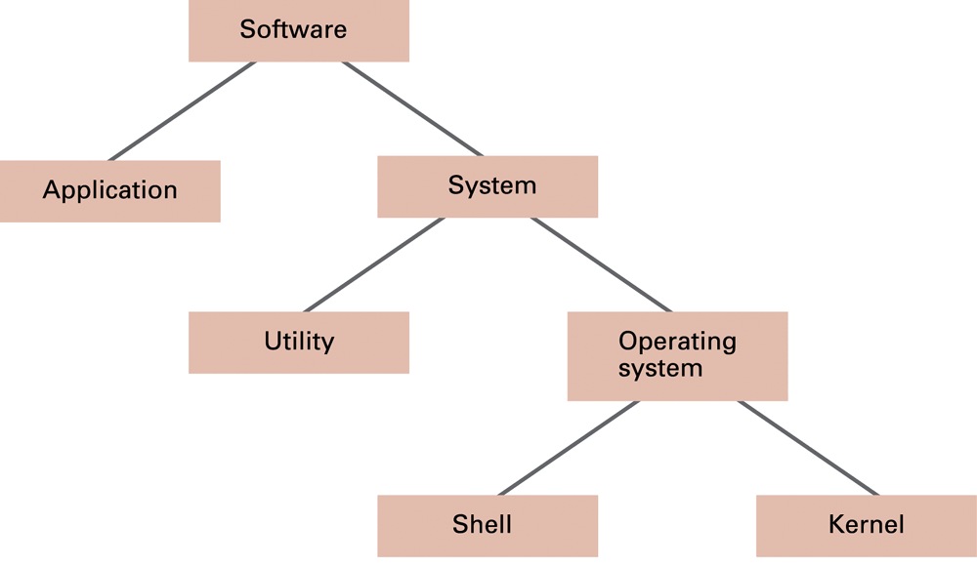
Figure 5.3 Software classification

Slide 18
5.2.2 Operating System Components
Shell: Communicates with users
Text based
Graphical user interface (GUI)
Kernel: Performs basic required functions
File manager
Device drivers
Memory manager
Scheduler and dispatcher

Slide 19
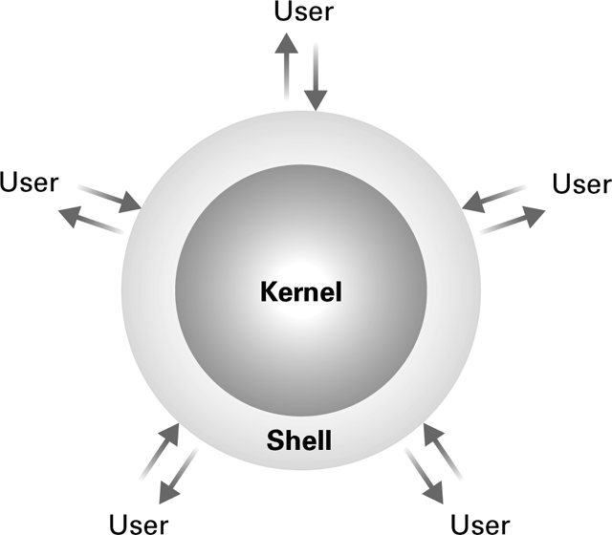
Figure 5.4 The shell as an interface between users and the operating system

Slide 20
File Manager
Directory (or Folder): A user-created bundle of files and other directories (subdirectories)
Directory Path: A sequence of directories within directories

Slide 21
Memory Manager
Allocates space in main memory
May create the illusion that the machine has more memory than it actually does (virtual memory) by playing a “shell game” in which blocks of data (pages) are shifted back and forth between main memory and mass storage

Slide 22
5.2.3 The booting process
Bootstrap: Program in ROM (example of firmware)
Run by the CPU when power is turned on
Transfers operating system from mass storage to main memory
Executes jump to operating system

Slide 23
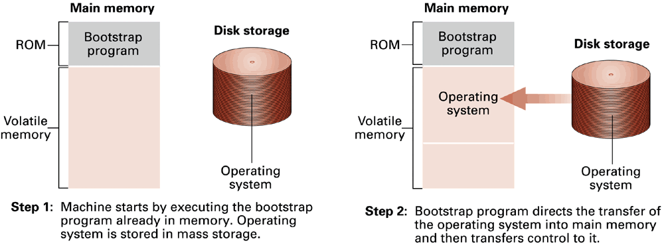
Figure 5.5 The booting process

Slide 24
5.1 The History of Operating Systems
5.2 Operating System Architecture
5.3 Coordinating the Machine’s Activities
5.3.1 Processes
5.3.2 Process administration
5.4 Handling Competition Among Processes

Slide 25
5.3.1 Processes
Process: The activity of executing a program
Process State: Current status of the activity
Program counter
General purpose registers
Related portion of main memory

Slide 26
5.3.2 Process Administration
Scheduler: Adds new processes to the process table and removes completed processes from the process table
Dispatcher: Controls the allocation of time slices to the processes in the process table
The end of a time slice is signaled by an interrupt.

Slide 27
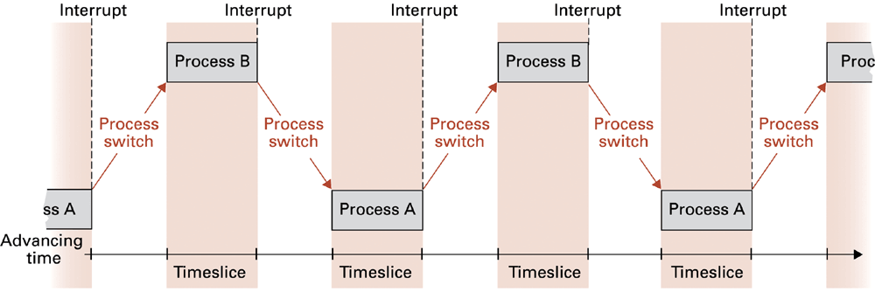
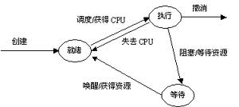
Figure 5.6 Time-sharing between process A and process B

Slide 28
5.1 The History of Operating Systems
5.2 Operating System Architecture
5.3 Coordinating the Machine’s Activities
5.4 Handling Competition Among Processes
5.4.1 Common approach
5.4.2 Deadlock

Slide 29
5.4 Handling Competition for Resources 5.4.1 Common approach
Semaphore(信号灯): A “control flag”
Critical Region: A group of instructions that should be executed by only one process at a time
Mutual exclusion: Requirement for proper implementation of a critical region

Slide 30
5.4.2 Deadlock(死锁)
Processes block each other from continuing
Conditions required for deadlock
1. Competition for non-sharable resources
2. Resources requested on a partial basis
3. An allocated resource can not be forcibly retrieved

Slide 31
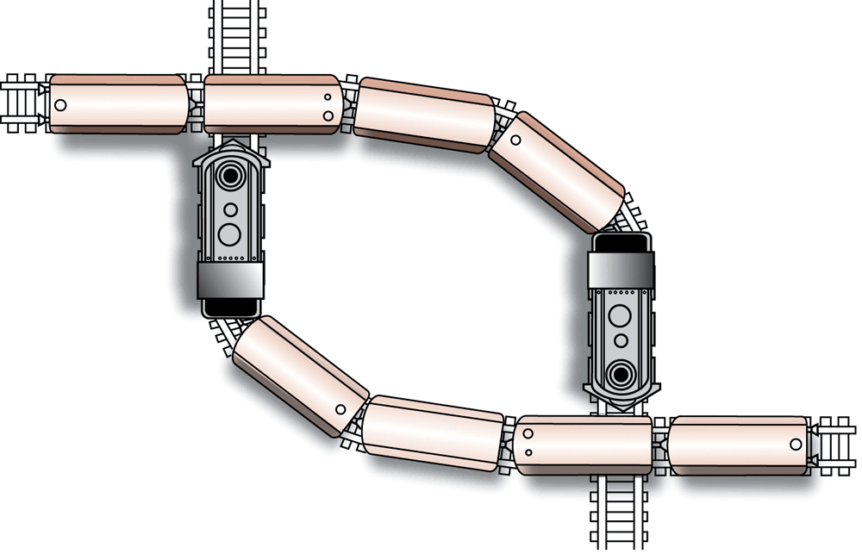
Figure 5.7 A deadlock resulting from competition for nonshareable railroad intersections

Slide 32
