Slide 1
Introduction to Computational Thinking Chapter 6: Networking and the Internet
Rui Mao
Shenzhen University
Shenzhen Institute of Computing Sciences

Slide 2
Chapter 6: Networking and the Internet
6.1 Network Fundamentals
6.1.1 Network Classifications
6.1.2 Protocols
6.1.3 Connecting Networks
6.1.4 Inter-process Communication
6.2 The Internet
6.3 The World Wide Web

Slide 3
6.1 Network Fundamentals 6.1.1 Network Classifications
Scope
Local area network (LAN,局域网)
Metropolitan area network (MAN,城域网)
Wide area network (WAN,广域网)
Ownership
Closed versus open
Topology (拓扑, configuration)
Bus (Ethernet,以太网)
Star (Wireless networks with central Access Point)

Slide 4
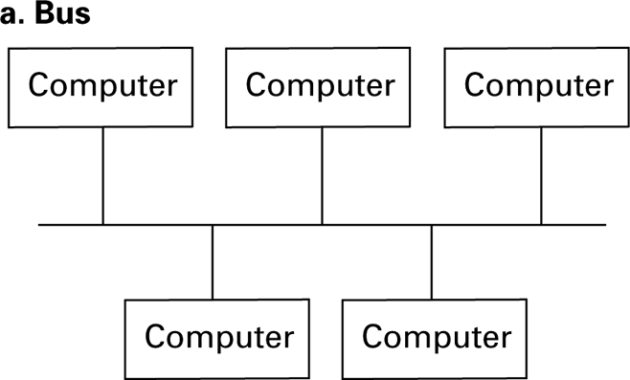
Figure 6.1 Network topologies
Bus vs. Star: communicate directly or via a central machine

Slide 5
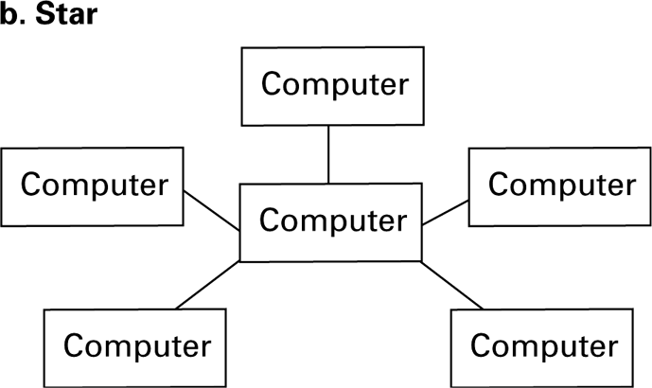
Figure 6.1 Network topologies (continued)

Slide 6
6.1.2 Protocols
CSMA/CD (Carrier Sense Multiple Access/Collision Detect, 载波监听多路访问/ 冲突检测)
Used in Ethernet
Silent bus provides right to introduce new message
CSMA/CA
Used in WiFi
Hidden terminal problem

Slide 7
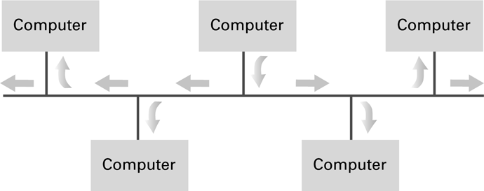
Figure 6.2 Communication over a bus network

Slide 8
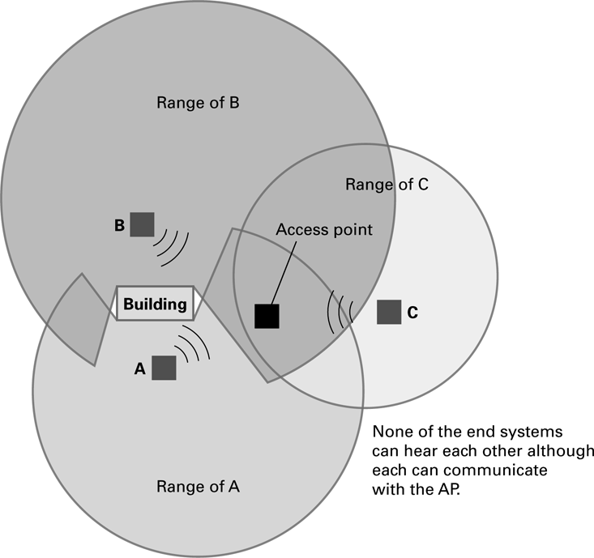
Figure 6.3 The hidden terminal problem

Slide 9
6.1.3 Connecting Networks
Repeater (中继器): Extends a network
Hub (集线器): like a 电源插座
Bridge (网桥): Connects two compatible networks, with filtering
Switch (交换机): Connect several compatible networks , with filtering
Router (路由器): Connects two incompatible networks resulting in a network of networks called an internet (互联网, vs. Internet)
Gateway (网关)

Slide 10
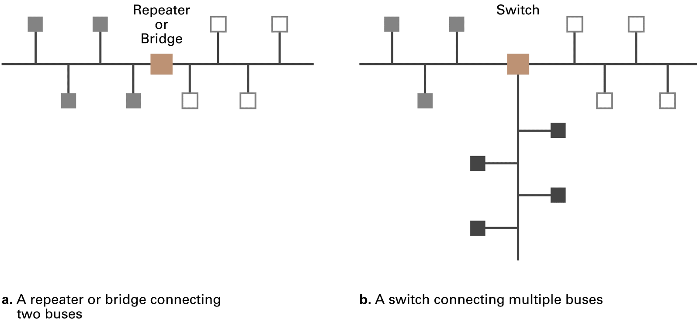
Figure 6.4 Building a large bus network from smaller ones

Slide 11
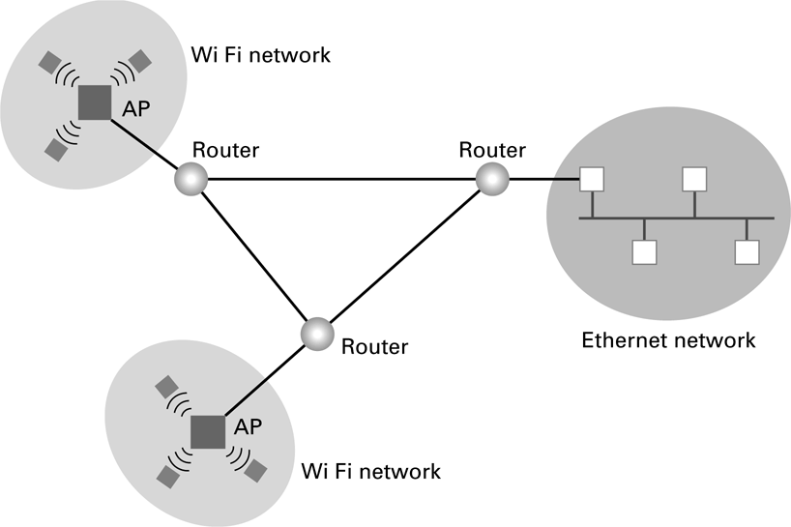
Figure 6.5 Routers connecting two WiFi networks and an Ethernet network to form an internet

Slide 12
6.1 Network Fundamentals
6.2 The Internet
6.2.1 Internet Architecture
6.2.2 Internet Addressing
6.2.3 Internet Applications
6.3 The World Wide Web

Slide 13
6.2 The Internet
The Internet: An internet that spans the world
Original goal was to develop a means of connecting networks that would not be disrupted by local disasters. (DARPA)
Today it has shifted from an academic research project to a commercial undertaking.

Slide 14
6.2.1 Internet Architecture
Internet Service Provider (ISP)
Tier-1
Tier-2
Access ISP: Provides connectivity to the Internet
Traditional telephone (dial up connection)
Cable connections
DSL
Wireless
Modem:调制解调器

Slide 15
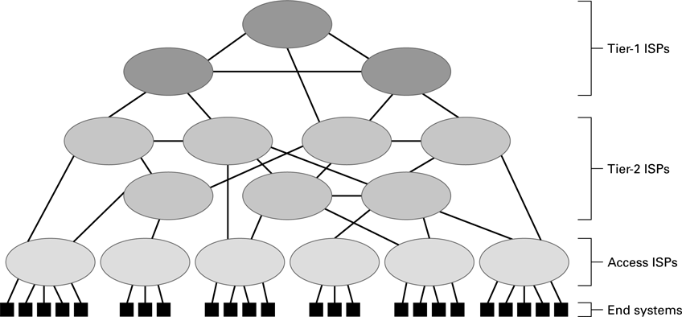
Figure 6.7 Internet Composition

Slide 16
6.2.2 Internet Addressing
IP address: pattern of 32 or 128 bits often represented in dotted decimal notation
IPV4
IPV6
Mnemonic [ni'mɔnik] address:
Domain names (域名)
Top-Level Domains：.com, .org, .gov, .ca, sustc.edu.cn
Domain name system (DNS)
Name servers
DNS lookup (域名解析)
Notes:
域名抢注，域名服务器攻击，国家安全

Slide 17
Internet Corporation for Assigned Names & Numbers (ICANN)
Allocates IP addresses to ISPs who then assign those addresses within their regions.
Oversees the registration of domains and domain names.

Slide 18
6.2.3 Internet Applications Traditional applications
Electronic Mail (email)
Domain mail server collects incoming mail (SMTP) and transmits outing mail
Mail server delivers collected incoming mail to clients via POP3 or IMAP
File Transfer Protocol (FTP)
Telnet and SSH

Slide 19
More Recent Applications
Voice Over IP (VoIP)
Internet Radio
N-unicast
Multicast

Slide 20
6.1 Network Fundamentals
6.2 The Internet
6.3 The World Wide Web
6.3.1 Web implementation
6.3.2 HTML

Slide 21
6.3 The World Wide Web 6.3.1 Web implementation
Hypertext and HTTP (HyperText Transfer Protocol)
Browser gets documents from Web server
Documents identified by URLs (Uniform Resource Locator)

Slide 22
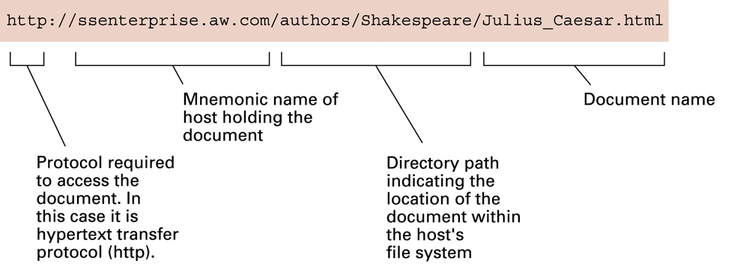
Figure 6.8 A typical URL

Slide 23
6.3.2 HTML
Hypertext Document Format
Encoded as text file
Contains tags to communicate with browser
Appearance
<h1> to start a level one heading
<p> to start a new paragraph
Links to other documents and content
<a href = . . . >
Insert images
<img src = . . . >

Slide 24
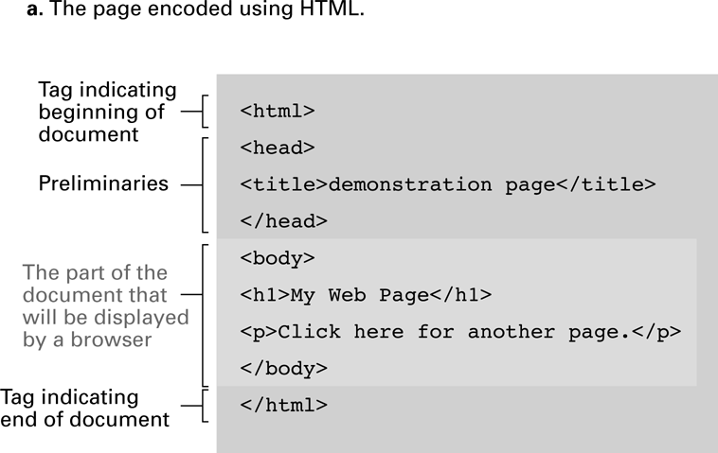
Figure 6.9 A simple Web page

Slide 25
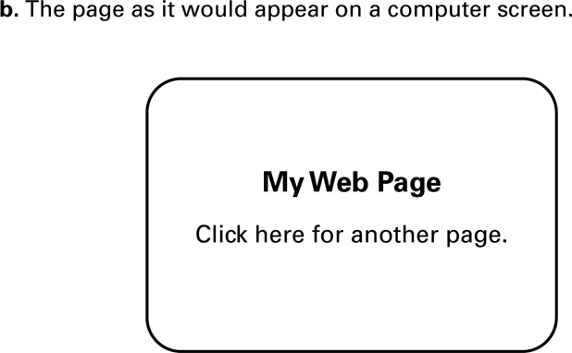
Figure 6.9 A simple Web page (continued)

Slide 26
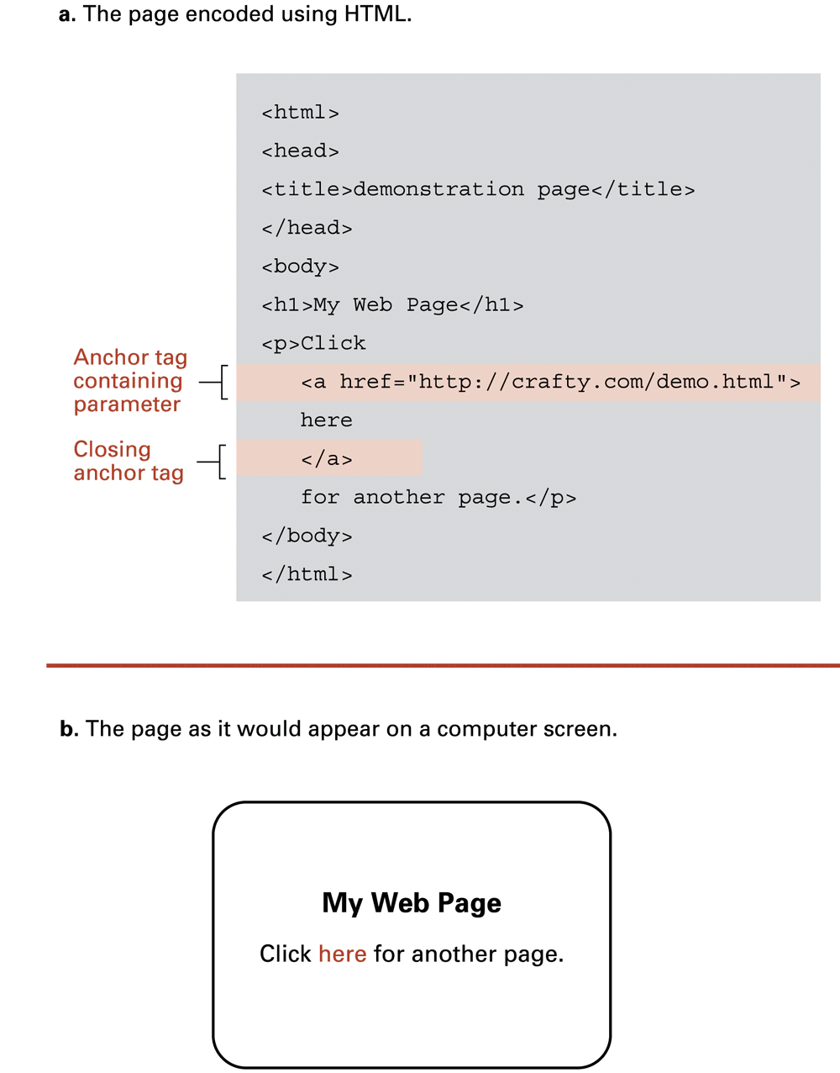
Figure 6.10 An enhanced simple Web page

Slide 27
Figure 6.10 An enhanced simple Web page (continued)

