Slide 1
Data Analysis for Transportation
PeMS04 Data set

Slide 2
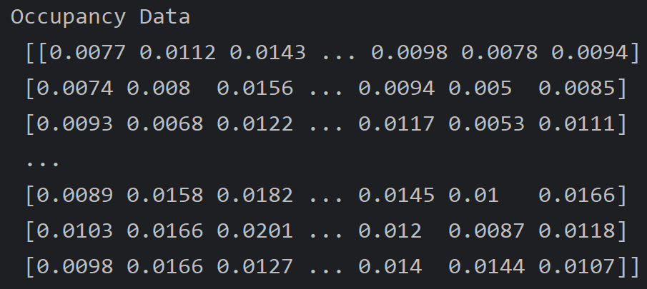
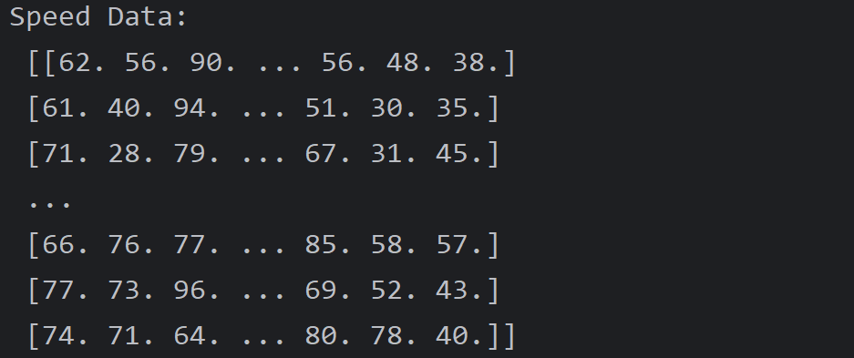
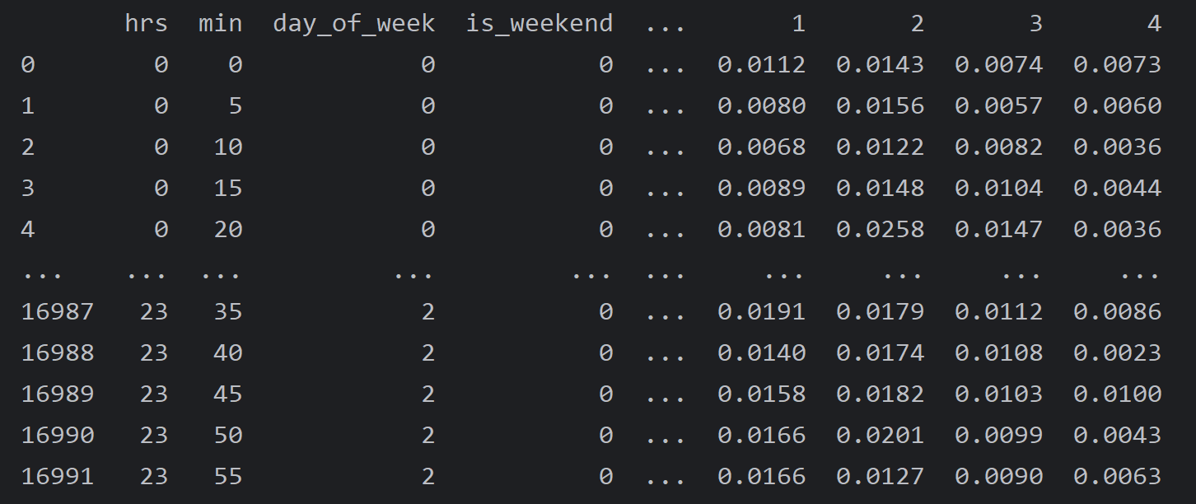
1. Instruction of Data set
Example of Sensor’s Data
PeMS04 (Caltrans Performance Measurement System 04) is a transportation dataset commonly used in traffic flow prediction and analysis research
It is a 16992 * 307 * 3 three dimensions tensor
16992: Steps of time (5min = 1/12 hr, 16992 = 59 days * 24hrs * 12)
307: Number of sensors
3: Three dimensions feature of each sensor
For 3 features of each Sensor refer to the document of PeMS04 is
# Volume/Flow: The number of vehicles passing the sensor at a certain point in time.
# Occupancy: The fraction of time the sensor is occupied by a vehicle (usually a 0-1 value).
# Speed: The average speed of the vehicle (in km/h or mph)
Combined Sensor’s Data with timestamps

Slide 3
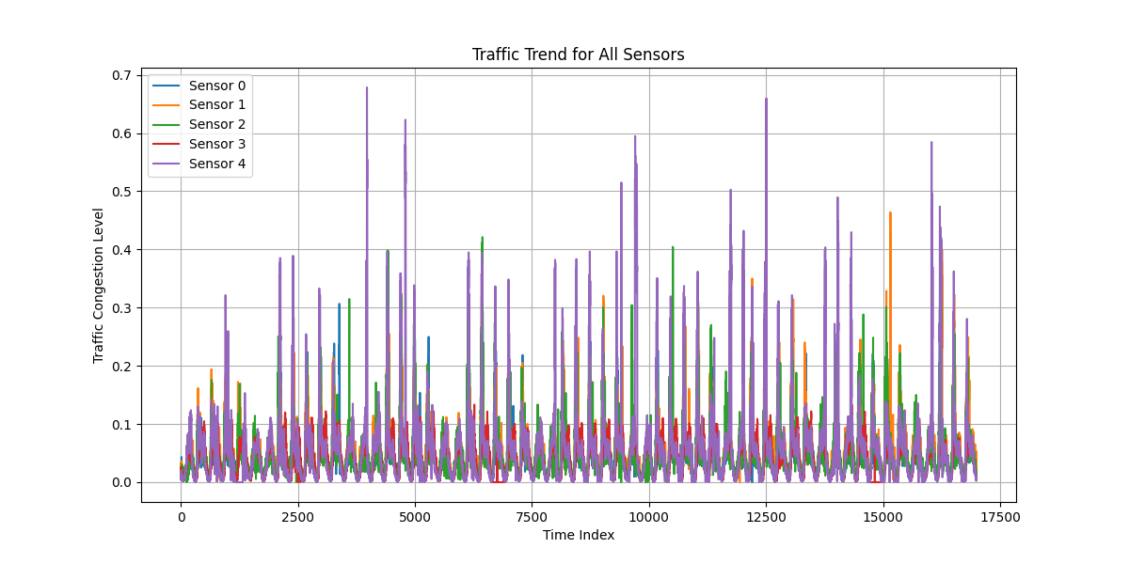
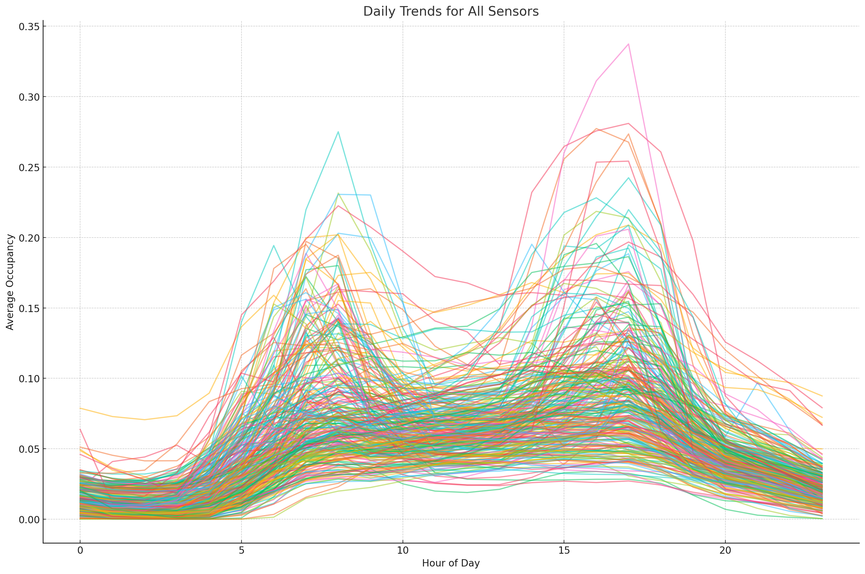
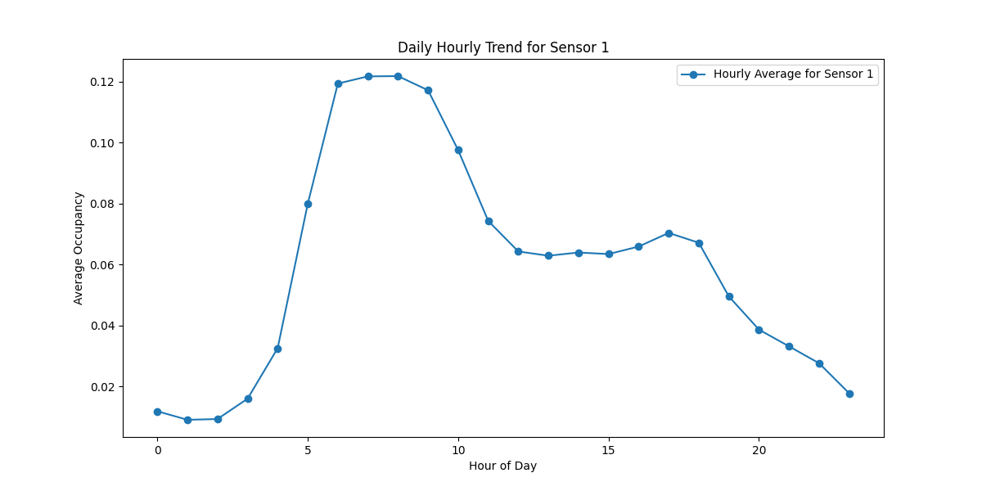
2. Occupancy Data overview
First 5 sensors observed occupancy trends by all time period
All Sensors observed occupancy trends by Hour of Day
Sensor 1 observed occupancy trends by Hour of Day

Slide 4
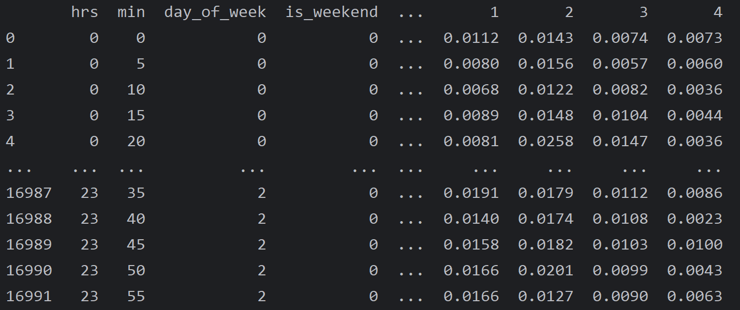
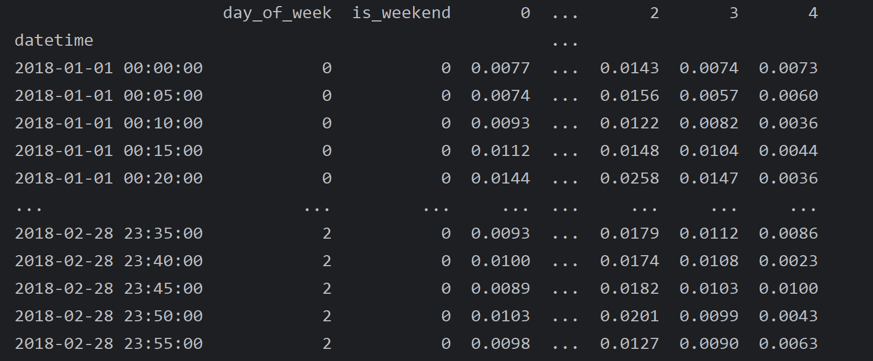
3. Data pre-processing
Integration
Integrate Data and Transform dimensions fit to the table that can be used for the training
Added Time Index
Setting the timestamps for each record, transfer the ‘hrs’, ‘min’ features to Pandas time index in order to more convenient to for analysis and modeling.
Normalization:
Based on the data observed, normalized all sensors data.

Slide 5
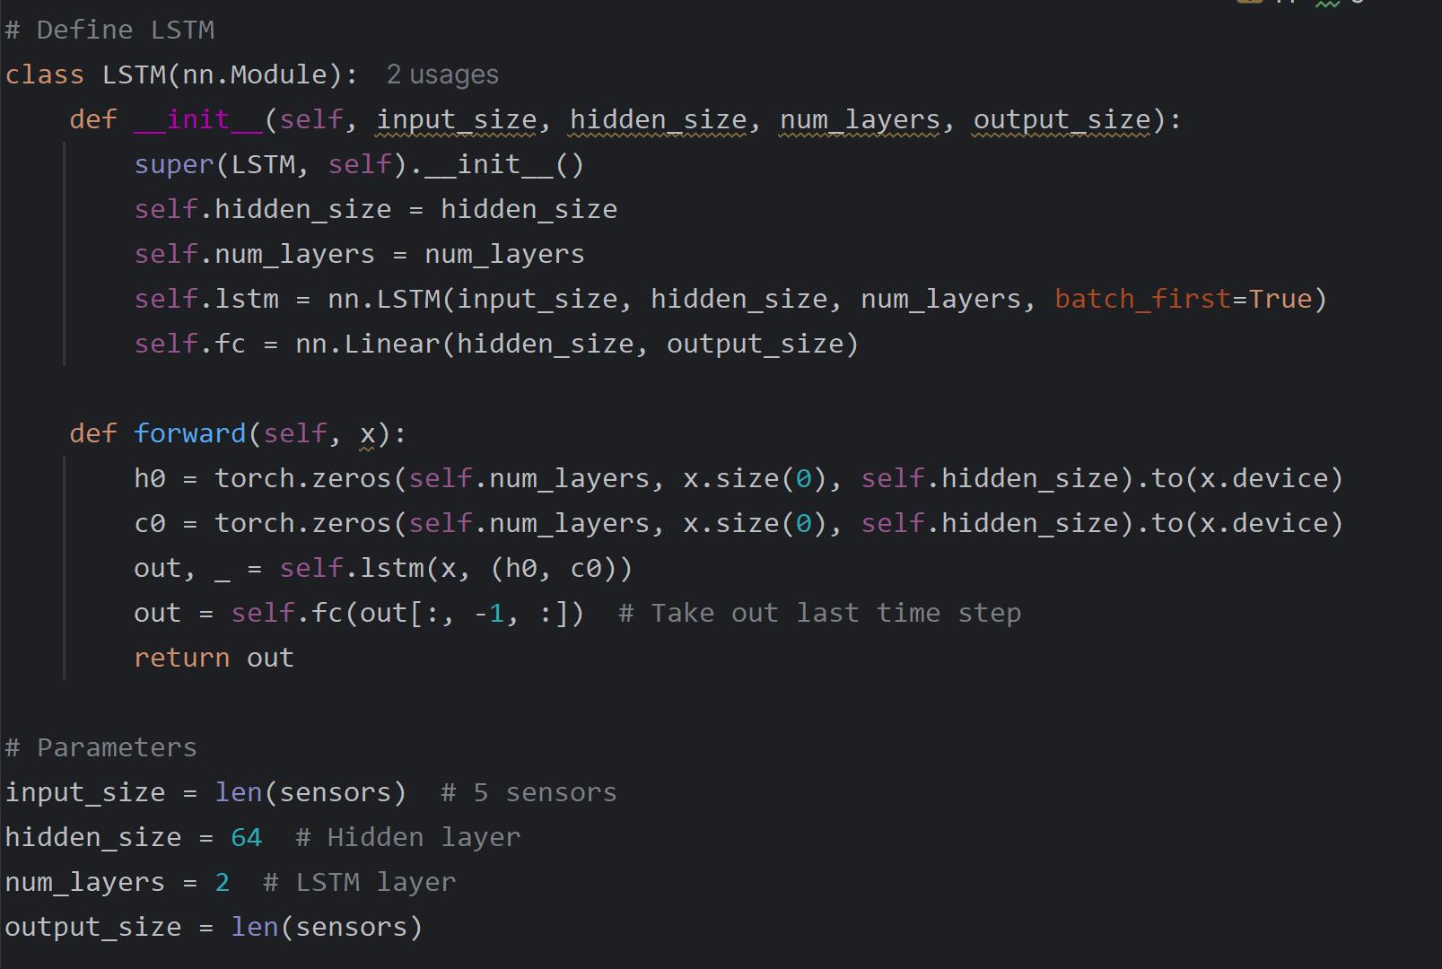
4. Model Selection
LSTM
The main reason that why choose LSTM are :
Can capture long-term dependencies in time series.
Suitable for multivariate time series.
Business Insight
LSTM with the higher accuracy, it can optimize the traffic flow based on the history data and provide more reasonable scheduling optimization.
LSTM is good at capture the short time period features, that means by making contingency predictions for unexpected incidents, such as forecasting potential congestion, it is possible to reduce additional costs incurred from being caught unprepared.

Slide 6
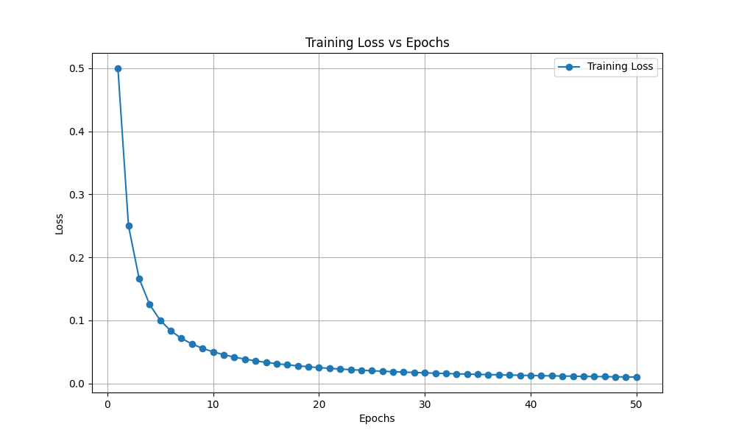
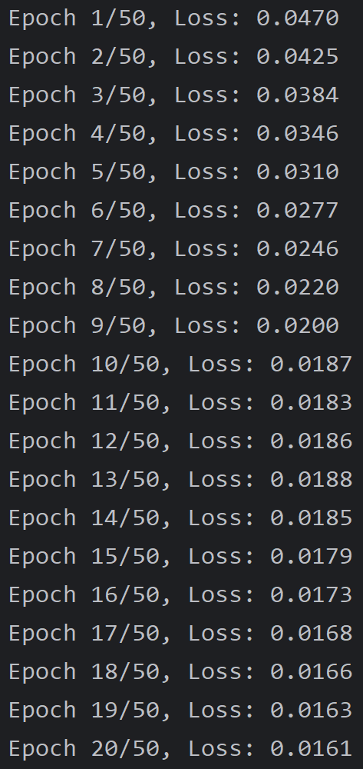
5. Training Process Observation
Set 50 epoch for training
Set last 3 days time steps as input data
Using MSE and RMSE to evaluate final results

Slide 7
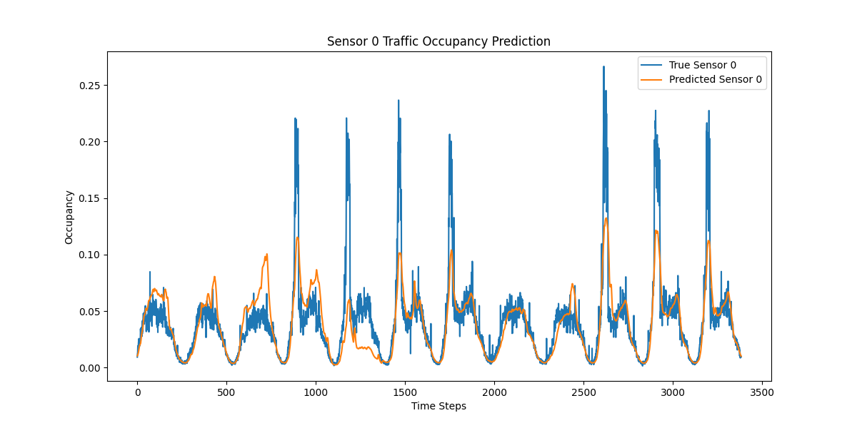
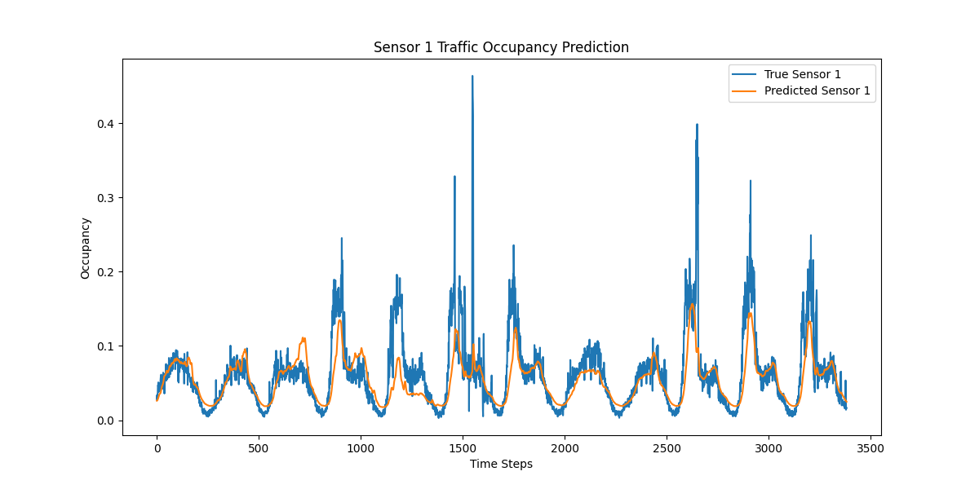
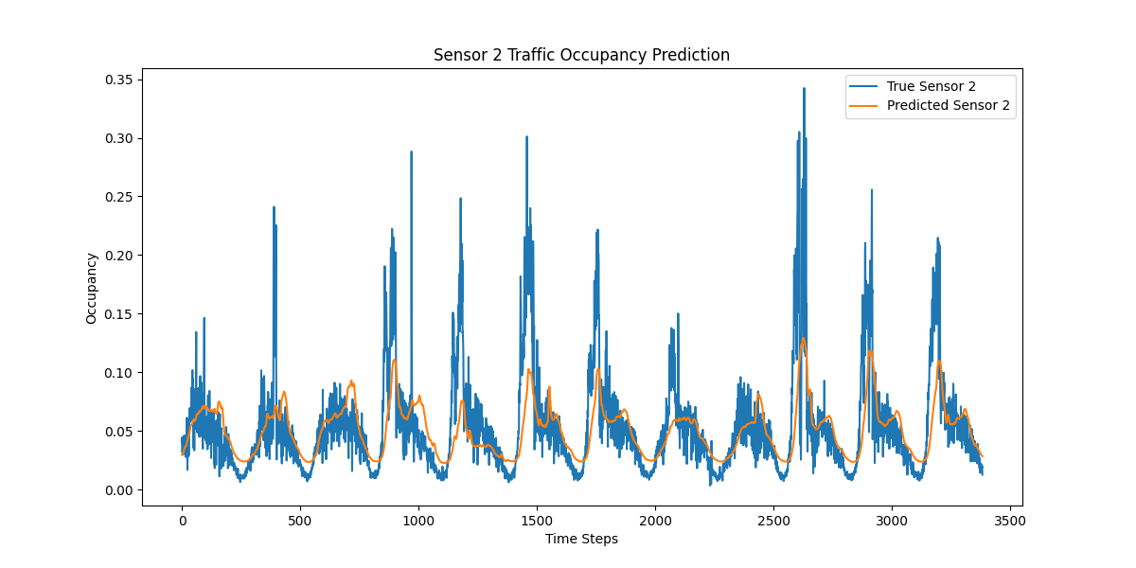
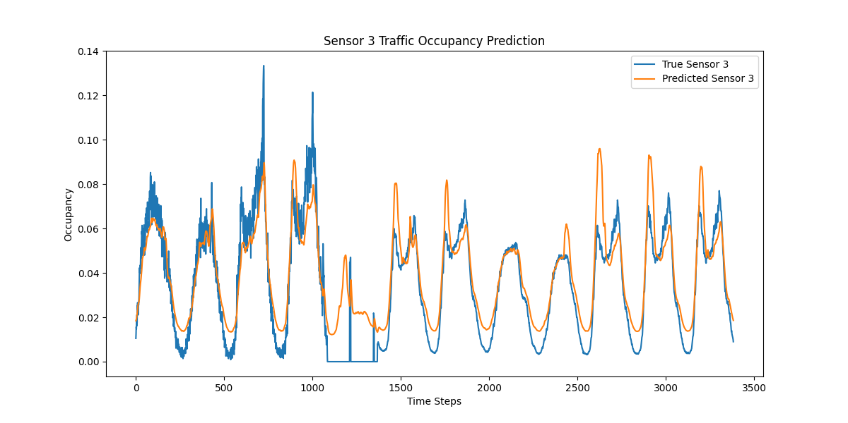
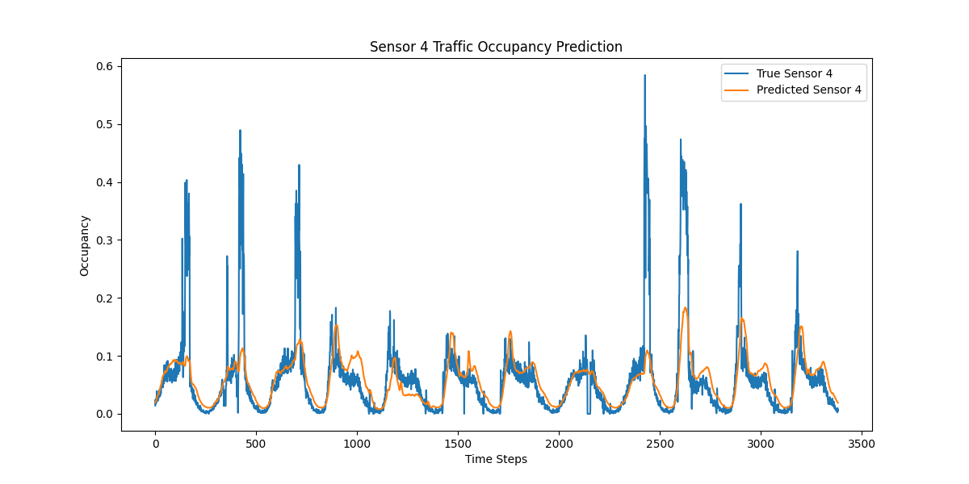
6. Evaluation and Final Result Visualization
For each sensor, generate the predict results compare with the true results.

Slide 8


