Slide 1



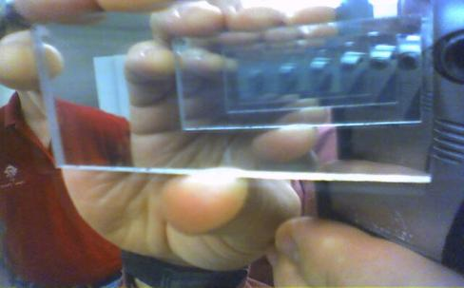
Recursion
Recursive Algorithms and Backtracking
Recursion
SoftUni Team
Technical Trainers
Software University
http://softuni.bg

Slide 2

Table of Contents
What is Recursion?
Recursive Factorial
Generating 0/1 Vectors and Combinations
Backtracking
The 8 Queens Problem
Finding All Paths in a Labyrinth Recursively
Recursion or Iteration?
Harmful Recursion and Optimizing Bad Recursion

Slide 3
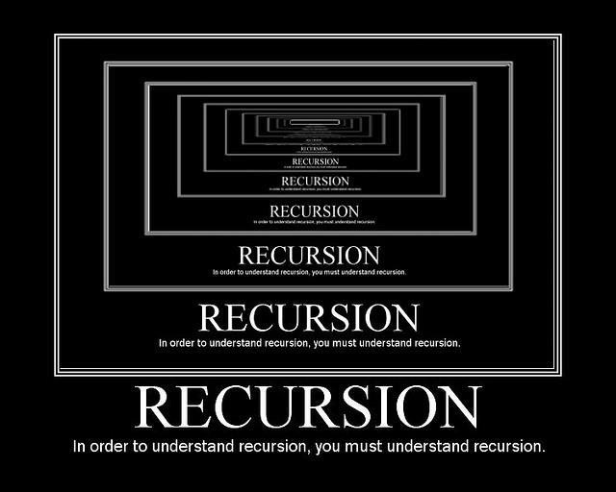
What is Recursion?

Slide 4

What is Recursion?
Recursion is when a method calls itself
Powerful technique for combinatorial and branched search algorithms design
Recursion should have:
Direct or indirect recursive call
The method calls itself directly
Оr through other methods
Exit criteria (bottom)
Prevents infinite recursion

Slide 5
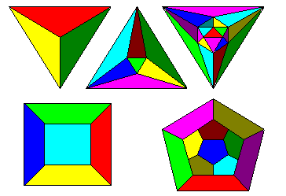
Recursive Factorial – Example
Recursive definition of n! (n factorial):
n! = n * (n–1)! for n > 0
0! = 1
5! = 5 * 4! = 5 * 4 * 3 * 2 * 1 * 1 = 120
4! = 4 * 3! = 4 * 3 * 2 * 1 * 1 = 24
3! = 3 * 2! = 3 * 2 * 1 * 1 = 6
2! = 2 * 1! = 2 * 1 * 1 = 2
1! = 1 * 0! = 1 * 1 = 1
0! = 1

Slide 6
Recursive Factorial – Example
Calculating factorial:
0! = 1
n! = n* (n-1)!, n>0
static decimal Factorial(int num) { if (num == 0)
return 1; else
return num * Factorial(num - 1); }
The bottom of the recursion
Recursive call: the method calls itself

Slide 7


Recursive Factorial
Live Demo

Slide 8
Performance: Recursion vs. Iteration
Recursive calls are slightly slower than iteration
Parameters and return values travel through the stack at each step
Prefer iteration for linear calculations (without branched calls)
Recursive factorial:
Iterative factorial:
static long RecurFact(int n) { if (n == 0)
return 1; else
return n * Fact(n - 1); }
static long IterFact(int num) { long result = 1;
for (int i = 1; i <= n; i++)
result *= i;
return result; }

Slide 9

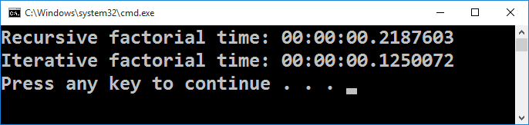
Factorial Performance
Live Demo

Slide 10
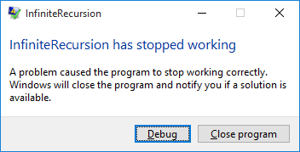
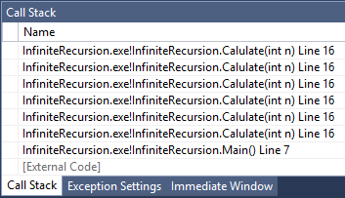

Infinite Recursion
Infinite recursion == a method calls itself infinitely
Typically, infinite recursion == bug in the program
The bottom of the recursion is missing or wrong
In C# / Java / C++ causes "stack overflow" error
static long Calulate(int n)
{
return Calulate(n + 1);
}

Slide 11
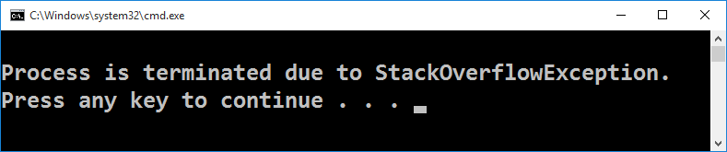
Infinite Recursion
Live Demo

Slide 12
Direct and Indirect Recursion
void A() {
…
A();
}
Direct recursion
A method directly calls itself
Indirect recursion
Method A calls B, method B calls A
Or even A → B → C → A
Funny example of infinite indirect recursion:
http://www.nakov.com/blog/2013/01/23/indirect-recursion/
void A() {
…
B();
}
void B() {
…
A();
}

Slide 13
Recursion Pre-Actions and Post-Actions
Recursive methods have 3 parts:
Pre-actions (before calling the recursion)
Recursive calls (step-in)
Post-actions (after returning from recursion)
Recursive computation can be based on:
Pre-actions + recursive calls (forward way)
Recursive calls + post-actions (backward way)
Pre-actions + recursive calls + post-actions (combined way)

Slide 14
Pre-Actions and Post-Actions – Example
static void PrintFigure(int n)
{
if (n == 0) // Bottom of the recursion
return;
// Pre-action: print n asterisks
Console.WriteLine(new string('*', n));
// Recursive call: print figure of size n-1
PrintFigure(n - 1);
// Post-action: print n hashtags
Console.WriteLine(new string('#', n));
}

Slide 15
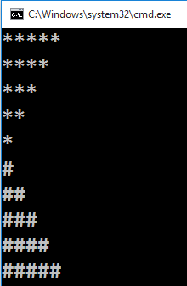
Pre-Actions and Post-Actions
Live Demo

Slide 16

Generating 0/1 Vectors
How to generate all 8-bit vectors recursively?
0 0 0 0 0 0 0 0
0 0 0 0 0 0 0 1
...
0 1 1 1 1 1 1 1
1 0 0 0 0 0 0 0
...
1 1 1 1 1 1 1 0
1 1 1 1 1 1 1 1
How to generate all n-bit vectors?

Slide 17
Generating 0/1 Vectors (2)
Algorithm Gen01(n): put 0 and 1 at the last position n and call Gen01(n-1) for the rest:
Gen01(6):
Gen01(5):
Gen01(-1):
Print;
Stop!
x | x | x | x | x | x | 0
x | x | x | x | x | 0 | y
Gen01(5)
→
Gen01(4)
…
x | x | x | x | x | x | 1
x | x | x | x | x | 1 | y
Gen01(5)
Gen01(4)

Slide 18

Generating 0/1 Vectors (3)
static void Gen01(int index, int[] vector)
{
if (index < 0)
Print(vector);
else
for (int i = 0; i <= 1; i++)
{
vector[index] = i;
Gen01(index-1, vector);
}
}
static void Main()
{
int n = 8;
int[] vector = new int[n];
Gen01(n-1, vector);
}

Slide 19

Generating 0/1 Vectors
Live Demo

Slide 20

Generating Combinations
Simple Recursive Algorithm

Slide 21
Generating Combinations
Combinations in math represent all the ways to extract a subset from a larger set of elements
Select k members from a set of n elements
Example: we can select 3 different elements from the set {4, 5, 6, 7, 8} in 10 different ways:
(4, 5, 6) (4, 5, 7) (4, 5, 8) (4, 6, 7) (4, 6, 8)
(4, 7, 8) (5, 6, 7) (5, 6, 8) (5, 7, 8) (6, 7, 8)
Combinations with and without repetitions can be easily generated with recursion

Slide 22
Generating Combinations (2)
Algorithm GenCombs(k): put the numbers [1 … n] at position k and call GenCombs(k+1) recursively for the rest of the elements:
GenCombs(0):
GenCombs(1):
GenCombs(n):
Print;
Stop!
1 | x | x | x | x | x | x
→
1 | 1 | x | x | x | x | x
…
GenCombs(1)
GenCombs(2)
Put all numbers in range [1..n] at position k
Put all numbers in range [1..n] at position k
Bottom of recursion

Slide 23
Generating Combinations (3)
static void GenCombs(
int[] arr, int index, int startNum, int endNum)
{
if (index >= arr.Length) // Combination found --> print it
Console.WriteLine("(" + String.Join(", ", arr) + ")");
else
for (int i = startNum; i <= endNum; i++)
{
arr[index] = i;
GenCombs(arr, index + 1,
i + 1, endNum);
}
}
static void Main()
{
int[] arr = new int[8];
GenCombs(arr, 0, 4, 8);
}

Slide 24

Generating Combinations
Live Demo

Slide 25
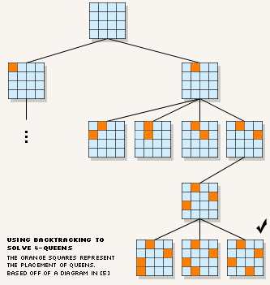
Backtracking
Solving Computational Problems by Generating All Candidates

Slide 26
Backtracking
What is backtracking?
Backtracking is a class of algorithms for finding all solutions to some combinatorial computational problem
E.g. find all paths from Sofia to Varna
How does backtracking work?
At each step tries all perspective possibilities recursively
Drop all non-perspective possibilities as early as possible
Backtracking has exponential running time!

Slide 27
Backtracking Algorithm (Pseudocode)
void Backtracking(Node node)
{
if (node is solution)
PrintSolution(node);
else
for each child c of node
if (c is perspective candidate)
{
MarkPositionVisited(c);
Backtracking(c);
UnmarkPositionVisited(c);
}
}

Slide 28
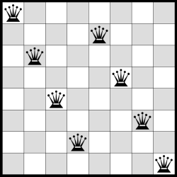
The "8 Queens" Puzzle
Backtracking in Practice

Slide 29
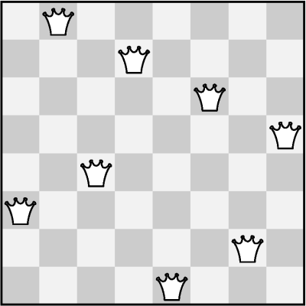
The "8 Queens" Puzzle
Write a program to find all possible placements of
8 queens on a chessboard
So that no two queens can attack each other
http://en.wikipedia.org/wiki/Eight_queens_puzzle

Slide 30
Solving The "8 Queens" Puzzle
Backtracking algorithm
For finding all solutions to the "8 Queens Puzzle"
At each step:
Put a queen at free position
Recursive call
Remove the queen
void PutQueens(row)
{
if (row == 8)
PrintSolution();
else
for (col = 0 … 7)
if (CanPlaceQueen(row, col))
{
MarkAllAttackedPositions(row, col);
PutQueens(row + 1);
UnmarkAllAttackedPositions(row, col);
}
}

Slide 31
The "8 Queens" Puzzle
In-Class Exercise (Lab)

Slide 32
Finding All Paths in a Labyrinth
We are given a labyrinth
Represented as matrix of cells of size M x N
Empty cells are passable, the others (*) are not
We start from the top left corner and can move in all 4 directions: left, right, up, down
We want to find all paths to the bottom right corner
 |  |  | *
* | * |  | * |  | *
 | * | * | * | * | *
Start position
End position

Slide 33
Finding All Paths in a Labyrinth (2)
There are 3 different paths from the top left corner to the bottom right corner:
0 | 1 | 2 | *
* | * | 3 | * |  | *
6 | 5 | 4
7 | * | * | * | * | *
8 | 9 | 10 | 11 | 12 | 13 | 14
0 | 1 | 2 | * | 8 | 9 | 10
* | * | 3 | * | 7 | * | 11
 |  | 4 | 5 | 6 |  | 12
 | * | * | * | * | * | 13
 |  |  |  |  |  | 14
0 | 1 | 2 | *
* | * | 3 | * |  | *
 |  | 4 | 5 | 6 | 7 | 8
 | * | * | * | * | * | 9
 |  |  |  |  |  | 10
1)
2)
3)

Slide 34
Finding All Paths in a Labyrinth (3)
Suppose we have an algorithm FindExit(x,y) that finds and prints all paths to the exit (bottom right corner) starting from position (x,y)
If (x,y) is not passable, no paths are found
If (x,y) is already visited, no paths are found
Otherwise:
Mark position (x,y) as visited (to avoid cycles)
Find recursively all paths to the exit from all neighbor cells: (x-1,y) , (x+1,y) , (x,y+1) , (x,y-1)
Mark position (x,y) as free (can be visited again)

Slide 35
Find All Paths: Algorithm
Representing the labyrinth as matrix of characters (in this example 5 rows and 7 columns):
Spaces (' ') are passable cells
Asterisks ('*') are not passable
The symbol 'e' is the exit (can occur multiple times)
static char[,] lab =
{
{' ', ' ', ' ', '*', ' ', ' ', ' '},
{'*', '*', ' ', '*', ' ', '*', ' '},
{' ', ' ', ' ', ' ', ' ', ' ', ' '},
{' ', '*', '*', '*', '*', '*', ' '},
{' ', ' ', ' ', ' ', ' ', ' ', 'е'},
};

Slide 36
Find All Paths: Algorithm (2)
static void FindExit(int row, int col)
{
if ((col < 0) || (row < 0) || (col >= lab.GetLength(1))
|| (row >= lab.GetLength(0)))
{
// We are out of the labyrinth -> can't find a path
return;
}
// Check if we have found the exit
if (lab[row, col] == 'е')
{
Console.WriteLine("Found the exit!");
}
if (lab[row, col] != ' ')
{
// The current cell is not free -> can't find a path
return;
}
(example continues)

Slide 37
Find All Paths: Algorithm (3)
// Temporaryly mark the current cell as visited
lab[row, col] = 's';
// Invoke recursion to explore all possible directions
FindExit(row, col - 1); // left
FindExit(row - 1, col); // up
FindExit(row, col + 1); // right
FindExit(row + 1, col); // down
// Mark back the current cell as free
lab[row, col] = ' ';
}
static void Main()
{
FindExit(0, 0);
}

Slide 38

Find All Paths in a Labyrinth
Live Demo

Slide 39
Find All Paths and Print Them
How to print all paths found by our recursive algorithm?
Each move's direction can be stored in a list
Need to pass the movement direction at each recursive call (L, R, U, or D)
At the start of each recursive call the current direction is appended to the list
At the end of each recursive call the last direction is removed from the list
static List<char> path = new List<char>();

Slide 40
Find All Paths and Print Them (2)
static void FindPathToExit(int row, int col, char direction)
{
...
// Append the current direction to the path
path.Add(direction);
if (lab[row, col] == 'е')
{
// The exit is found -> print the current path
}
...
// Recursively explore all possible directions
FindPathToExit(row, col - 1, 'L'); // left
FindPathToExit(row - 1, col, 'U'); // up
FindPathToExit(row, col + 1, 'R'); // right
FindPathToExit(row + 1, col, 'D'); // down
...
// Remove the last direction from the path
path.RemoveAt(path.Count - 1);
}

Slide 41

Find and Print All Paths in a Labyrinth
Live Demo

Slide 42

Recursion or Iteration?
When to Use and When to Avoid Recursion?

Slide 43
Recursion Can be Harmful!
When used incorrectly recursion could take too much memory and computing power
Example:
static decimal Fibonacci(int n)
{
if ((n == 1) || (n == 2))
return 1;
else
return Fibonacci(n - 1) + Fibonacci(n - 2);
}
static void Main()
{
Console.WriteLine(Fibonacci(10)); // 89
Console.WriteLine(Fibonacci(50)); // This will hang!
}

Slide 44



Harmful Recursion
Live Demo

Slide 45
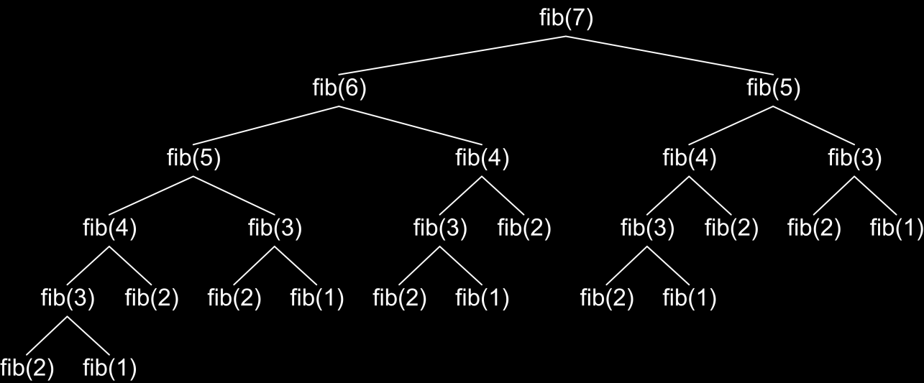
How the Recursive Fibonacci Calculation Works?
fib(n) makes about fib(n) recursive calls
The same value is calculated many, many times!

Slide 46
Fast Recursive Fibonacci
Each Fibonacci sequence member
Can be remembered once it is calculated
Can be returned directly when needed again
static decimal[] fib = new decimal[MAX_FIB];
static decimal Fib(int n)
{
if (fib[n] == 0)
{
// fib[n] is still not calculated
if ((n == 1) || (n == 2))
fib[n] = 1;
else
fib[n] = Fib(n - 1) + Fib(n - 2);
}
return fib[n];
}

Slide 47

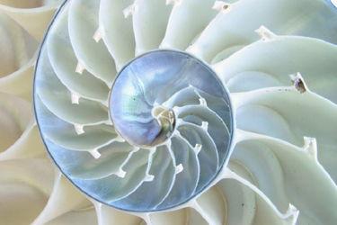
Fast Recursive Fibonacci
Live Demo

Slide 48
When to Use Recursion?
Avoid recursion when an obvious iterative algorithm exists
Examples: factorial, Fibonacci numbers
Use recursion for combinatorial algorithms where
At each step you need to recursively explore more than one possible continuation
I.e. for branched recursive algorithms
Examples: permutations, all paths in a labyrinth
If you have only one recursive call in the body of a recursive method, it can directly become iterative (like calculating factorial)

Slide 49

Summary
Recursion means to call a method from itself
It should always have a bottom at which the recursive calls stop
Very powerful technique for implementing combinatorial algorithms
Examples: generating combinatorial configurations like vectors, permutations, combinations, variations, etc.
Backtracking finds all solutions / optimal solution of combinatorial problem by generating all possibilities
Without non-perspective candidates
Recursion can be harmful when not used correctly

Slide 50









Recursion
https://softuni.bg/trainings/1194/Algorithms-September-2015

Slide 51
License
This course (slides, examples, labs, videos, homework, etc.) is licensed under the "Creative Commons Attribution-NonCommercial-ShareAlike 4.0 International" license
Attribution: this work may contain portions from
"Fundamentals of Computer Programming with C#" book by Svetlin Nakov & Co. under CC-BY-SA license
"Data Structures and Algorithms" course by Telerik Academy under CC-BY-NC-SA license

Slide 52






Free Trainings @ Software University
Software University Foundation – softuni.org
Software University – High-Quality Education, Profession and Job for Software Developers
softuni.bg
Software University @ Facebook
facebook.com/SoftwareUniversity
Software University @ YouTube
youtube.com/SoftwareUniversity
Software University Forums – forum.softuni.bg

