Slide 1


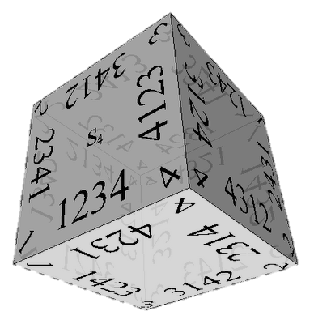

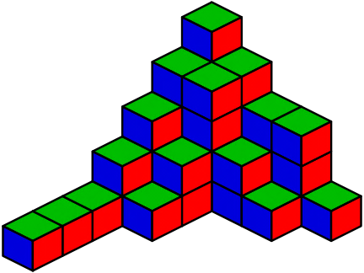
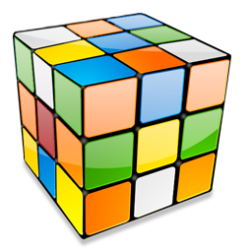
Combinatorial Algorithms
Generating Variations, Permutations, Combinations, …
Combinatorial
Algorithms
SoftUni Team
Technical Trainers
Software University
http://softuni.bg

Slide 2
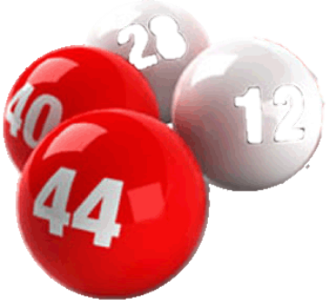



Table of Contents
Definitions in Combinatorics
Generating Variations
Generating Permutations
Generating Combinations
Binomial Coefficients
and Pascal's Triangle
Binary Vectors
and Gray Code

Slide 3
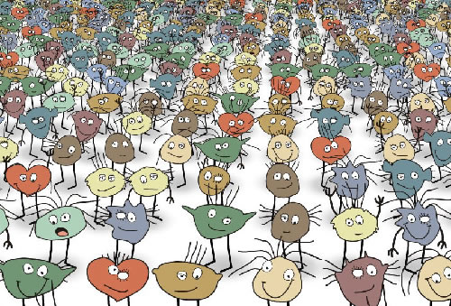


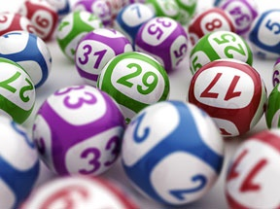
Definitions in Combinatorics

Slide 4
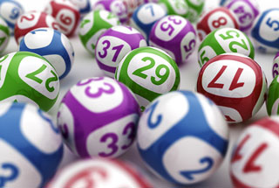
Combinatorics
Combinatorics is a branch of mathematics
  Study of countable discrete structures
Combinatorial problems arise in many
areas of mathematics / other sciences
  Notably in algebra, probability theory,
  statistics, topology, geometry, physics,
  chemistry, biology, gambling games, etc.
Programmer's combinatorics concerns
generating combinatorial structures

Slide 5
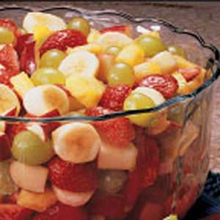
Definitions: Combinations
A combination is a way of selecting items from a collection
  Such that the order of the items does not matter
Example: "A fruit salad is a combination of
grapes, strawberries and bananas"
  We don't care what order the fruits are in
    "bananas, grapes and strawberries" or
    "grapes, bananas and strawberries" →
    it is the same salad
If the order doesn't matter → combination
  E.g. select 3 fruits (in any order) from a collection of 10 kinds of fruits

Slide 6
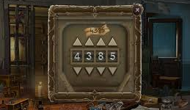
Definitions: Permutations and Variations
A permutation is a rearrangement of the items from a collection
A variation (permuted combination) is
  A way of selecting items from a collection
  Such that the order of the items matters
"The combination to the safe is 4385"
  Now we do care about the order
  "8453" would not work, it has to be exactly 4-3-8-5
If the order does matter → variation / permutation
  A variation / permutation is an ordered combination

Slide 7
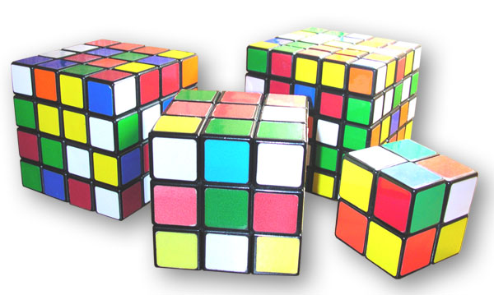
Variations

Slide 8
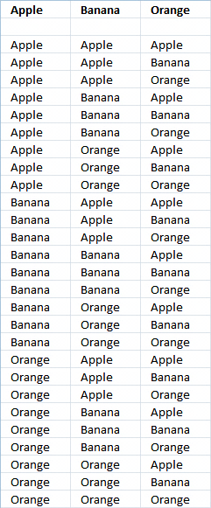
Variations
Variations (with repetition)
  Choose k items (ordered) from a collection
  of n items, with repetition
  Looks like k nested loops from 1 to n
When you have n things to choose from,
you have n choices each time
When choosing k of them, the variations are:
  n × n × ... × n (k times)
  V(n, k) = n^{k}

Slide 9
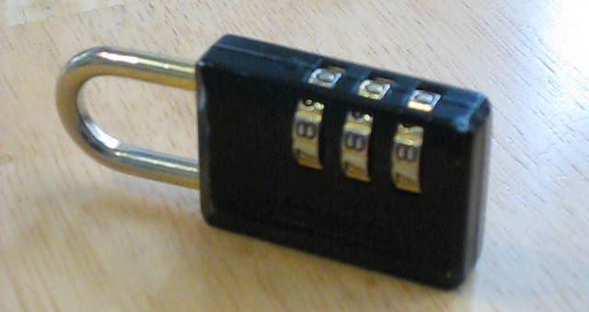
Variations (2)
Example: in the lock below, there are 10 numbers to choose from {0, 1, …, 9} and you choose 3 times some of them:
  10 × 10 × 10 (3 times) = 10³ = 1 000 variations
All variations from {0, 0, 0} to {9, 9, 9}

Slide 10
Algorithm: Variations with Repetition
Algorithm Var(index) to generate variations V(n, k)
  Put the numbers 0 … n-1 at the position index
  Call Var(index + 1) to generate the rest of the array
Var(0)
Var(1)
Var(k)
Print();
Stop!
0…n-1 | x | x | x | x
→
y | 0…n-1 | x | x | x
…
Var(1)
Var(2)

Slide 11
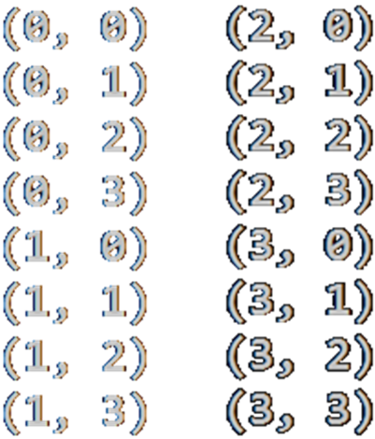
Generating Variations (with Repetition)
void GenerateVariations(int index)
{
if (index >= k)
{
Print(arr);
}
else
for (int i = 0; i < n; i++)
{
arr[index] = i;
GenerateVariations(index + 1);
}
}
int n = 4;
int k = 2;
int[] arr = new int[k];
GenerateVariations(0);

Slide 12
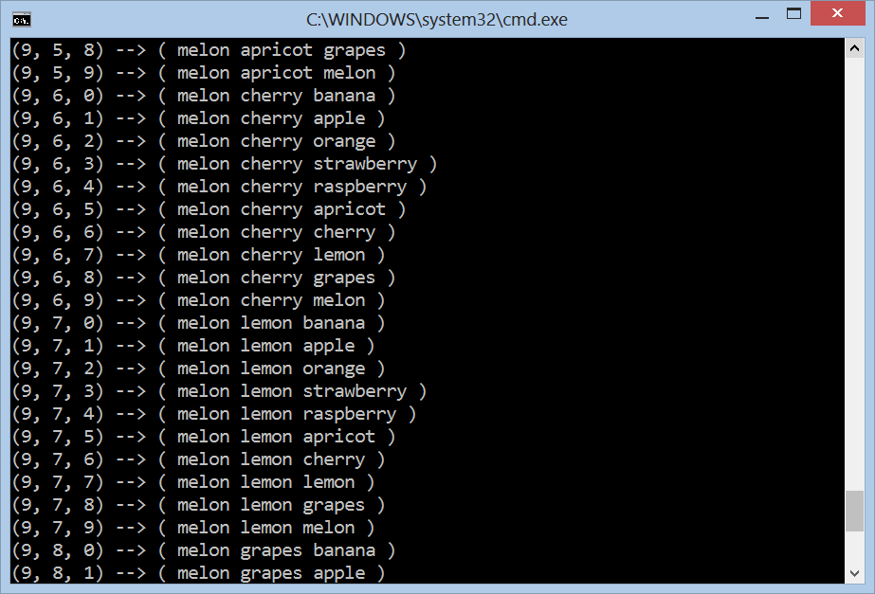
Generating Variations with Repetition
Live Demo

Slide 13
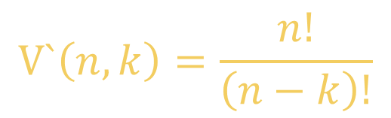
Variations without Repetition
Suppose we have 16 billiard balls
  But maybe you don't want to choose them all,
  just 3 of them, so that would be only
    16 × 15 × 14 = 3360
    There are 3360 different ways that 3 pool balls
    could be selected out of 16 balls
  16! / 13! = 16 × 15 × 14 = 3360
$$V`\left(n,k\right)=\frac{n!}{\left(n−k\right)!}$$
where n is the number of things to choose from, and you choose k of them (no repetition, order matters)

Slide 14

Variations without Repetition
Example:
  How many words of 2 different letters can you make with 4 letters { a, b, c, d }?
How to generate variations without repetition?
  The same way as variations with repetition
  Ensure you use each element at most once
ab, ac, ad, ba, bc, bd, ca, cb, cd, da, db, dc

Slide 15
Algorithm: Variations without Repetition
Algorithm VarNoRep(index) to generate variations V`(n, k)
  Put the unused numbers 0 … n-1 at the position index
  Call VarNoRep(index + 1) to generate the rest of the array
VarNoRep(0)
VarNoRep(1)
VarNoRep(k)
Print();
Stop!
0…n-1 | x | x | x | x
→
y | 0…n-1 | x | x | x
…
(unused
number)
(unused
number)
VarNoRep(1)
VarNoRep(2)

Slide 16
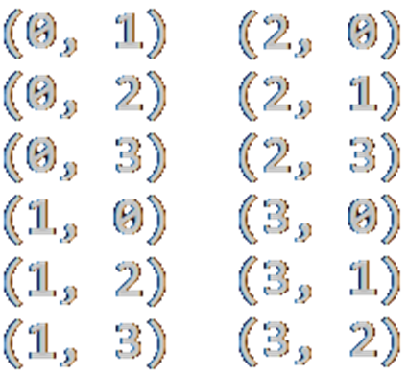
Generating Variations without Repetition
void VariationsNoRep(int index)
{
if (index >= k)
PrintVariations(arr);
else
for (int i = 0; i < n; i++)
if (!used[i])
{
used[i] = true;
arr[index] = i;
VariationsNoRep(index + 1);
used[i] = false;
}
}
int k = 2;
int n = 4;
int[] arr = new int[k];
bool[] used = new bool[n];
VariationsNoRep(0);

Slide 17
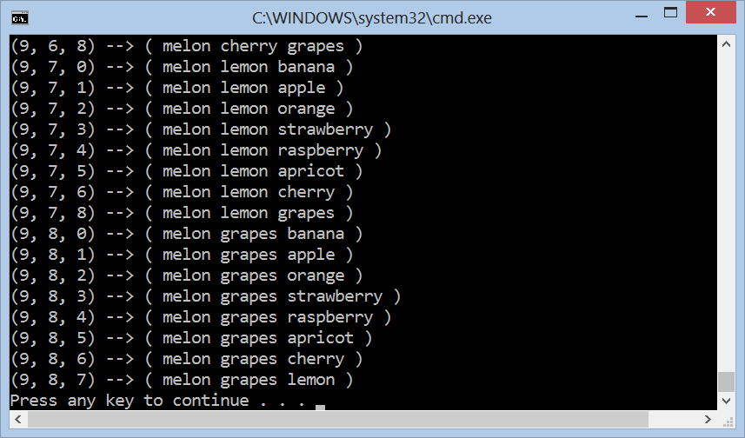
Variations without Repetition
Live Demo

Slide 18

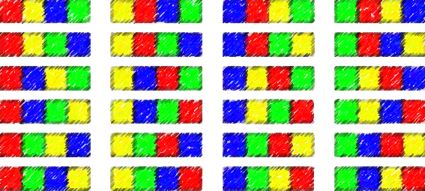

Permutations

Slide 19

Permutations
What order could 16 pool balls be in?
After choosing a ball (e.g. ball 9)
  We can't choose the same ball again
  First choice → 16 possibilities
  Second choice → 15 possibilities
  Third choice → 14 possibilities, etc.
Total permutations:
  16 × 15 × 14 × … × 2 × 1 = 16! = 20 922 789 888 000

Slide 20
Algorithm: Permutations
Algorithm Perm(k) to permute the elements [k … n-1]:
  Exchange the item at position k with the items at position k … n-1
  Call Perm(k + 1) to permute the rest of the array
Perm(0)
Perm(1)
Perm(n)
Print();
Stop!
→
…
y | x | x | x | x | x | x
y | z | x | x | x | x | x
Perm(1)
Perm(2)

Slide 21
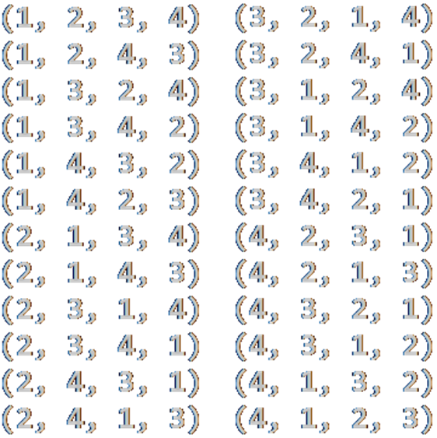
Generating Permutations
static void Perm<T>(T[] arr, int k)
{
if (k >= arr.Length)
Print(arr);
else
{
Perm(arr, k + 1);
for (int i = k + 1; i < arr.Length; i++)
{
Swap(ref arr[k], ref arr[i]);
Perm(arr, k + 1);
Swap(ref arr[k], ref arr[i]);
}
}
}
var arr = new int[]
{ 1, 2, 3, 4 };
Perm(arr, 0);

Slide 22
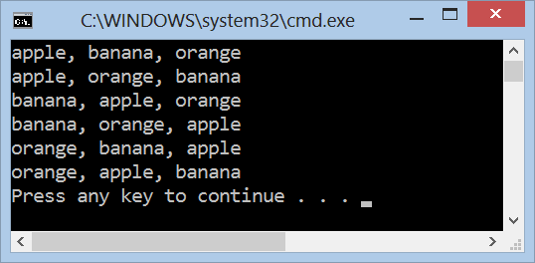
Generating Permutations
Live Demo

Slide 23
Permutations with Repetition
We have a set of elements, with repetition
  E. g. set = { 3, 5, 1, 5, 5 }
We want to generate all unique permutations (without duplicates):
  { 1, 3, 5, 5, 5 } { 1, 5, 3, 5, 5 } { 1, 5, 5, 3, 5 } { 1, 5, 5, 5, 3 }
  { 3, 1, 5, 5, 5 } { 3, 5, 1, 5, 5 } { 3, 5, 5, 1, 5 } { 3, 5, 5, 5, 1 }
  { 5, 1, 3, 5, 5 } { 5, 1, 5, 3, 5 } { 5, 1, 5, 5, 3 } { 5, 3, 1, 5, 5 }
  { 5, 3, 5, 1, 5 } { 5, 3, 5, 5, 1 } { 5, 5, 1, 3, 5 } { 5, 5, 1, 5, 3 }
  { 5, 5, 3, 1, 5 } { 5, 5, 3, 5, 1 } { 5, 5, 5, 1, 3 } { 5, 5, 5, 3, 1 }
We want to efficiently avoid the repeating ones
  i.e. to work fast for { 1, 5, 5, 5, 5, 5, 5, 5, 5, 5, 5, 5, 5, 5, 5, 5, 5, 5, 5, 5}

Slide 24
Algorithm: Permutations with Repetition
Algorithm PermRep(s, e) permutes the items [s … e]
  Exchange the item at positions l = k … n-2 with items at l … n-1
  Call PermRep(l + 1) to permute the rest of the array
PermRep(0, n-1)
PermRep(2, n-1)
PermRep(n-1, n-1)
s
l
s
l
Stop!
→
…
y | x | l | x | x | x
z | y | x | l | x | x
PermRep(l+1, n-1)
PermRep(l+1, n-1)

Slide 25
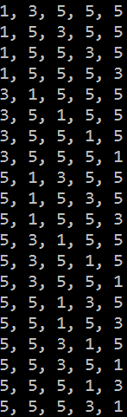
Generating Permutations with Repetition
static void PermuteRep(int[] arr, int start, int end)
{
Print(arr);
for (int left = end - 1; left >= start; left--)
{
for (int right = left + 1; right <= end; right++)
if (arr[left] != arr[right])
{
Swap(ref arr[left], ref arr[right]);
PermuteRep(arr, left + 1, end);
}
var firstElement = arr[left];
for (int i = left; i <= end - 1; i++)
arr[i] = arr[i + 1];
arr[end] = firstElement;
}
}
var arr = new int[] {3, 5, 1, 5, 5};
Array.Sort(arr);
PermuteRep(arr, 0, arr.Length-1);

Slide 26
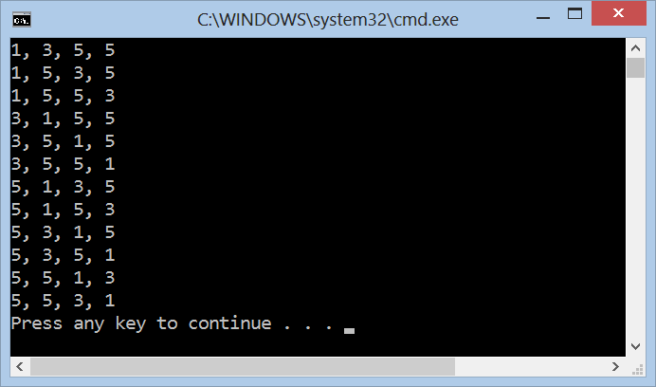
Generating Permutations with Repetition
Live Demo

Slide 27
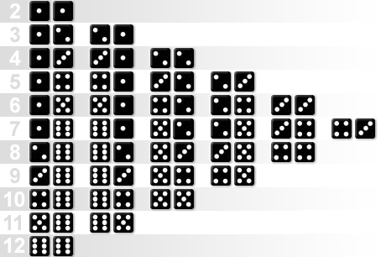
Combinations

Slide 28
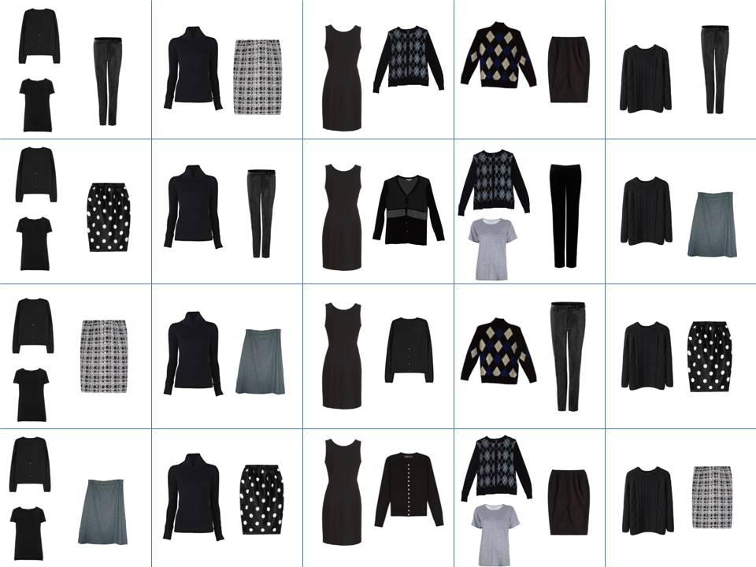
Combinations
Combinations → order does not matter!
Two types of combinations:
  Combinations with repetition
    E.g. coins in your pocket
    5, 5, 20, 20, 20, 10, 10
  Combinations with no repetition
    Lottery numbers
    TOTO 6/49, 6/42, 5/35
    2, 14, 15, 27, 30, 33

Slide 29

Combinations without Repetition
Back to the 3 of 16 billiard balls
  Many combinations will be the same
  We don't care about the order
Ways to choose k items from set of n items
Often called "n choose k" (Google it!)
This is how lotteries work, e.g. TOTO 6/49
Order matters | Order does not matter
1 2 3 1 3 2 2 1 3 2 3 1 3 1 2 3 2 1 | 1 2 3
1 2 4 1 4 2 2 1 4 2 4 1 4 1 2 4 2 1 | 1 2 4
$$C(n, k)=\left({n \atop k}\right)=\frac{n!}{\left(n−k\right)!k!}$$

Slide 30
Algorithm: Combinations without Repetition
Algorithm Comb(index, start) to generate variations C(n, k)
  Put the numbers i = start … n-1 at the position index
  Call Comb(index + 1, i + 1) to generate the rest of the array
Comb(0, start)
Comb(1, start)
Comb(k, start)
Print();
Stop!
i | x | x | x | x | x | x
→
y | i | x | x | x | x | x
…
Comb(1, i+1)
Comb(2, i+1)

Slide 31
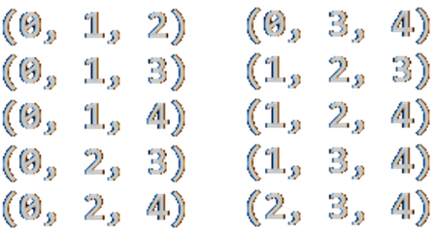
Generate Combinations without Repetition
void Comb(int index, int start)
{
if (index >= k)
{
PrintCombinations();
}
else
for (int i = start; i < n; i++)
{
arr[index] = i;
Comb(index + 1, i + 1);
}
}
int k = 3;
int n = 5;
int[] arr = new int[k];
Comb(0, 0);

Slide 32
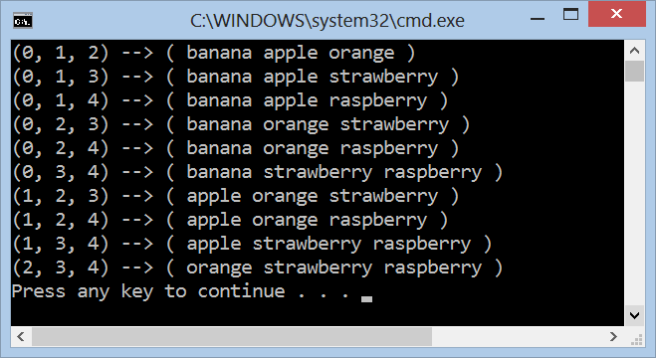
Generating Combinations without Repetition
Live Demo

Slide 33
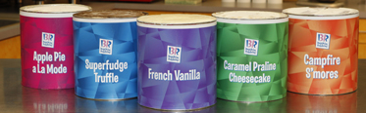
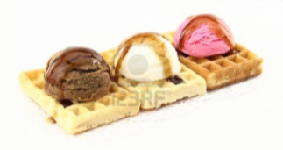

Combinations with Repetition
Ice-cream example
  5 flavors of ice-cream: banana,
  chocolate, lemon, strawberry and vanilla
  3 scoops
How many combinations will there be?
$$C′(n, k)=\left({n+k−1 \atop k}\right)=\left({n+k−1 \atop n−1}\right)=\frac{\left(n+k−1\right)!}{\left(n−1\right)!k!}$$

Slide 34
Algorithm: Combinations with Repetition
Algorithm Comb(index, start) to generate variations C'(n, k)
  Put the numbers i = start … n-1 at the position index
  Call Comb(index + 1, i) to generate the rest of the array
Comb(0, start)
Comb(1, start)
Comb(k, start)
Print();
Stop!
i | x | x | x | x | x | x
→
y | i | x | x | x | x | x
…
Comb(1, i)
Comb(2, i)

Slide 35
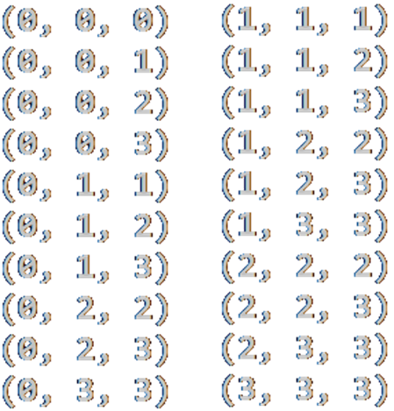
Generate Combinations with Repetition
void Comb(int index, int start)
{
if (index >= k)
{
PrintCombinations();
}
else
for (int i = start; i < n; i++)
{
arr[index] = i;
Comb(index + 1, i);
}
}
int k = 3;
int n = 4;
int[] arr = new int[k];
Comb(0, 0);

Slide 36
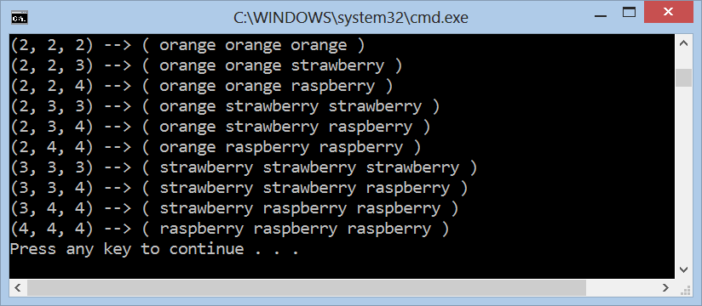
Generating Combinations with Repetition
Live Demo

Slide 37
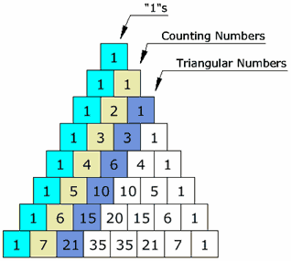


Binomial Coefficients and Pascal's Triangle

Slide 38

Binomial Coefficients
In combinatorics the binomial coefficients denote how many ways exist to choose k elements from a set of n elements
Binomial coefficients are the coefficients of the x ^{k} term in the polynomial expansion of the binomial power (1 + x) ^{n}
Arranged into rows, the Pascal's triangle is composed
$$C_{n}^{k}=\left({n \atop k}\right)=\frac{n!}{\left(n−k\right)!k!}$$
  (1 + x) ⁴ = 1 + 4 x + 6 x ² + 4 x ³ + 1 x ⁴

Slide 39
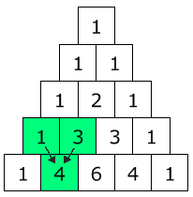

Pascal's Triangle
Pascal's triangle shows you how many combinations of objects without repetition are possible
  Go down to row n (the top row is 0)
  Move along k places
  The value there is your answer
Build the triangle:
  Start with "1" at the top
  Then continue placing numbers
  below it in a triangular pattern
$$C_{n}^{k}=\left({n \atop k}\right)=\frac{n!}{\left(n−k\right)!k!}$$

Slide 40
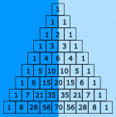
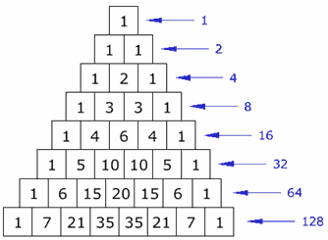
Pascal's Triangle's (2)
The Pascal's triangle is symmetrical
  Numbers on the left side have identical matching
  numbers on the right side, like a mirror image
Diagonals:
  First diagonal – only "1"s
  Second diagonal – 1, 2, 3, etc.
  Third diagonal – triangular numbers
Horizontal sums: powers of 2

Slide 41
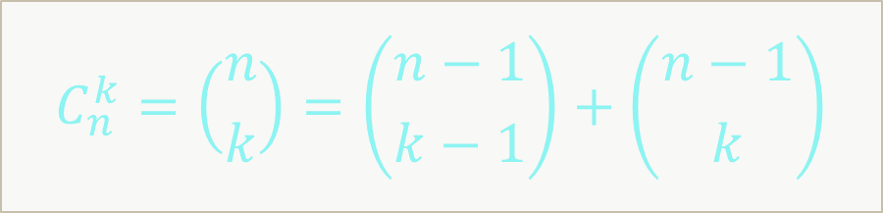
Binomial Coefficients: Recursive (Slow!)
decimal BinomSlow(int n, int k)
{
if (k > n)
return 0;
if (k == 0 || k == n)
return 1;
return Binom(n - 1, k - 1) + Binom(n - 1, k);
}
$$C_{n}^{k}=\left({n \atop k}\right)=\left({n−1 \atop k−1}\right)+\left({n−1 \atop k}\right)$$

Slide 42
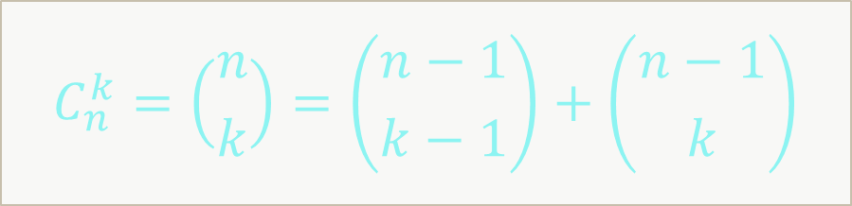
Binomial Coefficients: Recursive Calculation
const int MAX = 100;
static decimal[,] binomCoeff = new decimal[MAX, MAX];
static decimal Binom(int n, int k)
{
if (k > n)
return 0;
if (k == 0 || k == n)
return 1;
if (binomCoeff[n, k] == 0)
binomCoeff[n, k] = Binom(n - 1, k - 1) + Binom(n - 1, k);
return binomCoeff[n, k];
}
$$C_{n}^{k}=\left({n \atop k}\right)=\left({n−1 \atop k−1}\right)+\left({n−1 \atop k}\right)$$

Slide 43
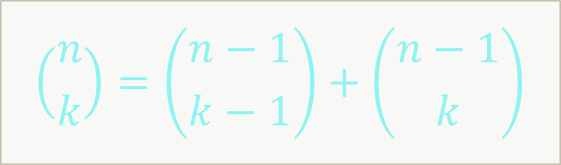
Pascal's Triangle: Bottom Up Calculation
int n = 10;
var pascal = new decimal[n + 1];
for (int row = 0; row <= n; row++)
{
for (int col = row; col >= 0; col--)
{
if (col == 0 || col == row)
pascal[col] = 1;
else
pascal[col] = pascal[col] + pascal[col - 1];
Console.Write(pascal[col] + " ");
}
Console.WriteLine();
}
$$\left({n \atop k}\right)=\left({n−1 \atop k−1}\right)+\left({n−1 \atop k}\right)$$

Slide 44
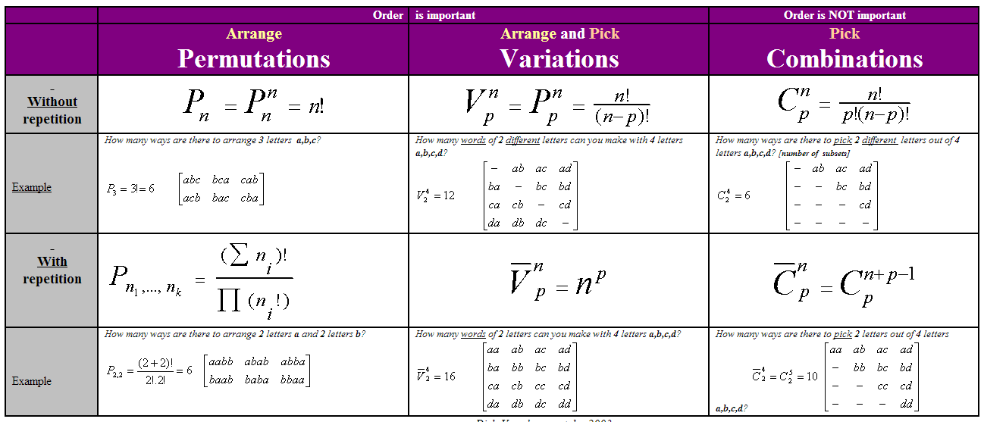
Combinatorial Formulas
Source: http://users.telenet.be/vdmoortel/dirk/Maths/PermVarComb.html

Slide 45
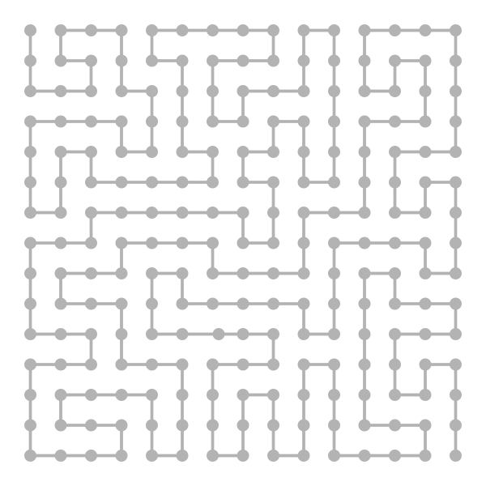
Binary Vectors

Slide 46
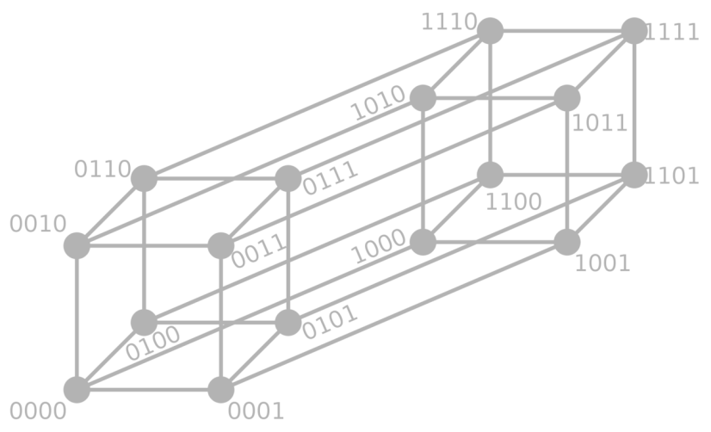
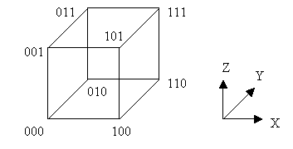
Binary Vectors
Some problems can be reformulated in terms of binary vectors
  E. g. generate all subsets of given items – (1, 0, 1, 1, 1, 0, …)
Combinatorial properties of binary vectors:
  Number of binary vectors of length n: 2^{n}
  Number of binary vectors of length n and with k `1` is C(n, k)

Slide 47
Gray Code
Gray code by bit width
2-bit | 4-bit
00 01 11 10 | 0000 0001 0011 0010 0110 0111 0101 0100 1100 1101 1111 1110 1010 1011 1001 1000
3-bit
000 001 011 010 110 111 101 100
Gray code (a.k.a. reflected binary code)
  A binary numeral system, where
  Two successive values differ by only one bit
Decimal | Gray | Binary
0 | 000 | 000
1 | 001 | 001
2 | 011 | 010
3 | 010 | 011
4 | 110 | 100
5 | 111 | 101
6 | 101 | 110
7 | 100 | 111

Slide 48
Gray Code Generator – Source Code
void ForwardGray(int k)
{
if (k < 0)
{
Print();
}
else
{
arr[k] = 0;
ForwardGray(k - 1);
arr[k] = 1;
BackwardGray(k - 1);
}
}
void BackwardGray(int k)
{
if (k < 0)
{
Print();
}
else
{
arr[k] = 1;
ForwardGray(k - 1);
arr[k] = 0;
BackwardGray(k - 1);
}
}

Slide 49
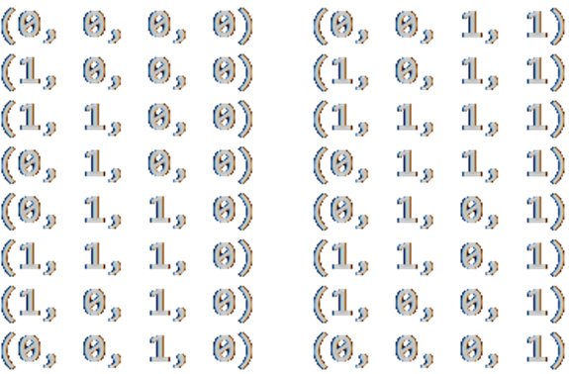
Gray Code Generator – Source Code (2)
const int n = 4;
static int[] arr = new int[n];
static void Main()
{
ForwardGray(n - 1);
}
static void Print()
{
Console.WriteLine("(" +
string.Join(", ", arr) +
")");
}

Slide 50
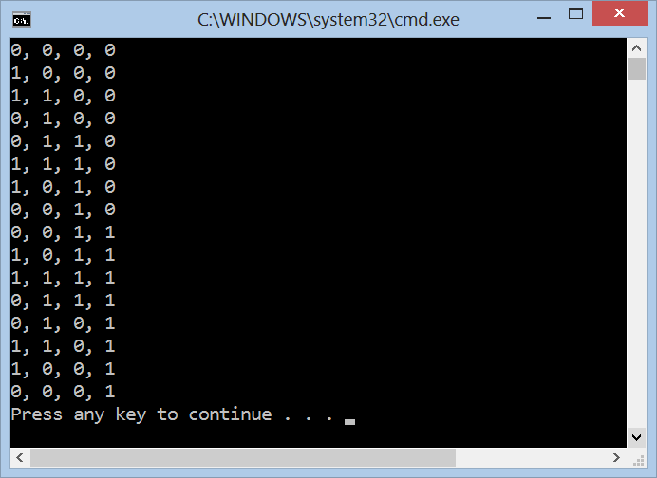
Gray Code
Live Demo

Slide 51


Summary
Recursive algorithms are powerful in
generating combinatorial structures
  Variations, permutations, combinations
  With and without repetition
Binomial coefficients provide can
compute the number of ways to choose
k distinct elements from a set of n elements
  Calculated by the Pascal's triangle
Gray code generates the binary vectors, so that
two successive values differ in only one bit

Slide 52









Combinatorial Algorithms
https://softuni.bg/trainings/1194/Algorithms-September-2015

Slide 53
License
This course (slides, examples, labs, videos, homework, etc.)
is licensed under the "Creative Commons Attribution-NonCommercial-ShareAlike 4.0 International" license
Attribution: this work may contain portions from
  "Fundamentals of Computer Programming with C#" book by Svetlin Nakov & Co. under CC-BY-SA license
  "Data Structures and Algorithms" course by Telerik Academy under CC-BY-NC-SA license

Slide 54






Free Trainings @ Software University
Software University Foundation – softuni.org
Software University – High-Quality Education, Profession and Job for Software Developers
  softuni.bg
  Software University @ Facebook
  facebook.com/SoftwareUniversity
  Software University @ YouTube
  youtube.com/SoftwareUniversity
  Software University Forums – forum.softuni.bg

