Slide 1




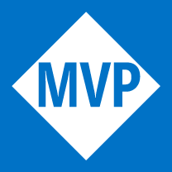
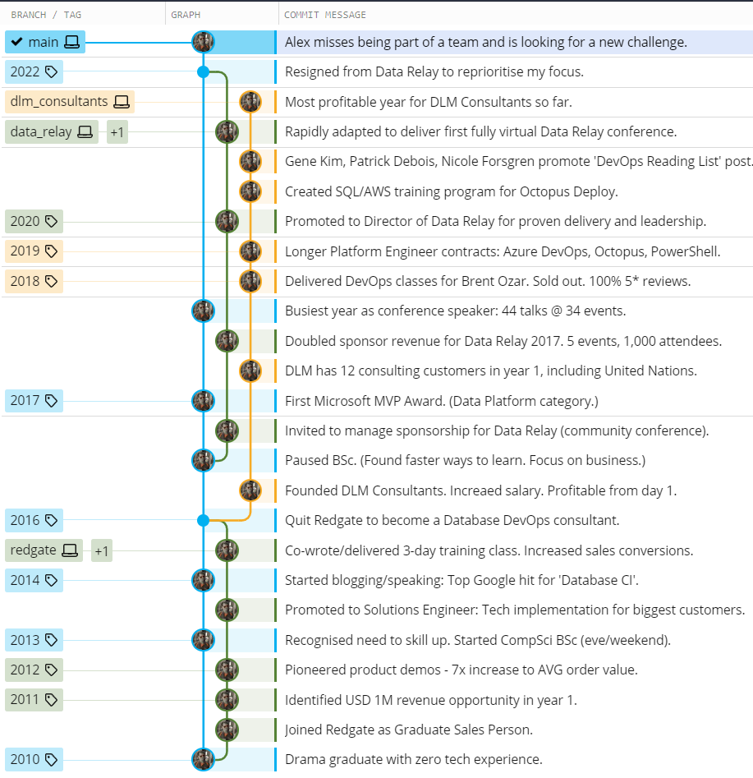
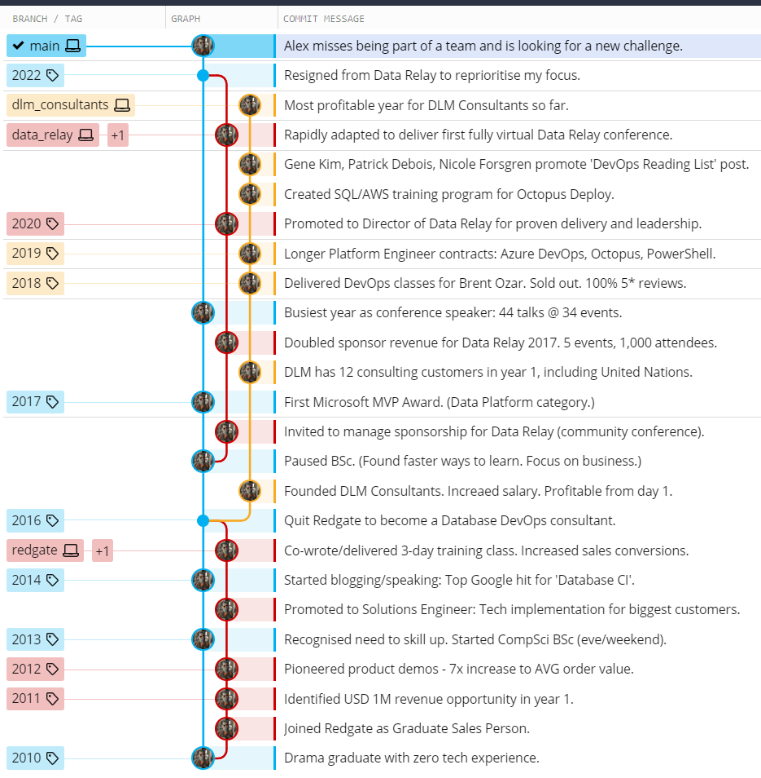
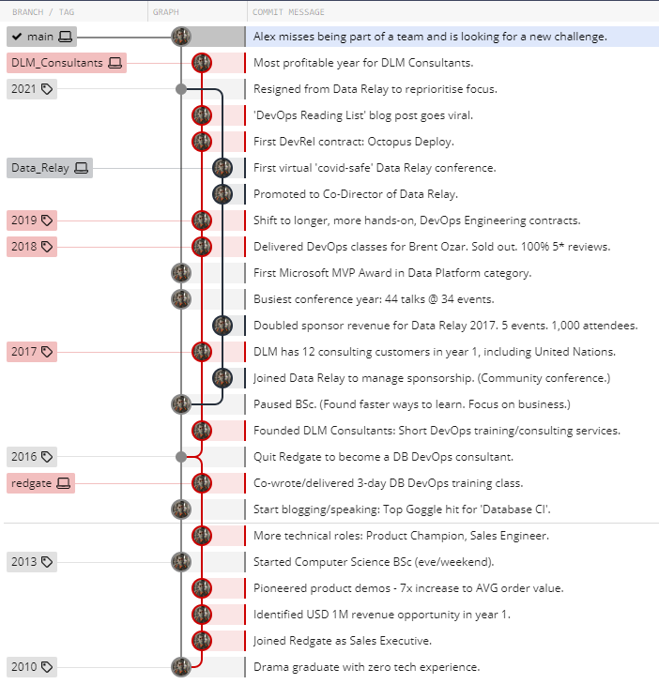




ALEX YATES
12 years of DevOps experience. Helps folks to iterate tooling, process, and culture, to improve DORA metrics and deliver better business outcomes.
Broad experience across DevOps engineering, consulting, training, coaching, sales/solutions engineering, public speaking, and directing companies.
Passionate learner, who works best in cross-functional teams where ideas are more easily shared, optimised, and implemented.
ajy.mail@gmail.com
github.com/Alex-Yates/curriculum-vitae
07762618250
38 North Lodge Park, Milton, CB24 6UB, UK
AWARDS + CERTS
6x Microsoft MVP Award 2017 – present
AWS Certified Cloud Practitioner 2022
Redgate “Davidson” Award 2015
SKILLS
DevOps consulting
Tech implementation
X-functional comms
Training
Community building
Public speaking
Learning quickly
Writing
Sales
SDLC and CI/CD tools
Database delivery
T-SQL, PowerShell
C#, Git
AWS, Azure
Java, JavaScript
EDUCATION BA (Hons) 2:1 Drama and Theatre Studies Royal Holloway Uni. London BSc (50% complete) Computer Science Open University (Distinction in all modules.
Paused to focus on business.)
PERSONAL INTEREST
EMPLOYMENT HISTORY:
Founder / DevOps Consultant: DLM Consultants (2016-present)
Significantly reduced customers’ risk and lead time for SQL changes.
Focus on upskilling and coaching existing teams to practice DevOps.
More detailed customer testimonials on the following page.
Sponsorship Manager / Director: Data Relay (2016-2022)
Doubled revenue in 12 months. Tripled revenue 36 months.
Promoted to director for showing success, responsibility, and leadership.
Sales Person / Solutions Engineer: Redgate (2010-2016)
Flourished in x-functional collaboration and tech sales/implementation.
Hit sales target 11 months in a row with record average order size.
Promoted to Solutions Engineer. Worked with dev team on new products.
Won company award for dev advocacy/public speaking/blogging.
CAREER HIGHLIGHTS:

Slide 2
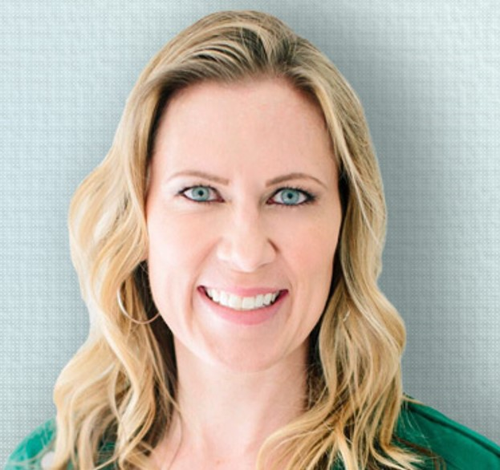
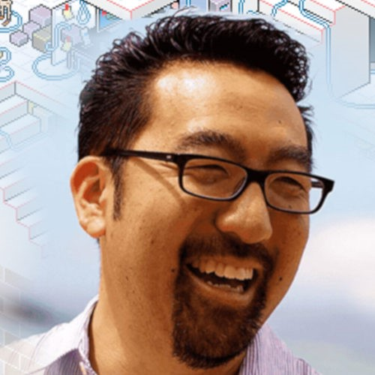

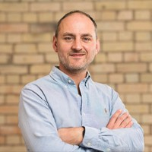
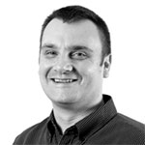
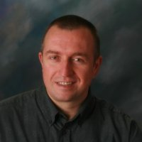
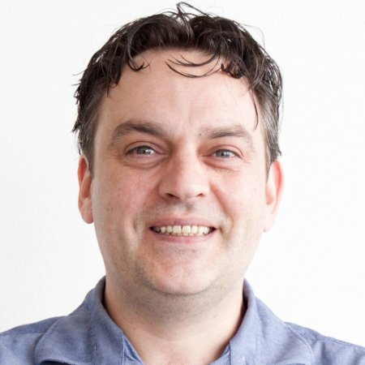
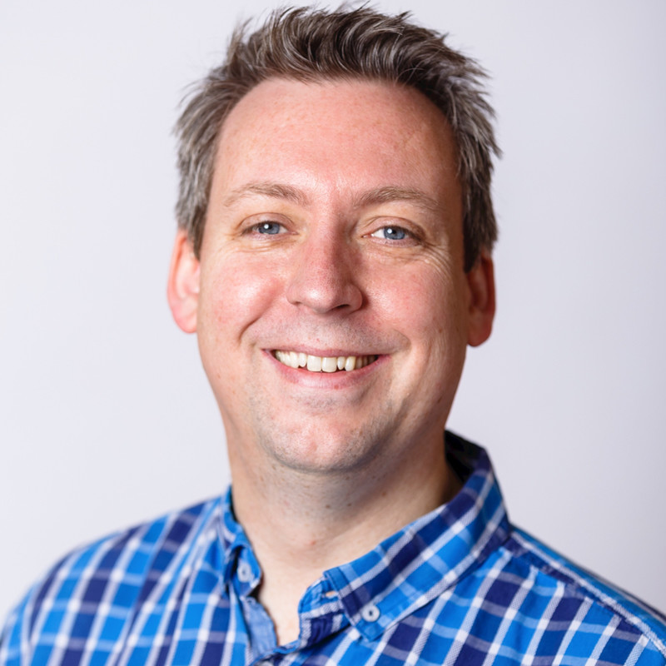


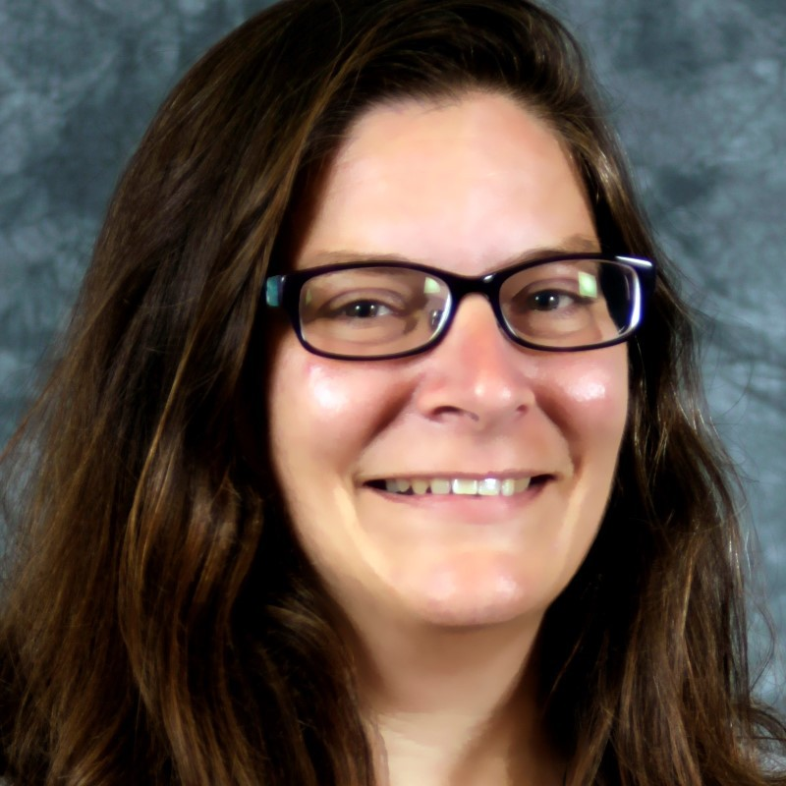

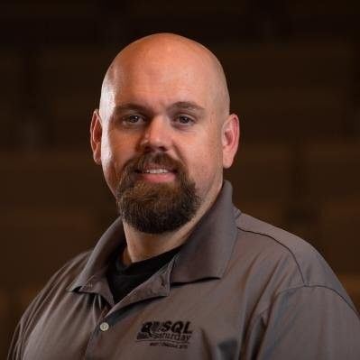
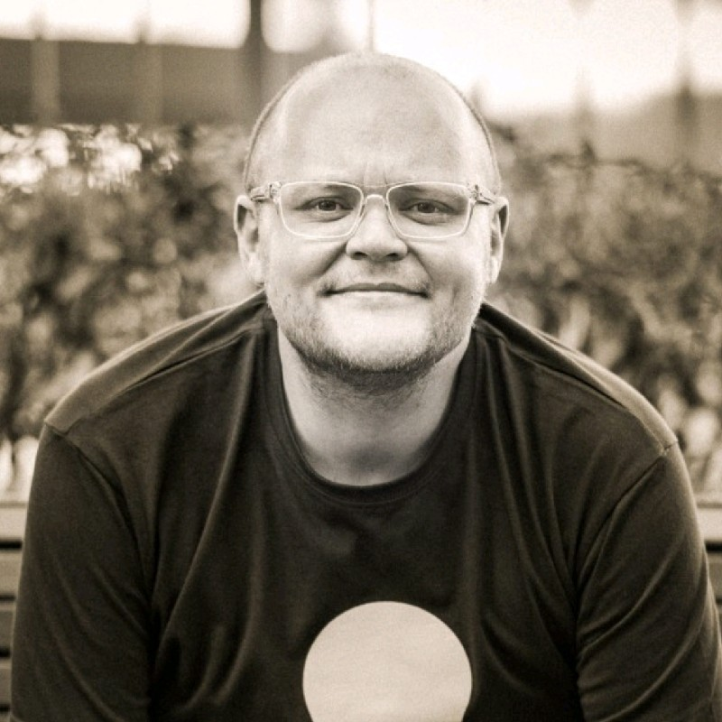

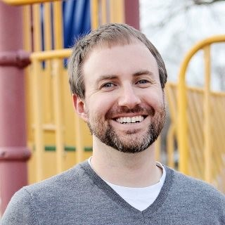


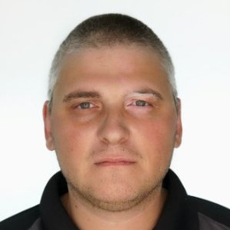
TESTIMONIALS:
This is easily the BEST book list I’ve ever seen, complete with decision tree to help you decide what books you might like. IT’S AMAZING 🤩 https://t.co/1m6CIWpZyV
Dr Nicole Forsgren, Wrote Accelerate
Holy cow — agreed! Thanks Alex Yates. Great selection of books and what an amazing flowchart!! 🎉🎉
https://twitter.com/RealGeneKim/status/1330780266068021248
Gene Kim, Wrote The Phoenix Project
I hired Alex as an inexperienced, but very intelligent grad. He learned tech fast, and could apply and discuss it in a clear and believable way. These skills quickly allowed Alex to develop his role.
Simon Johnson, Head of Sales, Redgate
I found Alex to be a key member of my team who picked up technologies and concepts quickly. It was great to be able to rely on him to handle a number of my responsibilities when I was unavailable. T. Austin, Dir. Customer Success, Redgate
Alex stood out for two reasons. First, he learned technology and its applications quickly. Second, he brought strong and passionate presentation skills. I'd happily work with him again.
Grant Fritchey, PASS President, Redgate
Alex is like a good teacher, he really wants you to understand how things work and he teaches patiently. He just wanted me to understand and make the product work.
Sjors Takes, Senior DBA, AlbumPrinter
Alex is a pleasure to work with; highly motivated, very capable at managing difficult projects, and fun to be around. He rapidly became a trusted, dependable, and critical team member.
Alex Whittles, Director, Data Relay
Adopting DevOps involves making difficult, hard-to-reverse changes. You need someone who’s done this before, listens well, and communicates the right information. That person is Alex Yates.
B. Ozar, Consultant, Brent Ozar Unlimited
Our implementation of DLM ranks as the most beneficial infrastructure project of my 26-year IT career. DB deploys are no longer a bottleneck.
Steve Cornwell, Architect, Microsoft and Farm Credit Mid-America
DLM's mentoring service was exactly what we needed. Alex coached from the side-lines, without taking over, while supporting our objectives with deep knowledge of the subject matter.
Anna Brown, Director of BI, AllVue
We produced a POC and presented it to the wider team. Even the skeptics could see the value. Alex also warned that the journey will be hard, which demonstrates his integrity.
Cihan Ucar, Snr Software Architekt, VAT
Alex is extremely knowledgeable as well as very easy to work with. Regardless if he was dealing with DBAs, developers, or managers, he conveyed important concepts and key take aways.
J. Morehouse, Prin. Consultant, DCAC
It was clear Alex knew his stuff with Octopus Deploy and DevOps.
Alex holds himself, the work he does, and the systems he works with, to a high standard. He builds quality.
D. Campbell, Community Dir, Octopus Deploy
Alex’s knowledge and experience is exemplary. His workshop delivery is both enjoyable and educational. I met all my objectives, confidently reprising the exercises on my own systems.
Rae Ellingham, Snr Dev, Car Care Plan
Within a few minutes, it was apparent Alex knew his stuff. Alex knew to ask the right questions to ensure the solution would work. He could easily have force fed a solution, but he didn’t.
Bob Walker, FCSA and Octopus Deploy
Alex impressed me with his profound insight into a broad range of CI products on the market. He takes pride in his integrity and informed advice. True asset on any team.
D. Andriychenko, Lead Dev, Rabobank
Alex’s style of including the team in the design process enabled us to not only meet our goal but exceed it greatly. And his rational challenge to our timeline led to an eye-opening realization.
Brian Locke, Systems Director, DataScan
It was tremendously valuable to have Alex pair with me as I got my head around Bamboo, tSQLt and the various DB automation tools. He was passionate about getting our PoC working.
Pencho Belneyski, Release Mgr, The UN

