Slide 1




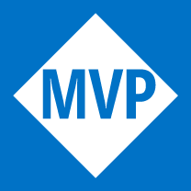
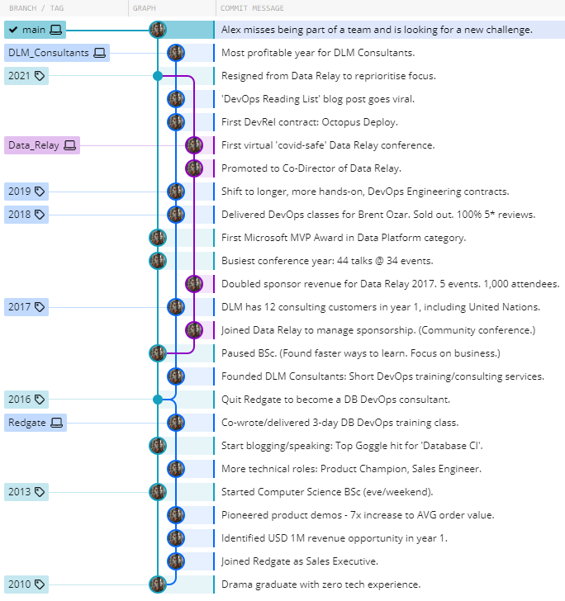
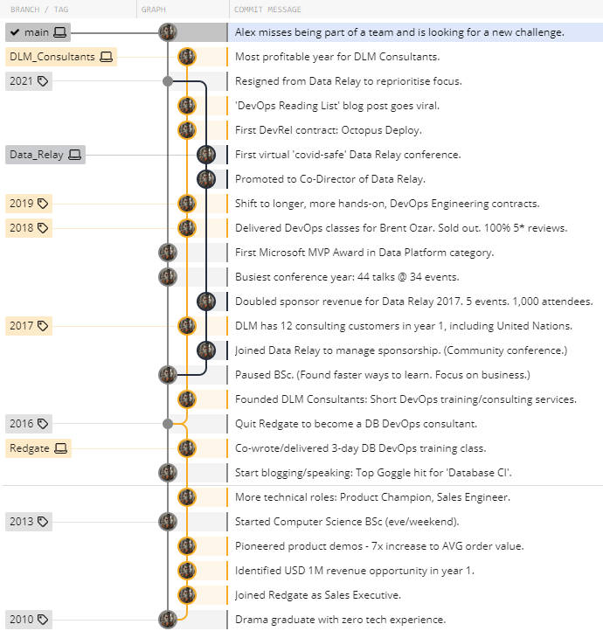


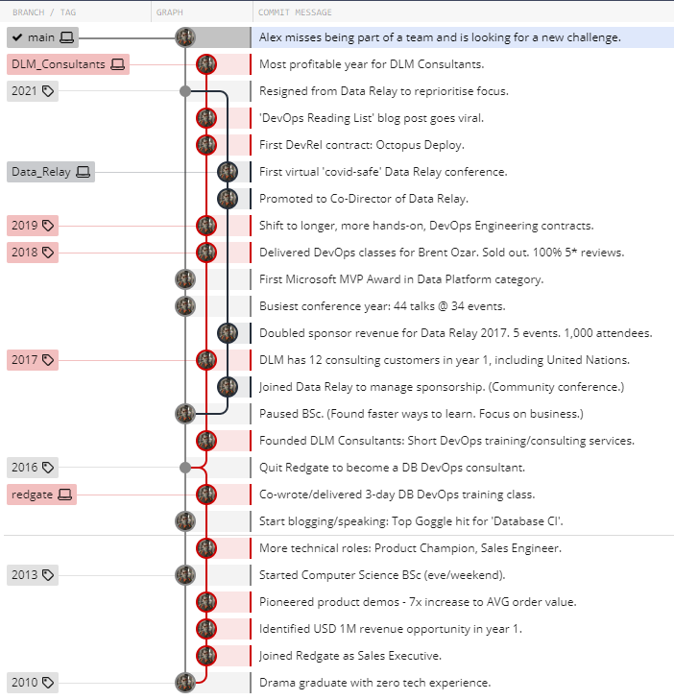




ALEX YATES
DevOps professional with 12 years of experience supporting customers to adopt DevOps tooling, process, and culture.
Broad experience across DevOps engineering, businesses, consulting, training, coaching, sales engineering, and public speaking.
A passionate learner who works best in cross-functional teams where ideas are more easily shared and implemented.
ajy.mail@gmail.com
github.com/Alex-Yates
07762618250
38 North Lodge Park,
Milton, CB24 6UB, UK
AWARDS + CERTS
5x Microsoft MVP Award 2017 – present
AWS Certified Cloud Practitioner 2022
Redgate “Davidson” Award 2015
SKILLS
DevOps consulting
Tech implementation
X-functional comms
Training
Community building
Public speaking
Learning quickly
Writing
Sales
SDLC and CI/CD tools
Database delivery
Git
AWS, Azure
T-SQL, PowerShell
C#, Java, JavaScript
EDUCATION BA (Hons) 2:1 Drama and Theatre Studies Royal Holloway Uni. London BSc (50% complete) Computer Science Open University (Distinction in all modules.
Paused to focus on business.)
PERSONAL INTEREST
Founder / Director / DevOps Consultant
2016 – present: DLM Consultants (Database DevOps consulting)
Database DevOps consulting, training, coaching, and mentoring. Dozens of consulting customers across US, EMEA and APAC.
Sponsorship Manager / Director
2016 – 2022: Data Relay (Community tech conference)
Tripled sponsor revenue by 2019. Promoted to a director.
Sales / Sales Engineer
2010 – 2016: Redgate Software (Database DevOps software)
Flourished in x-functional collaboration and tech sales/implementation.
CAREER HIGHLIGHTS:

