Slide 1
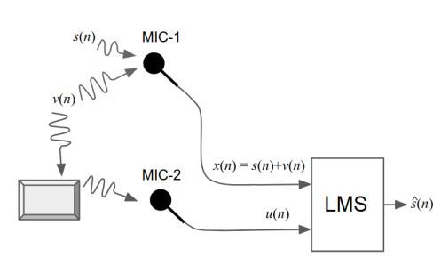

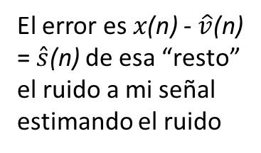

Problema 1
El error es $x\text{(}\text{n}\text{)}$ - $\hat{v}\text{(}\text{n}\text{)}$
= $\hat{s}\text{(}\text{n}\text{)}$ de esa “resto” el ruido a mi señal estimando el ruido
LMS
s(n)
x(n) = s(n) + v(n)
e(n)
$$\hat{s}\text{(}\text{n}\text{)}$$
v(n)
h(n)
u(n)
W(n)
Filtro adaptativo
$\hat{x}\text{(}\text{n}\text{)}$ = $\hat{v}\text{(}\text{n}\text{)}$
u(n) es ruido captado del ambiente, correlacionado con v(n), estimo el ruido v(n) con u(n).

Slide 2


$$x\left(n\right)=s(n)+v(n)$$
V= E[${ \text{|}\text{v}\text{(}\text{n}\text{) }\text{– }\hat{x}\left(n\right)|}^{2}$ ] = E[${\text{ |}\text{v}\text{(}\text{n}\text{) }\text{– }w^{∗}.u(n)|}^{2}$ ]= E[($\text{v}\text{(}\text{n}\text{) }\text{– }w^{∗}.u(n)$) ${\text{(}\text{v}\text{(}\text{n}\text{) – }w^{∗}.u(n)\text{)}}^{∗}$] = E[$\text{v}\text{(}\text{n}\text{)}{\text{v}\text{(}\text{n}\text{) }}^{∗}\text{– }w^{∗}.u(n)\text{v}\text{(}\text{n}\text{)}$ - $\text{v}\text{(}\text{n}\text{)} {u(n)}^{∗}$w(n) + $w^{∗}.u\left(n\right) {u(n)}^{∗}$w(n) ] = V = $σ_{v}^{2} − w^{∗}R_{u,v} − R_{v,u}w + w^{∗}R_{u}w$ J = E[${\text{ |}\text{x}\text{(}\text{n}\text{)} \text{– }\hat{v}\left(n\right)|}^{2}$ ] = E[$x\left(n\right)x{\left(n\right)}^{∗} −x\left(n\right)\hat{v}{\left(n\right)}^{∗} −\hat{v}\left(n\right)x{\left(n\right)}^{∗}+ \hat{v}\left(n\right) \hat{v}{\left(n\right)}^{∗}$] = E[$\left(s(n)+v(n)\right){\left(s(n)+v(n)\right)}^{∗} −\left(s(n)+v(n)\right)\hat{v}{\left(n\right)}^{∗} −\hat{v}\left(n\right){\left(s(n)+v(n)\right)}^{∗}+ \hat{v}\left(n\right)\hat{v}{\left(n\right)}^{∗}$] = E[$s\left(n\right)s{\left(n\right)}^{∗}+v\left(n\right)v{\left(n\right)}^{∗} −s\left(n\right)\hat{v}\left(n\right)−v\left(n\right)\hat{v}\left(n\right) −\hat{v}\left(n\right)∗s\left(n\right)−\hat{v}\left(n\right)v{\left(n\right)}^{∗}+\hat{v}\left(n\right)\hat{v}{\left(n\right)}^{∗}$] = E[$s\left(n\right)s{\left(n\right)}^{∗}+v\left(n\right)v{\left(n\right)}^{∗} −s\left(n\right)w{\left(n\right)}^{∗}u(n)−v\left(n\right)w{\left(n\right)}^{∗}u(n)−w{\left(n\right)}^{∗}u(n)∗s\left(n\right)−w{\left(n\right)}^{∗}u(n)v{\left(n\right)}^{∗}+w{\left(n\right)}^{∗}u(n) {\left(w{\left(n\right)}^{∗}u(n)\right)}^{∗}$] = E[$s\left(n\right)s{\left(n\right)}^{∗}+v\left(n\right)v{\left(n\right)}^{∗} −v\left(n\right)w{\left(n\right)}^{∗}u(n) −w{\left(n\right)}^{∗}u(n)v{\left(n\right)}^{∗}+w{\left(n\right)}^{∗}u\left(n\right)u{\left(n\right)}^{∗}w(n)$] = J = $σ_{s}^{2} + σ_{v}^{2} − R_{v,u}w\left(n\right) −w{\left(n\right)}^{∗}R_{u,v} + w{\left(n\right)}^{∗}R_{u} w\left(n\right)=σ_{s}^{2}+V$
$\hat{v}\left(n\right)=w{\left(n\right)}^{∗}u\left(n\right)$ y $s\left(n\right)$ descorrelacionado con $u\left(n\right)$

Slide 3
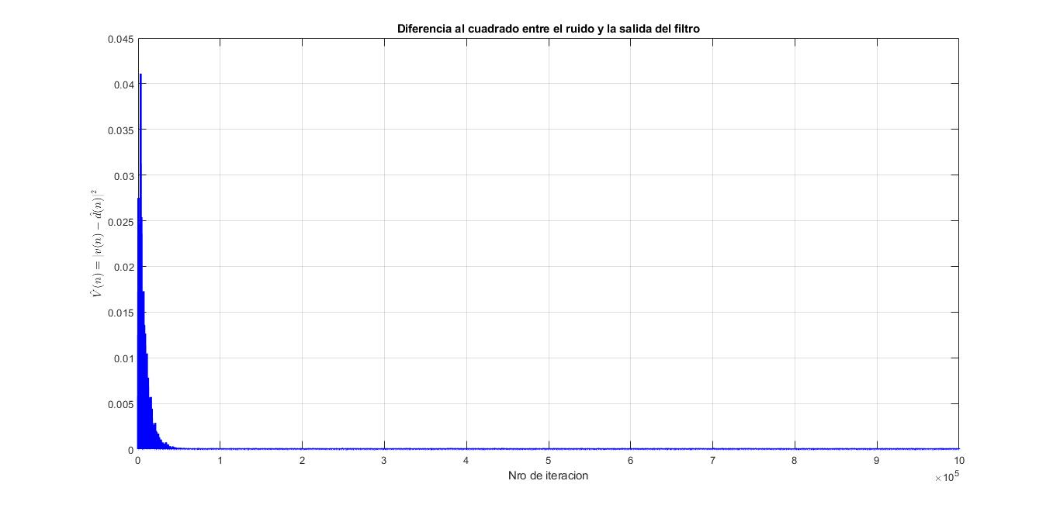
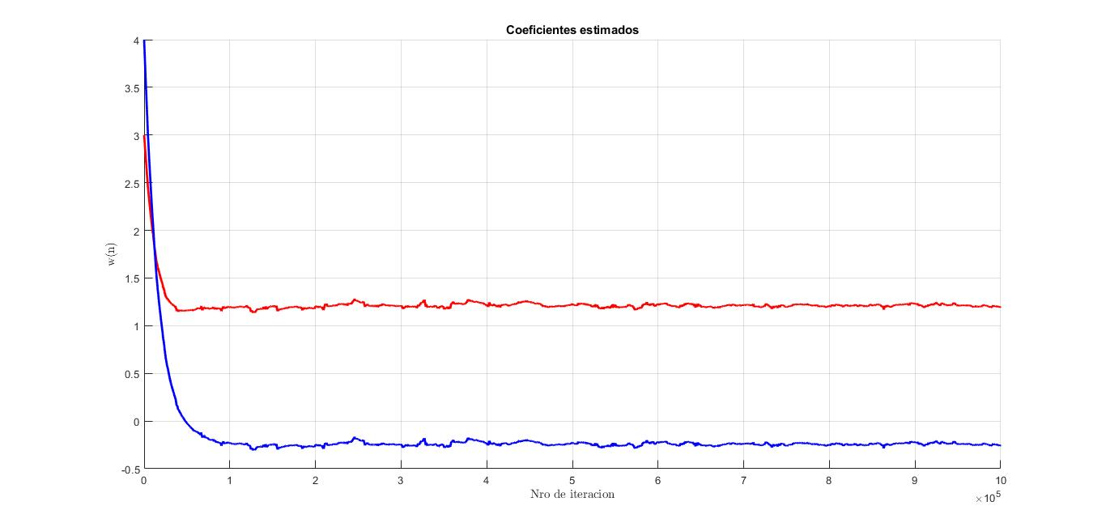
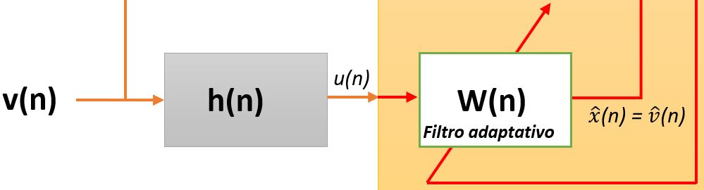
Problema 2: Filtrado LMS, $μ=0.5 , M=2, W\left(0\right)={\left[3,4\right]}^{T}$

Slide 4
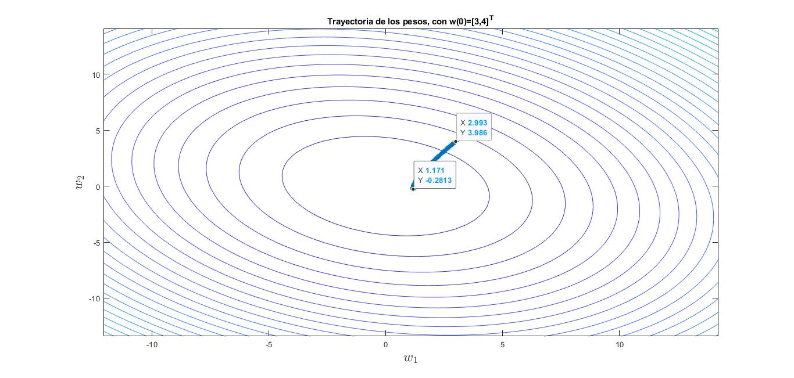
Problema 2
$$En LMS nunca se alcanza el optimo$$

Slide 5
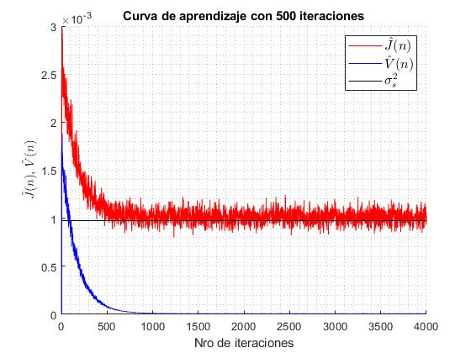
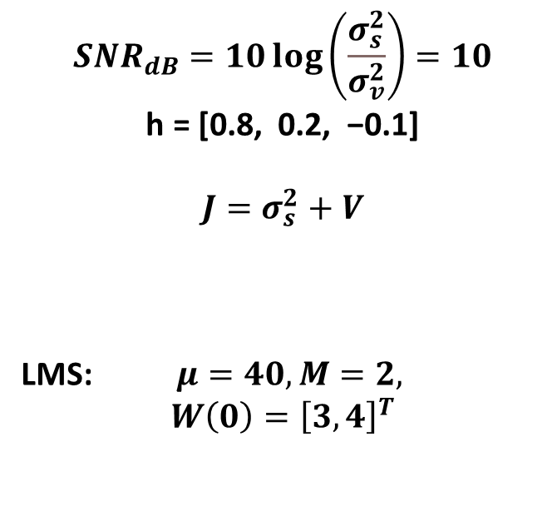
Problema 3
$$SNR_{dB}=10\log\left(\frac{σ_{s}^{2}}{σ_{v}^{2}}\right)=10$$
$\text{h}\text{ = [0.8, 0.2, −0.1]}$
$$J=σ_{s}^{2}+V$$
LMS: $μ=40, M=2,$
$$W\left(0\right)={\left[3,4\right]}^{T}$$

Slide 6
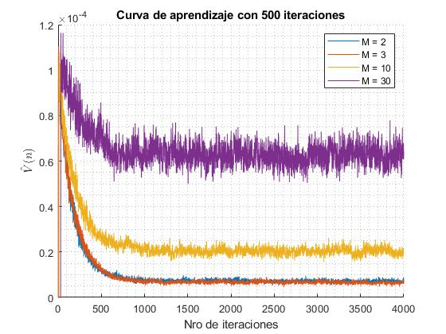
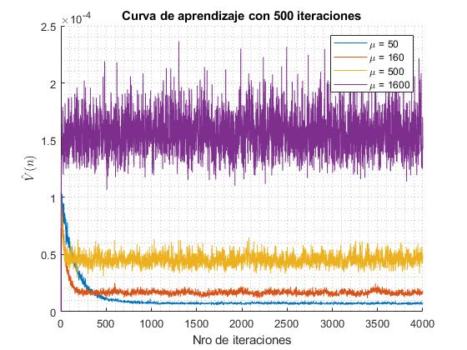
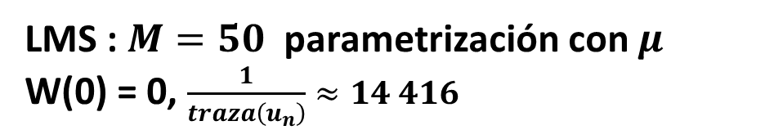
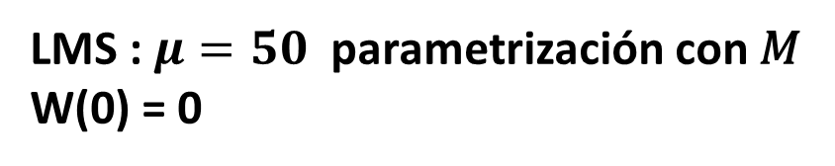
Problema 3
LMS : $M=50$ parametrización con $μ$
W(0) = 0, $\frac{1}{traza\left(u_{n}\right)}≈14 416$
LMS : $μ=50$ parametrización con 𝑀
W(0) = 0

Slide 7

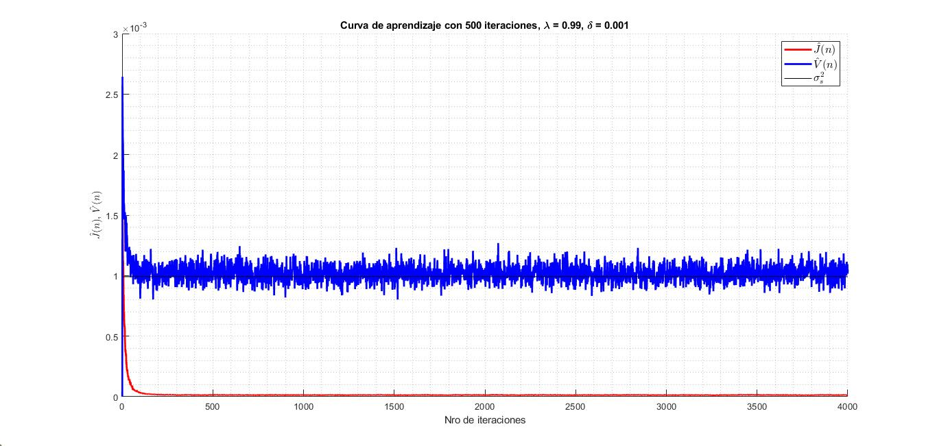

Problema 4: RLS, M = 2, $W\left(0\right)={\left[3,4\right]}^{T}$

Slide 8
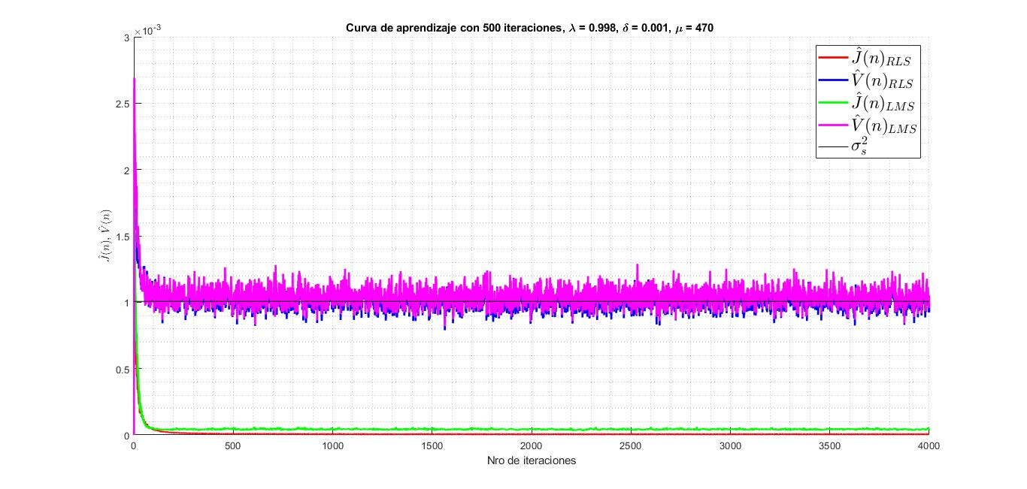
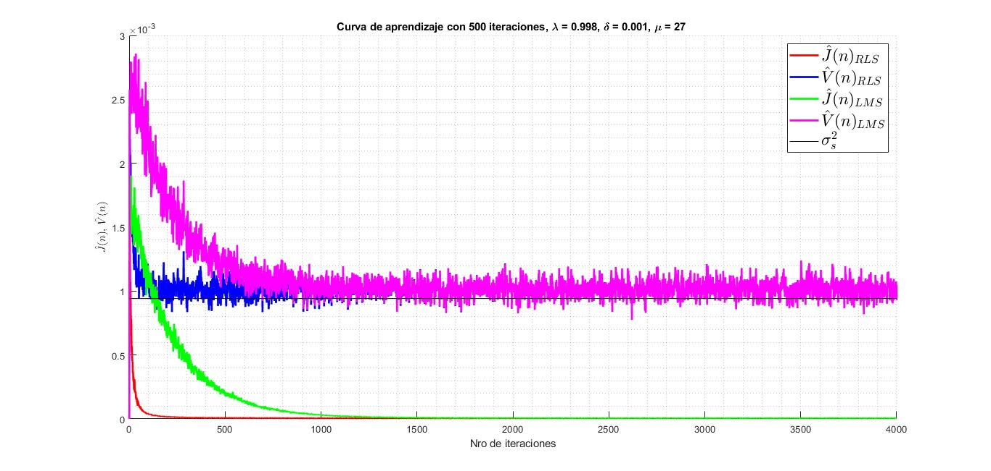


Problema 4
RLS y LMS : $λ=0,998.$ Modificando $μ$ para tener la potencias $\hat{v}\left(n\right)$ en $n→∞$tiendan a lo mismo
$$μ=27$$
RLS y LMS : $λ=0,998.$ Modificando $μ$para tener la misma pendiente inicial de las potencial de error.
$$μ=470$$
$λ=1 y procesos ergodicos, RLS converge$ a Wiener

