Slide 1
Classifying Album Covers
Can we predict the genre via album cover?

Slide 2

Dataset
About 56 000 images out of 11 genres
(in Spotify: categories)
Download via Python package Spotipy and Spotify API

Slide 3
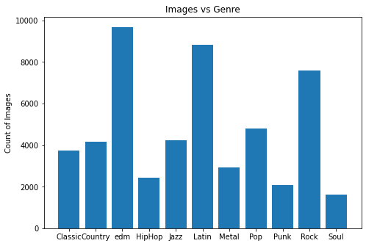
Data Preparing
Two-steps-preparing
Balancing the data with undersampling
Oversampling to fill up the minority category

Slide 4
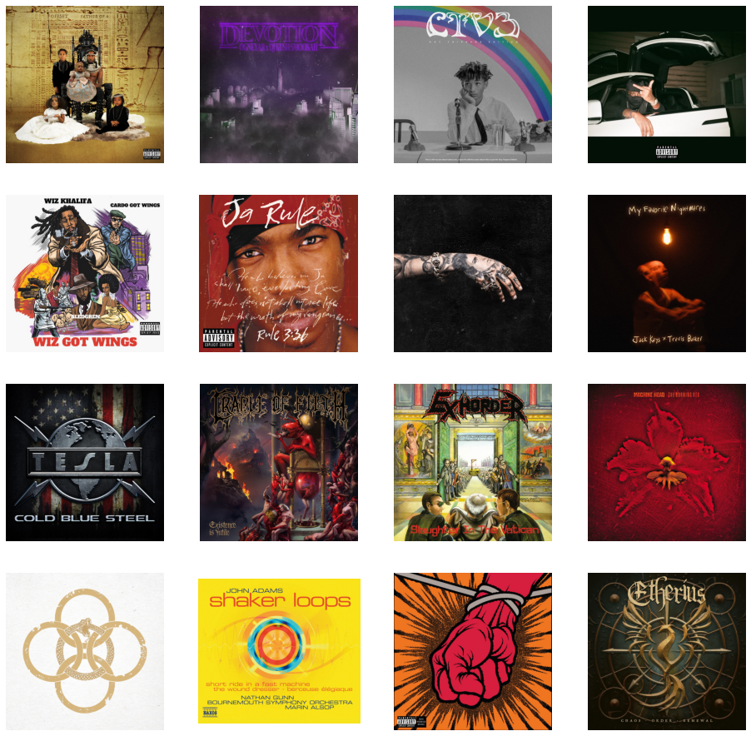
Genre Classification HipHop vs. Metal
Hypothesis:
The album covers from these genres make a bigger difference compared to other genres

Slide 5
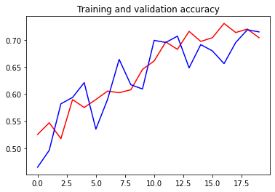
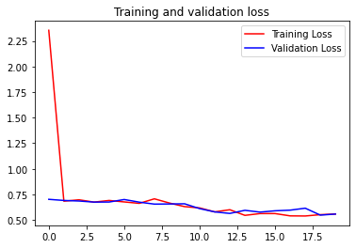
Results
Baseline: CNN with 3 up to 5 convolutional layers, batch normalization, preprocessing with Image Generator, Relu and Sigmoid Activation (Output Layer)
Accuracy better than with Binary Classification of Pictures in Jazz/Punk-Category

Slide 6
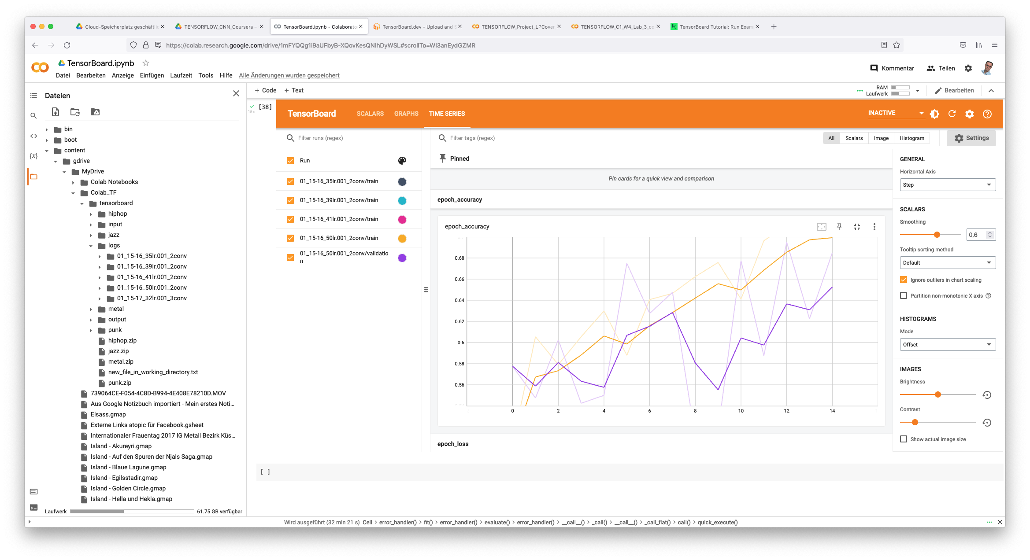
Visualization with Tensorboard

Slide 7





Testing with Files
Identification false
Genre: HipHop
Computer: Metal
Identification correct
Genre: Metal
Computer: Metal
Identification correct
Genre: HipHop
Computer: HipHop
Identification correct
Genre: Metal
Computer: Metal
Identification correct
Genre: HipHop
Computer: HipHop

Slide 8
Conclusions
Findings
Identification ist good when people on the cover (object identifiication)
Irritation by shrill colours, tend to identificate black colour as HipHop (repeat prejudice?)
Does pixel-based analysis make sense?
Model architecture
more precise with five convolutional layers
Transfer Learning with VGG 16, 19 or ResNet Model – better results?
Look Out for other model architecture – Generative Adversarial Networks?

Slide 9
Thanks for the Attention!

