Slide 1

Omni International 2017
Website Goals, Progress, Ideas

Slide 2
2017 - End of Year Goals
Increase sessions to +30,000
Increase Goal Conversion Rate to 2.5%
Pages per Session 4+
Gain 20 new leads a day – need to set this up to get an accurate total number of possible leads
Bring CPA (Click Per Action) down - Spend allot less on AdWords with the same results as if we were paying allot. $75 or less
Increase Average Quality Scores on all adds to 5 or above
Bring Average Page load time to below 4 seconds (cleaning of files, using cashing, loading files in correct order, optimizing images and how content loads)

Slide 3
This Years Numbers
Sessions: 16,363
Overall Goal conversion rate: 0.97%
Pages per Session: 4.41
CPA (Click Per Action): $93.41
Average Quality Score: 4.9
Average Page Load Time: 8.22 seconds

Slide 4
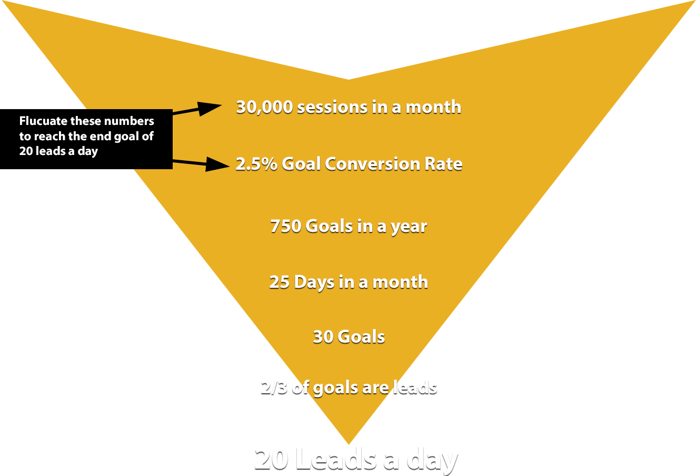
How to reach 20 leads in a day

Slide 5
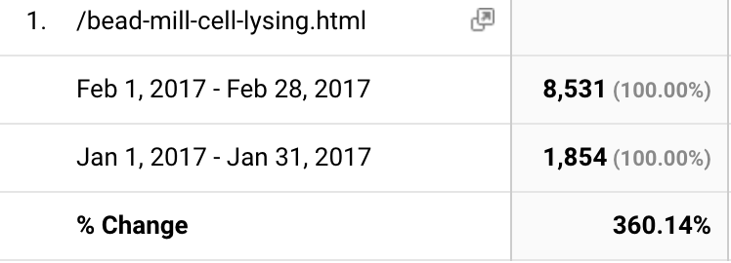
Pushing Bead Ruptors in 2017
Bead Ruptor Campaign
We have a 360.14% increase in traffic to our Bead Ruptor page since last month in January.
Page Page Views
Total Page-Views
February: 47,893 January: 26,799

Slide 6
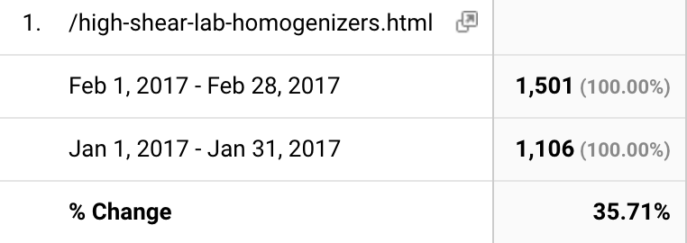
Rotor Stator campaign
We have a 35.71% increase in traffic to our Rotor Stator page since last month in January.
Page Page Views
Total Page-Views
February: 47,893 January: 26,799

Slide 7
January Sessions: 7,339 February Sessions: 9,502
Per our analytics, we are in progress to reach a
29.5% increase in sessions this month.

Slide 8
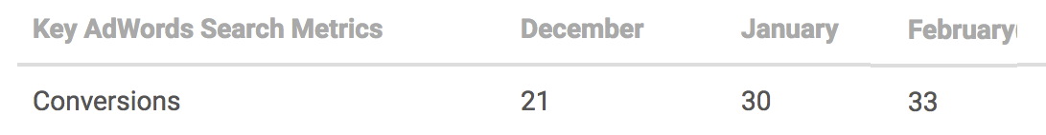
AdWord Conversions December, January, February
A conversion happens when someone clicks your ad and then takes
an action that you've defined as valuable to your business
Goals – Actions valuable to us
Contact submission
Quote submission
Purchase
Side Note: We removed ½ of our Goals in the middle of January.

Slide 9
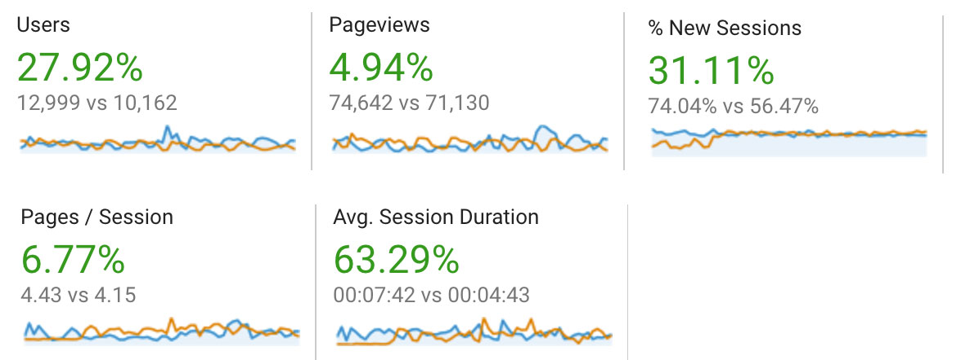
February vs. January Numbers
We are gaining not only more customers, we are getting customers
that interact with our site more. Which in return leads to
more revenue and more leads.

Slide 10
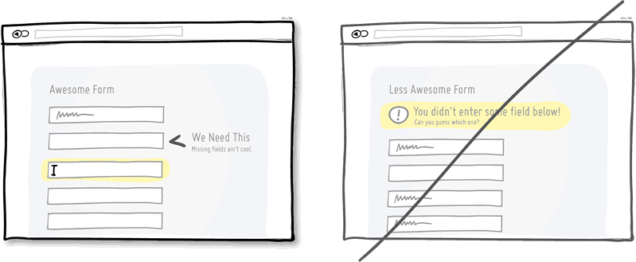
Ideas to increase sessions and increase GCR(Goal Conversion Rate)
Make purchasing easier on customers.
Bigger call to action buttons(submit, checkout, etc).
Remove excess forms – Coupon field
Inline Validation for forms
Forgiving inputs instead of being strict with data
Making customers enter dashes in phone numbers
Addresses only being entered a specific way

Slide 11
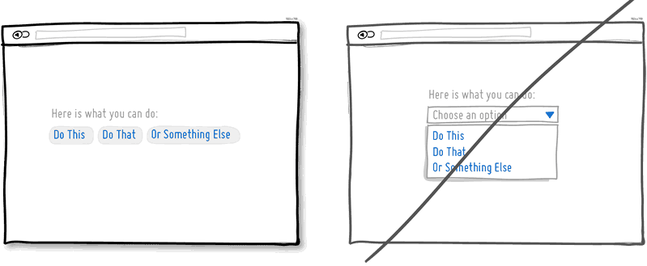
Ideas to increase sessions and increase GCR(Goal Conversion Rate)
Exposing Options instead of hiding them.
Each pull down menu that you use, hides a set of actions within which require effort to be discovered. If those hidden options are central along the path to getting things done by your visitors, then you might wish to consider surfacing them a bit more up front.

Slide 12
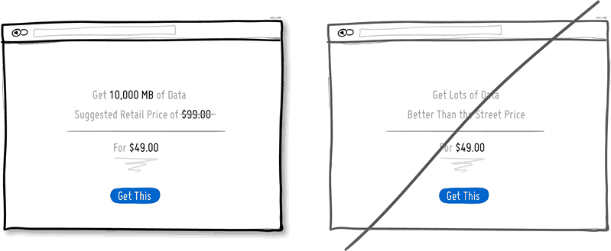
Ideas to increase sessions and increase GCR(Goal Conversion Rate)
Anchoring instead of starting with the price
It suggests that our decision making is affected by the first quantities which come to our attention. When we start with a larger number and roll down towards a smaller price, all of a sudden that price doesn't feel as large any longer.

Slide 13
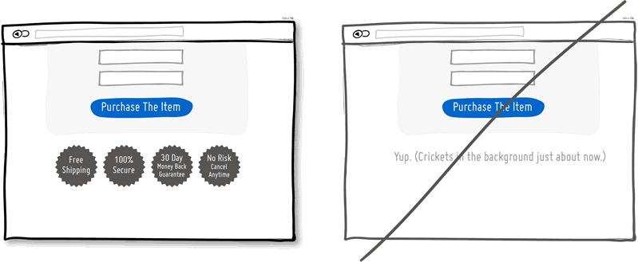
Ideas to increase sessions and increase GCR(Goal Conversion Rate)
Reassurances instead of assuming all is fine.
When you’re closing a sale, drop some reassurances. Throw in a guarantee, tell your customers that they will be satisfied, tell them that the payment is secure, that yes shipping is free, and yes that they can pull out at anytime without any risk. All is good and all will be fine. Don't worry, be happy. Putting a positive spin on a close is definitely worth a try as a conversion tactic.

Slide 14
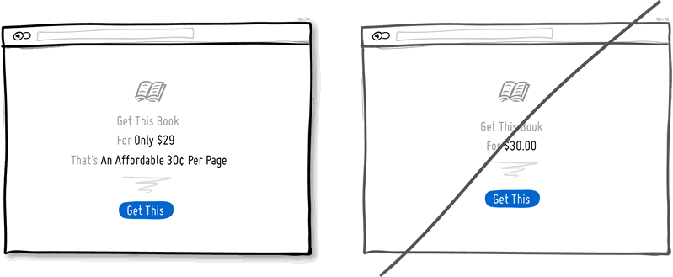
Ideas to increase sessions and increase GCR(Goal Conversion Rate)
You can let people judge the value of your product completely on their own, or you can help to do it for them. If you decide to make use of human irrationality, you can show the price in a way so that your offering becomes perceived as more valuable.
In the simplest way you can start off with framing words such as "only", "affordable", or "small fee of" alongside of the price.
The price then can also be broken down into a per unit price (ex: 30¢ per page rather than $30 for a book, or $1 per day instead of $30 per month for a membership).
Finally, prices can be shown with fewer digits ($30, instead of $30.00) for an additional effect of illusion.

Slide 15
Ideas to increase sessions and increase GCR(Goal Conversion Rate)
Price Illusions instead of just plain price
You can let people judge the value of your product completely on their own, or you can help to do it for them. If you decide to make use of human irrationality, you can show the price in a way so that your offering becomes perceived as more valuable.
In the simplest way you can start off with framing words such as "only", "affordable", or "small fee of" alongside of the price.
The price then can also be broken down into a per unit price (ex: 30¢ per page rather than $30 for a book, or $1 per day instead of $30 per month for a membership).
Finally, prices can be shown with fewer digits ($30, instead of $30.00) for an additional effect of illusion.

Slide 16
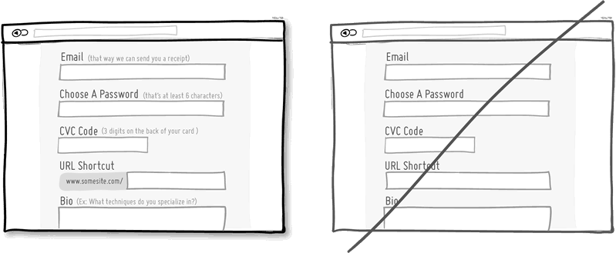
Ideas to increase sessions and increase GCR(Goal Conversion Rate)
Explaining instead of assuming the obvious
Some things which may seem obvious to us, might be less so to others. Form fields are probably the classic example of this with their open ended nature. That’s where explanations, descriptions, and hints come in.

Slide 17
Ideas to increase sessions and increase GCR(Goal Conversion Rate)
Explaining instead of assuming the obvious
Some things which may seem obvious to us, might be less so to others. Form fields are probably the classic example of this with their open ended nature. That’s where explanations, descriptions, and hints come in.

Slide 18
Improve SEO
Make adds more relevant/specific. Keywords should be used in body copy of page the add is linked to.
Add Rich-snippets through out the web-site. Gives Google more info to give to customers when searching.
Make pages load quicker. Optimize images, code, order of loading scripts.
Add more relevant information on site. Provide more info that is valuable to our customers.

Slide 19
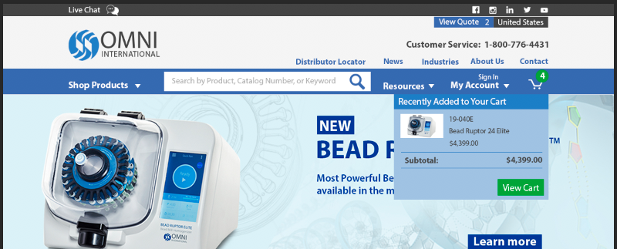
Header Redesign
Separate links that are most important and get the most clicks.
Make search bar larger – Ecommerce conversion rate is much higher
when customers use search bar. 0.22% without | 4.62% with
Drop down module to show what is currently in shopping cart.
When a product is added to cart the dropdown will appear instead of
taking you straight to the shopping cart.
Make our contact number more prominent as well as social media icons

Slide 20
The default channels are:
Direct:
In general, indicates visits where users navigated directly to the URL or the source of the visit is unknown
Determined by a source of direct and medium of (not set) or (none)
Organic Search:
Indicates visits from organic (unpaid) search results
Determined by medium of organic
Social:
Indicates visits from social networks (Facebook, Twitter, etc.)
Determined when Social Source Referral matches “yes;” Google Analytics also places these in the referral “bucket” matching a list of known social sources or when medium matches social, social-network, social-media, sm, social network, or social media
Email:
Indicates traffic from links clicked in email messages, whether mass email marketing or individual messages
Determined by medium of email
Referral:
Indicates traffic where users clicked a link from another site, excluding major search engines
Determined by medium of referral
Paid Search:
Determined by medium of cpc, ppc, or paid-search; also, excludes traffic in “Content” bucket of ad networks
Separates into two separate channels now
Brand paid Search – any paid traffic that used a branded keyword or term
Generic paid Search – any paid traffic that does not use a branded keyword or term
Display:
Indicates traffic from display advertising, such as Google AdWords remarketing campaigns
Determined by medium of display, cpm, or banner, or in “Content” bucket of ad networks (indicating Google Display Network)

