Slide 1

Sorting
Tutorial 9, COMP2521
Dylan Blecher

Slide 2
You have 5 seconds to sort these numbers…

Slide 3
GO!
40 2 7 16 3 5

Slide 4
Algo?
Time complexity?

Slide 5
Sorting Visualiser
https://visualgo.net/en/sorting
Merge sort: https://www.youtube.com/watch?v=4VqmGXwpLqc
Shell sort: https://www.youtube.com/watch?v=ddeLSDsYVp8&t=13s

Slide 6
Awesome Summary
https://www.bigocheatsheet.com/

Slide 7
Hello And Welcome To Your COMP2521 Exam…

Slide 8
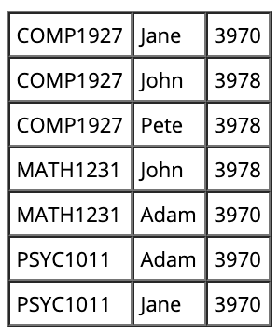
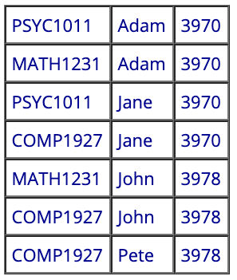
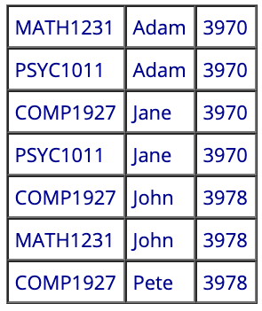
Q1: This table was sorted by name, resulting in this output. Was the sorting algorithm stable?

Slide 9
Q2: How bout now?

