Slide 1
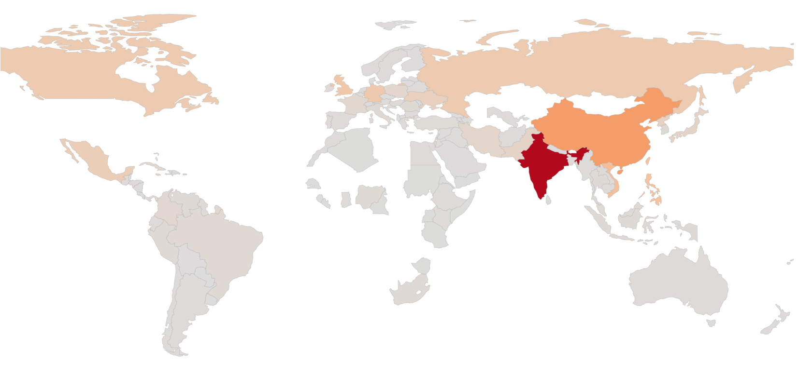
Is On-line Knowledge Transfer a Key Indicator for Migration of Professionals?
On-line Knowledge Transfer as an Indicator for Migration of Professionals
Background
Computer Science experts acquired a significant fraction of the knowledge they have by means of on-line discussion and research.
People who know of CS migrate and work in other countries. We show that together and see what happens.

