Slide 1

Wine reviews + Weather data
What is the best wine

Slide 2
Introduction
The source dataset is from: https://www.kaggle.com/datasets/zynicide/wine-reviews.
The data was scraped from the website WineEnthusiast on November 22nd, 2017.
Editors of the website write wine reviews and distribute points.
The dataset has 130.000 observations and 14 columns.
With further text processing, we were able to get even more features out of the dataset
In addition, we use the “Open Weather Map” API to retrieve the geo location and weather data of the wine's region.
We use python and a student subscription of open weather map for this.
What we want to achieve:
Classification of varieties based on the description of flavors.
Classification of reviewer points based on useful features (probably price, age, weather data).
Our repository: https://github.com/Alex020250/AppliedDataScience

Slide 3
Literature
Based on literature, “air temperature is considered the most important factor in the overall growth and productivity of winegrapes”.¹
Warmer climates result in more alcoholic, full-bodied wines with higher sugar levels, darker color and easier ripening.²
Cool climates (less than 15 ℃) results in crisp, higher-acidity, fresher-flavoured wine with lighter body, low sugar level but difficult ripening.³
In general, wine production in times of climate change is a big issue for wine makers.
At least for European wines this website describes each grape in much detail: https://www.deutscheweine.de/wissen/rebsorten/
¹ Jones, G. V., and F. Alves. 2012. Impact of climate change on wine production: a global overview and regional assessment in the Douro Valley of Portugal.
² Greg Spellman, Wine, weather and climate, University College Northampton, p. 230
³ Greg Spellman, Wine, weather and climate, University College Northampton, p. 230

Slide 4
Preprocessing
Wine data
The original dataset contains a ‘title’ column from which we derived additional attributes
With a regular expression we extracted: Variety, winery, producer and bottling date.
76% of the observations contain one of 11 twitter handles of the user that wrote the wine review
We got the number of followers for those 11 twitter users from Twitter API.
One interesting field is the ‘description’ field where the reviewer wrote a statement about the wine
Using the Rapid Miner plugin “Text Processing” we found out relevant words and use them for classification.
Weather data
We were able to geocode all 130.000 observations based on country and region and got a result for 68%.
For these regions we are able to get 7.000 weather datasets per day from the last year (2022).
Getting data of the wine’s bottling year would require a costly subscription.
We get temperature data for the relevant wine months and take min, max and average values.
April – October on the northern hemisphere and October – April on the southern one based on this literature¹.
In addition, we also get humidity and wind
¹ https://onlinelibrary.wiley.com/doi/10.1002/fes3.14

Slide 5
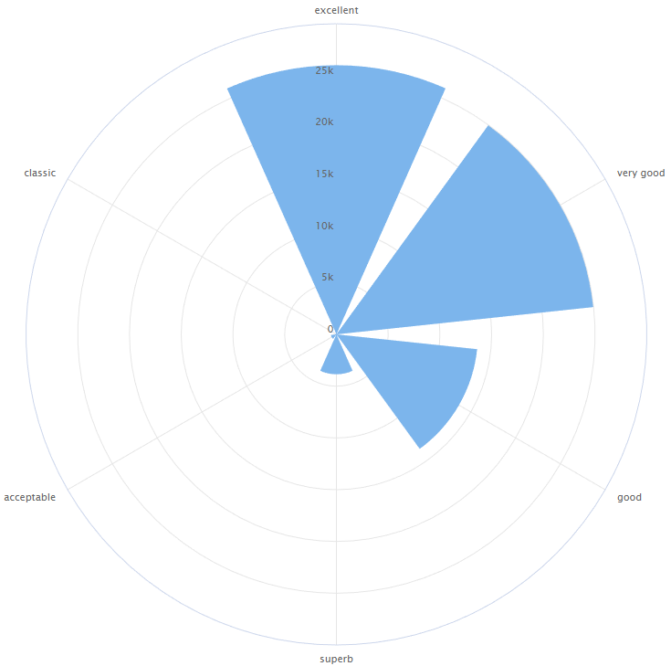
About the wine dataset
The points in the dataset are rated like this:
80 - 82 (acceptable)
83 - 86 (good)
87 - 89 (very good)
90 - 93 (excellent)
94 - 97 (superb)
98 - 100 (classic)

Slide 6
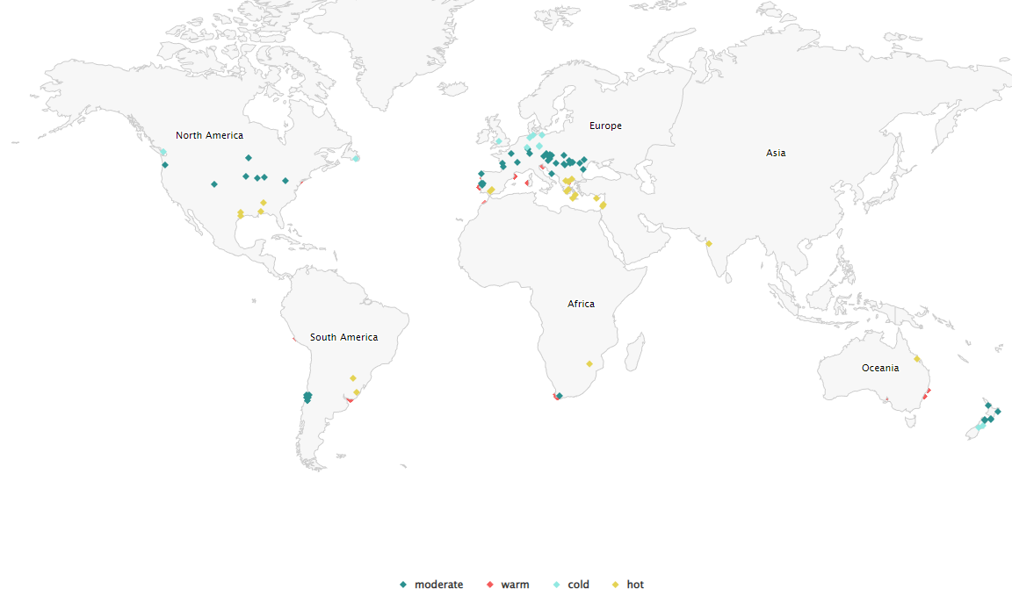
Distribution of wine regions

Slide 7
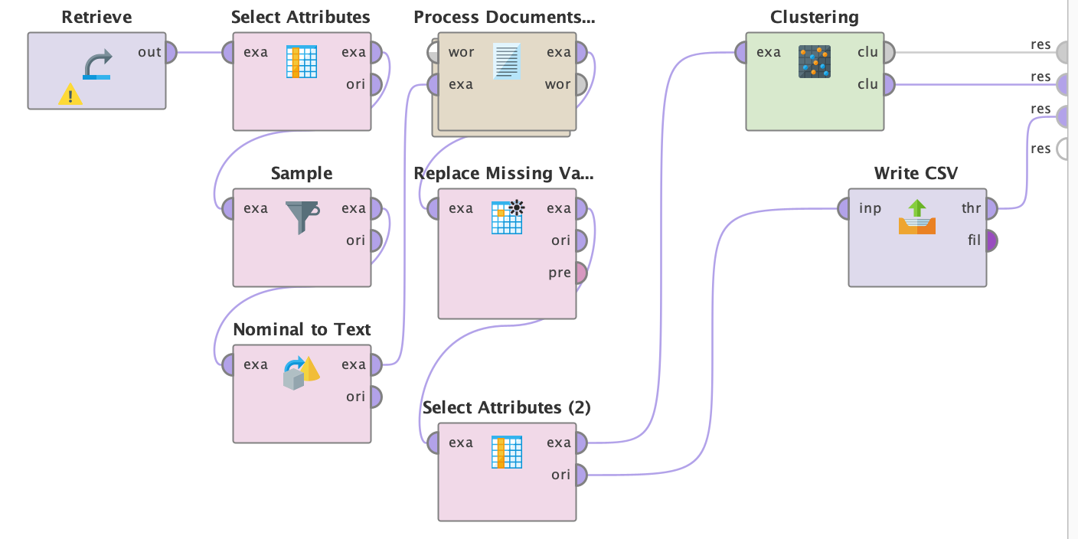
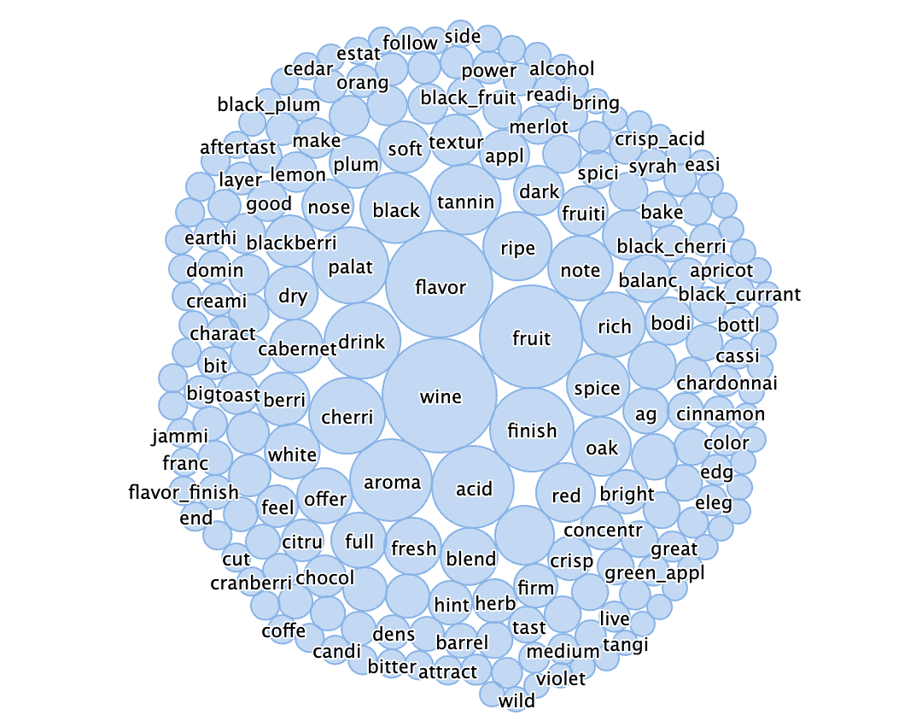
Classification of Variety
Term Document Matrix (TDM)
identification of words and word pairs by count
Problem: Filter of specific words without describing benefit for variety is needed (eg. Words like wine, aroma)
Solution: Identification of correlation between "variety" and "description" field

Slide 8
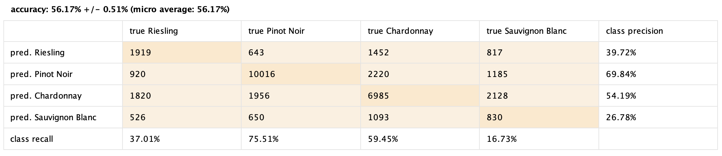
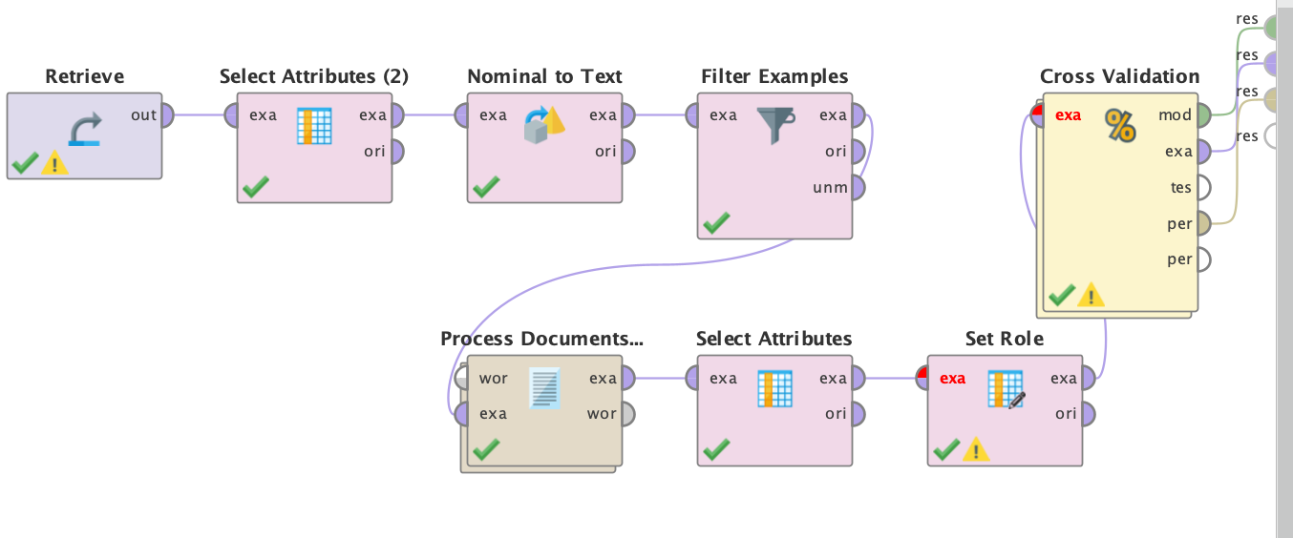
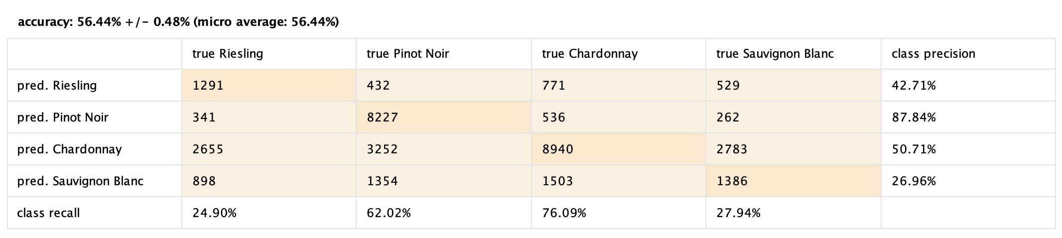
Classification "variety" by k-NN
drilldown for limited amount of varieties
by k-NN with five folds accuracy of 56%
Improvements:
Identification of relevant words to describe variety
Check for optimal amount of folds
Check accuracy with Naive Bayes

Slide 9
Further methods based on TDM
Classification
Support Vector Machines: Linear or non-linear classifier that finds the best boundary between "varieties"
Decision Trees: Split "varieties" into smaller subsets based on the most relevant describing words
Clustering
K-means to partition the data into clusters of "wine category" (white wine / red wine)
Hierachical clustering (agglomorative) - aggregate "varieties" into "wine category"
-> Problem: No label for "wine category"

Slide 10
Further methods
Recommendation Engine
User Rating Prediction
Item Recommendation
Hierarchical Classification
Wine taste and Temperature Cateories (Moderate, Warm, usw.)
Random Forest
Weather factors (temp, humidity, wind) and Rating

Slide 11
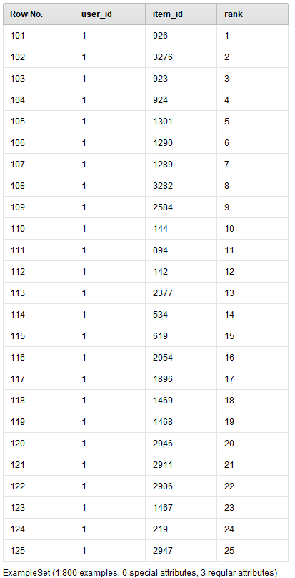
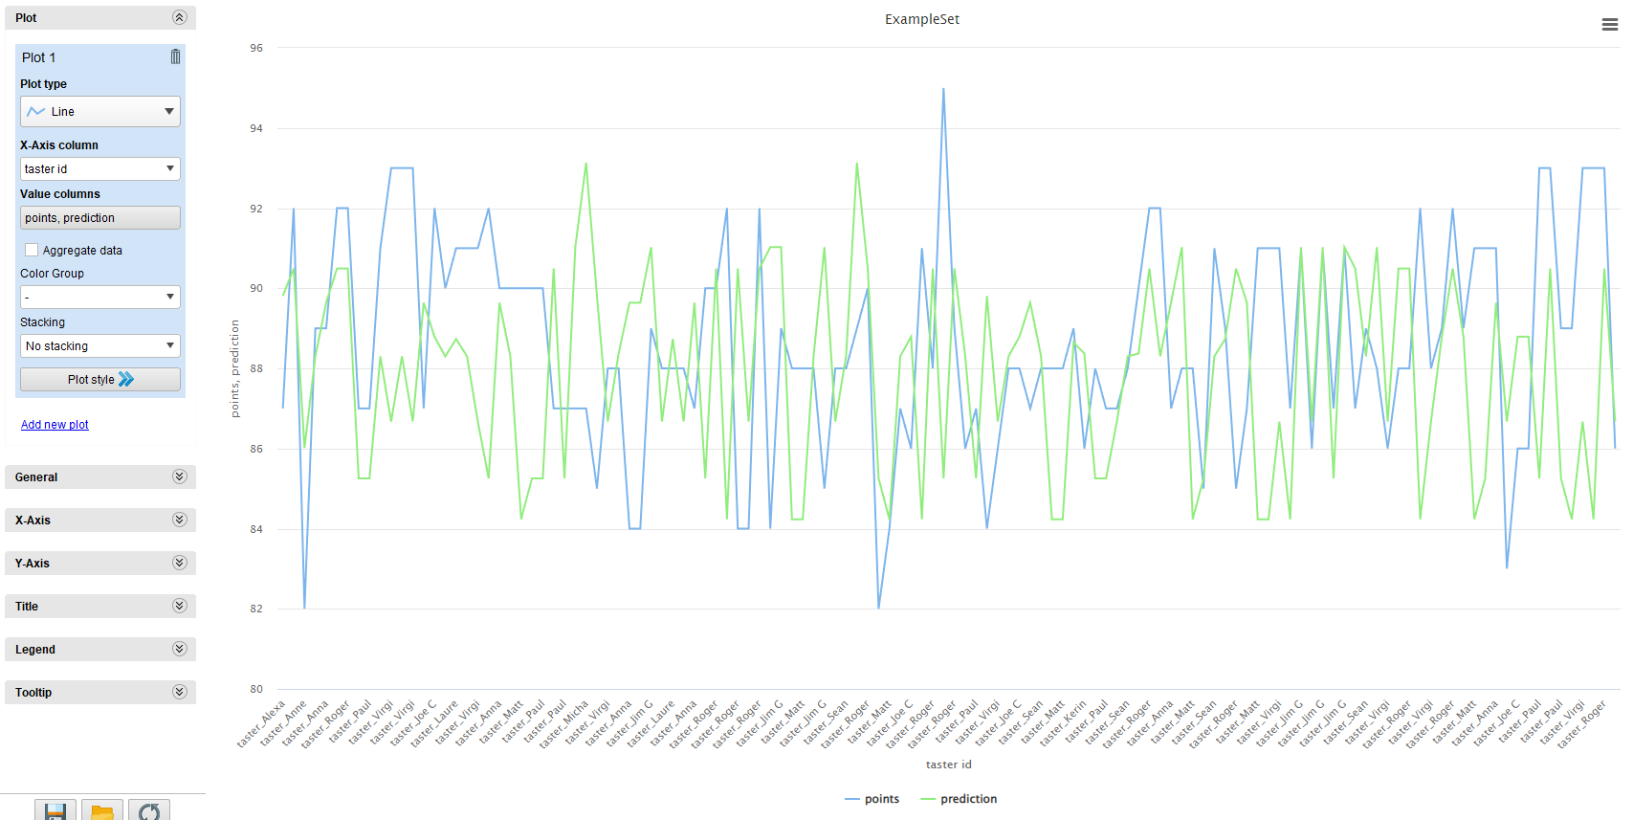
Recommendation Engine
User Rating Prediction
Item Recommendation
Goal: Finding patterns in consumer reviews and predicting their rating
Main attributes: Points and Predicted points of users
Goal: Recognizing the user's preference and providing appropriate recommendations.
Content-based filtering
To give proper recommendations, we need profile of the customers' preference and item description (wine)

Slide 12
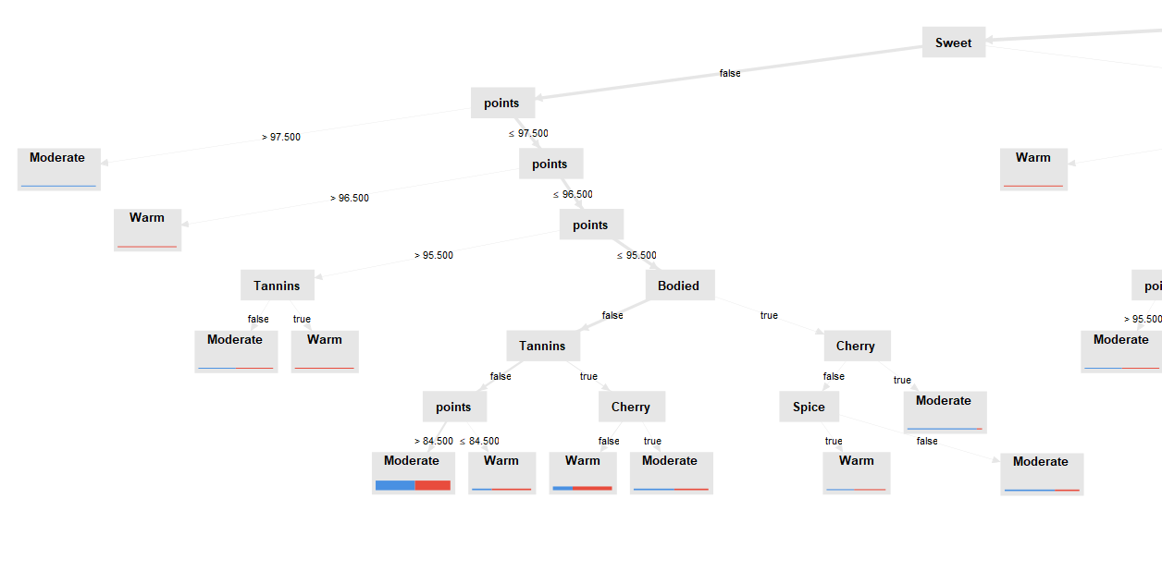
Hierarchical Classification
Goal: What are the characteristics of wine taste depending on climatic factors?
We can classify the taste of wine according to a specific weather category.
Selected Attributes: Wine taste (Acidity, Sweet, Dry etc.) and weather category (Moderate, Warm, etc.)

Slide 13
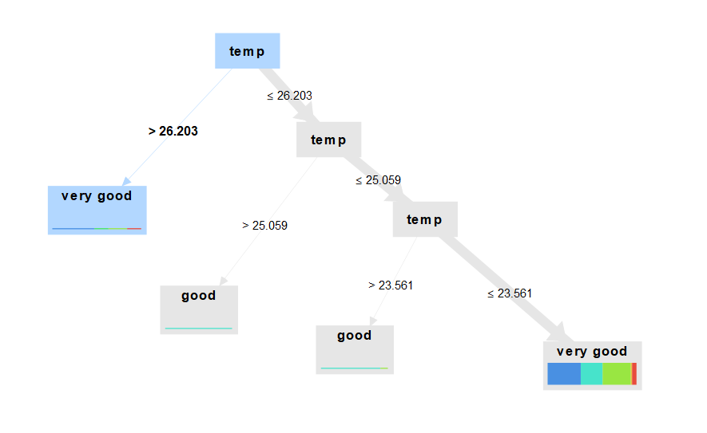
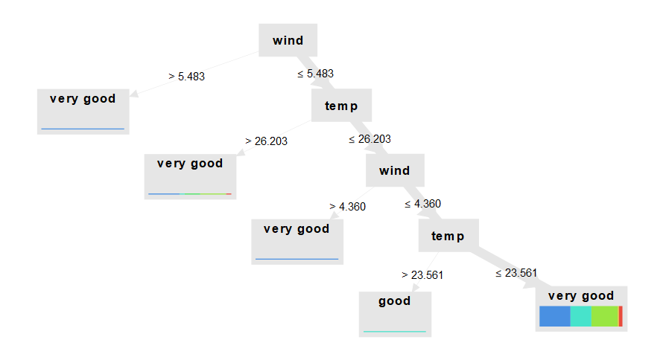
Random Forest (Decision Tree)
Goal: Wines (or Varieties) from which climate factors are rated better?
Selected Attributes: Temperature, Humidity, Wind and Rating (Classic, Very good, good, etc.), Variety

