Slide 1
ROS Introduction

Slide 2
Outline
What is ROS?
ROS Architecture
ROS Visualization
ROSbag

Slide 3

What is ROS?
An open source meta-operating system.
Implementation of commonly-used functionality.
Efficiently messages exchange and save between different processes and devices.

Slide 4
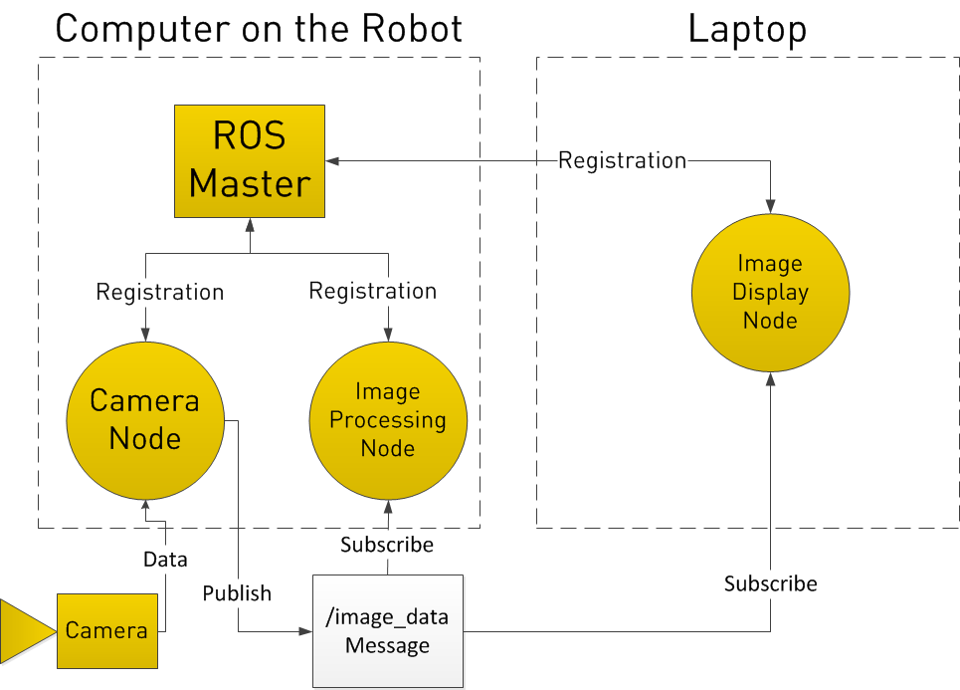
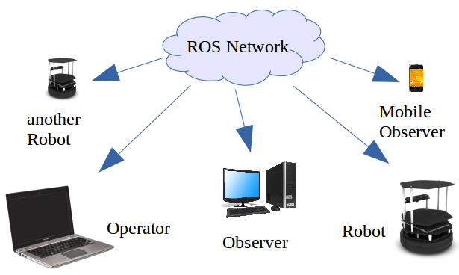
ROS Architecture

Slide 5
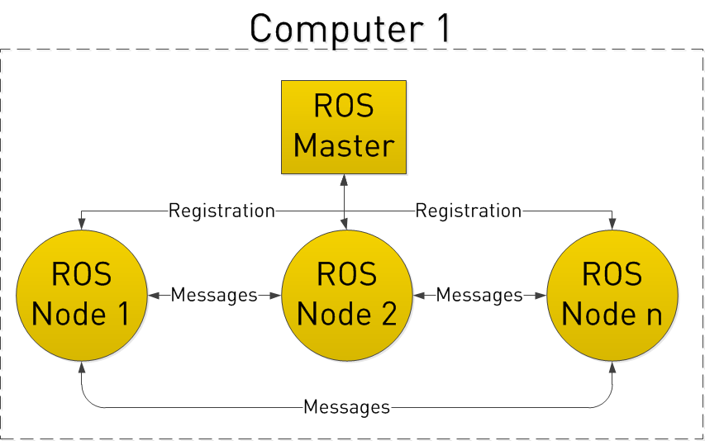
ROS Master
Provides naming and registration services to the rest of the nodes
Help nodes establishes TCP/IP connection

Slide 6
ROS Node
Nodes are wrote by C++, python or others
Nodes can publishes and subscribes topics
Launch files can remap topics and setup
parameters for nodes

Slide 7
ROS Message and Topic
Messages
Describe the data which nodes exchange
Data type can be Image, Pointcloud
and User defined
Topics
Buses which nodes exchange messages
Nodes publish and subscribe topic to
exchange messages

Slide 8
ROS Publisher and Subscriber
Publisher
publish topics to share messages
ros::Publisher pub = n.advertise<datatype>(topic_name, buffer);
Subscriber
subscribe topics to obtain messages
ros::Subscriber sub = n.subscribe(topic_name, buffer, Callback_function);
// Build the Callback_function to process messages
reference: http://wiki.ros.org/ROS/Tutorials/WritingPublisherSubscriber%28c%2B%2B%29

Slide 9
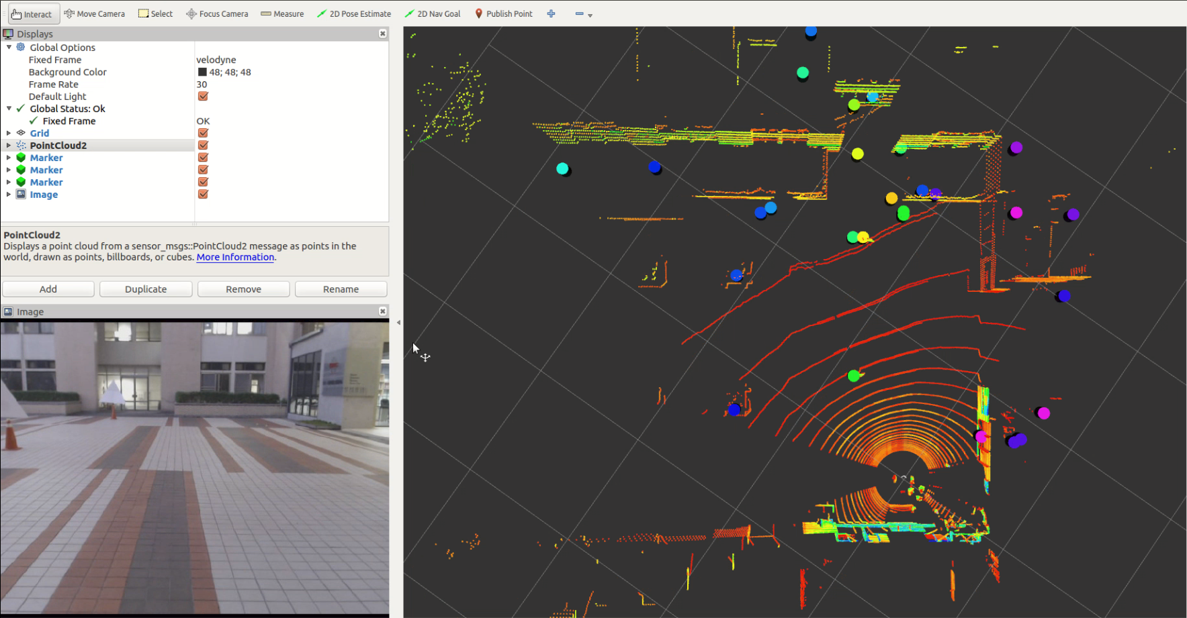
ROS Visualization (rviz)
RVIZ is a subscriber and visualize topic like pointcloud, image and transform.

Slide 10

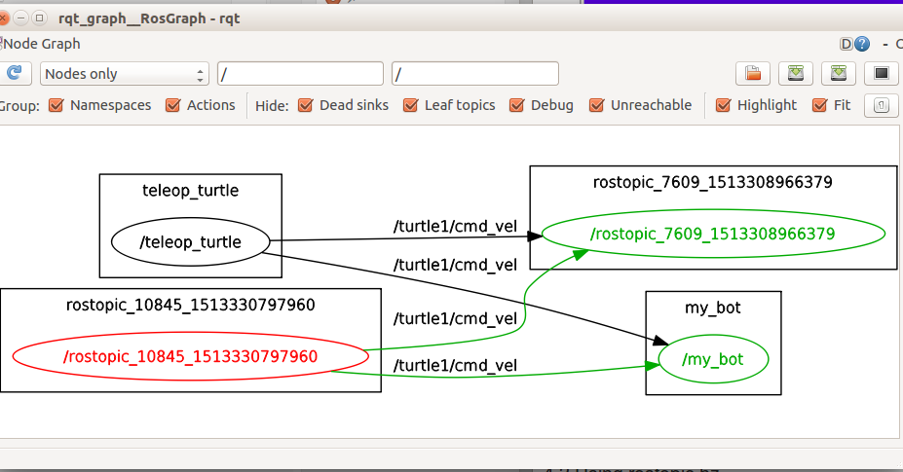
rosbag
rosbag is a set of tools for recording from and playing back to ROS topics.
rosbag

Slide 11
rosbag
rosbag record: Record a bag file
rosbag info: Summarize the contents of a bag file
rosbag play: Play back the contents of bag files.
……
reference: http://wiki.ros.org/rosbag/Commandline

Slide 12
rosbag record
rosbag record <topic1> <topic2>… Record <topic1> <topic2>…
rosbag record -a Record all topics.
rosbag record -o <NAME> <topic> Prepend <NAME> to beginning of bag name
rosbag record --split --size=1024 <topic> Split the bag when maximum size is reached

Slide 13
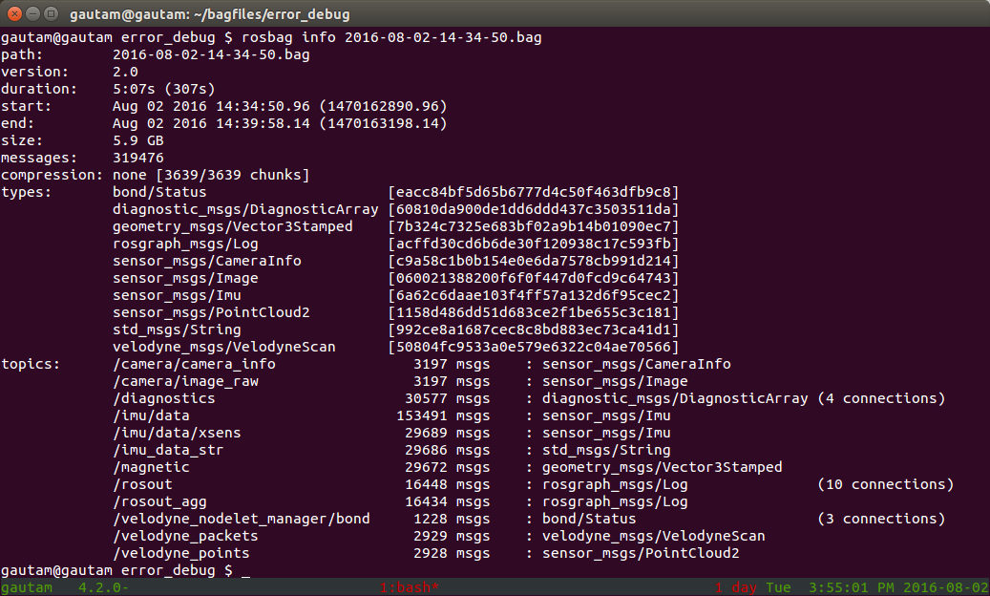
rosbag info

Slide 14
rosbag play
rosbag play <bag1> <bag2>… Play back the contents of <bag1> <bag2>…
rosbag play --pause <bag> Start in paused mode
rosbag play -l <bag> Loop playback
rosbag play --clock <bag> Publish the clock time
rosbag play *.bag Play back all bags in current directory

