Slide 1


Pancreatic Cancer
Stage Prediction
Using Machine Learning
Student:
Nischal Khanal
Student ID:
250969098
Module:
CET140 – Specialist Project
University:
University of Sunderland (ISMT College)
Lecturer:
Dr. Sam Danso
Date:
June 2026
Notes:
Good morning everyone. My name is Nischal Khanal, student number 250969098. This presentation is for CET140 Specialist Project, supervised by Dr. Sam Danso. Today I will be presenting my machine learning project on predicting the stage of pancreatic cancer using a dataset of 50,000 patient records. I will walk you through the full pipeline — from data exploration and preprocessing, through to model training, evaluation, and my final recommendation to TechHealthCare Solutions Ltd.

Slide 2
PRESENTATION OVERVIEW
What This Presentation Covers
01
Introduction
06
ML Models
Background on pancreatic cancer & ML in healthcare
Logistic Regression, Decision Tree, Random Forest
02
Project Objectives
07
Evaluation
What this project set out to achieve
Accuracy, F1, AUC-ROC, Confusion Matrix
03
Dataset
08
Results
50,000-record Kaggle dataset overview
Best model & key findings
04
Data Preprocessing
09
SEPLi
Cleaning, encoding, scaling, splitting
Social, Ethical, Legal & Professional considerations
05
EDA
10
Conclusion
Distributions, correlation, class balance
Summary, lessons learned, future scope
Notes:
Here is the roadmap for today's presentation. I'll start with some background on pancreatic cancer, then explain the project aims and dataset. After that I'll cover how I preprocessed the data, performed exploratory analysis, and trained three different machine learning models. I'll then evaluate their performance, share the results, and discuss some social, ethical, legal and professional issues before concluding.

Slide 3
INTRODUCTION
Why Pancreatic Cancer?
5%
Low Survival Rate
Only 5% of patients survive five years primarily because the disease is rarely detected at an early stage.
Five-Year
Survival Rate
Late-Stage Diagnosis
(Veeramani et al., 2020)
Symptoms like jaundice, back pain and weight loss appear late, by which time the cancer has often spread.
Diagnostic Challenge
Diagnosis requires expensive imaging (MRI/CT), which is inaccessible in many healthcare settings (Appelbaum et al., 2021).
Role of Machine Learning
ML models can analyse patient risk factors age, lifestyle, symptoms to flag high-risk patients for earlier investigation (Muhammad et al., 2019).
Sources: Veeramani et al. (2020); Muhammad et al. (2019); Appelbaum et al. (2021)
Notes:
Pancreatic cancer is one of the most lethal cancers — the five-year survival rate is just five percent, as reported by Veeramani and colleagues. The main reason for this is late detection. Symptoms only become obvious when the cancer is already at an advanced stage, and specialist diagnostic scans are expensive and not always available. This is where machine learning can help — by identifying high-risk patients early using basic patient data, so they can be referred for further tests before the disease progresses.

Slide 4






PROJECT OBJECTIVES
What This Project Aimed to Achieve
Review Existing Research
Source a Suitable Dataset
Review published ML approaches to pancreatic cancer prediction and identify gaps (CRISP-DM: Business Understanding).
Find and load an open, noagreement dataset of patient demographics, risk factors, symptoms and outcomes from Kaggle.
Clean & Prepare the Data
Build ML Classification Models
Handle missing values, encode categorical variables, scale features, and split into training and test sets.
Train and compare Logistic Regression, Decision Tree and Random Forest classifiers in Python (scikit-learn).
Evaluate Model Performance
Present Results to Management
Assess each model using Accuracy, Precision, Recall, F1 Score and ROC-AUC via 10 fold cross validation.
Summarise findings and make a clear recommendation to TechHealthCare Solutions Ltd on viability of investment.
Aligned with CRISP-DM methodology (Data Science PM, 2021)
Notes:
The project had six main objectives, all aligned with the CRISP-DM data science framework. First I reviewed existing research to understand what has already been tried. Then I sourced an openly available Kaggle dataset. After cleaning and preparing the data, I built three classification models in Python. I evaluated each model using five standard metrics, and finally I prepared this presentation to communicate the results to management — which maps directly to the Deployment phase of CRISP-DM.

Slide 5
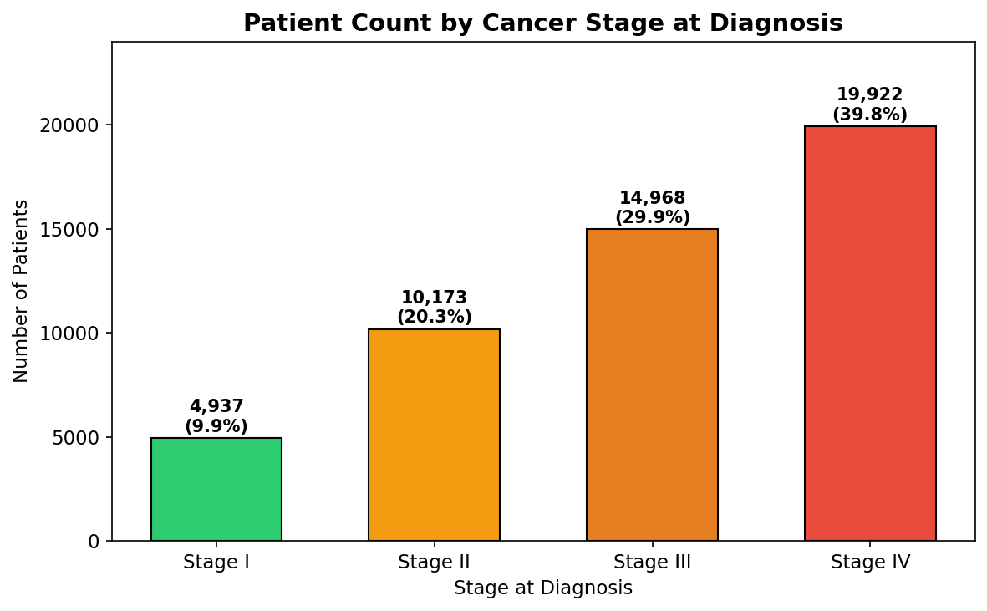
DATASET OVERVIEW
Panday, A. (2024) Pancreatic Cancer Prediction Dataset Kaggle
50,000
24
20
0
Patient Records
Total Columns
Input Features
Missing Values
Key Variables in the Dataset
Target Class Distribution
Feature | Type | Description
Age | Numeric | Patient age (years)
Gender | Categorical | Male / Female
Smoking History | Binary | 1 = smoker, 0 = non-smoker
Diabetes | Binary | Presence of diabetes
Chronic Pancreatitis | Binary | History of chronic pancreatitis
Jaundice | Binary | Symptom indicator
Weight Loss | Binary | Symptom indicator
Survival Time Months | Numeric | Months survived post-diagnosis
Stage at Diagnosis | Target | Stage I / II / III / IV
Source: Panday, A. (2024) Kaggle: kaggle.com/datasets/ankushpanday1/pancreatic-cancer-prediction-dataset
Notes:
The dataset I used was sourced from Kaggle — a publicly available synthetic dataset of 50,000 patient records with 24 columns. There were no missing values, which meant no imputation was needed. The target variable is Stage at Diagnosis, with four classes: Stage I through to Stage IV. As you can see in the chart, the dataset is imbalanced — Stage IV has the most records at around 20,000, while Stage I has the fewest at around 5,000. I kept 20 features as model inputs after dropping three non-predictive columns.

Slide 6
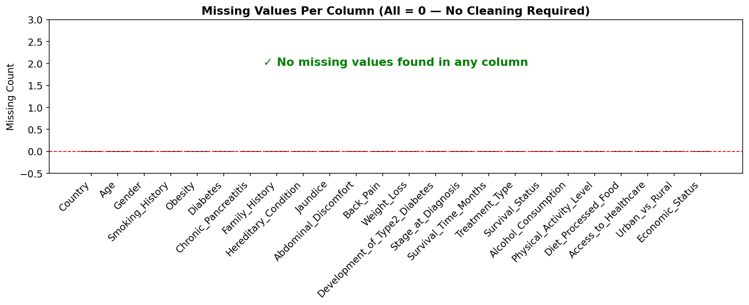
DATA PREPROCESSING
CRISP-DM Phase: Data Preparation
1
2
3
4
5
Drop
Columns
Check
Missing
Encode
Categoricals
Scale
Features
Train/Test
Split
→
→
→
→
Country, Treatment_Type,
Survival_Status removed
(leakage / non-clinical)
0 missing values found
across all 24 columns.
No imputation needed.
LabelEncoder on 6 cols:
Gender, Activity, Diet,
Healthcare access, etc.
StandardScaler applied
to all 20 features.
Mean=0, Std=1.
80% training (40,000)
20% test (10,000)
Stratified split.
Missing Values Check (from notebook)
Target Label Encoding
Stage | Encoded
Stage I | 0
Stage II | 1
Stage III | 2
Stage IV | 3
Notes:
Data preparation followed five steps. First I dropped three columns that either caused data leakage or were not clinically relevant as predictors. The missing values check — as shown in the chart — confirmed zero missing values, so no imputation was needed. Next, I applied LabelEncoder to six categorical columns. Then StandardScaler was applied to all 20 features, which is particularly important for Logistic Regression. Finally, I split the data 80-20 using a stratified split to preserve class proportions.

Slide 7
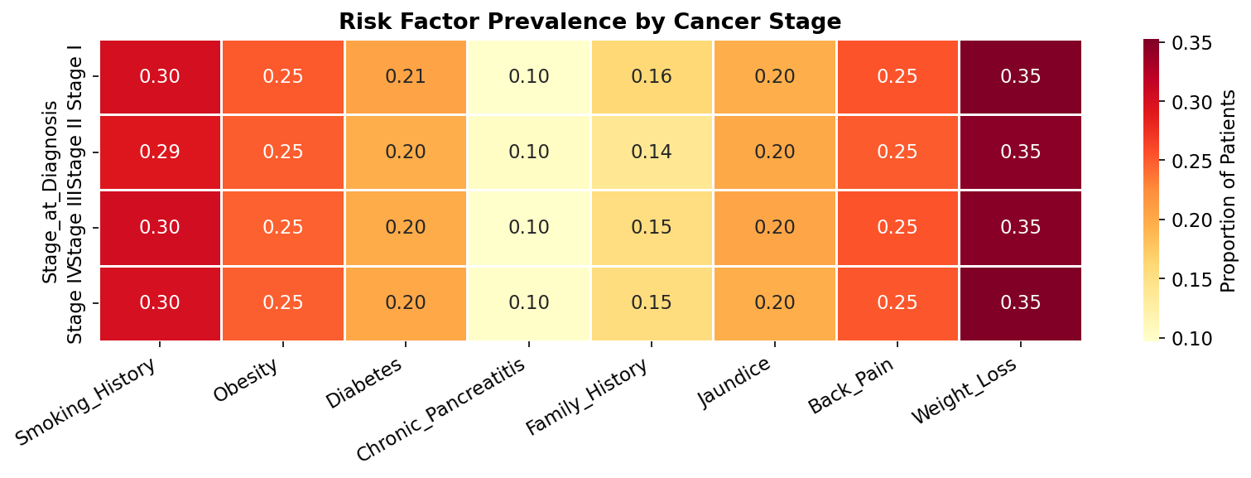
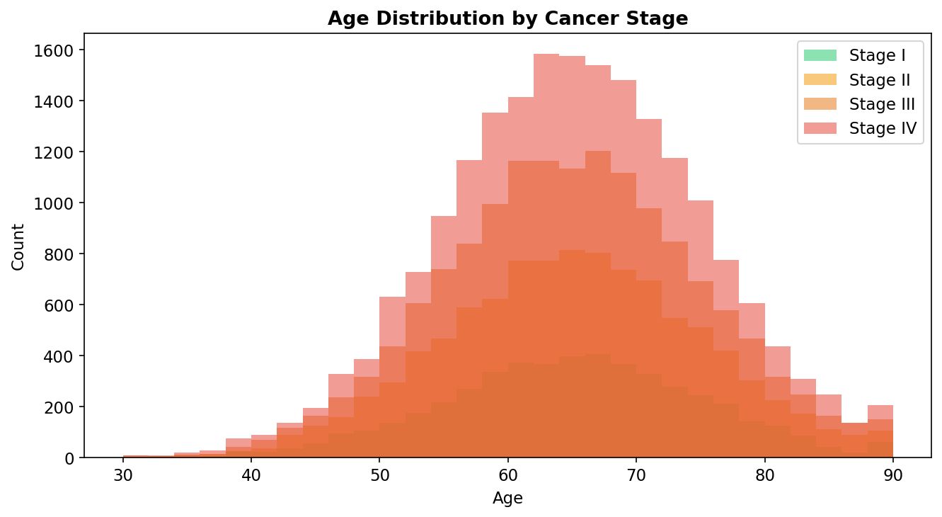
EXPLORATORY DATA ANALYSIS (EDA)
Understanding the Data Before Modelling
Risk Factor Prevalence by Stage
Age Distribution by Stage
Key Observations
Jaundice, Weight Loss and Back Pain show slightly higher prevalence at later stages consistent with clinical knowledge (Veeramani et al., 2020).
Age distributions are very similar across all four stages, suggesting age alone is a weak predictor reinforcing the need for multi-feature ML models.
The dataset is imbalanced (Stage IV = 39.8%, Stage I = 9.9%), so class_weight='balanced' was applied during modelling to avoid bias.
Notes:
The exploratory analysis gave me some useful insights. The risk factor heatmap shows that symptoms like jaundice and weight loss are slightly more common at later stages, which makes clinical sense. However, the age histograms show that age is broadly similar across all four stages — meaning it is not a strong standalone predictor. I also noticed the dataset is imbalanced, with nearly 40% of records being Stage IV. To address this, I applied class_weight='balanced' when training each model.

Slide 8
MACHINE LEARNING MODELS
Three Classifiers — Selected to Cover a Range of Complexity
01. Logistic Regression
02. Decision Tree
03. Random Forest
Parameters
Parameters
Parameters
max_iter = 2000
max_depth = 10
n_estimators = 100
class_weight = balanced
min_samples_split = 20
max_depth = 15
solver = lbfgs
class_weight = balanced
class_weight = balanced
Why chosen
Why chosen
Why chosen
Simple, fast and highly interpretable baseline model. Good starting point to check whether a linear decision boundary is sufficient for this problem.
Rule based model that produces a visual tree structure easy to explain to non-technical stakeholders such as TechHealthCare management.
Ensemble of 100 decision trees. Typically the strongest performer because it reduces variance by averaging across many trees.
Advantages
Advantages
Advantages
✓ Interpretable coefficients
✓ Human-readable rules
✓ High accuracy
✓ Fast to train
✓ Non-linear boundaries
✓ Handles imbalance well
✓ Low risk of overfitting
✓ No scaling needed
✓ Provides feature importance
(Muhammad et al., 2019; Appelbaum et al., 2021; Placido et al., 2023)
Notes:
I trained three classification models, which cover a spectrum from simple to complex. Logistic Regression was used as an interpretable baseline to check whether the problem can be solved with a linear model. The Decision Tree adds non-linear boundaries and produces readable rules — useful for explaining decisions to management. Random Forest is an ensemble of 100 decision trees and is typically the strongest performer. All three used class_weight='balanced' to handle the class imbalance identified in EDA.

Slide 9
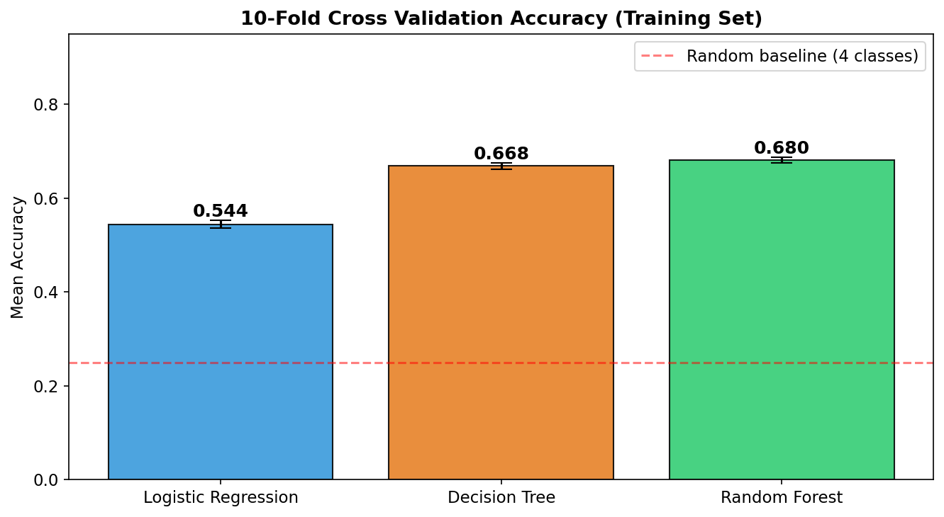
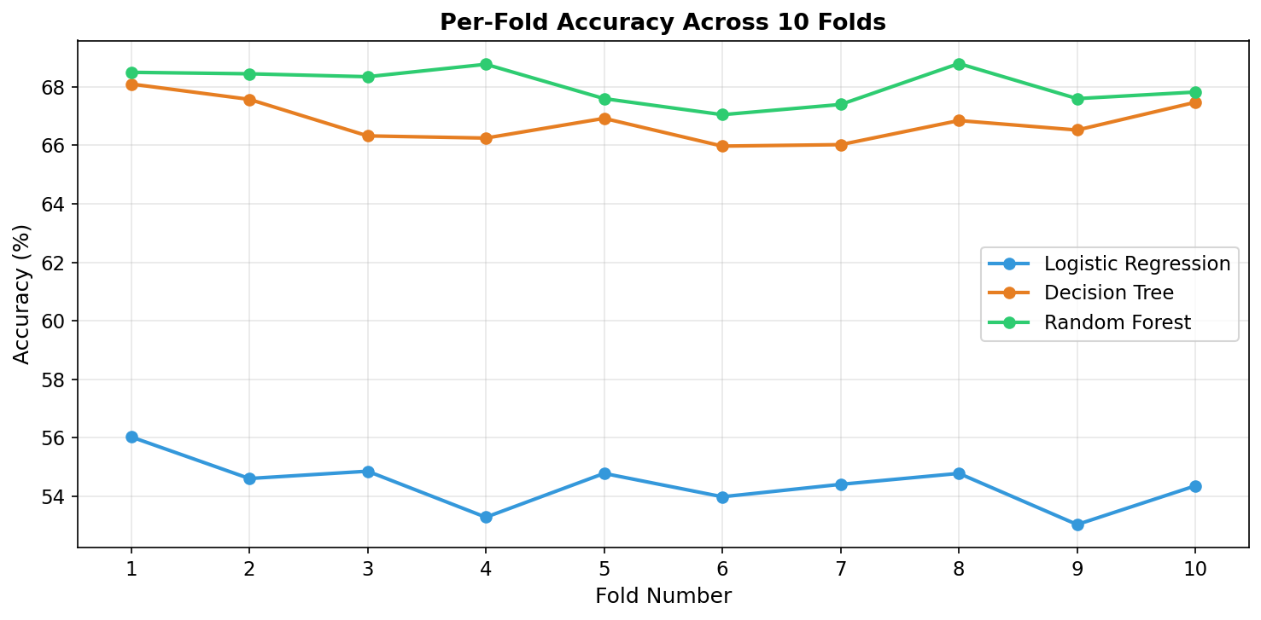
MODEL TRAINING & VALIDATION
10-Fold Stratified Cross-Validation on Training Set
50,000
Row Dataset
80% Train
40,000 rows
10-Fold
Stratified CV
Model
Training
20% Test
10,000 rows
Final
Evaluation
→
→
→
→
→
Cross-Validation Accuracy (Training Set)
Per-Fold Accuracy Across 10 Folds
Cross-Validation Summary: StratifiedKFold(n_splits=10, shuffle=True, random_state=42) was applied on the training set. Each fold preserves the original class proportions. Random Forest showed the most stable accuracy across folds.
Notes:
The training pipeline works as follows. The full 50,000-row dataset was split 80-20, giving 40,000 training rows and 10,000 test rows. On the training set, I applied 10-fold stratified cross-validation to estimate how well each model would generalise. The per-fold line chart on the right shows that all three models are consistent across folds — there are no major spikes or drops — which gives confidence that the results are not due to lucky splits. Random Forest consistently leads in both charts.

Slide 10
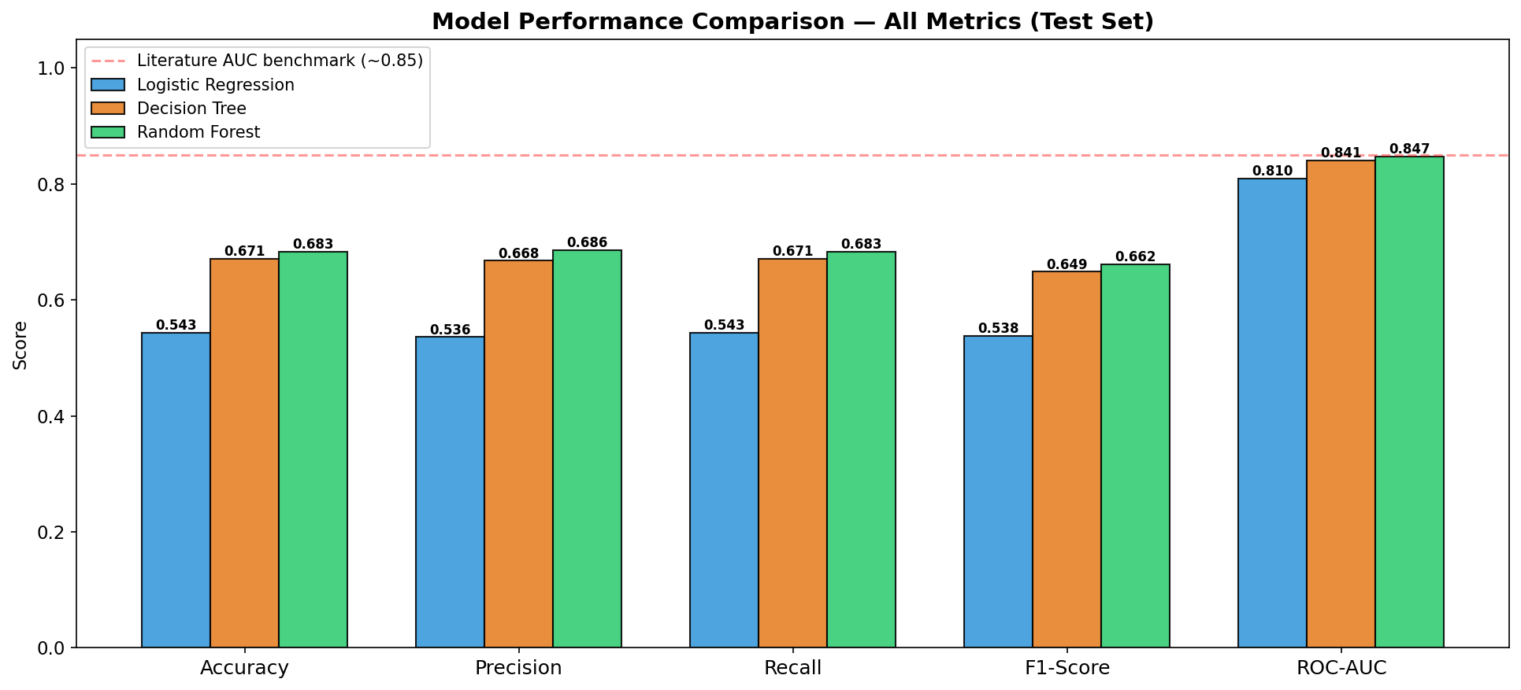
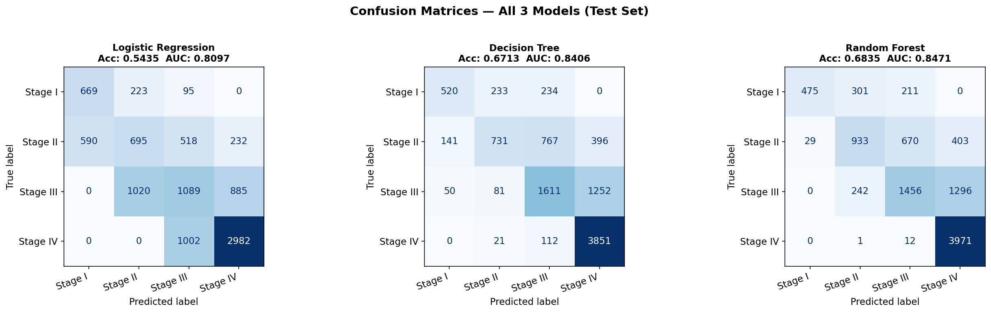
MODEL EVALUATION - TEST SET RESULTS
Metrics: Accuracy · Precision · Recall · F1-Score · ROC-AUC
Model | Accuracy | Precision | Recall | F1-Score | ROC-AUC
Logistic Regression | 54.35% | 53.58% | 54.35% | 53.84% | 0.8097
Decision Tree | 67.13% | 66.78% | 67.13% | 64.87% | 0.8406
Random Forest | 68.35% | 68.62% | 68.35% | 66.19% | 0.8471
All Metrics Comparison
Confusion Matrices (All 3 Models)
Notes:
Here are the test set results for all three models. Logistic Regression achieved 54% accuracy and a ROC-AUC of 0.81, which suggests a linear model is not sufficient for this problem. Decision Tree improved to 67% accuracy and AUC of 0.84. Random Forest performed best with 68.35% accuracy and an AUC of 0.847. The confusion matrices show that all models struggle most with Stage I and Stage II — the early stages — which tend to be confused with each other. This is actually expected, as early-stage patients have fewer distinct symptoms.

Slide 11
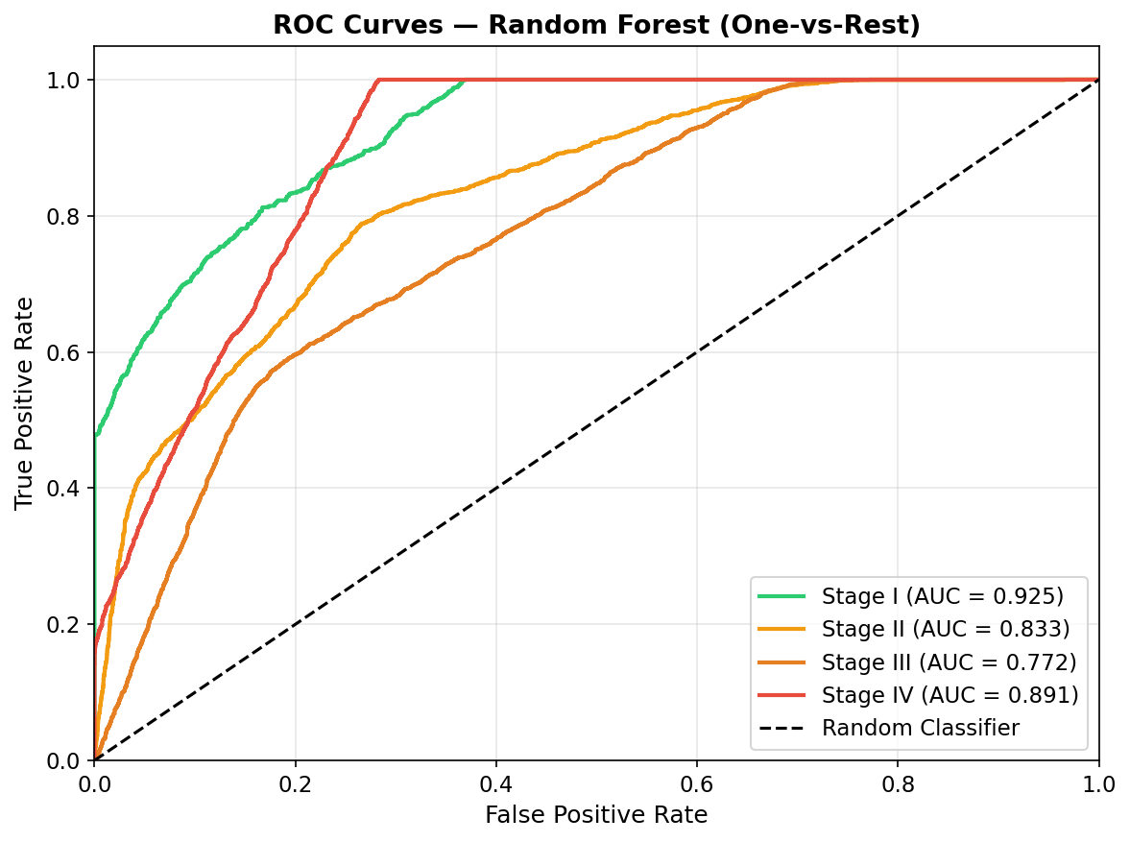
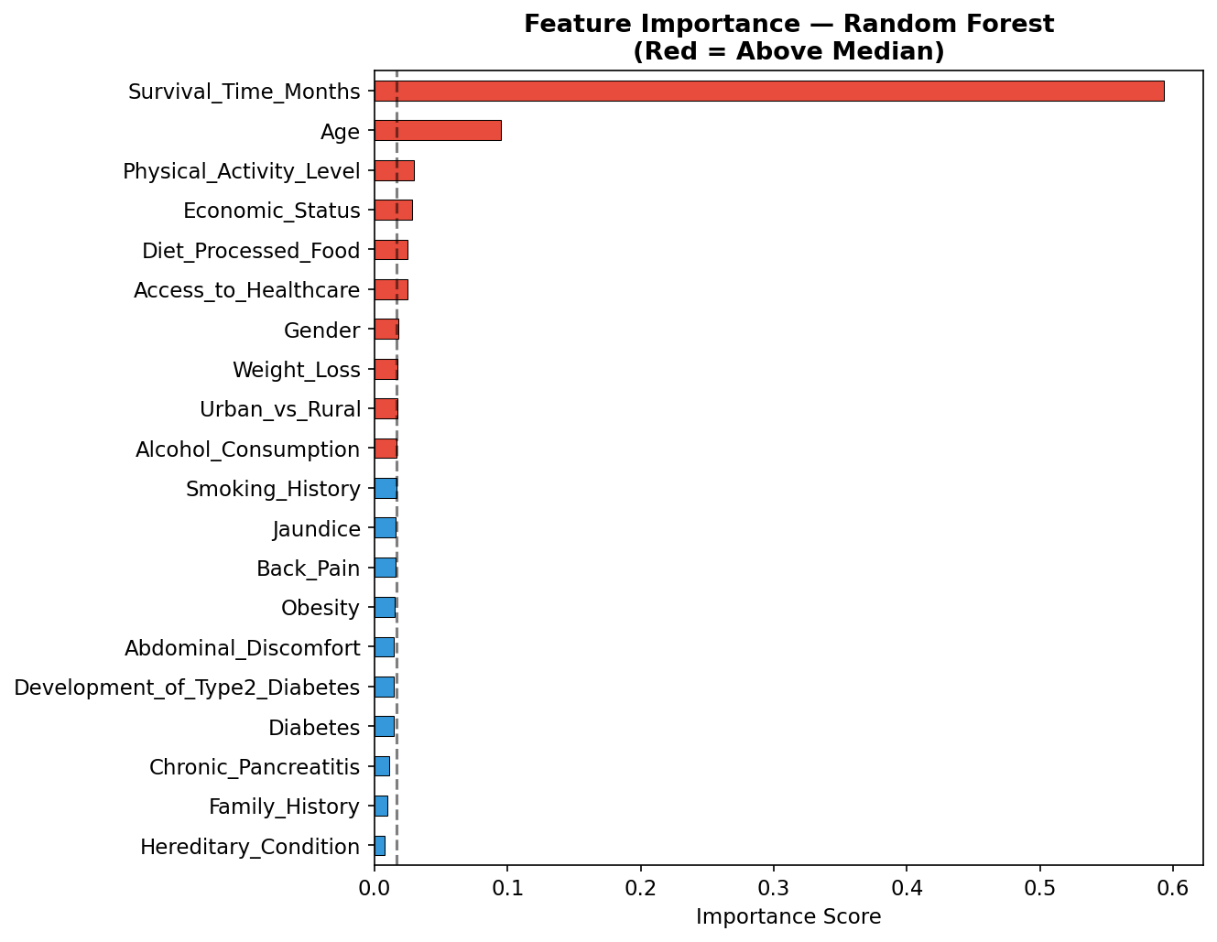
RESULTS & KEY FINDINGS
Best Model: Random Forest — AUC 0.847
0.847
68.35%
66.19%
vs 0.85
ROC-AUC
(Random Forest)
Test Accuracy
(Random Forest)
Weighted F1
(Random Forest)
Literature
Benchmark AUC
ROC Curves — Random Forest (One-vs-Rest)
Feature Importance — Random Forest
Notes:
The Random Forest is the best-performing model with an AUC of 0.847, which is very close to the literature benchmark of 0.85 reported by Muhammad and colleagues in 2019. Importantly, this was achieved using only a free Kaggle dataset and standard Python libraries — no specialist hospital data or infrastructure was needed. The ROC curves show strong separation for Stage I and Stage IV. The feature importance chart confirms that Survival Time in Months is the strongest predictor, which makes clinical sense — earlier stages have longer survival.

Slide 12





CHALLENGES & LIMITATIONS
Honest Reflections on the Project
Synthetic Dataset
Class Imbalance
The Kaggle dataset is synthetically generated, not from real clinical records. This limits how confidently results can be extrapolated to real-world clinical settings.
Stage IV accounts for ~40% of records while Stage I is only ~10%. Despite using class_weight='balanced', early-stage predictions were weaker.
Feature Limitations
Multiclass Complexity
The dataset lacks imaging data (CT/MRI) and biomarkers (CA 19-9), which are the primary tools clinicians use for diagnosis in practice.
Predicting four stages simultaneously is harder than binary classification. Stage I vs Stage II confusion was the main source of model error.
No Hyperparameter Tuning
Possible Improvements
Due to scope and time constraints, GridSearchCV was not applied. Tuning hyperparameters could push Random Forest accuracy higher.
Future work should use real clinical datasets (e.g. MIMIC-IV), apply SMOTE for imbalance, and explore XGBoost or neural network classifiers.
Notes:
It's important to be transparent about the limitations of this project. The dataset is synthetic, so the results cannot be directly applied in a clinical setting without validation on real patient data. The class imbalance — with Stage IV being overrepresented — made early-stage prediction harder. The dataset also lacks the imaging and biomarker data that clinicians actually rely on. Future improvements would include using a real clinical dataset, applying SMOTE to handle imbalance, and experimenting with XGBoost.

Slide 13
SEPLI — SOCIAL, ETHICAL, LEGAL & PROFESSIONAL ISSUES
Responsible Use of Machine Learning in Healthcare
S
Social
E
Ethical
→ Earlier detection improves patient outcomes and quality of life
→ Dataset contains no names/IDs privacy preserved in this project
→ Risk of over-reliance patients may panic at false positives
→ Must not overstate model accuracy wrong predictions can harm patients
→ Low specificity models (Malhotra et al., 2021) can cause unnecessary referrals
→ Bias risk: dataset may not represent all demographics equally
→ Must remain a decision support tool not a replacement for doctors
→ Responsible AI requires transparency about model limitations (Placido et al., 2023)
L
Legal
P
Professional
→ Any real clinical use must comply with UK Data Protection Act 2018
→ BCS Code of Conduct (2022): be honest about competence and limitations
→ Patient data requires explicit informed consent under GDPR
→ Human oversight must remain AI augments, not replaces, clinical judgement
→ Healthcare AI must meet NHS/MHRA digital health regulations
→ Model must be thoroughly validated before any clinical deployment
→ Open dataset used no data-sharing agreement required for this project
→ Data Scientist accountable for transparency in reporting results to management
Notes:
Any machine learning project in healthcare must address social, ethical, legal and professional issues. Socially, the model could help detect cancer earlier — but over-reliance on an automated prediction could be harmful. Ethically, I used an anonymous dataset and have been transparent about the model's limitations throughout. Legally, real-world use would require compliance with the Data Protection Act 2018 and GDPR. Professionally, as a Data Scientist, I am bound by the BCS Code of Conduct to be honest about what the model can and cannot do, and to ensure human oversight remains in any deployment.

Slide 14
CONCLUSION
Summary & Recommendation to TechHealthCare Solutions Ltd
★ Recommendation: The Random Forest model achieved ROC-AUC = 0.847 comparable to Muhammad et al. (2019) benchmark of -0.85 using only free open-source tools and a public dataset. This confirms the machine learning approach is viable. TechHealthCare Solutions Ltd should consider investing in real clinical data collection to build a deployable system.
Objectives Achieved
All six project objectives were completed. Three ML models were trained and evaluated using five standard metrics and 10-fold cross-validation.
CRISP-DM Followed
The project followed all six CRISP-DM phases: Business Understanding → Data Understanding → Preparation → Modelling → Evaluation → Deployment.
Best Model Identified
Random Forest outperformed both Logistic Regression and Decision Tree on Accuracy, F1-Score and ROC-AUC across all evaluation settings.
Lessons Learned
Data quality and feature selection matter more than model choice. Class imbalance must be handled early. Synthetic data limits real-world conclusions.
AI in Healthcare — Future
With real clinical data, biomarkers, and tuned deep learning models, AUC above 0.90 is achievable (Placido et al., 2023), making this a worthwhile investment.
Notes:
To conclude, this project successfully demonstrated that machine learning can be used to predict pancreatic cancer stage from patient data using freely available tools. The Random Forest model achieved an AUC of 0.847, which is comparable to published research. The CRISP-DM framework kept the project structured throughout. The main limitation is the synthetic dataset, but even with this constraint, the results provide TechHealthCare Solutions Ltd with a clear, evidence-based foundation to decide whether further investment in real clinical data and a deployable AI system is worthwhile.

Slide 15
REFERENCES & THANK YOU
Appelbaum, L., Cambronero, J. P., Stevens, J. P., Horng, S., Pollick, K., Silva, G., Haneuse, S., Piatkowski, G., Benhaga, N., Duey, S., Stevenson, M. A., Mamon, H., Kaplan, I. D., & Rinard, M. C. (2021). Development and validation of a pancreatic cancer risk model for the general population using electronic health records. European Journal of Cancer, 143, 19–30.
BCS. (2022). Code of conduct for BCS members. BCS, The Chartered Institute for IT. https://www.bcs.org/media/2211/bcs-code-of-conduct.pdf
Data Science PM. (2021). CRISP-DM: A clear and concise overview. https://www.datascience-pm.com/crisp-dm-2/
Malhotra, A., Rachet, B., Bonaventure, A., Pereira, S. P., & Woods, L. M. (2021). Can we screen for pancreatic cancer? PLOS ONE, 16(6), e0251876.
Muhammad, W., Hart, G. R., Nartowt, B., Farrell, J. J., Johung, K., Liang, Y., & Deng, J. (2019). Pancreatic cancer prediction through an artificial neural network. Frontiers in Artificial Intelligence, 2, Article 2.
Panday, A. (2024). Pancreatic cancer prediction dataset [Dataset]. Kaggle. https://www.kaggle.com/datasets/ankushpanday1/pancreatic-cancer-prediction-dataset
Placido, D., Yuan, B., Hjaltelin, J. X., Haue, A. D., Chmura, P. J., Yuan, C., & Brunak, S. (2023). A deep learning algorithm to predict risk of pancreatic cancer from disease trajectories. Nature Medicine, 29(5), 1113–1122.
UK Government. (2018). Data Protection Act 2018. https://www.legislation.gov.uk/ukpga/2018/12/contents
Veeramani, R., Goswami, A., Aditya, H., & Ranjan, P. (2020). Machine learning method for pancreatic cancer detection using Naïve Bayes and Decision Tree algorithm. International Journal of Innovative Technology and Exploring Engineering, 9(7), 1137–1141.
Python Libraries Used: pandas · numpy · matplotlib · seaborn · scikit-learn
Notes:
Thank you for listening to my presentation. Here are all the references I used in APA 7th edition format, including the Kaggle dataset, the five academic papers reviewed in the research report, and the CRISP-DM methodology guide. The models were built entirely using Python's pandas, numpy, matplotlib, seaborn and scikit-learn libraries. I am happy to take any questions now.

