Slide 1
Automatic PID Retuning for the Phantom Omni
Controllers compared
Thesis PD
Frequency-domain design
QUARC PID
Manual hardware tuning, joint 1
Particle Swarm Optimization vs Genetic Algorithm: simulation results for the 3-DoF Geomagic Touch
PSO-PID
Particle Swarm Optimization
GA-PID
Genetic Algorithm
Implements Sec. 7.9 "Adaptive Control and Automatic Retuning" of Omni Bundle - Haptic Device's Industrial Approach (Găvan, 2026)
Notes:
This deck reports the simulation results of the automatic PID retuning milestone. Four controllers are compared throughout, and they keep the same colour on every slide and figure: blue thesis PD, orange manual QUARC PID, green PSO-PID, amber GA-PID.

Slide 2
Results at a glance
Both optimizers remove the steady-state sag and widen the delay margin of the thesis PD design
Total cost
Worst steady-state error
Seam-welding RMS error
First unstable delay
18.5 → 1.05
7.8° → 0.06°
33.8 → 2.2 mm
32.5 → 42.5 ms
Thesis PD → PSO-PID on the shared objective
Joint 2, Thesis PD → PSO-PID
Thesis PD → PSO-PID, local loop
Thesis PD → PSO-PID, delay sweep
PSO-PID: best overall
GA-PID: close second
Lowest cost: 1.05 (GA 1.47, thesis PD 18.54)
Stays stable up to 42.5 ms of loop delay
0-1.8 % overshoot over a 20 ms UDP loop
Slightly lower seam error: 2.14 mm vs 2.17 mm
Less delay-robust: first unstable at 37.5 ms
Up to 4.1 % overshoot over a 20 ms UDP loop
Notes:
Headline numbers. The cost drops by a factor of about 18, the worst steady-state error by two orders of magnitude, and the seam-welding error from 34 mm to about 2 mm. PSO wins on cost and on delay robustness; GA is a close second and marginally better on seam RMS.

Slide 3
Why retune the controllers?
The thesis PD design is well damped, but it cannot reject gravity and friction
Thesis PD design
Manual QUARC PID
Goal of this work
ωc = 35 rad/s, PM = 70°, delay margin 34.9 ms
Well damped, no overshoot
No integral action: gravity and friction leave 3.6-7.8° of steady-state error
Published for joint 1 only: Kp 2.73, Ki 1.20, Kd 0.081
Integral action cuts the error to 1.1°
PM 48°: 49.5 % overshoot once the loop runs over a 20 ms UDP link
Search all 9 gains (Kp, Ki, Kd × 3 joints) automatically
Score every candidate with and without network delay
Compare PSO and GA on the same evaluation budget
PD steady-state error
QUARC overshoot, 20 ms delay
Gains searched
3.6-7.8°
49.5 %
9 (3 per joint)
Notes:
Two reference designs exist. The analytical PD meets its frequency-domain targets but has no integral term, so a constant gravity and friction bias leaves 3 to 8 degrees of error. The hand-tuned QUARC PID fixes the error but has little phase margin, so it rings when the loop is closed over the network. The goal is an automatic, delay-aware search over all nine gains.

Slide 4
Kinematic model
Three active joints, two 131 mm links, guarded by a workspace safety shell
Joint | θi | di [m] | ai [m] | αi [rad]
1 (base) | q1 | 0 | 0 | -π/2
2 (shoulder) | q2 | 0 | L1 = 0.131 | 0
3 (elbow) | q3 - π/2 | 0 | L2 = 0.131 | 0
Workspace shell
0.05 m ≤ r ≤ 0.25 m
Max step jump
0.15 m between targets
Forward kinematics
Inverse kinematics
x = (L1 cos q2 + L2 cos(q2 + q3)) cos q1
y = (L1 cos q2 + L2 cos(q2 + q3)) sin q1
z = -L1 sin q2 - L2 sin(q2 + q3)
Closed form, elbow-up
DLS Jacobian
λ ∈ [0.01, 0.05]
Notes:
Denavit-Hartenberg chain of the three actuated joints. Targets outside the 5 to 25 cm shell, or jumps larger than 15 cm, raise a WorkspaceError. The damped least-squares inverse Jacobian is used by the task-space velocity controller later in the deck.

Slide 5
Per-joint dynamics and timing
J q̈ + B q̇ + d(q̇) = τ for each joint, integrated with RK4 at 1 kHz
Joint | J [kg·m²] | B [N·m·s/rad] | τmax [N·m]
1 (base) | 0.0031 | 0.0089 | 0.865
2 (shoulder) | 0.0022 | 0.0170 | 0.865
3 (elbow) | 0.0009 | 0.0058 | 0.432
Control loop
UDP link
1 kHz
50 Hz
Ts = 1 ms, QUARC real-time
Commands and feedback every 20 ms
Disturbance d(q̇)
Delay margin
Tip force
Constant gravity/static bias of 0.10 / 0.20 / 0.05 N·m plus smooth Coulomb friction
Calibrated to reproduce the thesis's 3-8° PD steady-state error
34.9 ms
3.3 N
Analytical, ωc = 35 rad/s, PM = 70°
Peak (0.88 N continuous) sets τmax
Notes:
Each joint is a decoupled inertia-damper with a disturbance term. The disturbance magnitudes are calibrated assumptions chosen to reproduce the thesis's measured PD error, not identified on hardware. Torque limits come from the tip-force rating multiplied by the lever arm.

Slide 6
Closed-loop simulation chain
Every candidate gain set is simulated with the network inside the loop
1
2
3
4
5
Reference
PID
Actuator
Joint plant
Feedback
50 Hz UDP commands held by a zero-order hold
Derivative on measurement, 100 Hz low-pass, clamping anti-windup
Torque saturation at 0.87 / 0.87 / 0.43 N·m
RK4 at 1 kHz with gravity bias and Coulomb friction
0 ms or 20 ms transport delay
Two scenarios per candidate
Vectorised over the population
0 ms: local QUARC loop
20 ms: loop closed over one UDP period
30 candidates simulated in one numpy pass
About 0.1 s per iteration per scenario
Notes:
The simulation chain used to score every candidate. The delay sits in the feedback path, so the controller sees a stale measurement, which is the condition that destabilises aggressive gains. Because the whole population is simulated as one array, a full 60-iteration run takes about 15 seconds.

Slide 7
One objective, two delay scenarios
Cost = mean over the 0 ms and 20 ms scenarios, summed over the three joints
Performance terms
Phase margin < 45°
Penalty × 5
ITAE (time-weighted absolute error)
× 4.0
Overshoot (per unit)
× 2.0
Delay margin < 30 ms
Settling time, 2 % band (per s)
× 1.0
Penalty × 5
Steady-state error (per unit)
× 10.0
The thesis PD scores 18.54 on this objective, mostly from its steady-state error.
RMS torque above continuous rating
× 0.5
Notes:
The objective mixes tracking performance with robustness. Averaging over a delay-free and a 20 ms scenario makes the tuning delay-aware, and the two penalties keep the optimizers from trading away phase margin or delay margin. The 30 ms delay floor equals 1.5 UDP periods.

Slide 8
Two population-based optimizers
Same budget for both: 30 individuals × 60 iterations in the same 9-D search space
Particle Swarm Optimization
Genetic Algorithm
Global-best swarm
Inertia weight decreasing 0.9 → 0.4
Cognitive c1 = 1.6, social c2 = 1.6
Velocity clamped to 20 % of the range
Reflective search-space walls
Real-coded, tournament selection (k = 3)
SBX crossover, η = 15, rate 0.9
Gaussian mutation, 20 % per gene, σ = 10 % of range
Elitism: the 2 best survive unchanged
Bounded genes
Shared setup: Kp ∈ [0.1, 8], Ki ∈ [0, 8], Kd ∈ [0, 0.4] per joint · thesis PD seeded as one individual · random seed 0
Notes:
Both optimizers get the same number of individuals, iterations, search bounds and seed, so their results are directly comparable. Seeding the thesis design into the initial population guarantees neither ends worse than the analytical baseline.

Slide 9
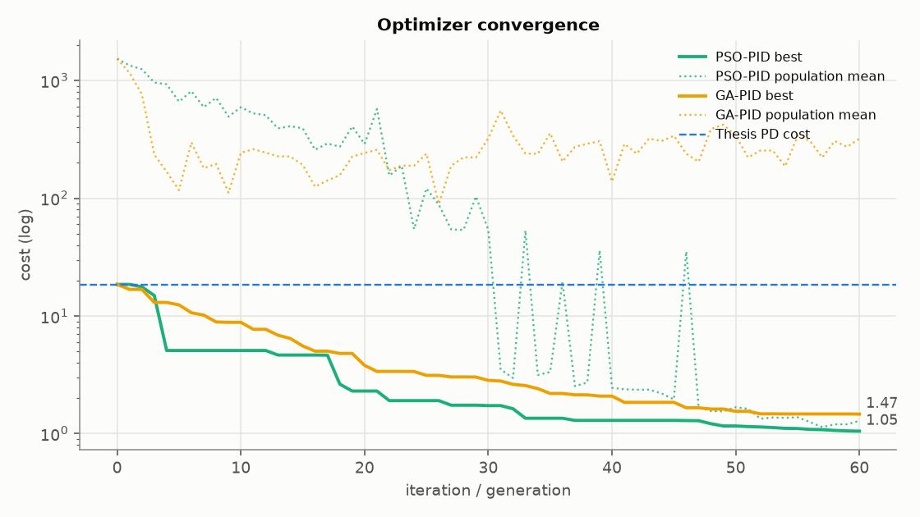
Convergence
PSO finishes 29 % below GA; both beat the thesis PD cost from the first iterations
Thesis PD
18.54
GA-PID
1.47
PSO-PID
1.05
GA: 1710 evaluations in 14.8 s
PSO: 1830 evaluations in 13.7 s
Notes:
Solid lines are the best cost found so far, dotted lines the population mean, on a log scale. PSO drops below a cost of 5 within four iterations and keeps improving. The GA population mean stays high because mutation keeps exploring, while the PSO swarm collapses onto the optimum after about 45 iterations.

Slide 10
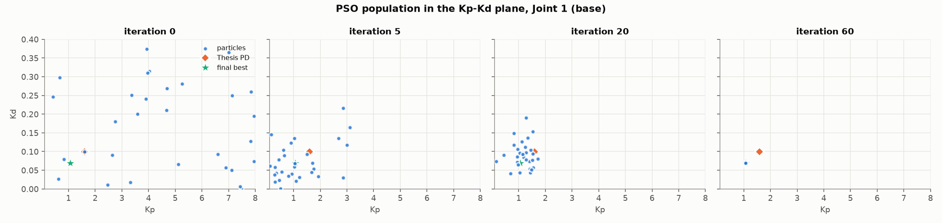
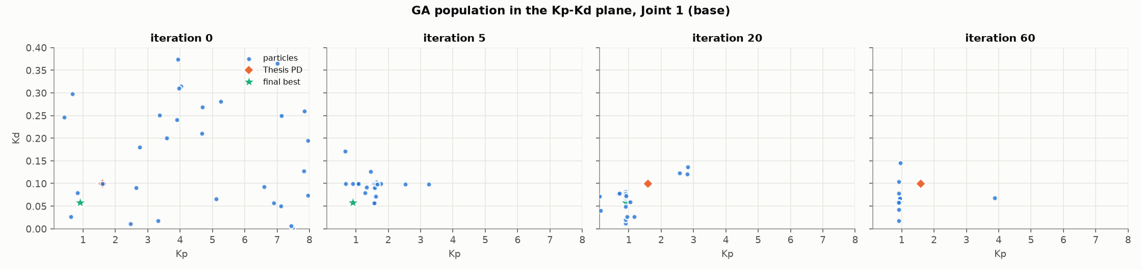
How the populations evolve
Both searches converge below the thesis PD point, at Kp ≈ 0.9-1.1 and Kd ≈ 0.06-0.07 for joint 1
Notes:
Joint 1 gains in the Kp-Kd plane at iterations 0, 5, 20 and 60. The orange diamond is the thesis PD design, the green star the final best. The PSO swarm contracts to a single point; the GA population keeps a spread because of mutation, with a few outliers still at iteration 60.

Slide 11
Tuned gains and stability margins
Both optimizers trade bandwidth (ωc 21-30 rad/s) for integral action and larger delay margins
Controller | Joint | Kp | Ki | Kd | PM [°] | ωc [rad/s] | Delay margin [ms]
Thesis PD | 1 | 1.592 | 0 | 0.0989 | 66.6 | 35 | 32.6
 | 2 | 1.481 | 0 | 0.0665 | 66.9 | 36 | 32.7
 | 3 | 0.568 | 0 | 0.0276 | 66.8 | 35 | 32.7
PSO-PID | 1 | 1.062 | 3.352 | 0.0691 | 60.4 | 25.0 | 42.2
 | 2 | 1.100 | 6.612 | 0.0474 | 55.6 | 25.4 | 38.1
 | 3 | 0.408 | 1.871 | 0.0231 | 65.1 | 28.0 | 40.6
GA-PID | 1 | 0.910 | 3.190 | 0.0575 | 55.8 | 21.5 | 45.3
 | 2 | 1.206 | 7.103 | 0.0474 | 53.4 | 26.4 | 35.4
 | 3 | 0.417 | 1.720 | 0.0245 | 67.3 | 29.5 | 39.8
Notes:
Full 9-parameter search, position loop. Margins include the derivative filter and sampling. Both optimizers lower the crossover frequency from about 35 to 21-30 rad/s and add integral gains of 2 to 7, which lifts the delay margin above the thesis's 34.9 ms on most joints. GA joint 2 is the weakest at 35.4 ms.

Slide 12
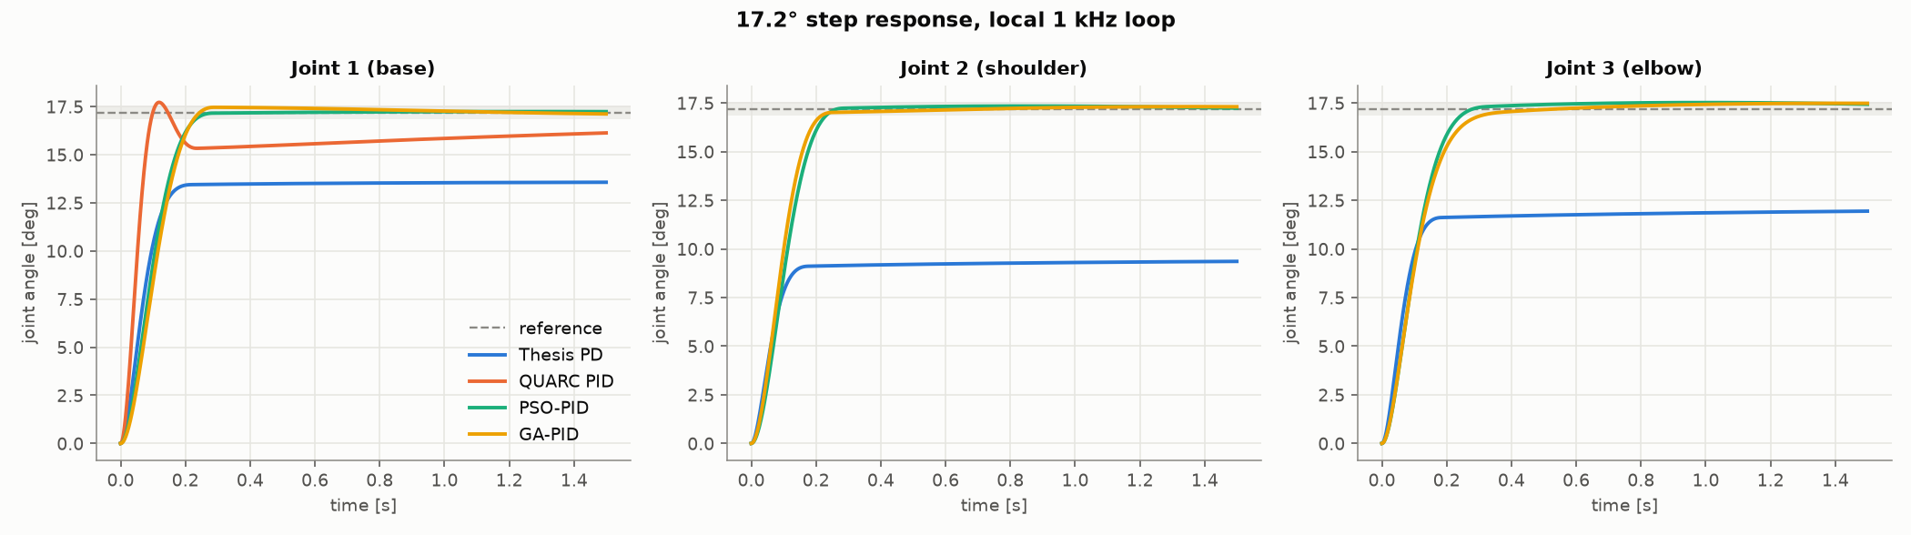
Step response, local 1 kHz loop
Only the integral controllers reach the 17.2° reference; the thesis PD stalls 3.6-7.8° short
Thesis PD
QUARC PID (J1)
PSO-PID
GA-PID
Never settles
1.1° error, 3 % OS
Settles in 231-244 ms
Settles in 217-305 ms
Notes:
A 0.3 rad (17.2 degree) step on each joint, no delay. The thesis PD is fast but settles 3.6, 7.8 and 5.3 degrees short because of the gravity and friction bias. PSO and GA settle within the 2 percent band in roughly a quarter of a second, with steady-state errors of at most 0.26 and 0.29 degrees.

Slide 13
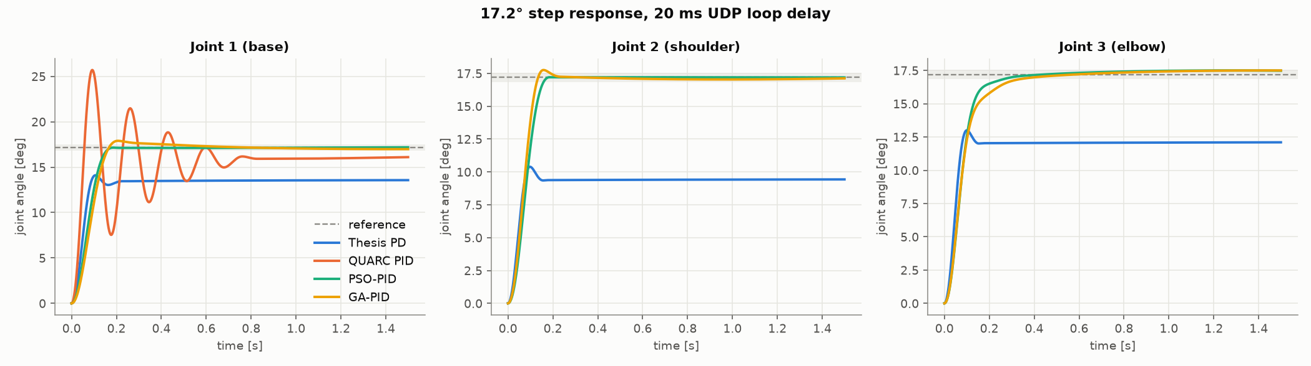
Step response over a 20 ms UDP loop
With one UDP period of delay the manual QUARC gains ring at 49.5 % overshoot; PSO stays below 2 %
Thesis PD
QUARC PID (J1)
PSO-PID
GA-PID
0 % OS, same sag
49.5 % overshoot
0-1.8 % overshoot
1.8-4.1 % overshoot
Notes:
The same step with 20 ms of feedback delay. QUARC PID with only 48 degrees of phase margin oscillates for almost a second. PSO settles in 158 to 264 ms; GA in 187 to 396 ms, with joint 1 overshooting 4.1 percent.

Slide 14
Steady-state error
Integral action cuts the steady-state error by one to two orders of magnitude
QUARC PID, joint 1
1.08°
Why it works
A PD loop can only resist a constant bias proportionally
The integral term drives the remaining error to zero
Same with 20 ms delay: PSO ≤ 0.30°, GA ≤ 0.31°
Notes:
Steady-state error in degrees for the local loop. The thesis PD error is the 3 to 8 degree sag documented in the thesis. With 20 ms of delay the picture is the same: PSO 0.01, 0.00 and 0.30 degrees, GA 0.20, 0.08 and 0.31 degrees.

Slide 15
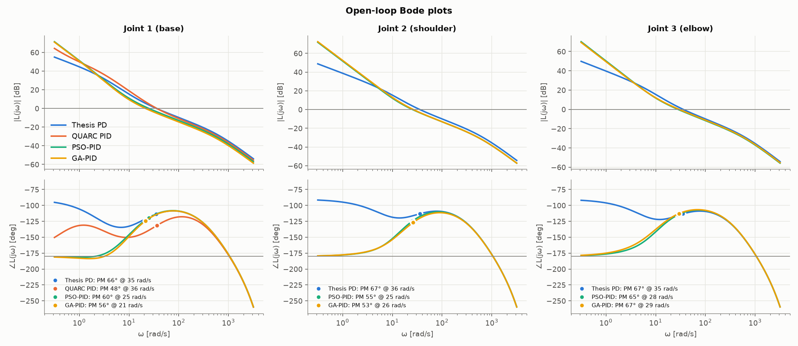
Open-loop frequency response
The optimized loops cross over lower (21-29 rad/s) yet keep 53-67° of phase margin
Thesis PD
QUARC PID
PSO-PID
GA-PID
PM 66-67° @ 35 rad/s
PM 48° @ 36 rad/s
PM 56-65° @ 25-28 rad/s
PM 53-67° @ 21-29 rad/s
Notes:
Open-loop Bode plots per joint. The integral action raises low-frequency gain by about 20 dB, which is what rejects the bias. The optimizers lower the crossover so the loop tolerates more delay, while QUARC PID crosses at the same 36 rad/s as the PD with much less phase margin. Crossover frequencies are in rad/s.

Slide 16
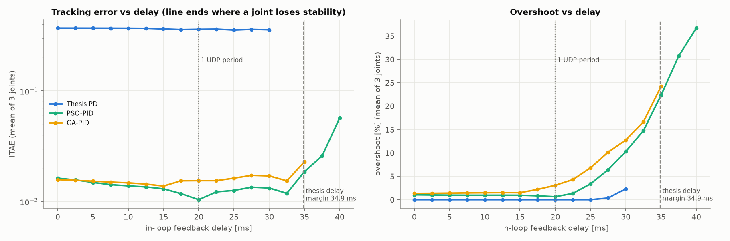
Robustness to loop delay
PSO-PID stays stable 10 ms longer than the thesis PD, beyond the 34.9 ms design margin
Thesis PD: first unstable at
GA-PID: first unstable at
PSO-PID: first unstable at
32.5 ms
37.5 ms
42.5 ms
Notes:
Delay swept from 0 to 50 ms in 2.5 ms steps; each line ends where one joint loses stability. The PD becomes unstable just before its analytical 34.9 ms margin because the derivative filter and sampling add phase lag. PSO tolerates 42.5 ms, more than two UDP periods.

Slide 17
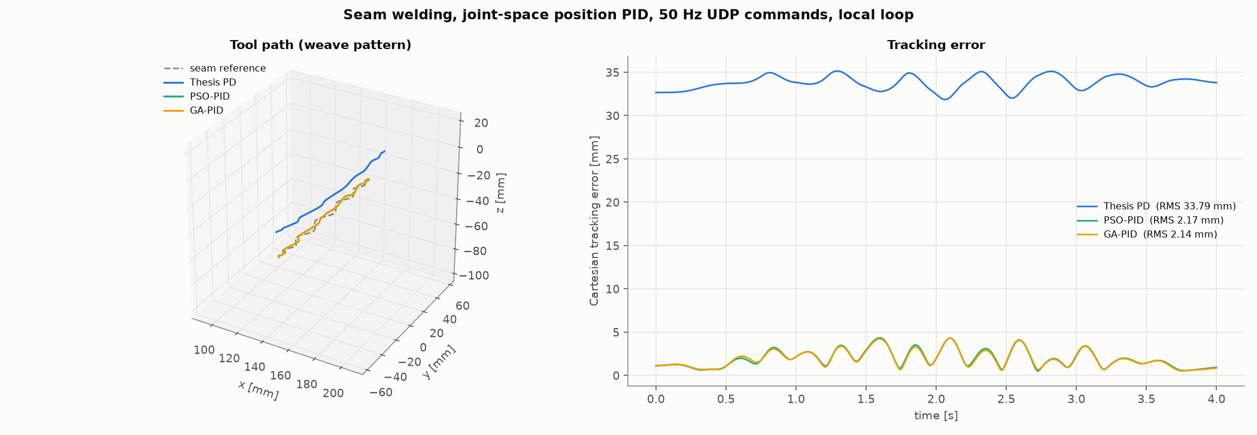
Seam welding, local loop
The PD sag becomes 34 mm of tool error on the 12 cm weave seam; the tuned PIDs track within 2.2 mm
Thesis PD
PSO-PID
GA-PID
33.8 mm RMS
2.17 mm RMS
2.14 mm RMS
Notes:
A 4 second, 12 cm seam with a 3 mm, 2 Hz weave, commanded at 50 Hz over UDP and tracked in joint space. Max errors: thesis PD 35.1 mm, PSO 4.33 mm, GA 4.31 mm. The PD's offset is the joint sag mapped through the kinematics.

Slide 18
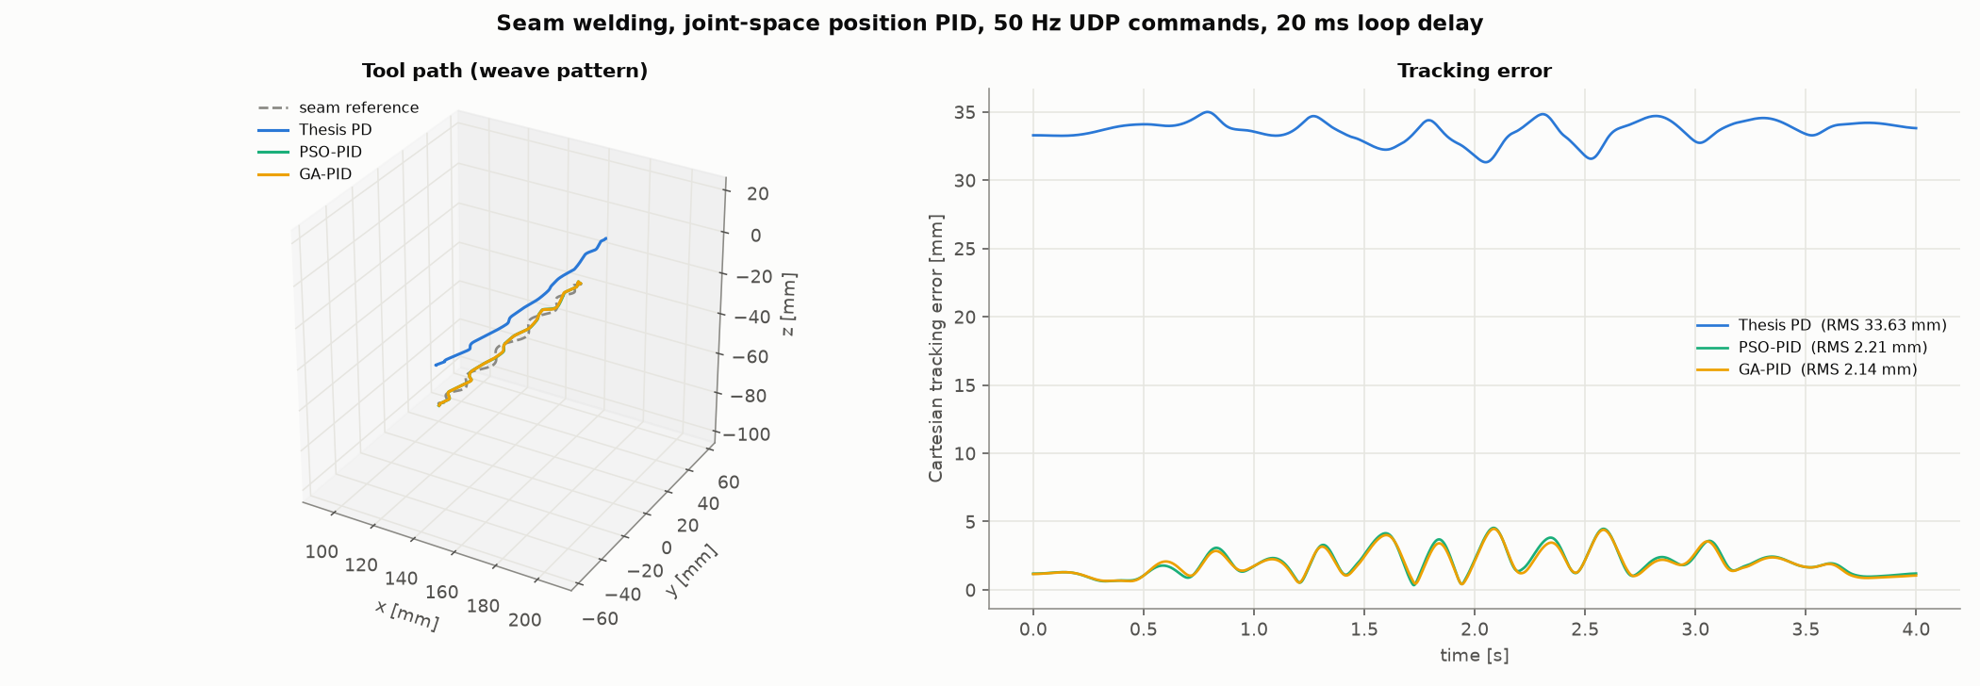
Seam welding over a 20 ms loop
Tracking holds up over the UDP delay: 2.21 mm (PSO) and 2.14 mm (GA) RMS
Thesis PD
PSO-PID
GA-PID
33.6 mm RMS
2.21 mm RMS
2.14 mm RMS
Notes:
The same seam with 20 ms of feedback delay. Errors barely change, because the delay-aware tuning already accounted for it. Max errors: thesis PD 35.0 mm, PSO 4.54 mm, GA 4.46 mm.

Slide 19
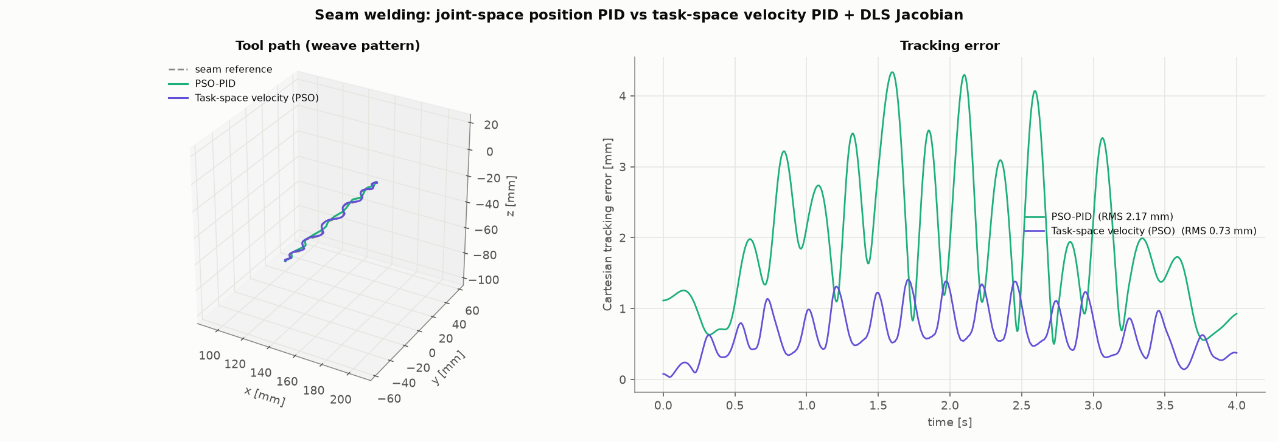
Task-space velocity control
A Cartesian loop with a DLS Jacobian and PSO-tuned velocity PIDs cuts the error 3× to 0.73 mm
Joint-space PSO-PID
Task-space velocity (PSO)
Max error
2.17 mm RMS
0.73 mm RMS
4.33 → 1.41 mm
Notes:
Cartesian P loop, then the damped least-squares Jacobian, then per-joint velocity PIDs, also tuned with PSO. The Cartesian feed-forward velocity compensates the tracking lag of the position loop. Velocity-loop gains: Kp 0.153, 0.113, 0.045; Ki 2.40, 2.41, 0.89; Kd about 0.001.

Slide 20
Conclusions and next steps
Automatic, delay-aware tuning beats both reference designs; PSO is the stronger optimizer here
What the results show
Limitations and next steps
Integral action is what removes the 3-8° sag; a PD loop cannot reject the bias
Delay-aware tuning trades bandwidth for margin: stable up to 42.5 ms
PSO reached the lowest cost: 1.05 against 1.47 for GA
Task-space velocity control cuts seam error 3× to 0.73 mm
Friction and gravity magnitudes are calibrated, not identified on hardware
Gravity is a constant bias; torque limits are approximate
Next: run the PSO gains on the QUARC hardware loop
Next: identify friction and gravity, then retune online
Notes:
Summary. The gains come from a simulation whose disturbance model is calibrated rather than measured, so the next step is to validate the PSO gains on the real Geomagic Touch through QUARC, then identify the friction and configuration-dependent gravity to make the retuning adaptive.

