Slide 1



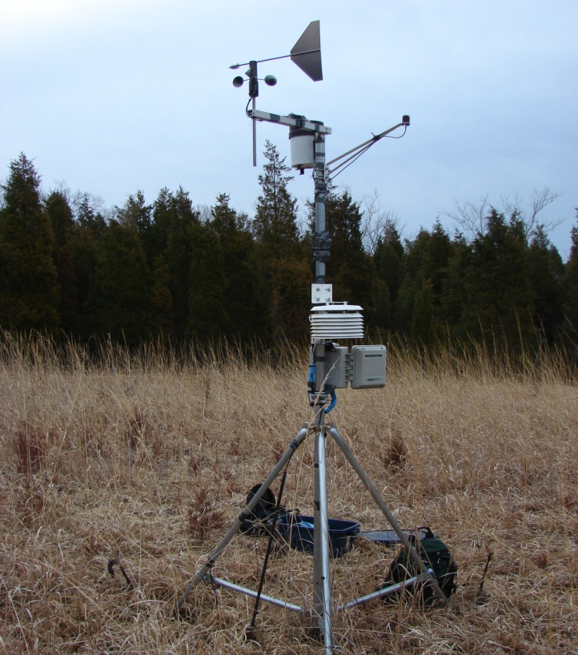
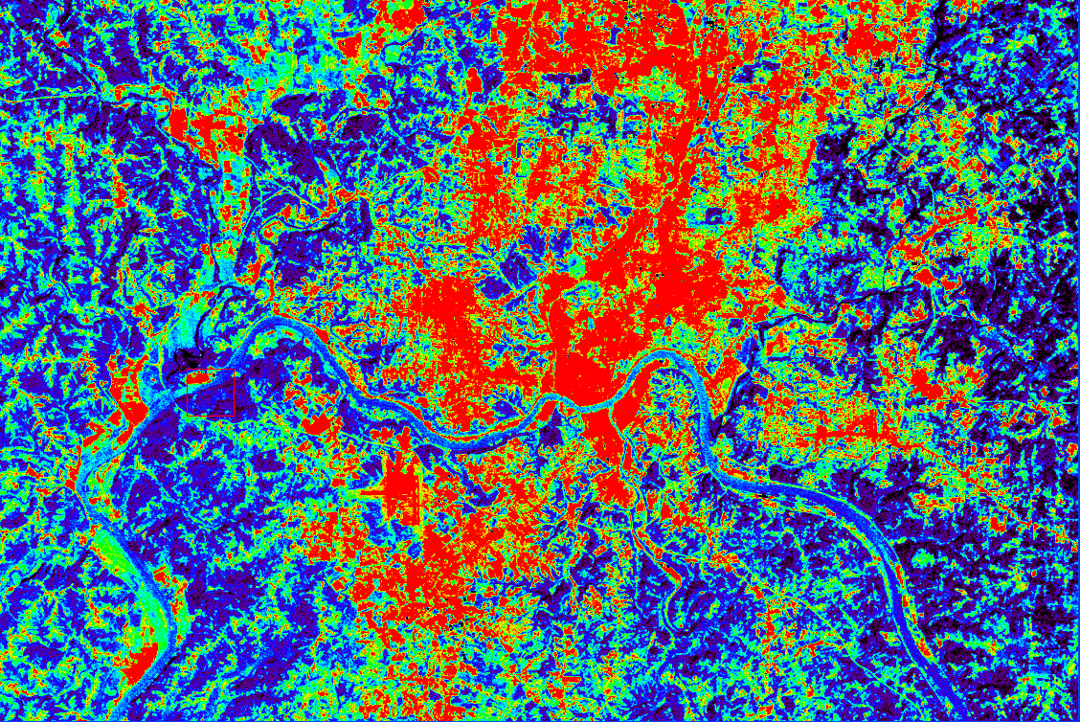
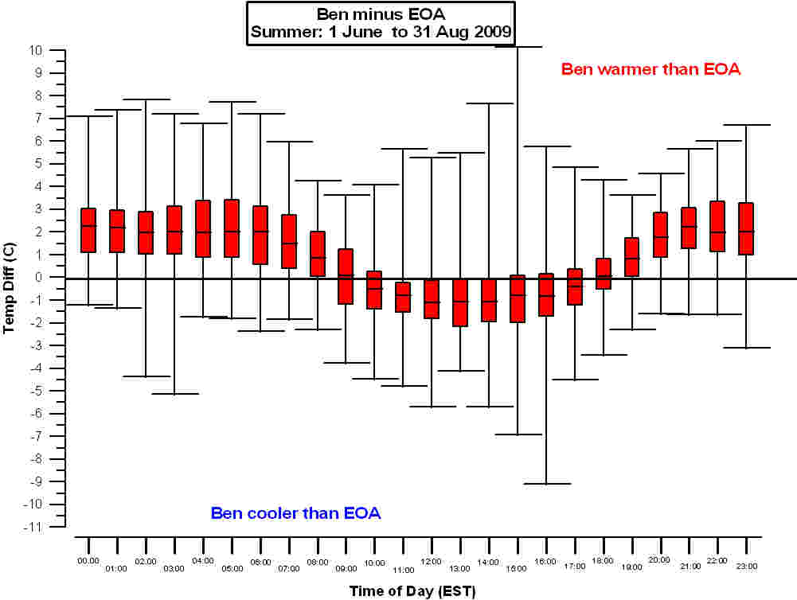
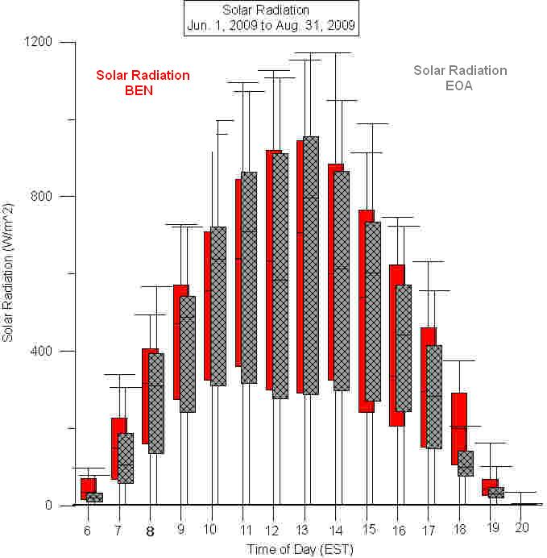
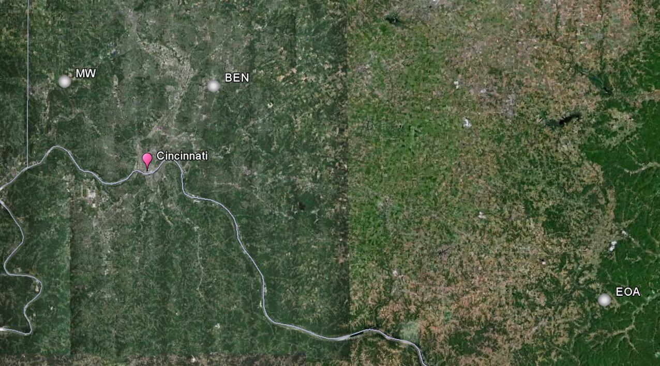
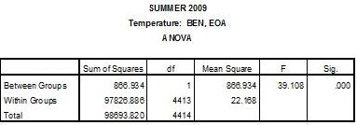
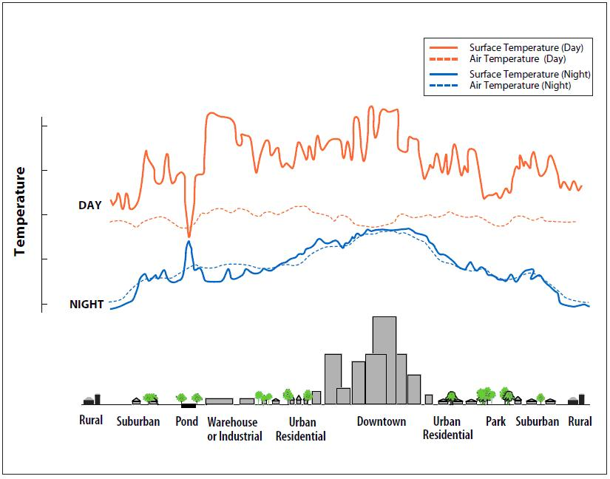
Spatial Examination of the Urban Heat Island in the Cincinnati, Ohio Metropolitan Area
Alexandria R. Horne
Department of Geography, University of Cincinnati
I. Introduction
This research examines the differences of near-surface air temperatures at three sites in different land use situations around the Cincinnati, Ohio metropolitan area (Figure 1) as acquired from weather stations. The hourly data were collected from December 1, 2008, to August 31, 2010.
The goals of this study are as follows:
1. Obtain near-surface (1.8 m) air temperature, solar
radiation and wind speed data from three sites.
2. Examine air temperature data from each site to
determine if the sites exhibit a spatial temperature
difference.
3. Analyze sites with respect to seasonal variations,
diurnal variations and the urban heat island (UHI)
effect.
4. Identify additional factors that may lead to spatial
differences in temperature.
The results found in this study include:
1. Due to sensor error and data loss, not all season within
the study area could be compared.
2. 7 out of 11 seasonal comparisons showed statistically
unequal temperatures.
All seasons showed statistically equal amounts of
received solar radiation.
The most extreme temperature differences are seen on
summer nights when the urban station is warmer,
consistent with the urban heat island effect.
IV. Conclusions
This study concludes that:
1. The suburban BEN and MW sites, separated by 33 km,
have very similar mean seasonal temperatures
2. Compared to the rural EOA site located about 112 km
to the east, both the BEN and MW sites demonstrate:
• Warmer summers by about 1.0 ºC
• Warmer springs (0.3-0.5 ºC)
• Cooler winters by 0.5 - 0.75 ºC
3. The BEN and MW sites consistently experience greater
seasonal contrasts compared to the rural EOA site. This
is l likely due to the indirect impacts of local land use
on the surface energy balance.
4. Both the BEN and MW sites are consistently warmer
than the rural site EOA at night and cooler during the
day for all seasons.
5. All stations received statistically equal amounts of
solar radiation.
6. Finally, this study has ruled out differences in wind
speed as a factor in air temperature differences.
  Figure 5. GLOVIS thermal image of the Cincinnati area September, 2001 (USGS, 2011).
III. Results
Figure 2. Photograph (left) of the HOBO U30 USB Data Logger model U30-NRC used in this study as well as the fully assembled weather station (right).
One study revealed that in the city of Cincinnati, the air temperature of the urban core area averaged 2.0 °C warmer than rural reference sites over a one-year period as measured by a network of data loggers taking air temperature readings every 15 minutes (Hinkel, 2007). A related study by Bell (2004) found an average 2.0 °C air temperature UHI from 2002 to 2003 by using a network of 13 weather stations along a 70 km north-south transect through the Cincinnati area.
Figure 4: Glovis image of Cincinnati , September 2001 (USGS, 2011)
II. Study Sites and Methods
The three weather stations (Hobo U-30, Figure 2) were situated along an urban-suburban-rural gradient extending eastward from Cincinnati.
Figure 1. Satellite image showing the three sites used in this study (Google Earth)
Table 1. Characteristics of study sites
Season / Year | Sites | Average Temperature Difference (ºC)
winter 2008-2009 | BEN - EOA | -0.7689
spring 2009 | BEN - EOA | 0.3885
spring 2009 | BEN – MW | 0.0006
spring 2009 | EOA - MW | -0.3157
summer 2009 | BEN - EOA | 0.882
winter 2009-2010 | BEN – EOA | -0.5025
winter 2009-2010 | BEN – MW | 0.2561
winter 2009-2010 | EOA – MW | 0.7503
spring 2010 | BEN – EOA | 0.5154
spring 2010 | BEN - MW | -0.0375
spring 2010 | EOA - MW | -0.4978
summer 2010 | BEN - EOA | 1.083
Literature Cited
Bell, J.H. (2004). Characteristics of the Urban Heat Island in Greater Cincinnati, Ohio; June 25, 2002 to June 24, 2003. Master’s Thesis, Department of Geography, University of Cincinnati.
Hinkel, K.M. (2007). The Urban Heat Island of Cincinnati. Geography Research Forum 27:10-28.
USGS (2011). Global Visualization Viewer (GLOVIS). Retrieved 1 March 2011 from <http://glovis.usgs.gov/>
An ANOVA was run to check for significant differences between hourly means between the stations by season for air temperature (table 2) and solar radiation respectively. The ANOVA results for temperature show that a majority of the time the results are significant, meaning that there is a significant temperature difference between the stations. Seasons were broken into three month periods with winter: December-February, spring: March-May, summer : June –August and fall: September – November.
Table 2. ANOVA (alpha = 0.05) results comparing mean of hourly
temperatures between stations BEN and EOA for June 1 to August 31,
2009.
Figure 3. (left) Box-and-whisker plot of temperature difference by hour between stations BEN and EOA for June 1 to August 31, 2009. Box-and-whisker plot (right) showing the amount of solar radiation received at station BEN with solar radiation received at station EOA overlaid and skewed slightly right .
Acknowledgments
I would like to thank the Department of Geography at the University of Cincinnati for laboratory assistance. Funding for this project was provided to KMH by the National Science Foundation grant number 0713813.
The BEN site is statistically warmer than the two other study sites (see table 2). Note that this site is located in an urban area near two major highways while the other two study sites are located in rural areas .
Table 3. Average temperature difference between stations by season.
Site Name | Latitude (Decimal Deg.) | Longitude (Decimal Deg.) | Elevation (meters) | Site Characteristics
Benedict (BEN) | 39.26492 | -84.35149 | 256 | Urban Cincinnati, near intersection of two major highways, near small, forested nature preserve in well maintained grassy area.
Miami-Whitewater (MW) | 39.26445 | -84.73410 | 251 | Suburban, center of large fragmented forest in patch of short grass, located on top of hill.
Edge of Appalachia (EOA) | 38.83564 | -83.38568 | 241 | Rural, in small, former agricultural clearing amongst large fragmented forest land.
Contact Information
Alexandria R. Horne, B.S.
hornear@mail.uc.edu
University of Cincinnati
Figure 5. Typical surface and air temperature patterns observed in a UHI scenario. (Voogt and Oke, 2003).

