Slide 1
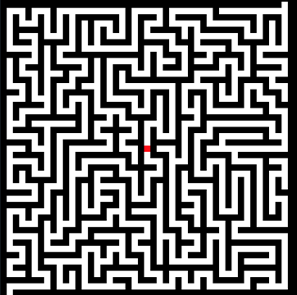
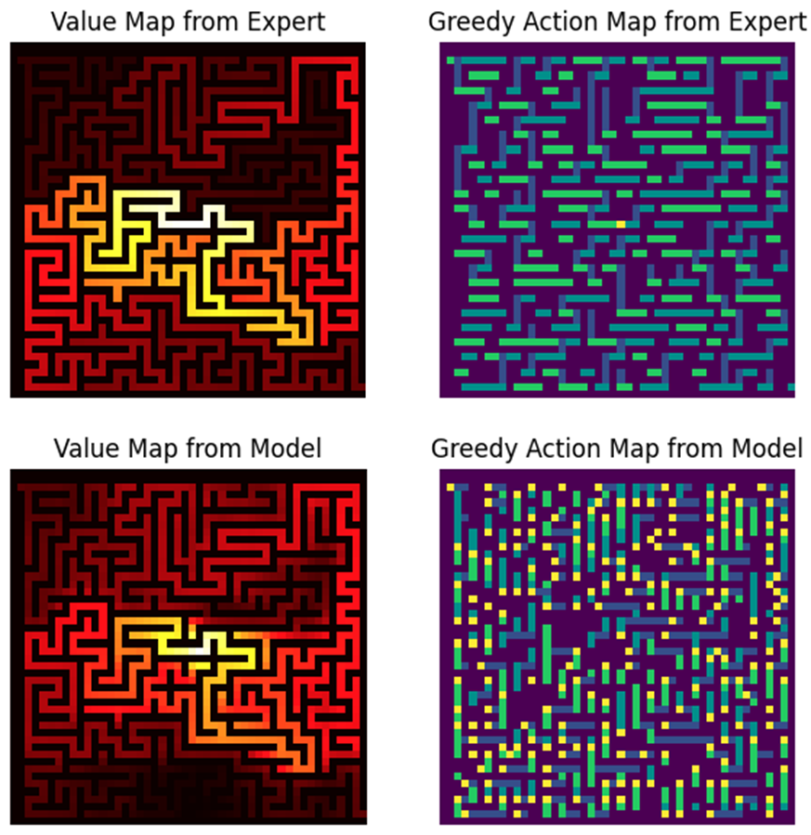
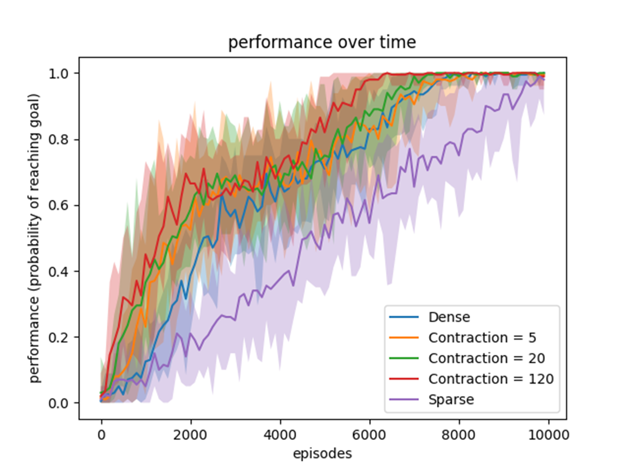
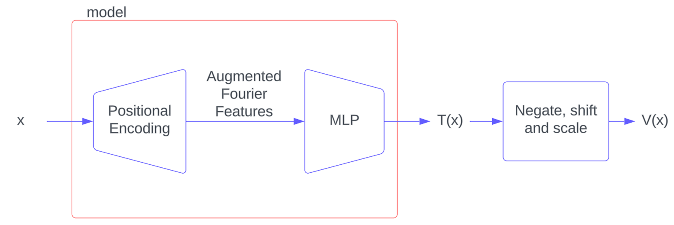
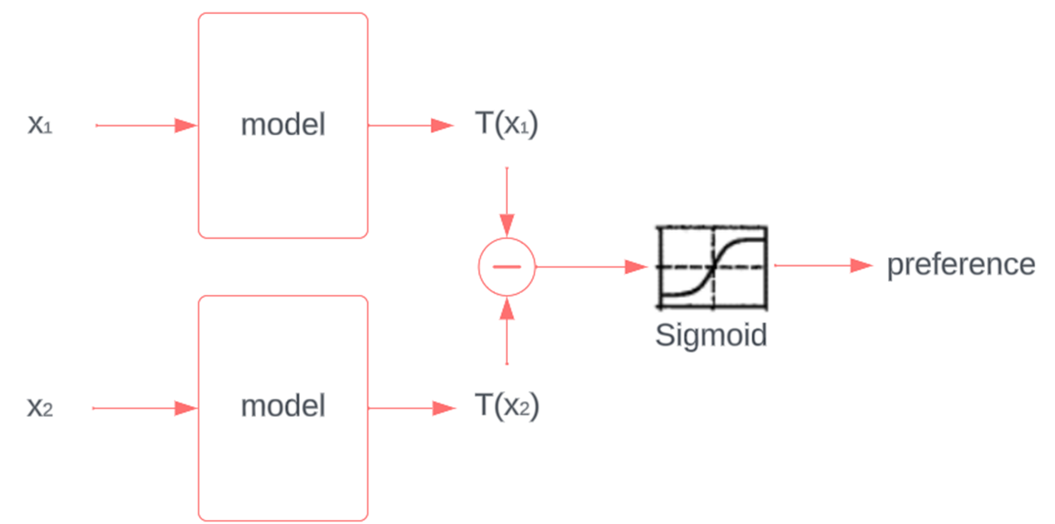


Taming the Value Landscape of Preference Reinforcement Learning
1. The environment
4. The immediate outputs of the model
6. The resulting training graph
2. The model during inference
3. The model during Probabilistic Temporal Ranking (PTR) training
5. Novel Gaussian attenuation

