Slide 1
HackStreet Boys Techincal demo Presentation

Slide 2

How many times have you been looking for a product but it was'nt availible ?
Electrocardiogram ECG

Slide 3
The problem we face
Study conducted in 2019 among adults in Manaus.
Medication Consumption: Over 53.2% participants had used medication in the past two weeks.
Access Challenges: 14.4% reported being unable to obtain needed treatments.
Main Barrier: Lack of financial resources was the primary reason for not accessing treatments.
Access Disparities: Individuals with poorer health status and chronic diseases faced greater difficulty accessing treatments.
Implications: Highlighted disparities in medication access, particularly affecting vulnerable groups.
Emphasized the need for targeted interventions to improve medication access for vulnerable populations.

Slide 4

.Main project ideas
.Used technologies
.Design and architecture approach
.Conclusions
Pharmacy provider and
delivery management system

Slide 5
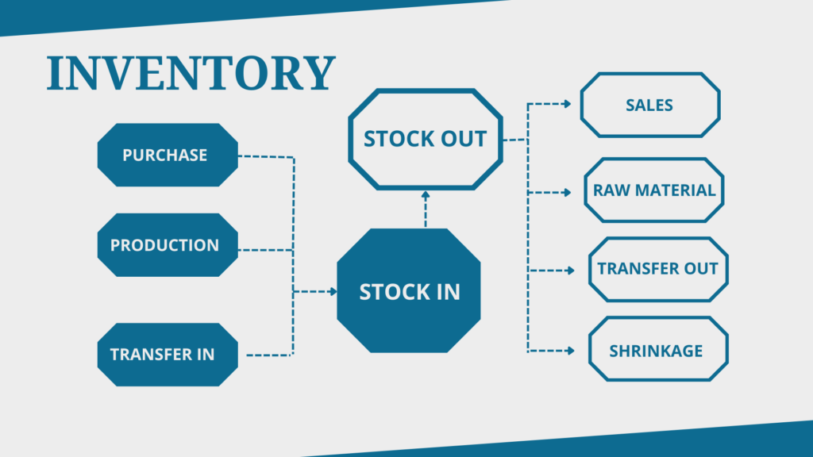
Main project ideas
A modernized webapp used for providing
licensed pharmacies with drugs.
Simulating a delivery system.
A feedback system for users to provide
reviews for placed orders
Data analysis for review gathered data

Slide 6
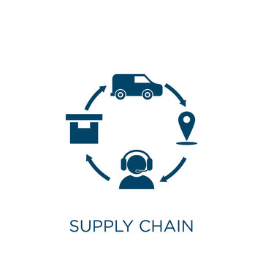
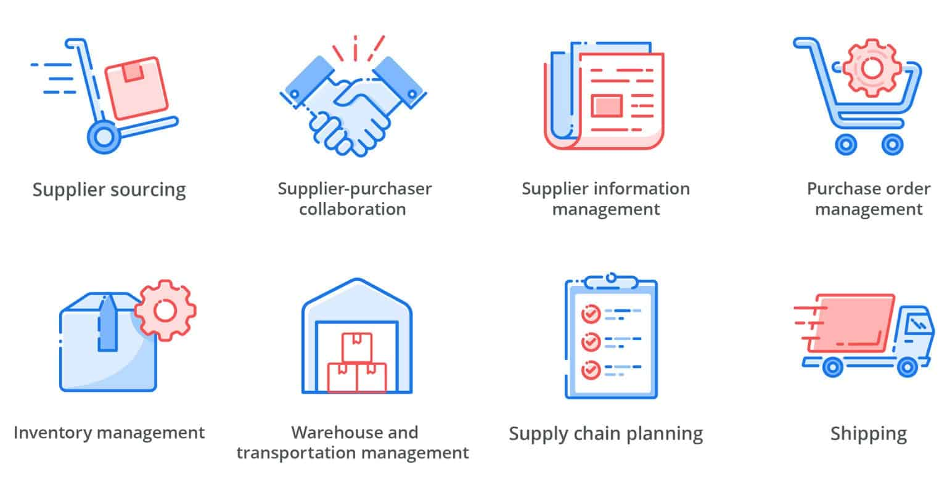

Slide 7

Projected Profits Analysis
Subscription & sales
6 months of free subscription
Analyse
the most demanded medicines, and the technics
Invest
in adds and hiring influences to get more users as possible

Slide 8
Speaking engagement metrics
country | Number of Pharmacies
ROMANIA | 8,135
BULGARIA | 4,197
FRANCE | 3900
BELGIUM | 2,227
SWITZERLAND | 2,852

Slide 9
Technologies
Database
Relational database
MySQL
Back-end
Object Oriented Programming
Java
Spring-Boot
Frond-end
JavaScript
CSS
React

Slide 10
Thank you
Referances : https://www.ncbi.nlm.nih.gov/pmc/articles/PMC7573467/
https://en.wikipedia.org/wiki/Healthcare_in_Romania
https://customcompounding.com.au/medicines-become-unavailable/

