Slide 1
HackStreet Boys Techincal demo Presentation
ZIANI ABDELDAJLIL
Jaden Horst
Stirb Calin-Alexandru

Slide 2

How many times have you been looking for a product but it wasn't available ?
Question

Slide 3
The problem we face
Study conducted in 2019 among adults in Brazil.
Access Challenges: 14.4% reported being unable to obtain needed treatments.
Solution :
Improve medication access for populations.
Individuals with chronic diseases faced greater difficulty accessing treatments.
Improve medication access for populations.

Slide 4

.Main project ideas
.Design and architecture approach
.Used technologies
Pharmacy provider and
delivery management system

Slide 5
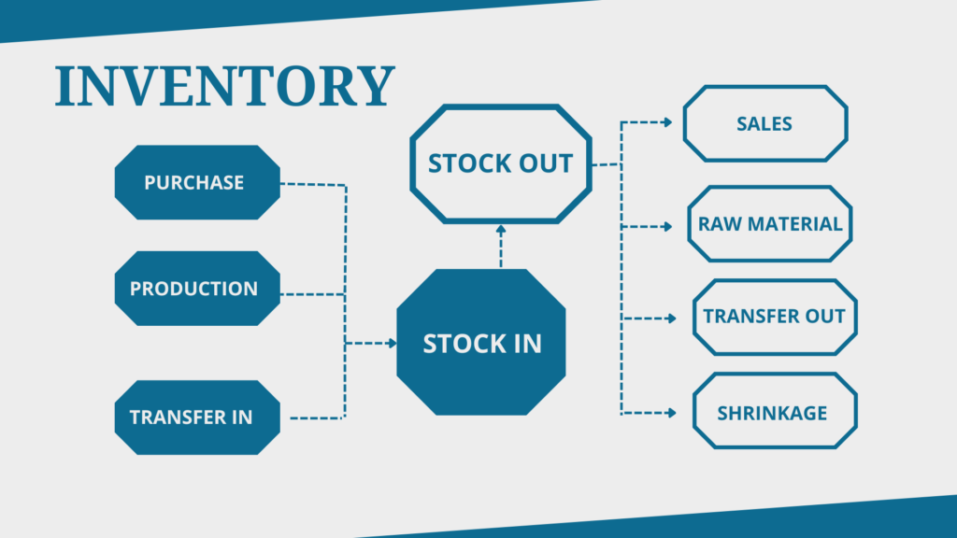
Main project ideas
A modernized webapp used for providing
licensed pharmacies with drugs.
Simulating a delivery system.
A feedback system for users to provide
reviews for placed orders
Data analysis for review gathered data

Slide 6
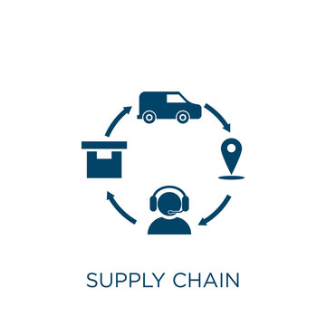
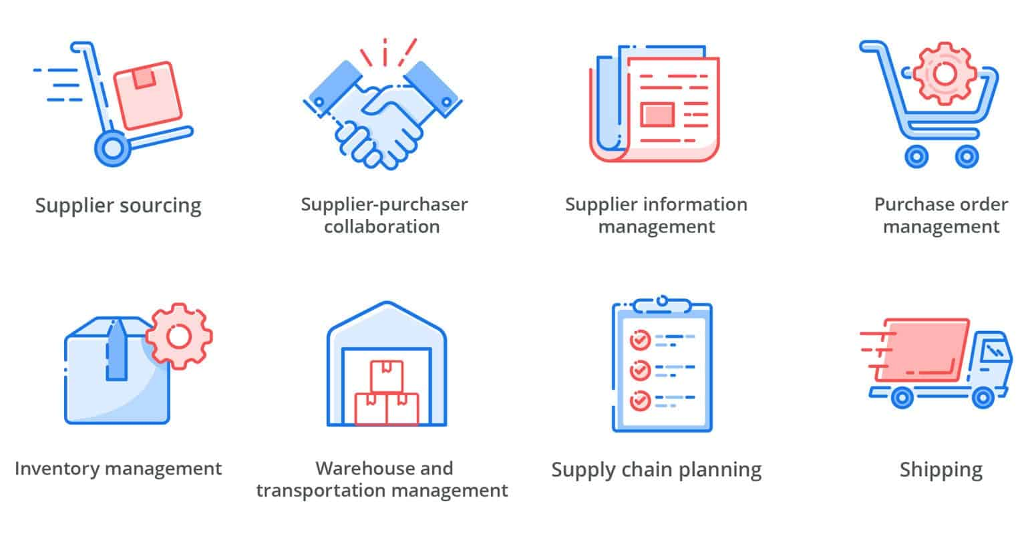

Slide 7

Project's Profits Analysis
Sales
Analysis
the most demanded medicines
Invest
Ads and sponsers

Slide 8
Advantages of the country
country | Number of Pharmacies
ROMANIA | 8,135
BULGARIA | 4,197
FRANCE | 3900
SWITZERLAND | 2,852
BELGIUM | 2,227

Slide 9
Technologies
Java
Spring-Boot
Frond-end & Back-end
JavaScript
CSS
React
Database
Relational database
MySQL
Back-end
Object Oriented Programming

Slide 10
Thank you
References :https://www.ncbi.nlm.nih.gov/pmc/articles/PMC7573467/
https://en.wikipedia.org/wiki/Healthcare_in_Romania
https://customcompounding.com.au/medicines-become-unavailable/

