Slide 1
Complex Vector Fluid Flow Analyser GUI
MANUAL
Alejandro Ito Aramendia

Slide 2
Outline
The objective of this GUI is to make the automation and model creation of complex vector fluid flow easier to do and visualise.
Multiple tabs have been created in order to aid the step-by-step process of creating a video model of urethra flow.
This GUI permits the ability to change model parameters with ease and clarity, substituting the need to edit long lines of MATLAB code.
For confidentiality purposes the code for this project may not be shared as it is still being used by a research team.

Slide 3
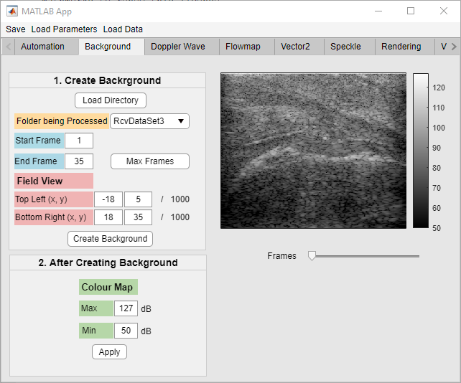
Dataset Selection and Background Creation
1.
Objective
To choose a dataset to model and display its background (B-Mode image).
Steps
Load the directory that holds the dataset folders and then choose a desired dataset to be processed.
Enter frame values to be processed (max frames to input maximum available frames).
Defined the image section that will be shown.
Create Background.
Select colour map if required.
View the background using the Frames slider.
2.
3.
4.
6.
5.

Slide 4
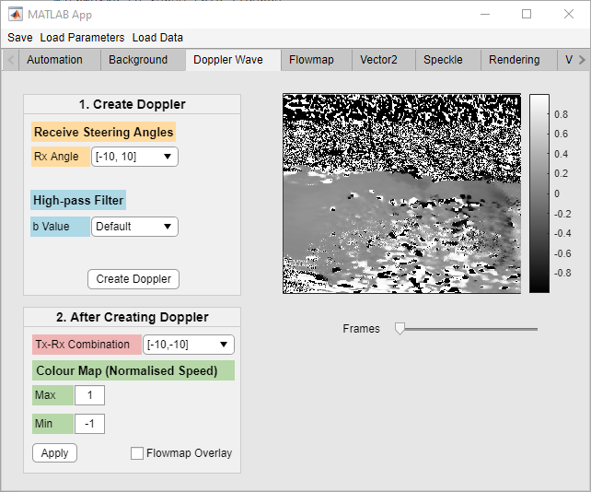
Doppler Image Creation
1.
Objective
To display the image created from doppler imaging (speed).
Steps
Enter the transducer receiver angles.
Enter a high-pass filter to denoise the data.
Create Doppler.
Select transmitter and receiver angle combination to display.
Select colour map if required.
View doppler image using the Frames slider.
2.
3.
4.
5.
6.

Slide 5
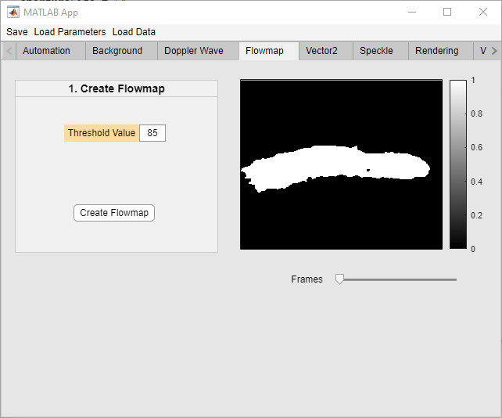
Flowmap Creation
1.
Objective
To create a binary image of the flow region.
Steps
Enter threshold value for binary image.
Create Flowmap.
View the flowmap using the Frames slider.
2.
3.

Slide 6
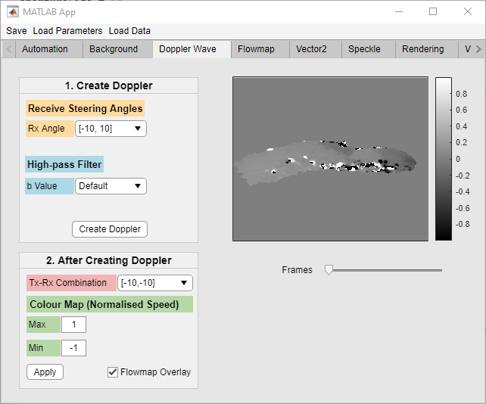
Doppler Image with Flowmap Overlay
Objective
To view a focused view of the doppler image.
Steps
Check the Flowmap Overlay box.
1.

Slide 7
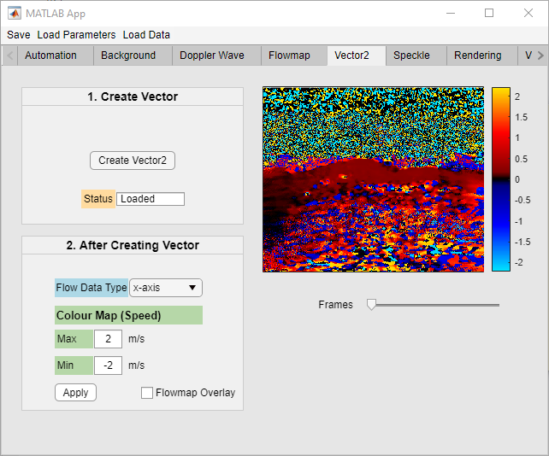
Vector Image Creation
Objective
To display the vector flow (velocity) of the fluid.
Steps
Create Vector2.
Select axis to display.
Select colour map if required.
View the vector image using the Frames slider.
1.
2.
4.
3.

Slide 8
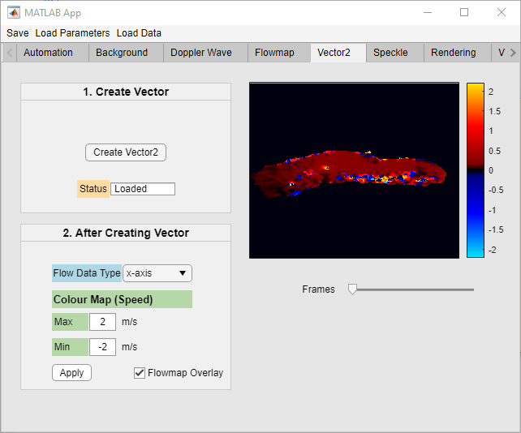
Vector Image with Flowmap Overlay
Objective
To view a focused view of the vector image.
Steps
Check the Flowmap Overlay box.
1.

Slide 9
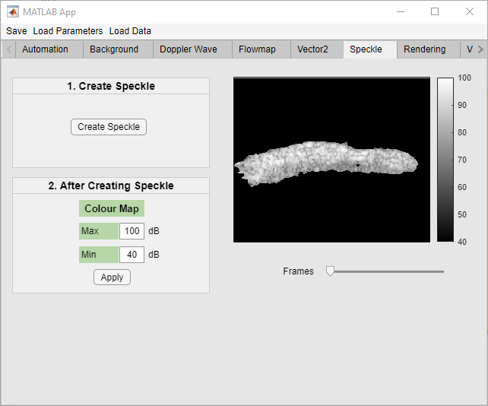
Speckle Image Creation
1.
Objective
To display the speckle imaging.
Steps
Create Speckle.
Select colour map if required.
View the speckle image using the Frames slider.
2.
3.

Slide 10
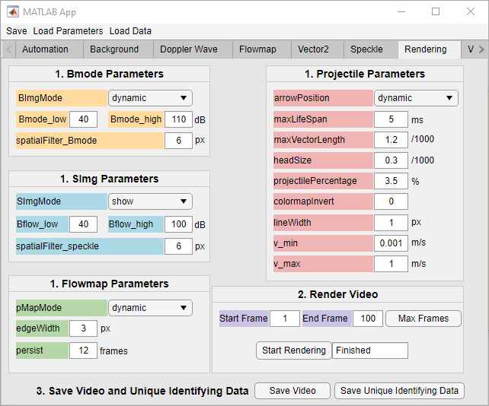
Rendering Parameters for Video Creation
1.
Objective
To set the video parameters for creating and saving the video data.
Steps
Set all parameters required for rendering.
Select frame range.
Start Rendering.
Save video and data if needed.
2.
4.
3.

Slide 11
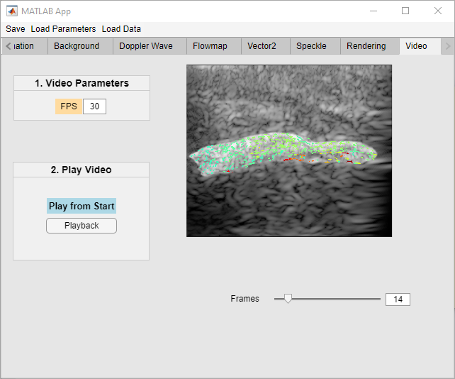
Final Video Display
Objective
To view the final video of the fluid flow.
Steps
Set the FPS of the video.
Playback to start video from the beginning.
View video manually using the Frames slider.
1.
2.
3.

Slide 12
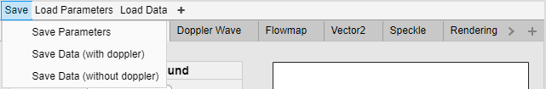
Saving and Loading Parameters and Data
Objective
To allow the user to close the program and open it up again so that they can resume from where they left off.
Save Parameters
To save all entered parameters from each tab in a file.
Load Parameters
To change all the input values to what was saved in the parameter file.
Save Data
To save all the image data from each tab to a file. Choose without doppler option if you have already created vector2 and want to save space. If vector2 is not yet created, you must save with doppler.
Load Data
Display all previously saved image data on to each tab.
IMPORTANT NOTE: When clicking ‘Save’, you must not let the mouse hover over ‘load parameters’ when directing to a saving option. This will trigger load parameters if not.

Slide 13
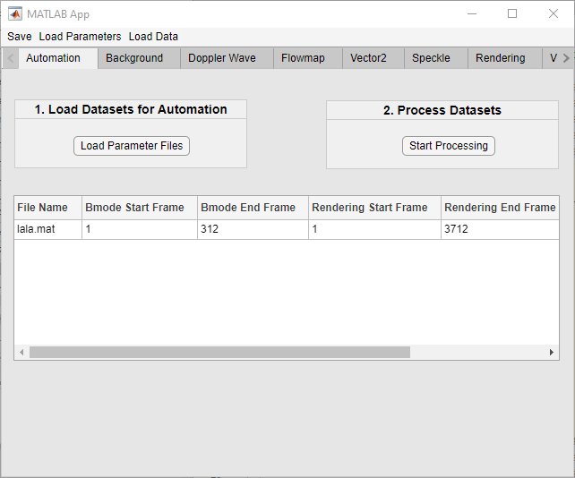
Automation
Objective
To automate the generation of datasets.
Steps
Load parameter files of the datasets wanted to be automated.
Enter the desired frame range for B-mode imaging and video rendering.
If during parameter selection before saving parameter files, all images were processed and only rendering remained, check the rendering box.

Slide 14
FAQs
Q) What is the difference between the ‘Save Data’ in the rendering tab and the ‘Save Data’ at the top on the menu bar?
A) The ‘Save Data’ in the rendering tab, is used to save only the minimum required imaging data to reproduce the rendered video along with a few necessary parameters. For example, the ‘Doppler’ image is not required for rendering. Instead ‘Vector’, which is an extension of ‘Doppler’ is used. On the other hand, the ‘Save Data’ in the menu bar saves ALL image data.

