Slide 1
Mobile Device Security
MSIT 458 - Information Security
December 4, 2010
Team Magic:
Michael Gong
Jake Kreider
Chris Lugo
Kwame Osafoh-Kantanka

Slide 2
Agenda
The Problem
Existing mobility solution
Developing the new solution
Explanation of solution

Slide 3
Introduction
"For many professionals, the mobile phone has become a mobile office,“
- Mike Jones, Symantec
"There is no question that mobile security will eventually equal – if not surpass – PC security as a threat to IT departments,"
- Denise Culver, Heavy Reading Mobile Networks Insider
“By 2014, 90 per cent of firms will support corporate applications on personal devices”
- The Economic Times, Nov. 30th, 2010

Slide 4
Problem Statement
With the explosive growth of smartphones, tablets and mobile devices, companies must find a means of providing access to their internal systems and information to their mobile workforce securely and seamlessly.

Slide 5
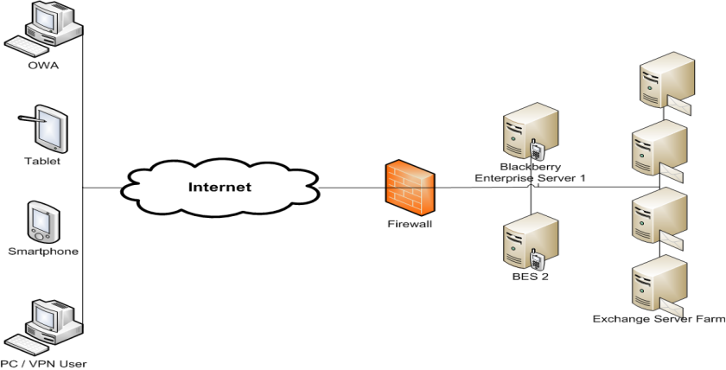
Existing Enterprise Blackberry solution
Microsoft Exchange 2003
Blackberry Enterprise Server 4.1 SP7
10,000 email boxes
2,000 using mobile devices
Only company provided Blackberry devices are supported

Slide 6

Key Mobile Device Security Concerns
Confidentiality
Commercial Data
Ex: Financial, IP, etc.
Personal Data
Ex: Customer, Employee records, PCI, etc.
User Personal Data
Diplomatic cables
Accessibility
Resource uptime
High Availability / Recoverability
Archive
Maintain device flexibility while protecting against security risks

Slide 7
Current Needs of the Business and Solution Approach
Business users today are more mobile than ever before and are looking to access the enterprise from multiple devices:
Apple iOS
Android
Blackberry
Windows Mobile
Users today are more technically skilled than before and are unfortunately able to develop “Business Managed Solutions” which may not meet the security requirements of the enterprise
High Level Requirements &
Solution Approach
Must securely support users on the 4 identified leading mobile platforms
Must leverage the significant existing Exchange and Blackberry investment
The answer – A Mobile Device Management (MDM) Solution

Slide 8
Developing the solution

Slide 9
Solution Requirements
MS Exchange
Exchange 2003 or Exchange 2007 SP2
ActiveSync (EAS) enabled
Enterprise Certificate services / certificate based authentication
Mobile Device support
Support latest Mobile OS’s
Employee-provided device
Support for VPN, Wi-Fi, ActiveSync and encryption
Centralized IT management & control
Support for common file attachments

Slide 10
Solution Requirements (cont’d)
Security
All devices should be enrolled into corporate network
Provisioning of mobile devices should be secure
Security policies should be targeted to right groups/employees
Restriction of some/all mobile applications
Complex/multi-character passwords required
Updates of mobile OS required
Encryption of all forms of corporate data
Tracking and inventory of all devices
Access control over corporate email system
Sanction and disconnect modified devices or rouge device
Selective/full remote wipe of device

Slide 11
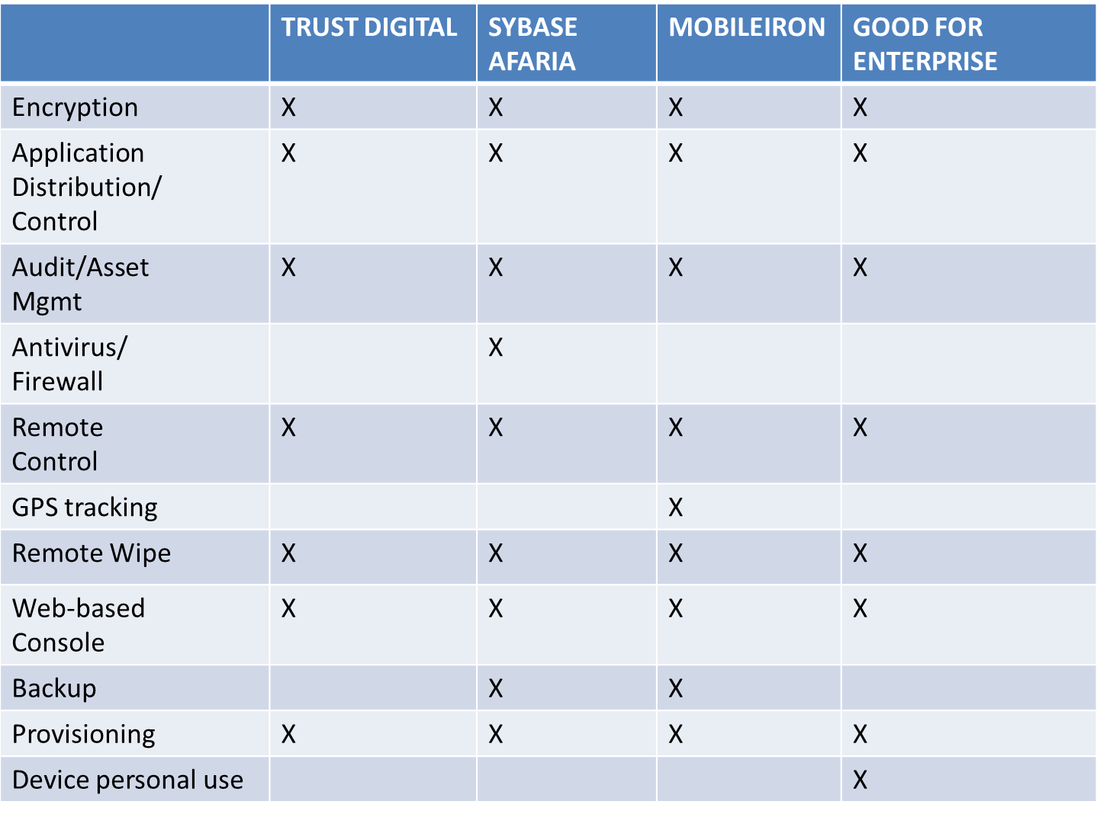
MDM vendor selection/comparison

Slide 12

Chosen Solution
Good Technology
Manage & Protect access to vital company
information
Without imprisoning the user or their device
With flexibility…
Manage the entire device
OR
Manage the Good application
Plays nice in the mobile sandbox!
"Corporate policies should focus on regulating behavior, rather than devices..."
— Gartner, May 2010

Slide 13
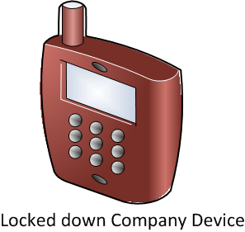
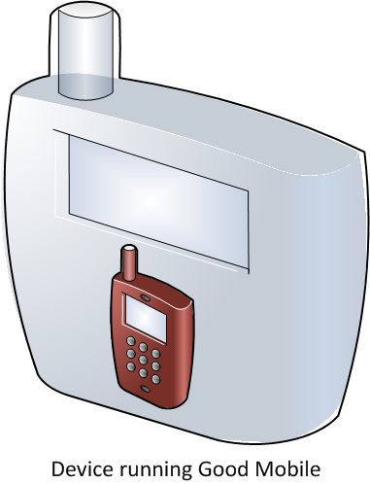

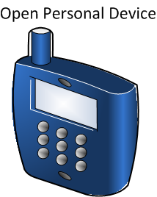

Making a Good device

Slide 14
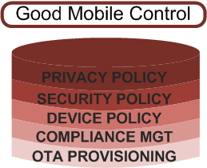
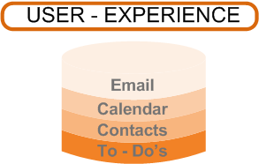

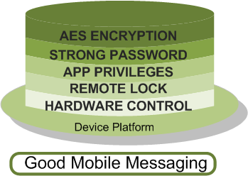
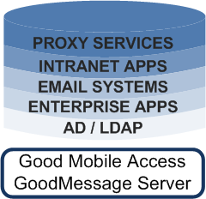
Security Architecture

Slide 15
Operational Architecture

Slide 16
Cost Comparison
Per Device Comparison
 | Blackberry Enterprise Server | Good Technology
Annual data plan service | $504 | $0*
Annual Inclusive maintenance & support | $4 | $159
Total annual cost | $508 | $159
Good Technology Solution
 | Capital | Expense
Software (2000 licenses) | $140,468 | -
Hardware | $178,801 | $34,410
Maintenance | - | $57,775
Sub Total | $319,269 | $92,185
TOTAL 2 year capacity | $411,454

Slide 17


Business/Legal Consequences
Financial Liability
May be required to pay stipend for device/usage
Additionally corporate data plans apply in some instances
Employee may be taxed for fringe benefit
Nonexempt employees create issues
Legal Liability
Evidence of illegal activity must not go unreported
Archiving may be required

Slide 18

Consequences to Privacy
While some employees will only need access to PIM-data, many will need full device management.
In these cases, all data must be subject to review and/or archive by the company
Email, SMS/MMS, IM, music, etc.
All activity (applications, browser, peripheral control, etc.) must be subject to audit and control at any time.
How to handle all of this??

Slide 19
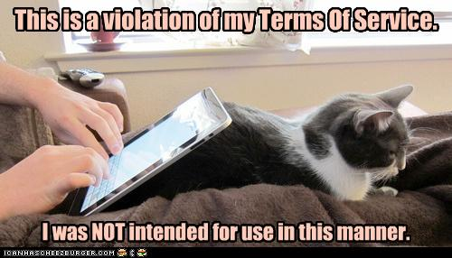
Education!
Most people will agree to any ToS without second thoughts.
Acceptance of the restrictions rely completely on employees’ understanding them
Rewards are worth the
risks …

Slide 20

Consequences
Despite shared liability, employee-provided cell phones for business purposes are extremely popular.
Conveniences for employee
Savings for employer
Trend will continue

Slide 21
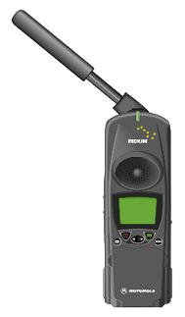




Conclusion
Employee-owned mobile phones provide risks, challenges.
However, benefits are great to both company and employees.
Our provided solution, leveraging Good Technology, is the most efficient and feasible way to implement a corporate private mobile device policy.

