Slide 1
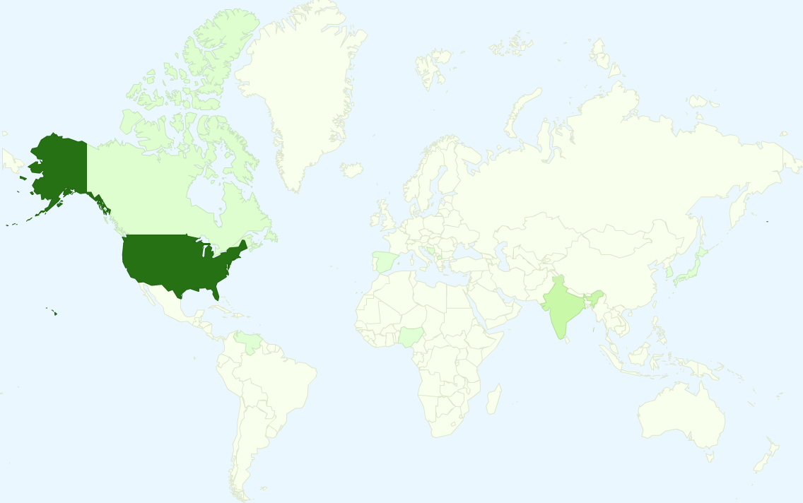
Legend
Over 90 turkers
10 to 20 turkers
Less than 10 turkers

