Slide 1
Capstone Project
The Battle of the Neighborhoods
Applied Data Science Capstone by IBM / Coursera
24.07.2021
Alex AZ

Slide 2
Introduction
The restaurant chain of Eastern European cuisine "EEC", St. Petersburg, Russia plans to expand to foreign countries. It was decided to open the first foreign restaurant in Tallinn, Estonia - the nearest capital of a foreign state to St. Petersburg.
Preliminary analysis has shown that the most popular area of Tallinn for both tourists and locals is Old Town or Vanalinn (https://www.visittallinn.ee/eng/visitor/ideas-tips/tips-and-guides/top-must-see-sights).
Thus, the location of the restaurant was determined by the old town and the adjacent territories within walking distance (up to 1.5 km) from Town Hall Square - the cultural and historical center of the old town.
The aim of the project is to determine the most promising locations for placing the restaurant, taking into account the presence of restaurants in general and with Eastern European cuisine in particular in the area under consideration.

Slide 3
Data
Main factors
Based on the formulation of a business problem, the main factors influencing its solution will be:
coverage area for analysis (1.5 km from Town Hall Square);
total number of restaurants of all types in the area under consideration (density);
number of Eastern European restaurants in the area under consideration (density);
distance between neighboring restaurants of Eastern European cuisine;
distance from the center of the considered area (Town Hall Square) to each restaurant of Eastern European cuisine found in it.

Slide 4
Data
Sources
The sources of the necessary data will be:
coordinates of the center of the considered area (Town Hall Square) will be obtained using the Nominatim geocoding API;
centers of individual locations of the considered area will be generated algorithmically, and their coordinates will be obtained using reverse geocoding;
number of restaurants, their type and location will be obtained using the Foursquare API.

Slide 5
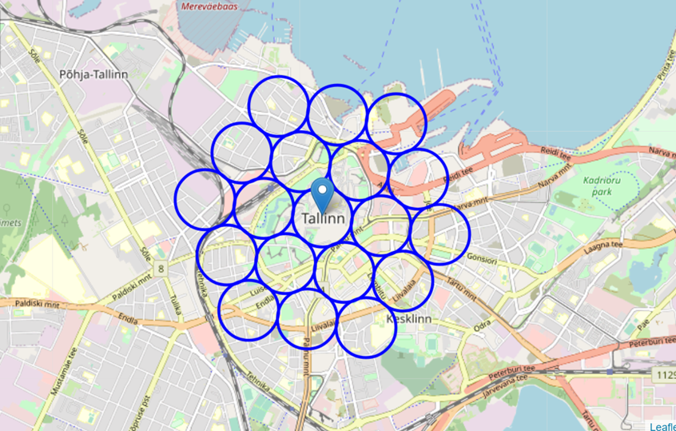
Data
Neighborhood Candidates
We visualize the data we have - the location of the center of the area under consideration (Town Hall Square) and the boundaries of potential locations within it.

Slide 6
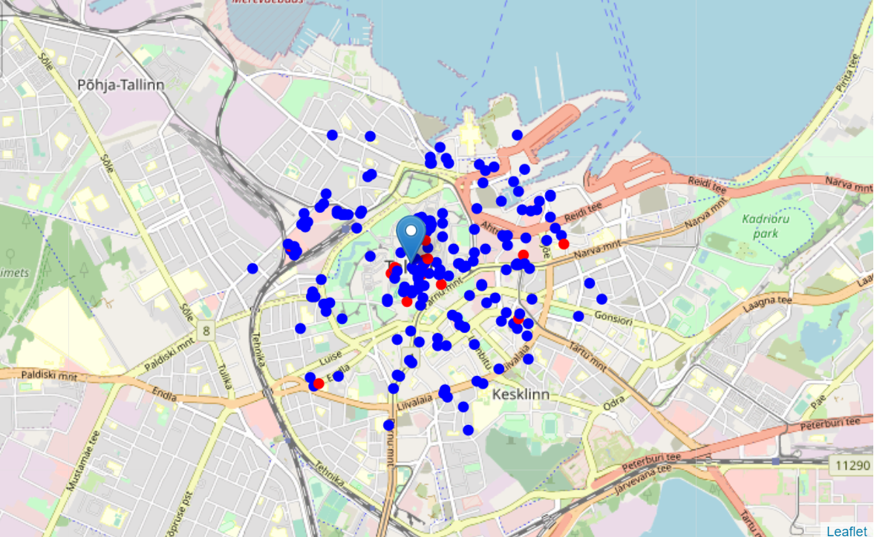
Data
Foursquare
We found in the area under consideration all the restaurants in general and Eastern European cuisine in particular (blue and red, respectively).

Slide 7
Methodology
At the first stage, we collected the necessary data - the location of all restaurants within 1.5 km from Town Hall Square, as well as restaurants of Eastern European cuisine (in accordance with the Foursquare categorization).
The second stage of our analysis is the calculation and study of the "density" of restaurants in different locations of the considered area in order to identify several promising locations near Town Hall Square with a small number of restaurants in general and the absence of restaurants of Eastern European cuisine nearby. To do this, we will use heat maps.
Thus, the results of our project will become the starting point for a detailed study at the "street level" and, taking into account the analysis of additional factors beyond the scope of this study, determining the optimal location of the first foreign restaurant of the company "EEC.

Slide 8
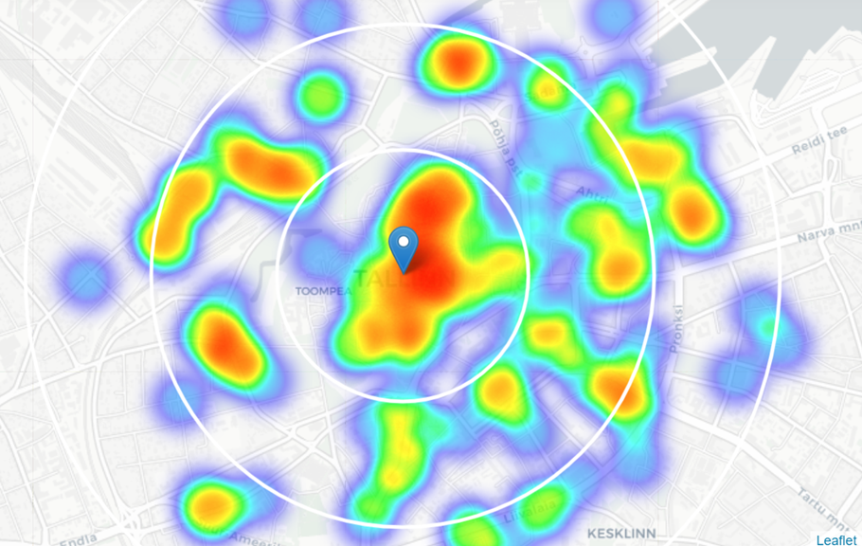
Analysis
Density of all restaurant
We created a heat map showing the density of restaurant locations.

Slide 9
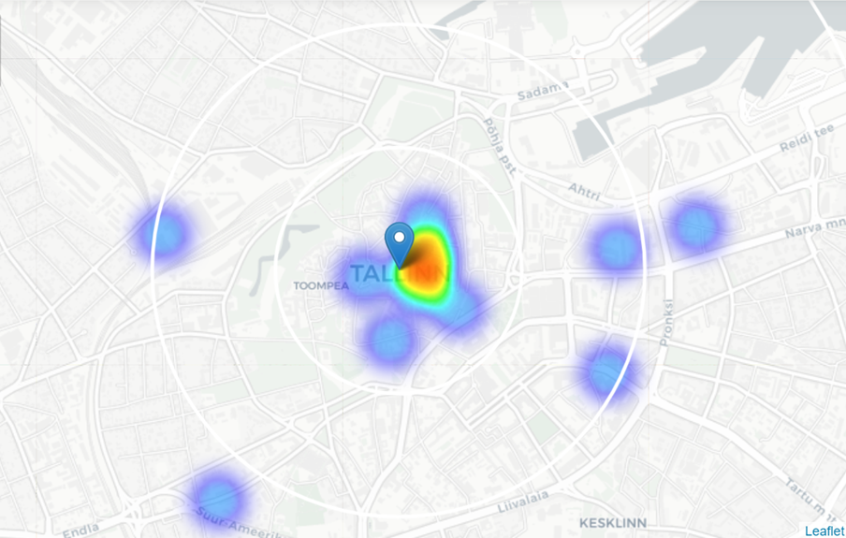
Analysis
Density of Eastern European restaurants
We created a heat map showing the density of Eastern European restaurants.

Slide 10
Results
Our research shows that there are a relatively large number of restaurants of different types / categories in the historical part of Tallinn and in the surrounding area (~200 in our area of interest, with a radius of 1.5 km around Town Hall Square).
The largest concentration of restaurants was found in the center and to the east of Town Hall Square, while there are locations with a relatively low density of restaurants in the west and north.
The density of restaurants of Eastern European cuisine, as the analysis shows, is quite low in the entire area under consideration.

Slide 11
Discussion
On the one hand, the locations to the west and north of Town Hall Square can be considered as a priority for further more detailed research, including in the "field" conditions.
However, this does not mean that these locations are the optimal places for our restaurant. Perhaps there are good reasons for the low density of restaurants in these locations, which can become stop factors for opening our restaurant there.
The recommended locations should be considered only as a starting point for further, more detailed analysis.

Slide 12
Conclusion
The purpose of this project was to determine the most promising locations for placing an Eastern European cuisine restaurant in the historical part of Tallinn, taking into account the presence of restaurants in general and with Eastern European cuisine in particular in the area under consideration.
Having calculated the distribution of the density of restaurants according to Foursquare data, we have identified the locations (to the west and north of Town Hall Square) that will be used as starting points for a detailed study.
The final decision on the location of the restaurant will be made by the interested parties on the basis of additional information about the locations and the competitive environment obtained during their study directly on the spot.

