Slide 1
Visualization of Marginal Effects in Neural Networks
Alex Afanasev & Jacqueline Seufert
A dynamic approach with R Shiny

Slide 2
Introduction
Understanding and visualizing the effects of the predictor variables on the predicted response is essential in supervised learning
Black box models such as neural networks lack interpretability and transparency
The most common approach is a Partial Dependence Plot

Slide 3
Theory – Neural Networks
Definition Neural Network: A computing system made up of a number of simple, highly interconnected processing elements, which process information by their dynamic state response to external inputs.
Applications:
Identifying associations or detecting regularities within a set of patterns where:
the volume, number of variables or diversity of the data is large
the connections between variables are vaguely understood
the relationships are challenging to describe satisfactorily with standard approaches
Visualization of Marginal Effects in Neural Networks

Slide 4
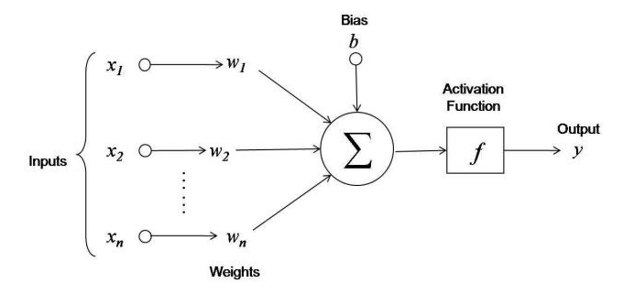
Theory – Neural Networks
Functionality:
Simplified functionality:
The input nodes take in information (numeric activation values)
Based on weights and transfer functions, the activation value is passed from node to node.
Each node sums received activation values → modifies value based on transfer function
Activation flows through network, through hidden layers, until it reaches the output nodes.
The output nodes then reflect the input in a meaningful way to the outside world.
Visualization of Marginal Effects in Neural Networks

Slide 5
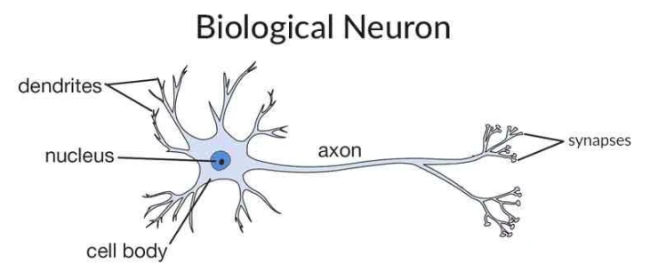
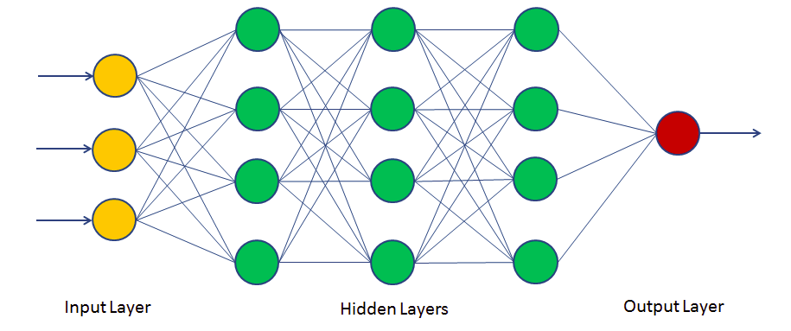
Theory – Neural Networks
Visualization of Marginal Effects in Neural Networks

Slide 6
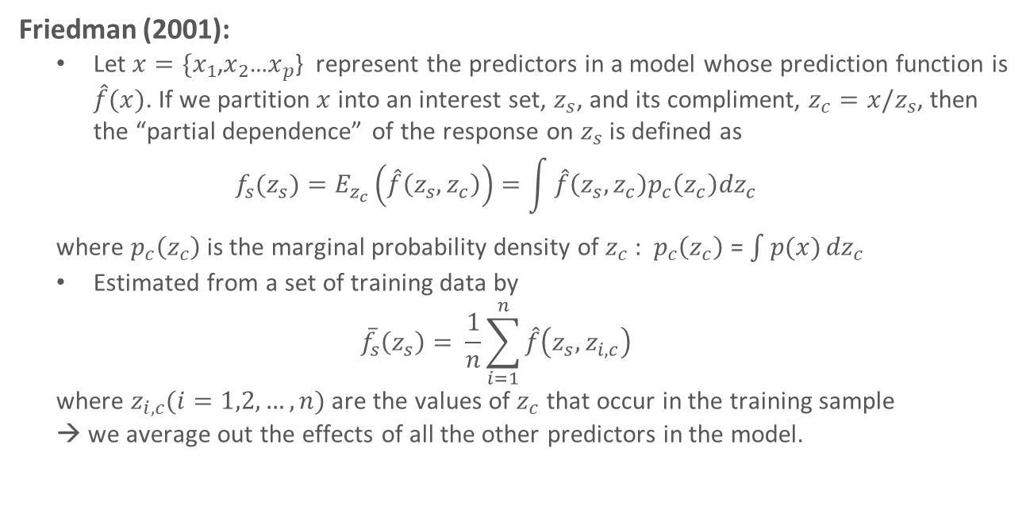
Literature – Partial Dependence Plots
Friedman (2001):
Let $x=\{x_{1}$,$x_{2}$…$x_{p}$} represent the predictors in a model whose prediction function is $\hat{f}(x)$. If we partition $x$ into an interest set, $z_{s}$, and its compliment, $z_{c}=x/z_{s}$, then the “partial dependence” of the response on $z_{s}$ is defined as
$$f_{s}{(z}_{s})=E_{z_{c}}\left(\hat{f}\left(z_{s}, z_{c}\right)\right)=\int{\hat{f}\left(z_{s}, z_{c}\right)p_{c}\left(z_{c}\right){dz}_{c}}$$
where $p_{c}\left(z_{c}\right)$is the marginal probability density of $z_{c}$: $p_{c}\left(z_{c}\right)$ = ${\int{p(x)}dz}_{c}$
Estimated from a set of training data by
$${\overline{f}}_{s}\left(z_{s}\right)= \frac{1}{n}\sum_{i=1}^{n}{\hat{f}\left(z_{s}, z_{i,c}\right)}$$
where $z_{i,c}(i=1,2,…,n)$are the values of $z_{c}$ that occur in the training sample
→ we average out the effects of all the other predictors in the model.
Visualization of Marginal Effects in Neural Networks

Slide 7
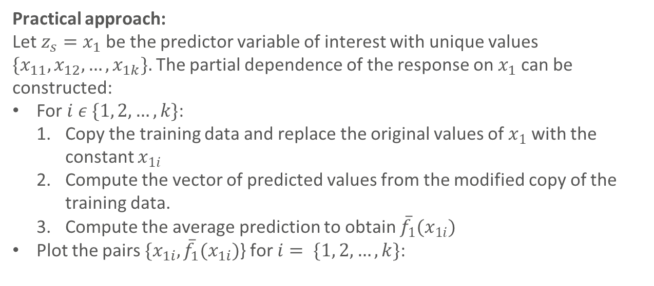
Literature – Partial Dependence Plots
Practical approach:
Let $z_{s}=x_{1}$be the predictor variable of interest with unique values $\{x_{11},x_{12},…,x_{1k}\}.$The partial dependence of the response on $x_{1}$can be constructed:
For $i ε \{1, 2,…,k\}$:
Copy the training data and replace the original values of $x_{1}$with the constant $x_{1i}$
Compute the vector of predicted values from the modified copy of the training data.
Compute the average prediction to obtain ${\overline{f}}_{1}(x_{1i})$
Plot the pairs ${\{x}_{1i},{\overline{f}}_{1}(x_{1i})$} for $i= \{1, 2,…,k\}$:
Visualization of Marginal Effects in Neural Networks

Slide 8
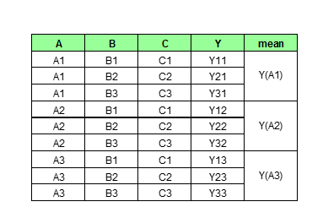
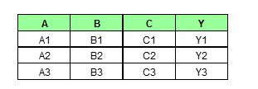
Theory – Partial Dependence Plots
Illustration
Combine every unique value of factor A with combinations of the other factors
Predict the response variable Y
Calculate the mean of the predicted response for every unique value of A
Visualization of Marginal Effects in Neural Networks

Slide 9
Evaluation – Partial Dependence Plots
Advantages | Disadvantages
Intuitive: Average prediction if all data points to assume a particular feature value | Maximum number of features: 2 due to the limited visualization possibilities
Clear interpretation in uncorrelated case: Partial dependence plot shows how the average prediction in dataset changes when j-th feature is changed. | Not always display feature distribution. Overinterpret regions with almost no data due to omitted distribution
Easy to implement. | Assumption of independence between feature
Causal interpretation. | Hidden heterogeneity due to average marginal effect
Visualization of Marginal Effects in Neural Networks

Slide 10
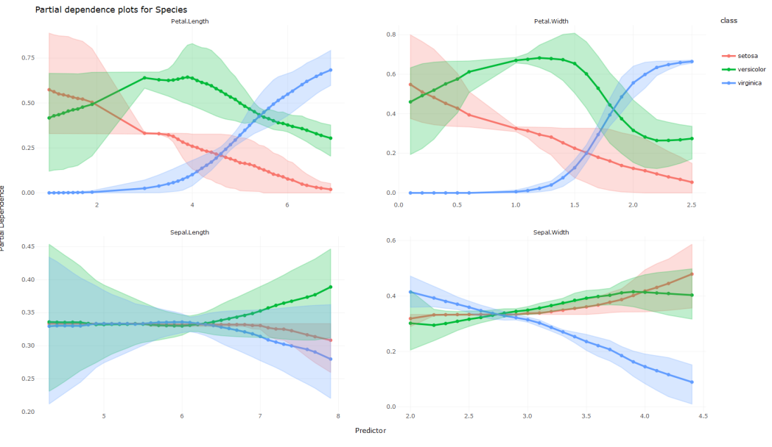
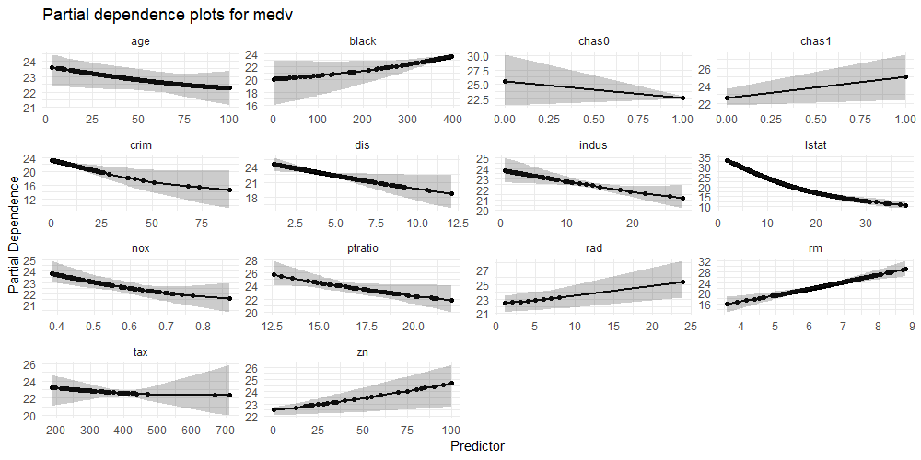
NeuralNetworkVisualization
A R Package for creating beautiful partial dependence plots for Neural Networks using ggplot2, plotly and shiny.

Slide 11
Functions
Step-by-step procedure:
Fit a neural network using the NeuralNetwork class (uses the famous neuralnet package for fitting the model)
Create visualizations of the partial dependencies using the plot_partial_dependencies function (This creates visualizations in ggplot2 and if wanted in plotly, adds a confidence interval)
Visualize the plots inside a shiny app using the function run_shiny_app

Slide 12
Recommendations beyond the scope of NeuralNetworkVisualization
A PDP is not always appropriate. Thus, there are several methods which could help to extend the package’s functionality.
Interacting features: Disaggregating the global effect estimates of the partial dependence to local effect estimates for single observations → ICE plot
Correlated features lead to extrapolation: Main effect of the feature at a certain value compared to the average prediction of the data → ALE plot
Nonlinear relationships: Plot a snippet of the change in the predicted response for a unit change in the predictor of interest while keeping the remaining predictors constant

Slide 13
Sources
"Neural Network Primer: Part I" by Maureen Caudill, AI Expert, Feb. 1989
https://towardsdatascience.com/first-neural-network-for-beginners-explained-with-code-4cfd37e06eaf
https://www.datacamp.com/community/tutorials/neural-network-models-r
Friedman, J. H. (2001): Greedy function approximation: A gradient boosting machine. Annals of Statistics, 29, 1189 - 1232.
https://towardsdatascience.com/introducing-pdpbox-2aa820afd312
https://christophm.github.io/interpretable-ml-book/pdp.html

