Slide 1
Model of statistical errors in the search for the deuteron EDM in the storage ring

Slide 2

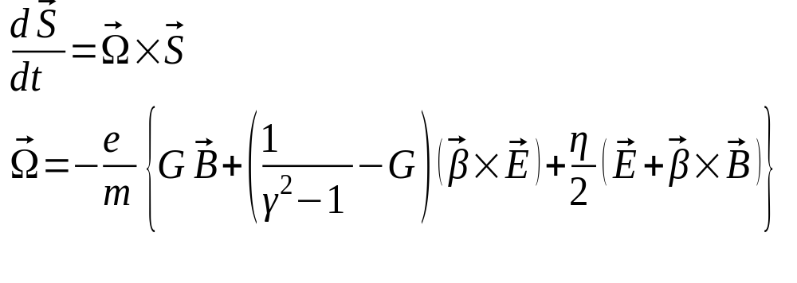


Methodology
When put into an electromagnetic field, the particle spin begins to precess according to the T-BMT equation:
MDM
EDM
By measuring the beam’s polarization, we can determine the frequency
Comparing the CW vs CCW frequencies, determine

Slide 3
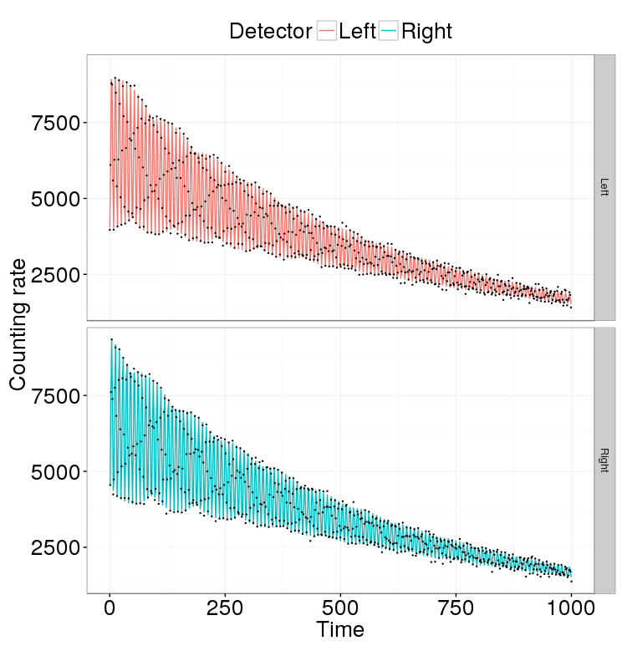
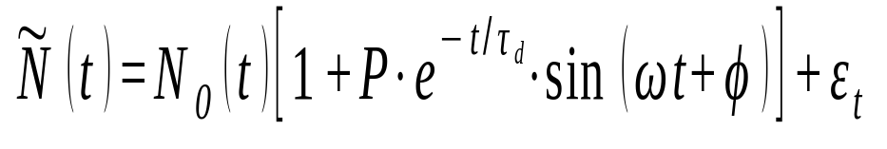
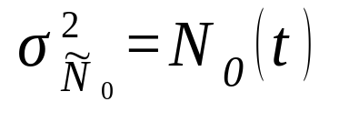
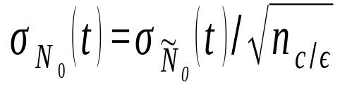
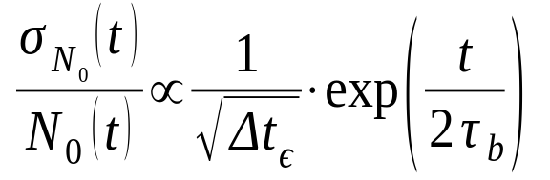
Detector counting rate
Number of counts is Poisson distributed, hence

Slide 4
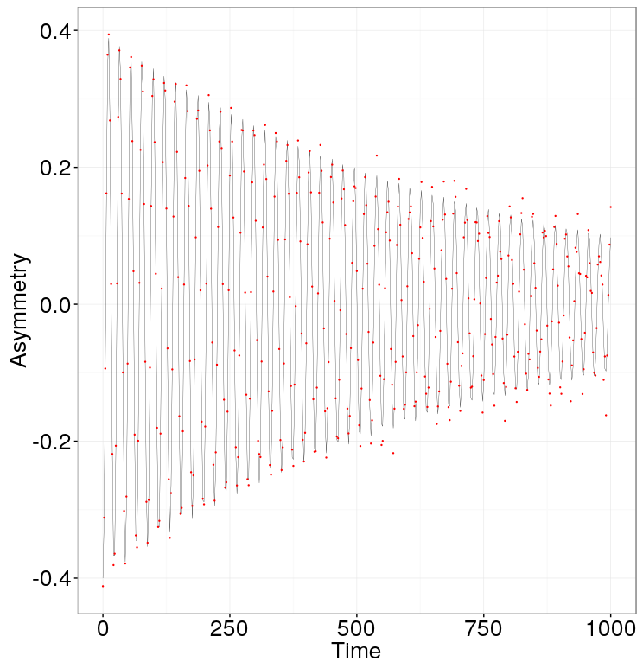
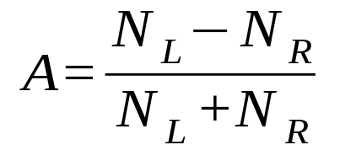
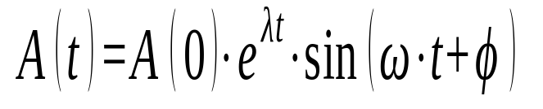
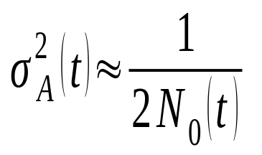
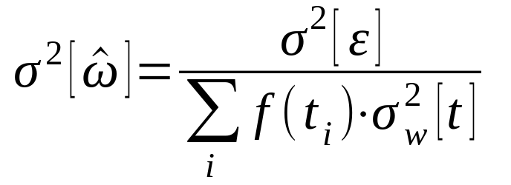
Cross section asymmetry
A measure of polarization
Definition:
Model:
Error:

Slide 5
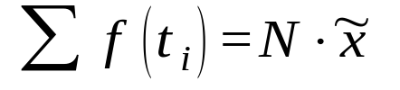
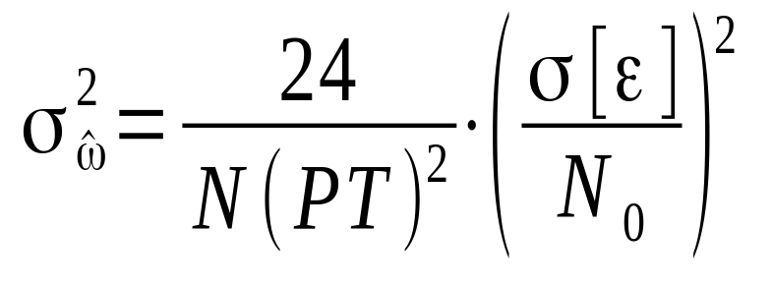
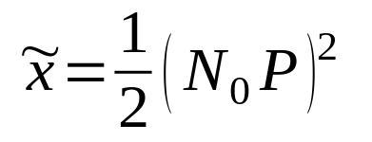
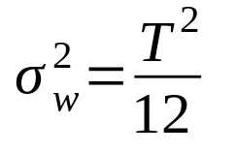
Standard Error
No decoherence
Uniform sampling

Slide 6
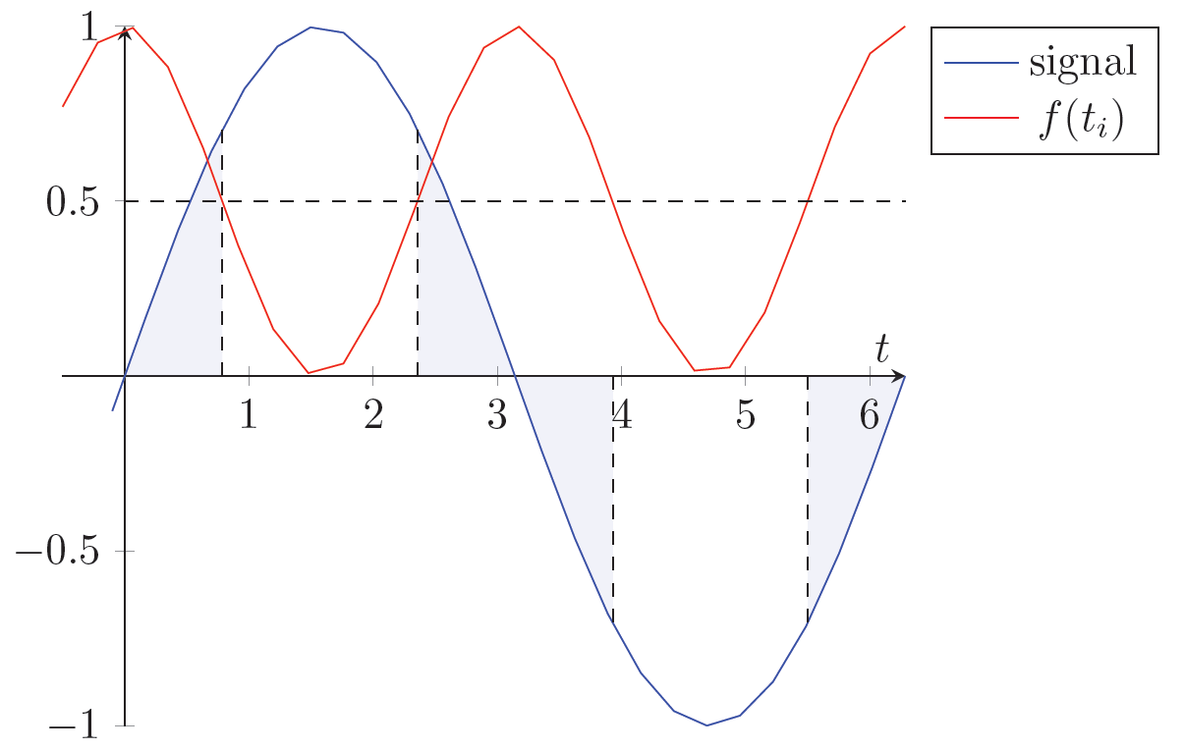
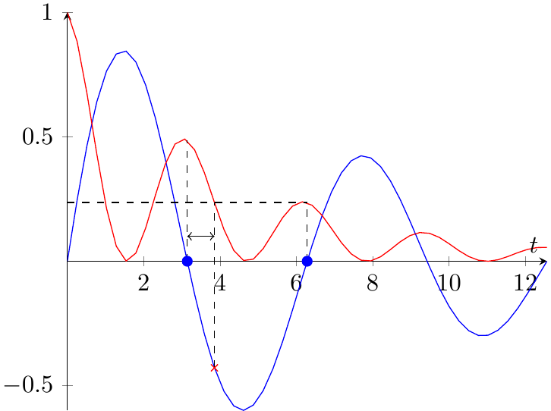
Limiting factors
Sample Fisher information can be increased by sampling during rapid change
Limited by polarimetry sampling rate
Point Fisher information falls exponentially due to decoherence
Can't economize the beam too much

Slide 7
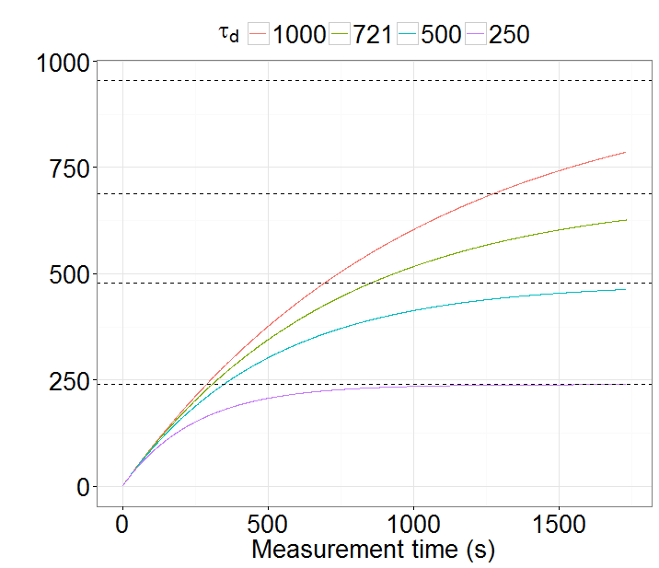
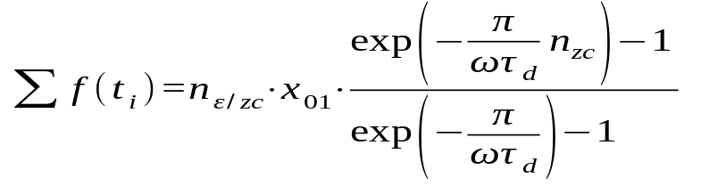
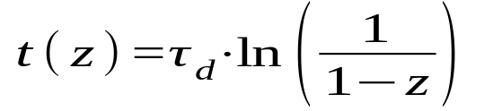
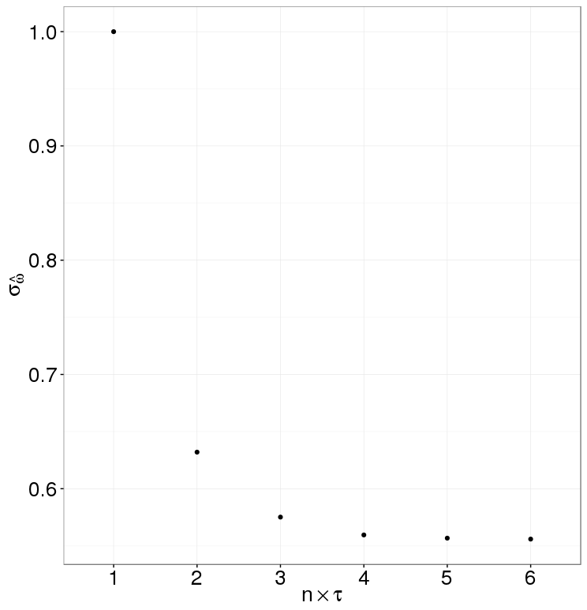
Time-spread
FI limit (%) | Reached (×τ_{d}) | SNR@3% error
95 | 3.0 | 1.7
90 | 2.3 | 3.3
70 | 1.2 | 10.0

Slide 8
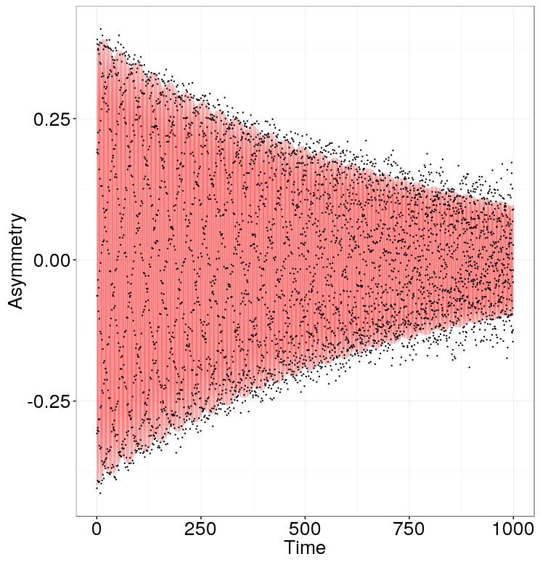
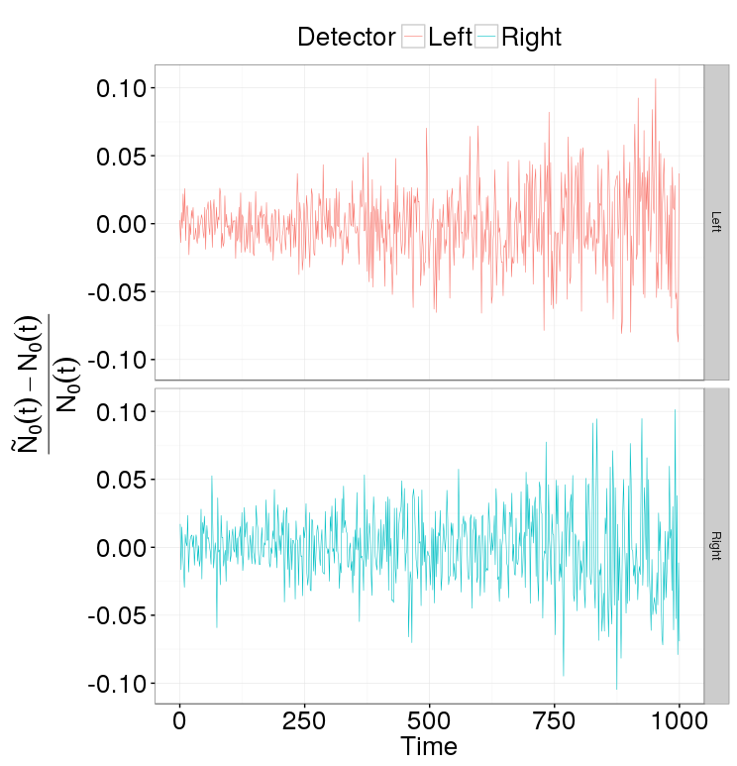
Simulation
Uniform sampling
75% of the beam (7.5⋅ 10⁸ useful scatterings)
3% initial counting rate error
Standard error 7.55⋅10⁻⁷ rad/sec
If ω is known down to 10⁻⁶, can improve the result by 30%

Slide 9
Thank You

