Slide 1



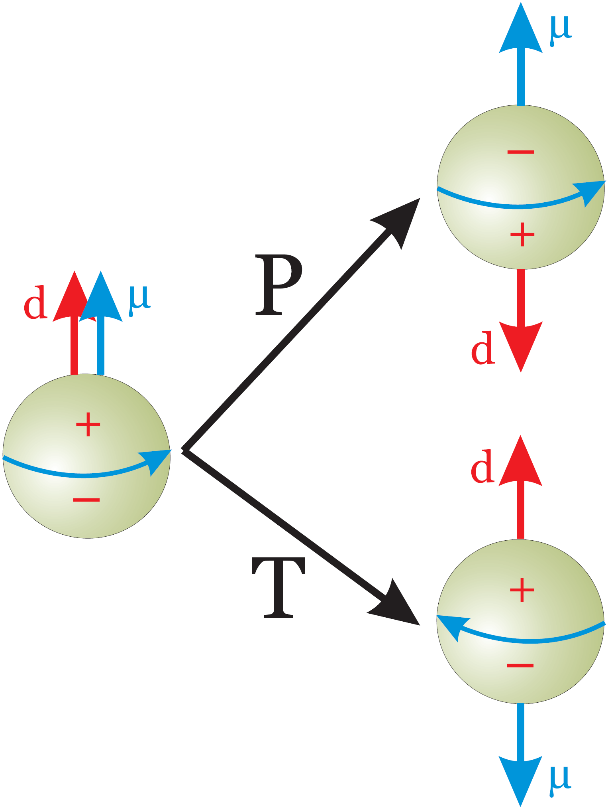
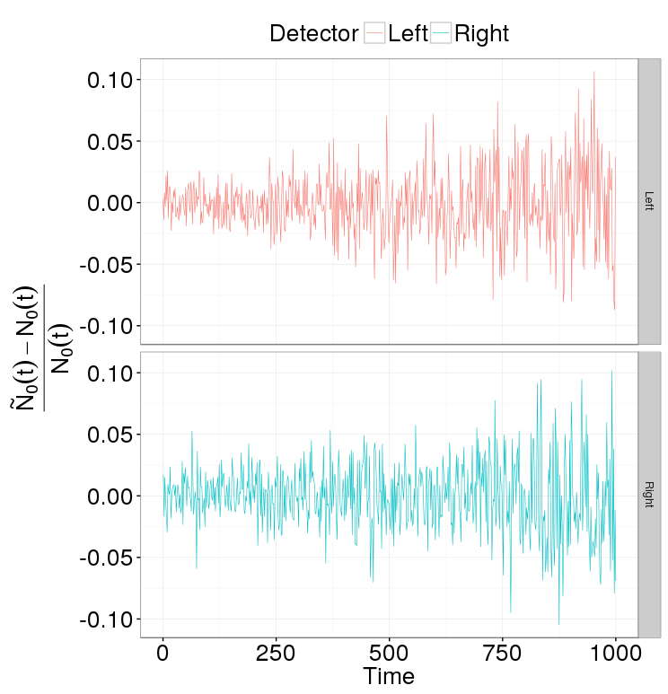
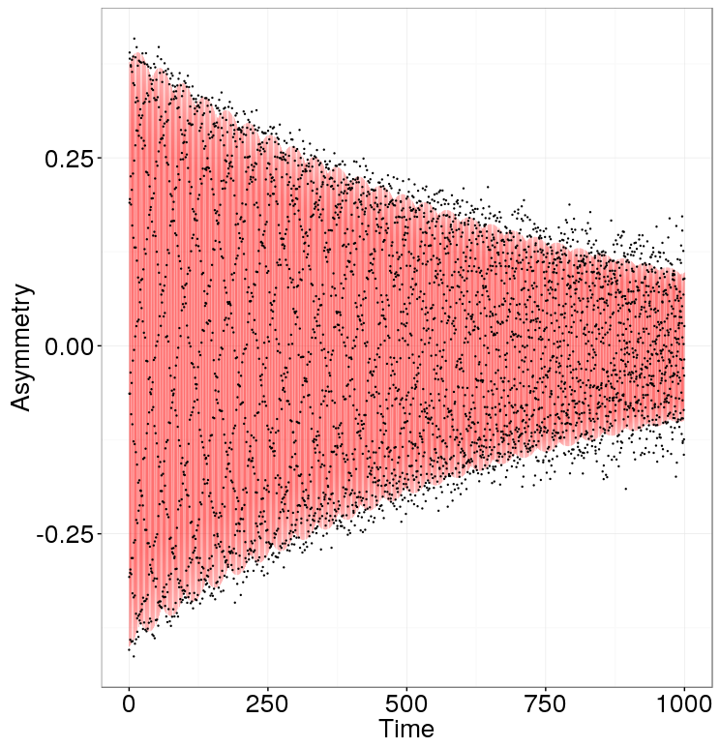
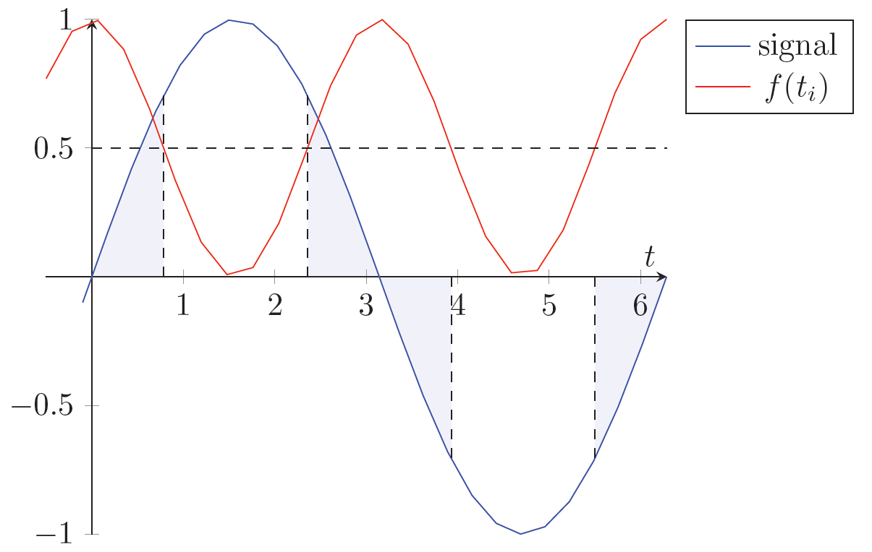
Model of statistical errors in the search for the deuteron EDM in the storage ring
A. Aksentyev^{1,2}, Y. Senichev¹,
¹ Institute for Nuclear Physics, Forschugszentrum Jülich, Jülich, Germany
² National Research Nuclear University “MEPhI,” Moscow, Russia
By allowing for values within experimental reach, particle EDMs serve as excellent probes for physics beyond the SM. The storage ring method for searching for the deuteron EDM consists in measuring the beam spin tune via polarimetry. Since the number of particles in one fill is limited, one must maximize the utility of the beam. This raises the question of sampling efficiency, as the signal, being an oscillating function, varies in informational content. To address this question, we define a numerical model and compare the uniform and frequency-modulated sampling strategies.
CW beam
CCW beam
MDM spin precession ≈ 3 rad/sec
EDM spin precession ≈ 10⁻⁹ rad/sec
Solution: CW/CCW procedure
Uniform sampling
Sample size equivalent to 2,000 events/20 millisec for 1000 sec
A measurement of the EDM on the order of 10⁻²⁹ e∙cm requires a standard error of the frequency estimate be better than 10⁻⁹ rad/sec
Modeling shows that such precision can be achieved in one year of measurement by the application of a modulated sampling strategy
Sampling | Fisher Info a.u.
uniform | 1.00
50% compaction | 1.64
80% compaction | 1.94
By modulating the sampling frequency we can potentially improve the precision of the frequency estimate by a factor of √2
An error on the order of 10⁻⁶ rad/sec is sufficient for a 30% improvement in precision

