Slide 1
Statistical Error
A.E. AKSENTEV^{1,2}, Y.V. SENICHEV¹
¹ IKP, Forschungszentrum Jülich, Germany
² National Research Nuclear University «MEPhI», Russia

Slide 2
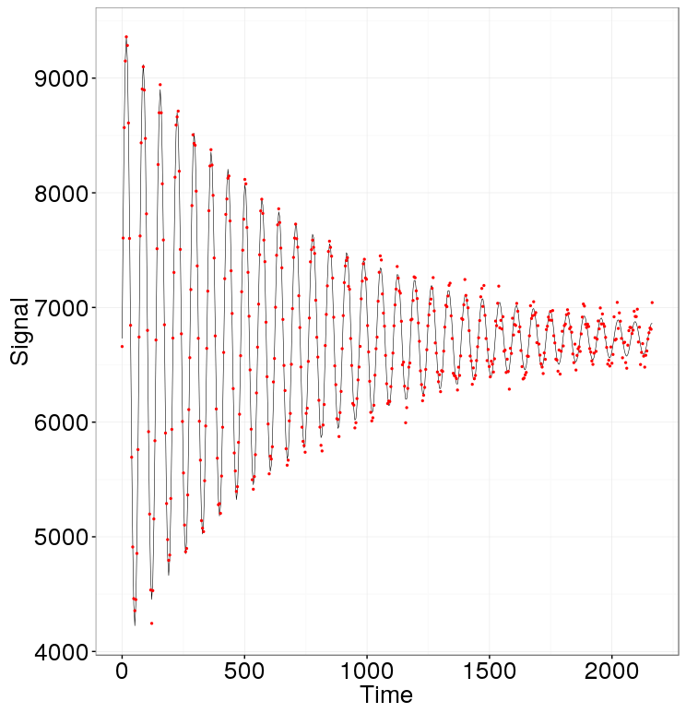
Problem statement

Slide 3
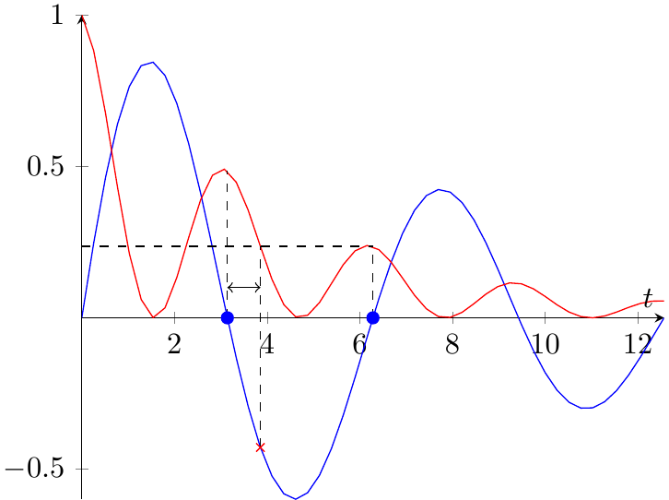
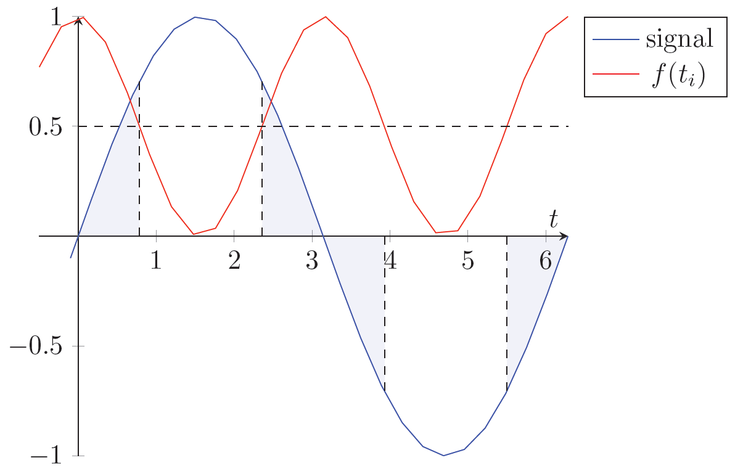
Two aspects

Slide 4
Goals
Under what conditions sampling modulation is beneficial
How much modulation makes sense
At what point measurement is no longer reasonable

Slide 5
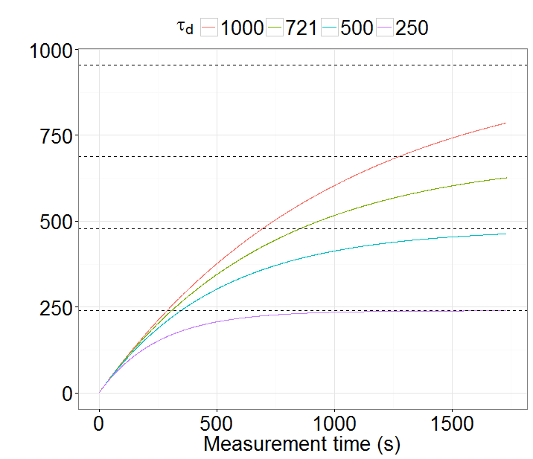
Spread
FI limit (%) | Reached (×τ_{d}) | SNR@3% error
95 | 3.0 | 1.7
90 | 2.3 | 3.3
70 | 1.2 | 10.0
50 | 0.7 | 16.5

Slide 6
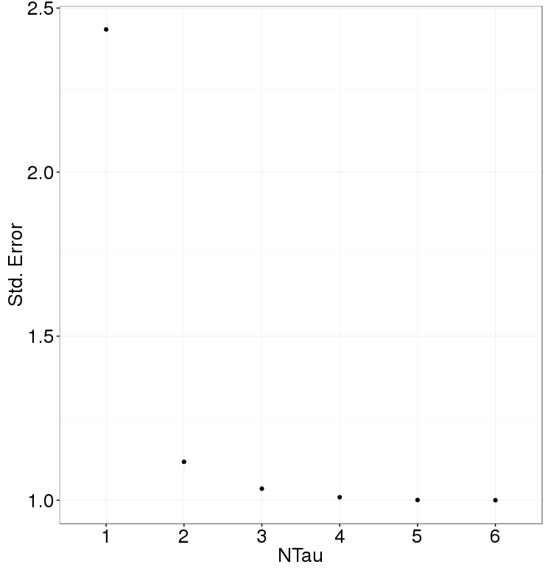
Simulation

Slide 7
Modulation: Beam lifetime doesn't matter

Slide 8
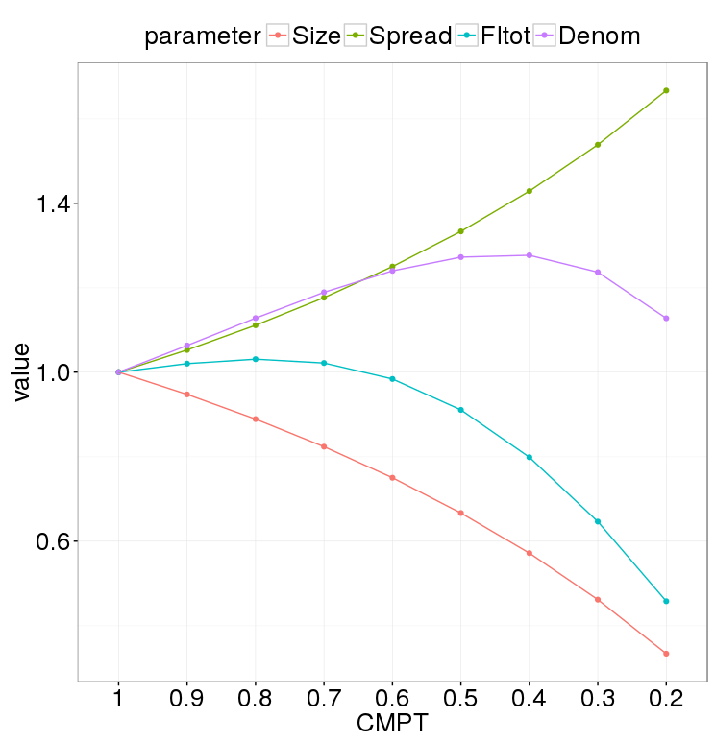
Modulation: beam lifetime matters
Notes:
The precision gain due to the increase in the spread is limited. After we’ve established the optimal experiment duration, we can then balance compaction time, number of pellets with the required duration.

Slide 9
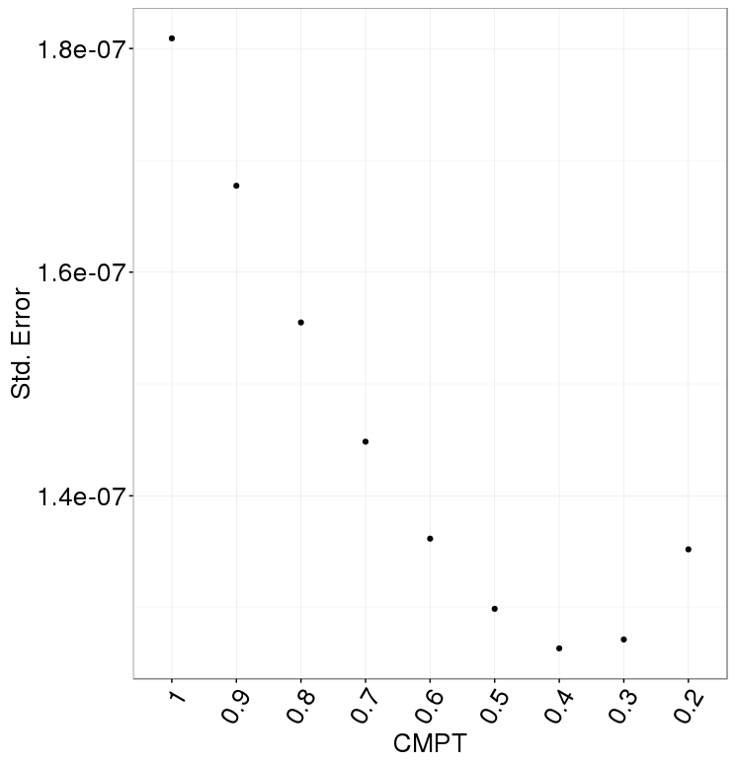
Statistical precision
Notes:
Guessed modulation frequency 3*(1+-1e-4)
Measurement error 3% everywhere

