Slide 1

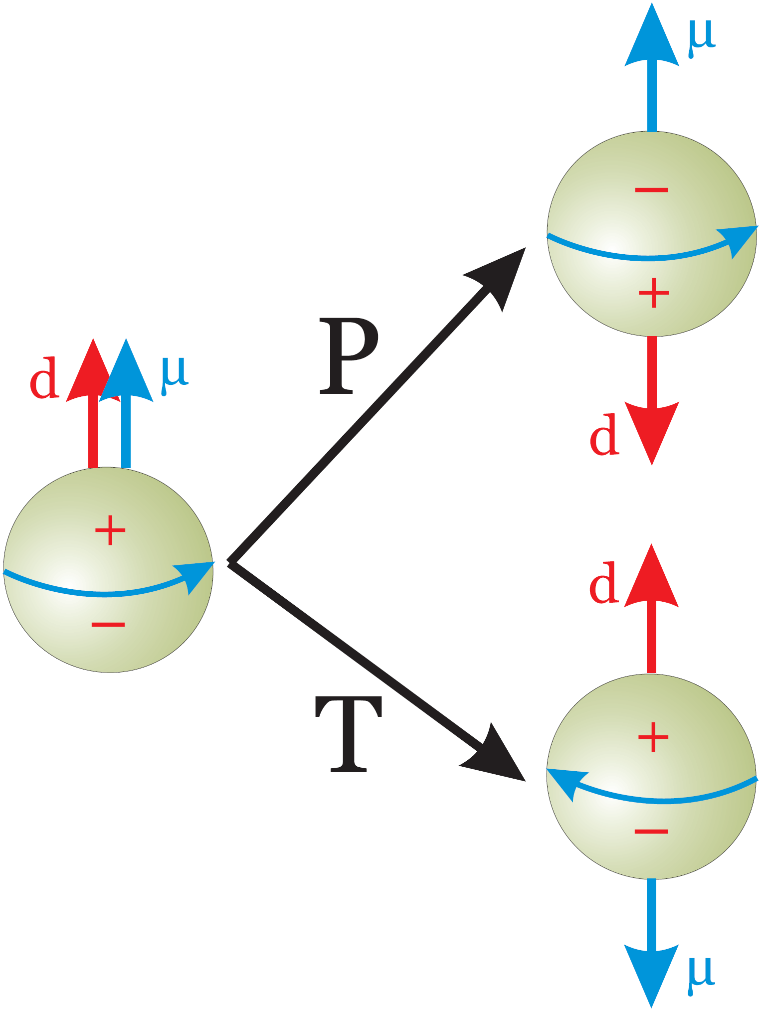
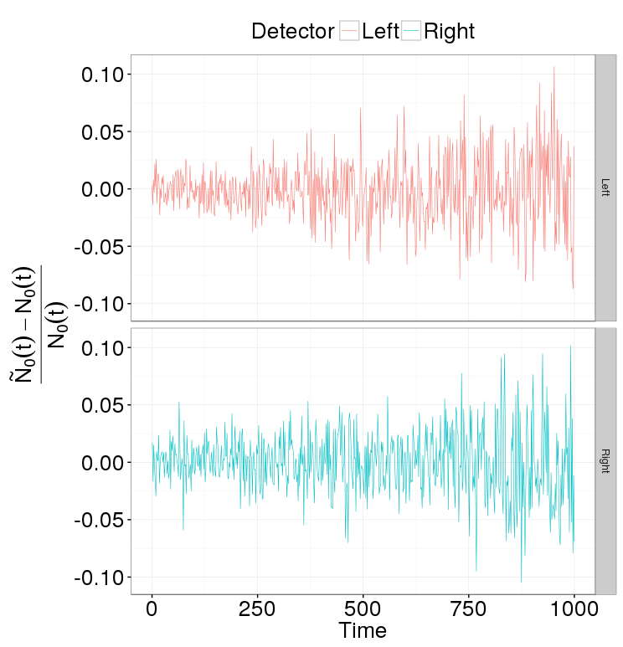
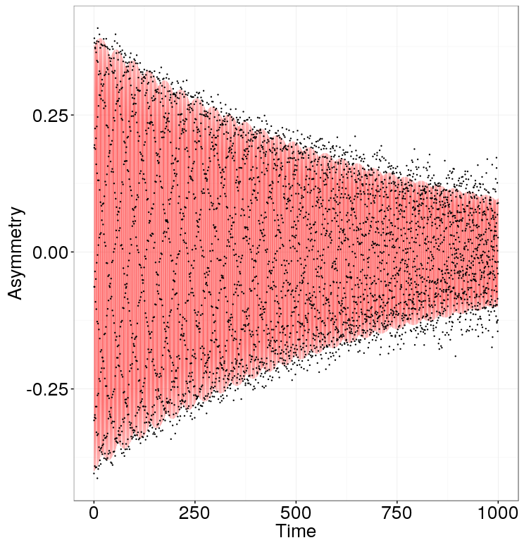
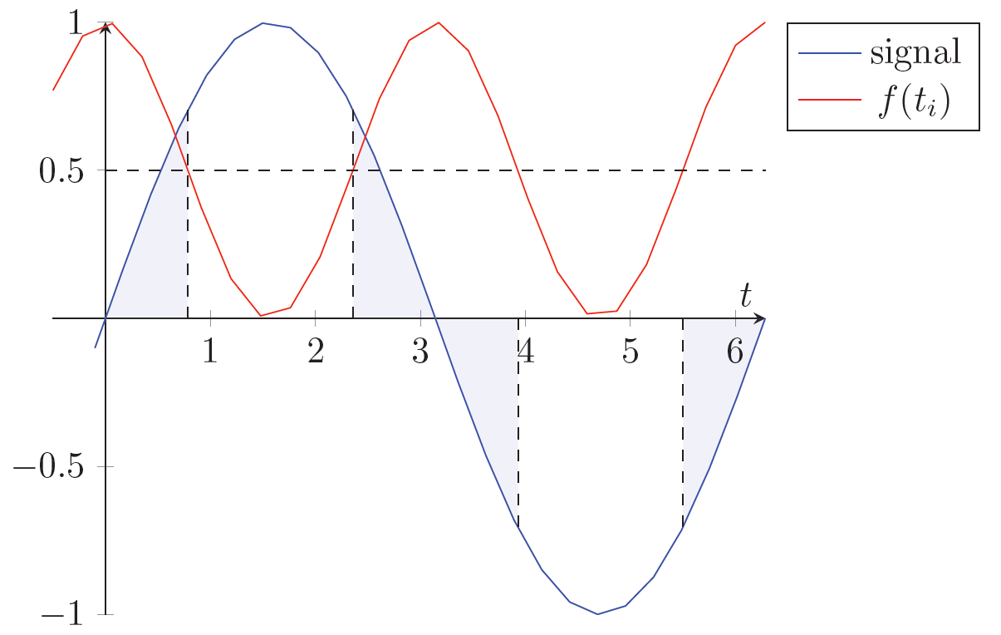
The amount of matter in the universe far exceeds that of antimatter
One of the Sakharov conditions for that is the violation of CP-symmetry
CP- and P-symmetry violations entail non-vanishing P- and T-violating Electric Dipole Moments
The SM can accommodate CP-violation, but the predicted baryogenesis rate is still far less than what one would expect; simultaneously, it predicts nucleon EDMs of magnitudes 5 orders less than the current upper bound for the neutron
Hence searches for particle EDMs promise to reveal physics beyond the SM
CW beam
CCW beam
MDM spin precession ≈ 3 rad/sec
EDM spin precession ≈ 10⁻⁹ rad/sec
Solution: CW/CCW procedure
Uniform sampling
Sample size equivalent to 2,000 events/20 millisec for 1000 sec
Sampling | Fisher Info a.u.
uniform | 1.00
50% compaction | 1.64
80% compaction | 1.94

