Slide 1
Statistical Error
A.E. AKSENTEV
IKP, Forschungszentrum Jülich, Germany
National Research Nuclear University «MEPhI», Russia

Slide 2
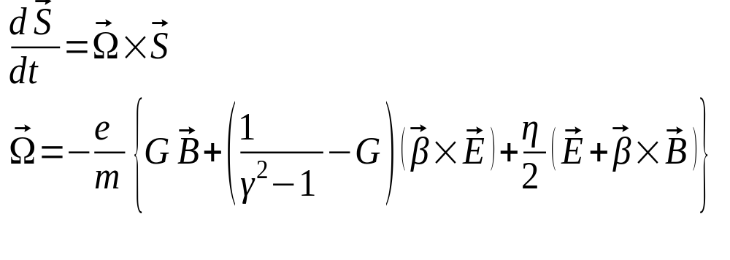


Methodology
When put into an electromagnetic field, the particle spin begins to precess according to the T-BMT equation:
MDM
EDM
By measuring the beam’s polarization, we can determine the frequency
Comparing the CW vs CCW frequencies, determine

Slide 3
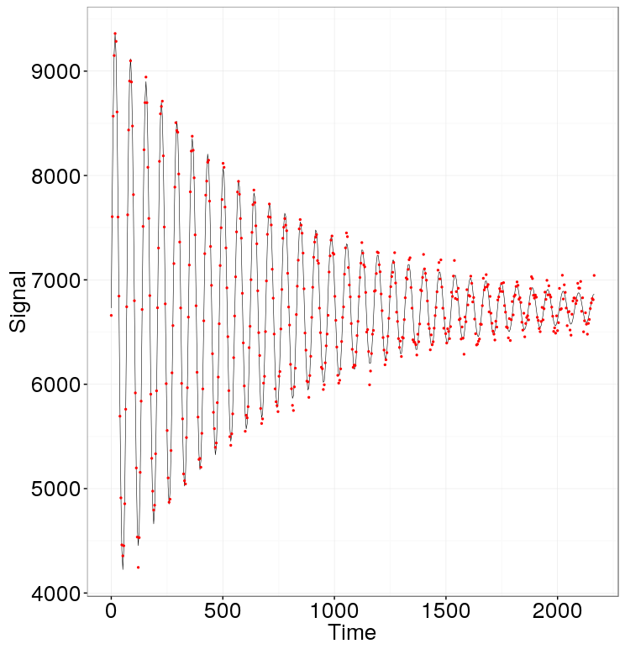
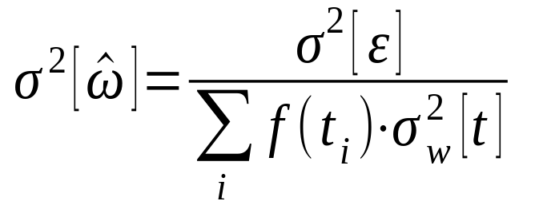
Problem statement

Slide 4
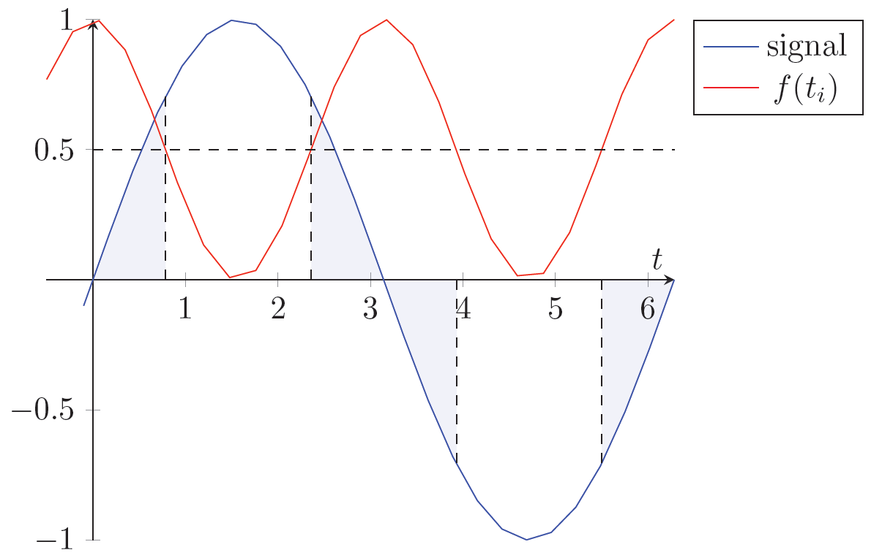
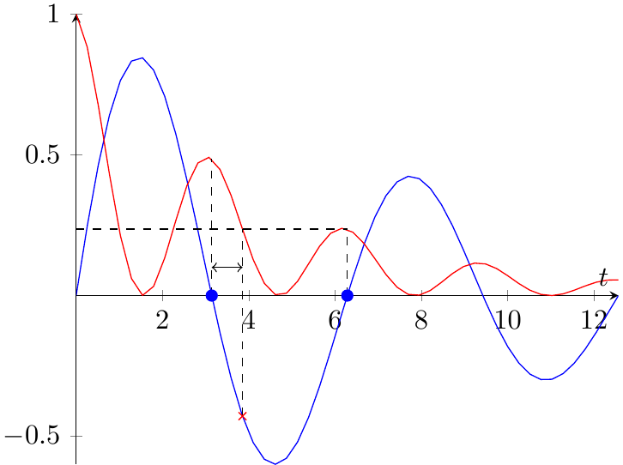
Two aspects

Slide 5
Goals
Under what conditions sampling modulation is beneficial
How much modulation is appropriate
At what point measurement is no longer informative

Slide 6
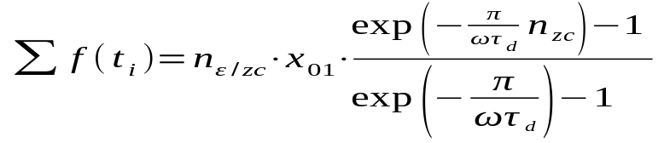
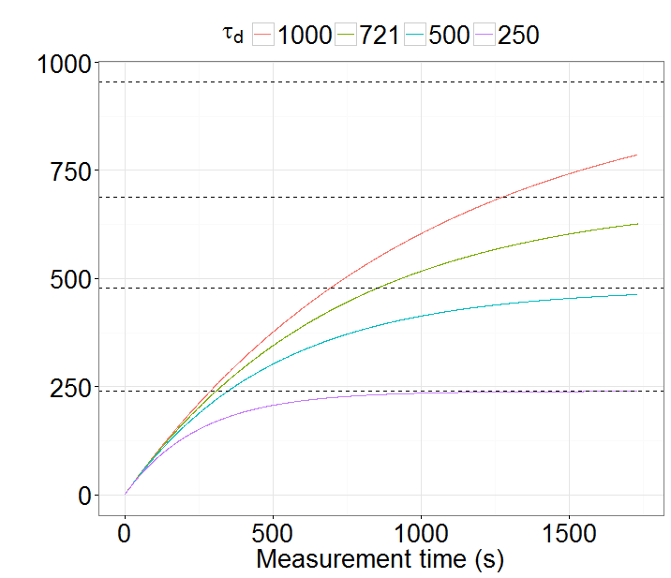
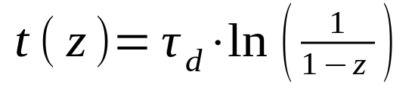
Spread
FI limit (%) | Reached (×τ_{d}) | SNR@3% error
95 | 3.0 | 1.7
90 | 2.3 | 3.3
70 | 1.2 | 10.0
50 | 0.7 | 16.5

Slide 7
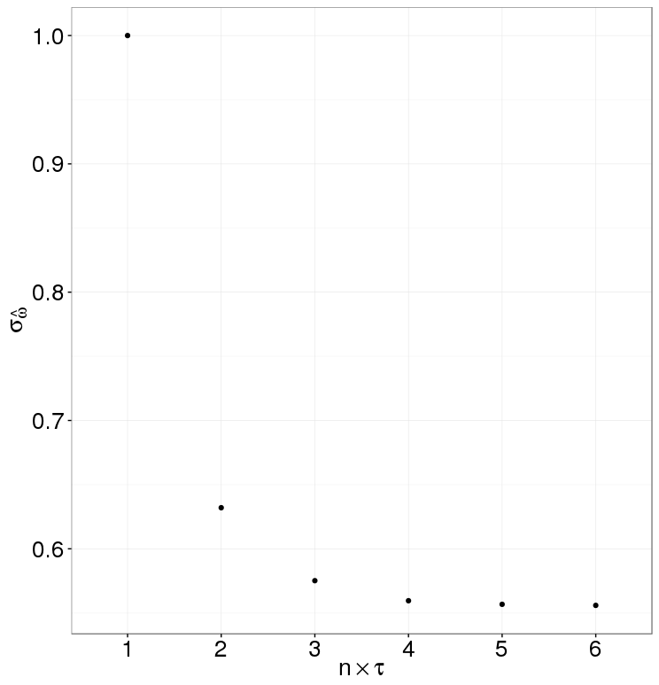
Simulation

Slide 8
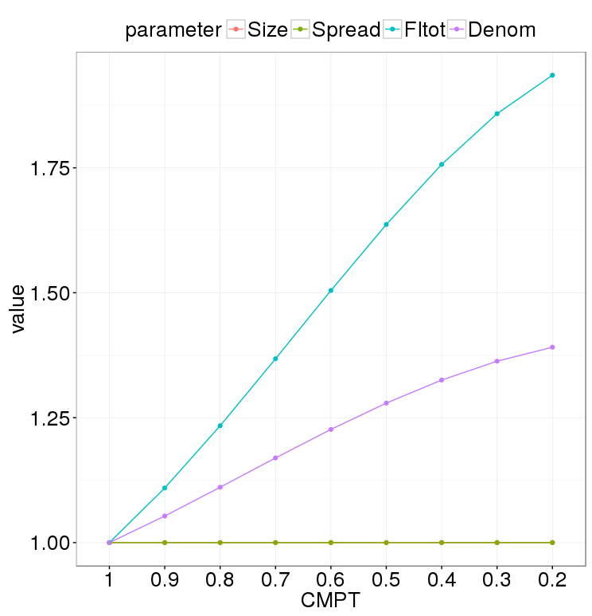
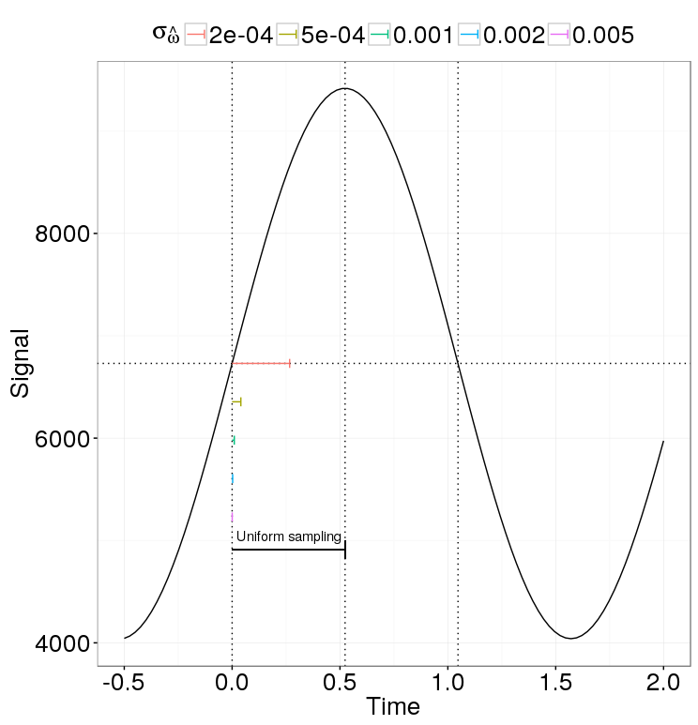
Modulation

Slide 9
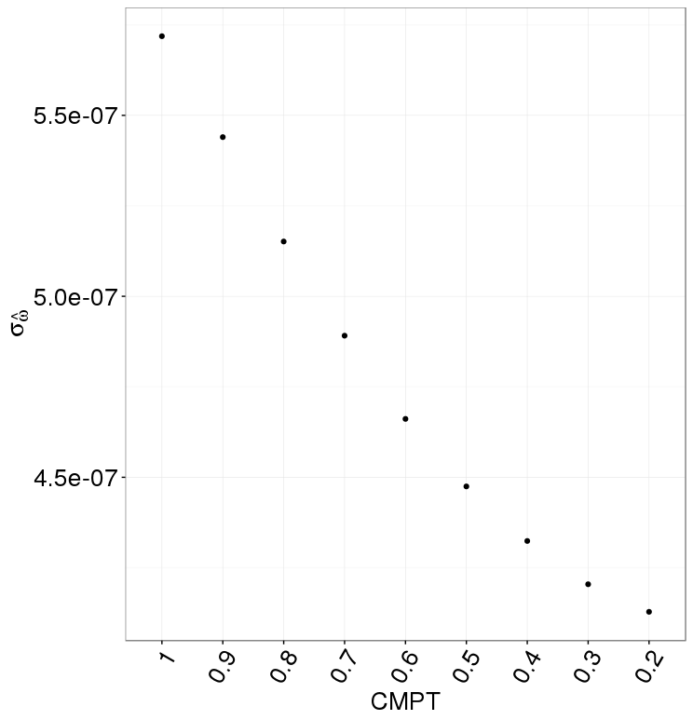

Slide 10
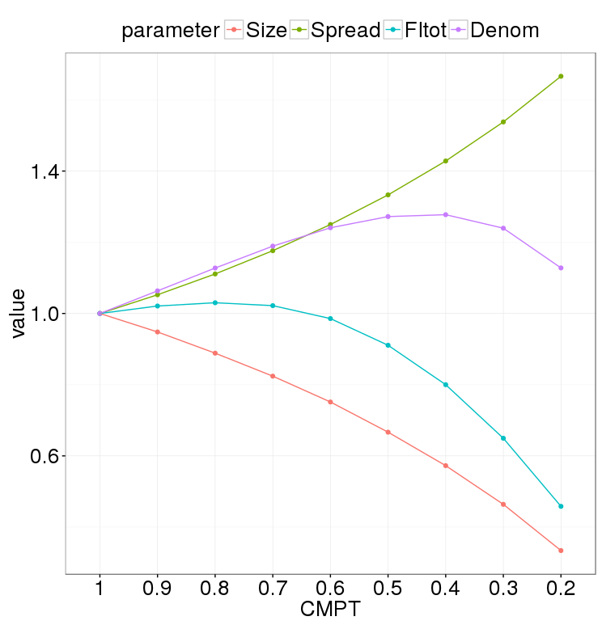
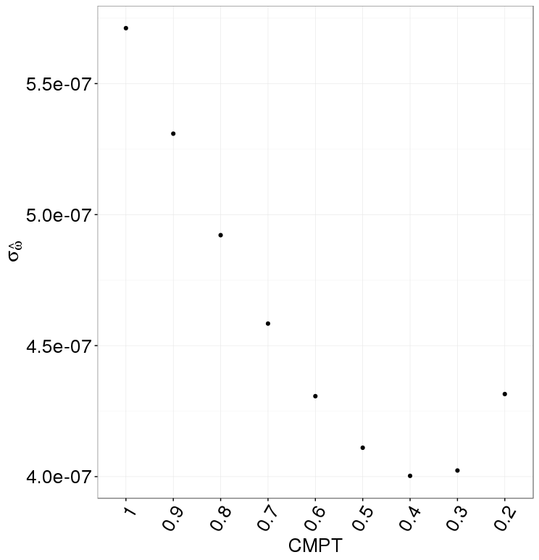
Modulation: Beam lifetime does matter
Notes:
Guessed modulation frequency 3*(1+-1e-4)
Measurement error 3% everywhere

Slide 11
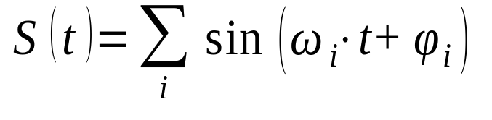
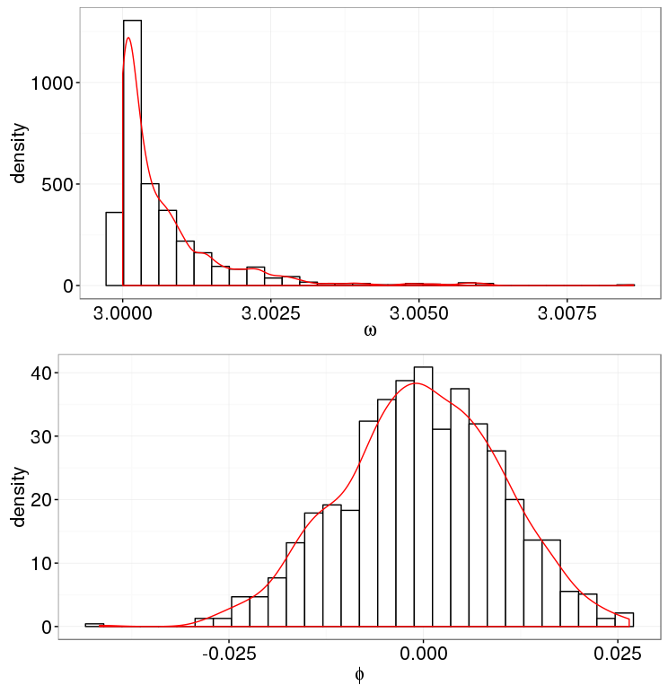
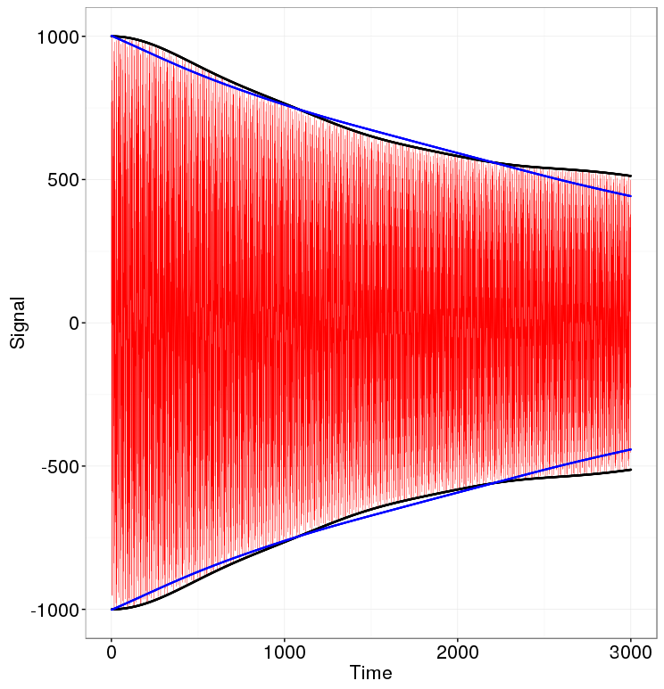
Decoherence

Slide 12
Ways to proceed
1. Find the correct model specification
2. Make the frequency spectrum small enough so that the data fit sufficiently well to a simpler model
- Sextupoles to reduce X- & Y-emittance sizes
- RF for better momentum resolution

