Slide 1
Statistical precision in charged particle EDM search in storage rings
A.E. AKSENTEV^{1,2}, Y.V. SENICHEV¹
¹ IKP, Forschungszentrum Jülich, Germany
² National Research Nuclear University «MEPhI», Russia

Slide 2
Foundation
When put into an electromagnetic field, the particle spin begins to precess according to the T-BMT equation:
MDM
EDM
By measuring the beam’s polarization, we can determine the frequency
Comparing the CW vs CCW frequencies, is determined

Slide 3
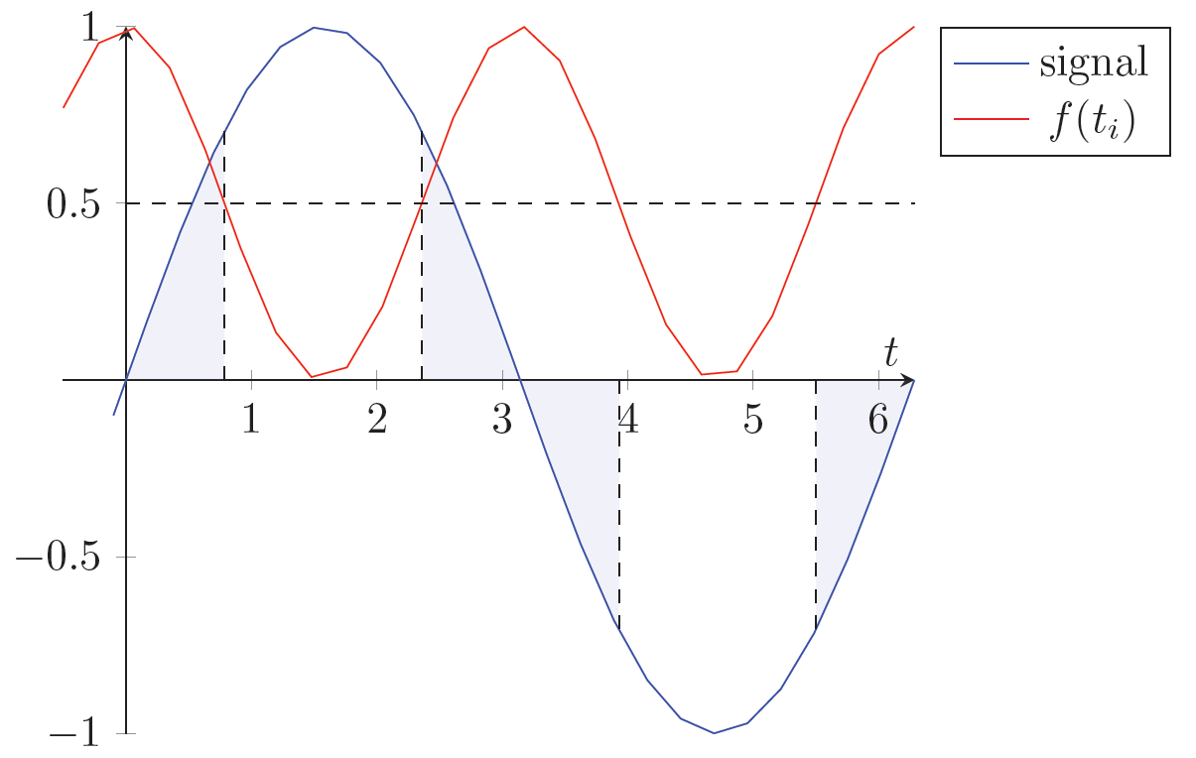
Problem statement
In first approximation, we fit the signal
MLE estimator of ω has variance

Slide 4
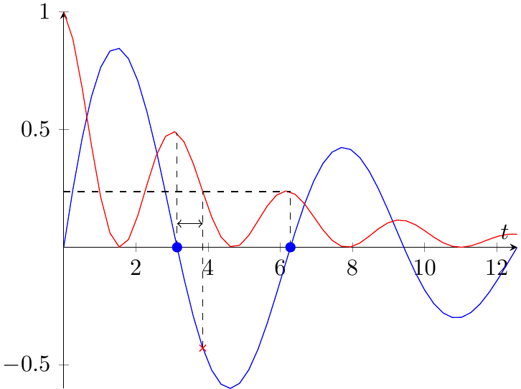
Angles
We want the sample as spread out in time, as possible
Spin tune decoherence
We want the measurements congregated around the nodes
Polarimetry counts per measurement
Spin tune decoherence
Notes:
We want the sample as spread out as possible, but the later sample points will be less informative than the earlier ones (decoherence).
We want the sample points as congregated around the nodes as possible, but a measurement takes a finite time to take, so we can fit only as much within a given time frame (unless we decrease the precision of a measurement; counts/measurement), and while we wait for the next node, the measurements’ informativity falls (decoherence)
However, if we increase the number of pellets while reducing measurement time, we can balance the decrease in the number of counts per measurement caused by the reduction of the time with the increase due to the greater scattering rate.

Slide 5
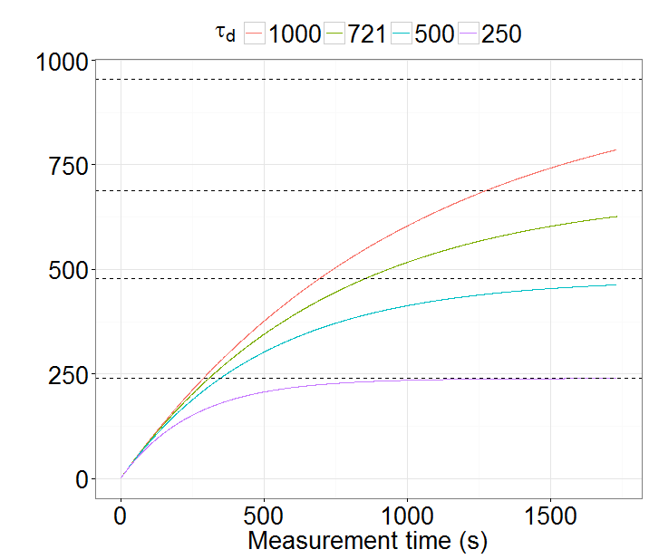
Spread
FI limit (%) | Reached (×τ_{d}) | SNR@3% error
95 | 3.0 | 1.7
90 | 2.3 | 3.3
70 | 1.2 | 10.0
50 | 0.7 | 16.5

Slide 6
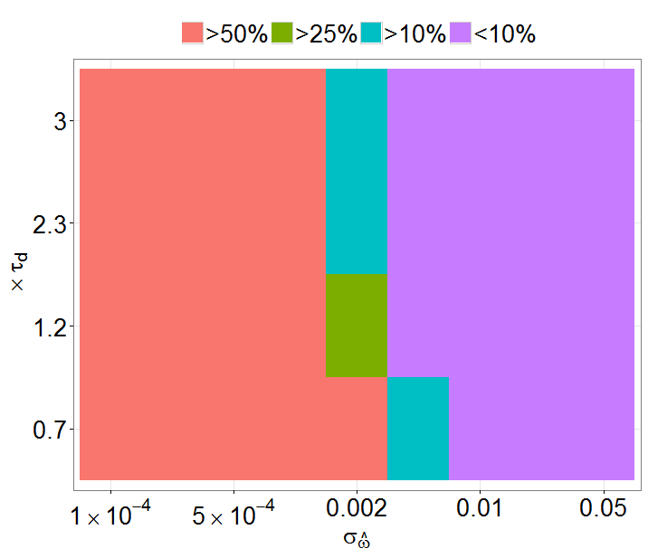
Modulation
Notes:
The precision gain due to the increase in the spread is limited. After we’ve established the optimal experiment duration, we can then balance compaction time, number of pellets with the required duration.

Slide 7
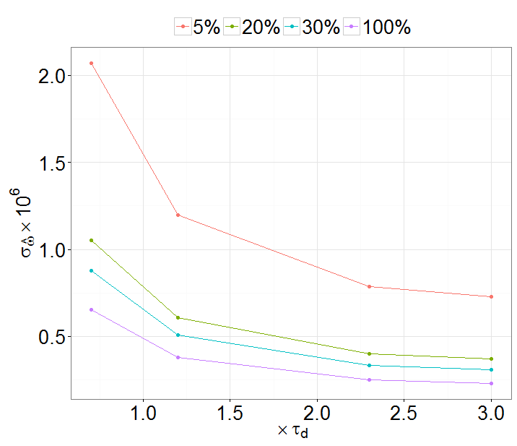
Statistical precision
Notes:
Guessed modulation frequency 3*(1+-1e-4)
Measurement error 3% everywhere

