Slide 1
Statistical precision in charged particle EDM search in storage rings
A.E. AKSENTEV^{1,2}, Y.V. SENICHEV¹
¹ IKP, Forschungszentrum Jülich, Germany
² National Research Nuclear University «MEPhI», Russia

Slide 2
Foundation
When put into an electromagnetic field, the particle spin begins to precess according to the T-BMT equation:
MDM
EDM
By measuring the beam’s polarization, we can determine the frequency
Comparing the CW vs CCW frequencies, is determined

Slide 3
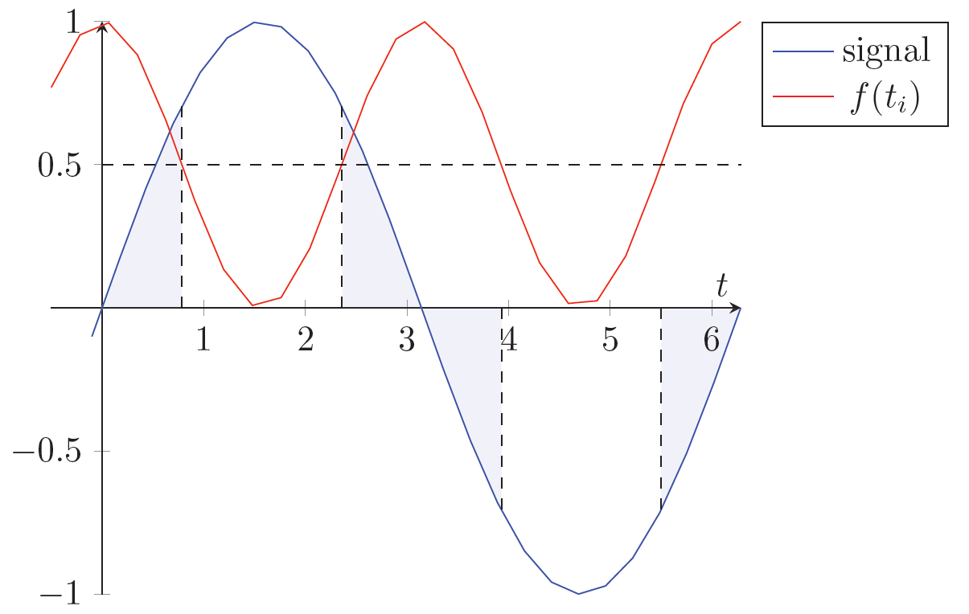
Problem statement
In first approximation, we fit the signal
MLE estimator of ω has variance

Slide 4
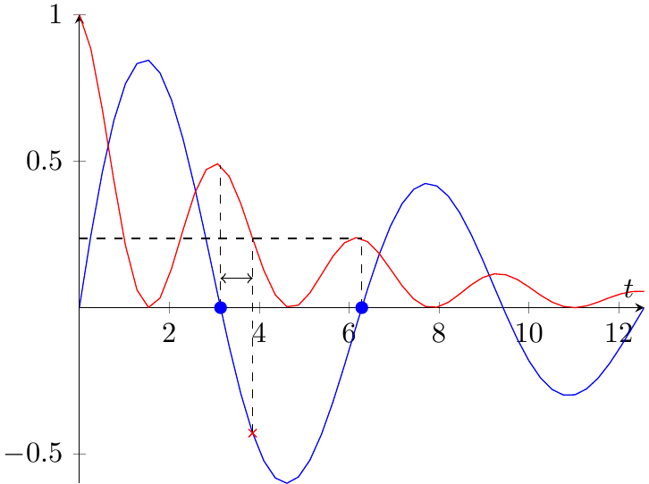
Angles
We want the sample as spread out in time, as possible
Spin tune decoherence
We want the measurements congregated around the nodes
Polarimetry counts per measurement
Spin tune decoherence
Notes:
We want the sample as spread out as possible, but the later sample points will be less informative than the earlier ones (decoherence).
We want the sample points as congregated around the nodes as possible, but a measurement takes a finite time to take, so we can fit only as much within a given time frame (unless we decrease the precision of a measurement; counts/measurement), and while we wait for the next node, the measurements’ informativity falls (decoherence)

Slide 5
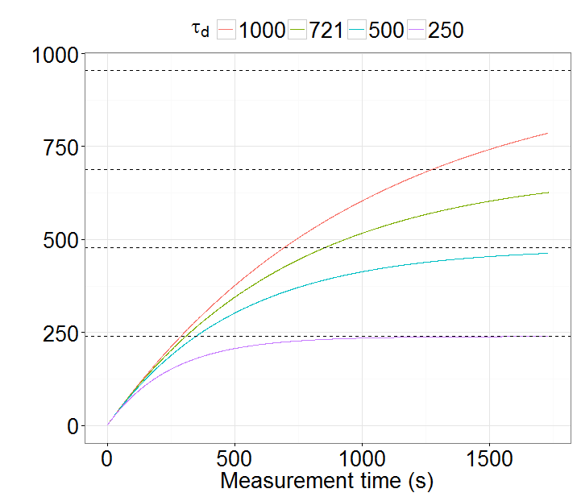
Spread
FI limit (%) | Reached (×τ_{d}) | SNR @3% error
95 | 3.0 | 1.7
90 | 2.3 | 3.3
70 | 1.2 | 10.0
50 | 0.7 | 16.5

Slide 6
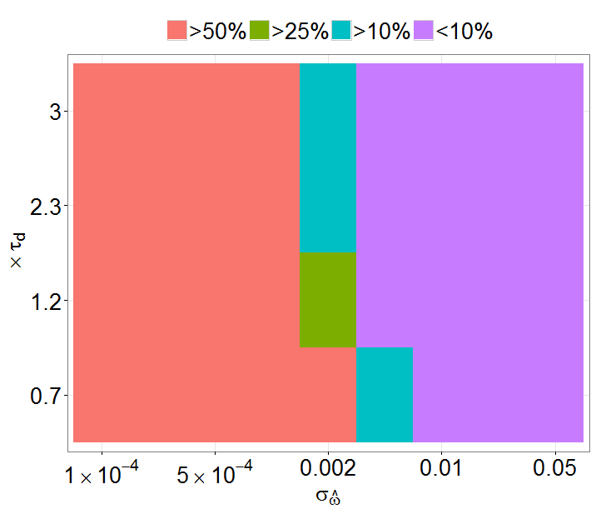
Modulation
Notes:
From Spread, compute the number of nodes
Measurement error as a function of the number of counts/measurement
From required standard error, Spread, and measurement error compute F
Express F via the number of nodes, measurements/node; F = n(meas/node) * fraction * x01; x01 is the mean value of fisher info in the 1st region, hence determined by the compaction factor. x01 = tau/2 + sin (w*tau)/(2*w), tau = measurement pulse uptime
Equate the latter two, can now compute tau; can compute the duty cycle

