Slide 1
Model of statistical errors in the search for the deuteron EDM in the storage ring
Alexander Aksentev for the JEDI collaboration

Slide 2
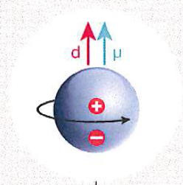
Electric Dipole Moment and Standard Model
In frame of SM among the not yet understood
phenomena are the reasons
for the violation of the CP symmetry.
But CP violation is the only known mechanism
that could explain the matter-antimatter
asymmetry found in Universe.
The electric dipole moments (EDM) of fundamental particles are excellent probes
of physics beyond the standard model (SM), e.g. SUSY,
since they allow for values within experimental reach whereas
the SM predictions are several orders below them.

Slide 3
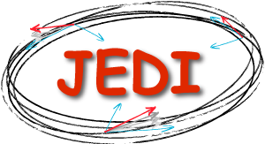
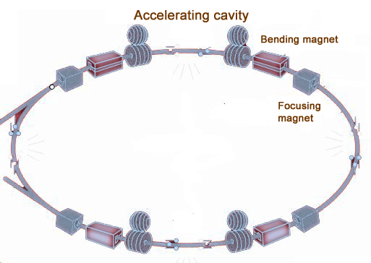

Storage Ring EDM measurement
Presumable EDM 10⁻²⁹ e⋅cm
EDM spin precession ≈ 10⁻⁹ red/sec
MDM spin precession ≈ 3 rad/sec
Solution: CW/CCW procedure
CW beam
CCW beam

Slide 4
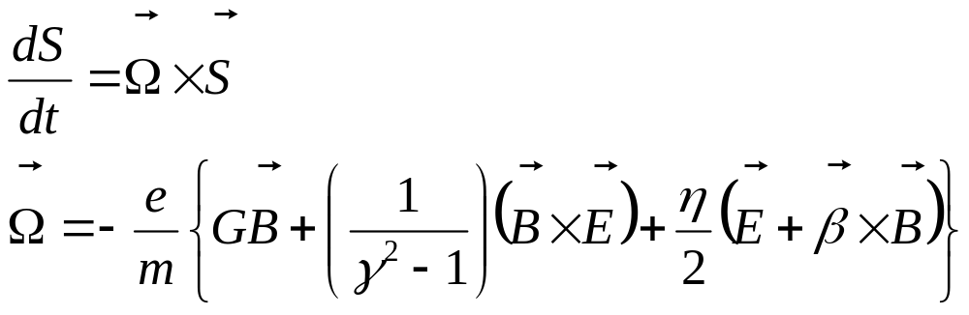
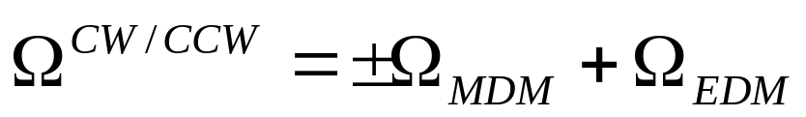

CW/CCW procedure
When put into an electromagnetic field, the particle spin begins to precess according to the T-BMT equation:
MDM
EDM
By measuring the beam’s polarization, we can determine the frequency
Comparing the CW vs CCW frequencies, determine

Slide 5
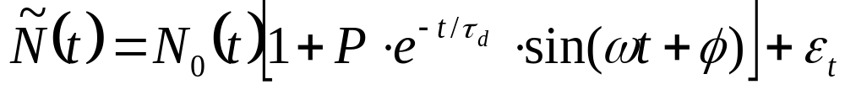
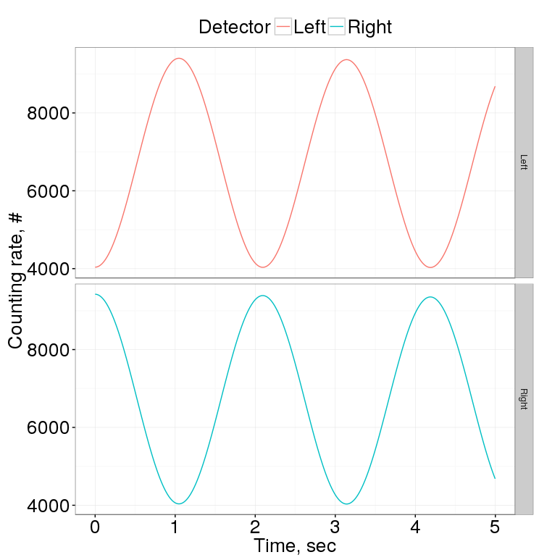
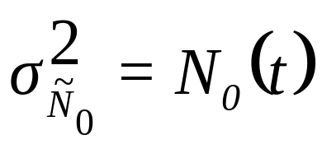
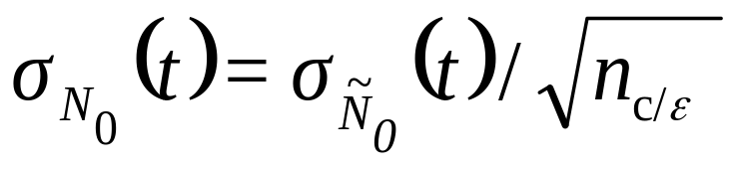
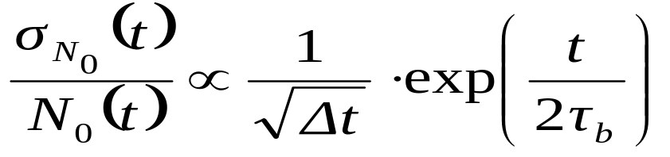
Detector counting rate
Number of counts is Poisson distributed, hence

Slide 6
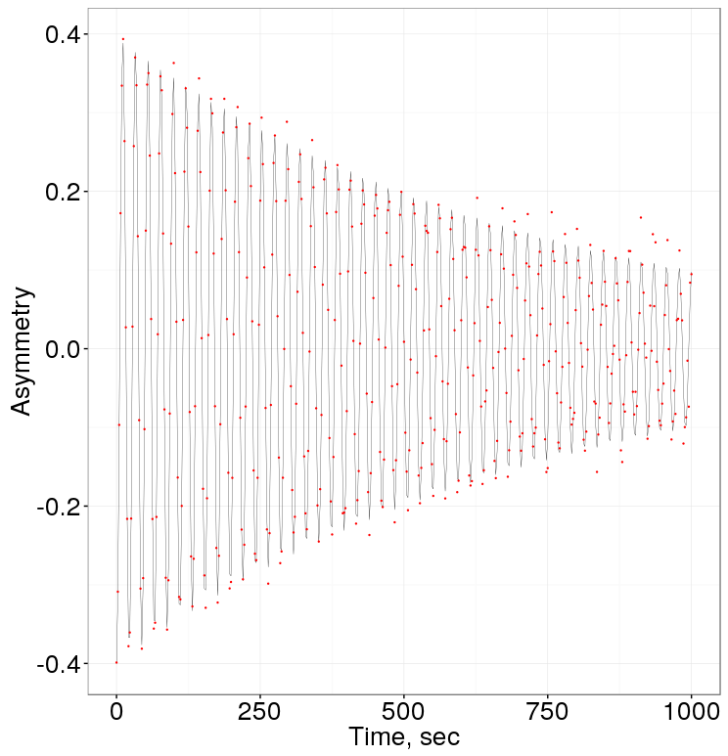
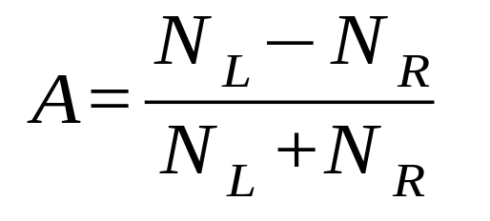
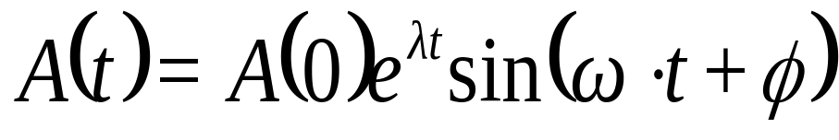
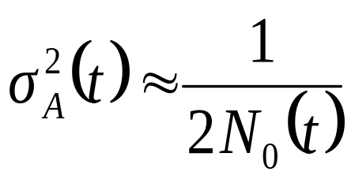
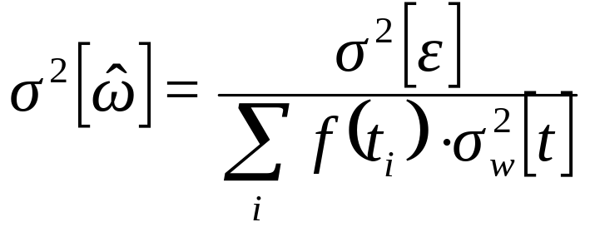
Cross section asymmetry
A measure of polarization
Definition:
Model:
Error:

Slide 7
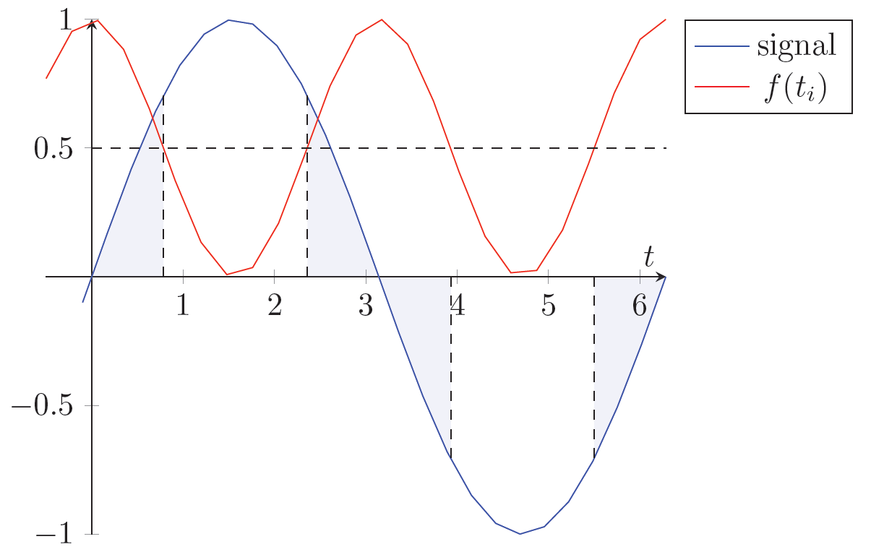
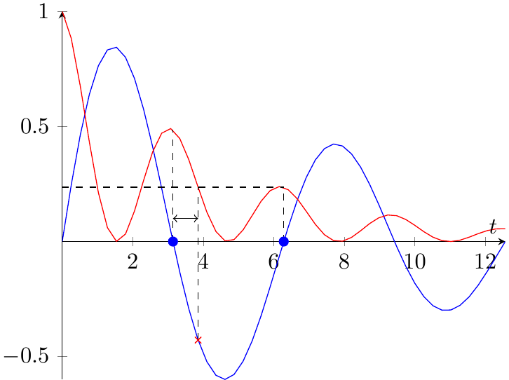
Limiting factors
Sample Fisher information can be increased by sampling during rapid change
Point Fisher information falls exponentially due to decoherence
Sampling | Fisher Info, a.u.
uniform | 1.00
50% modulation | 1.64
80% modulation | 1.94

Slide 8
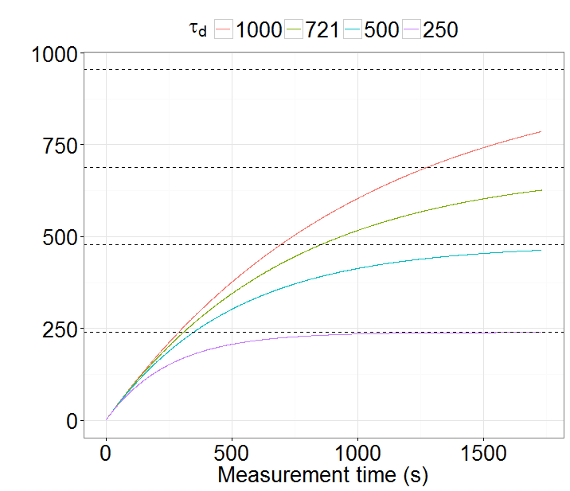
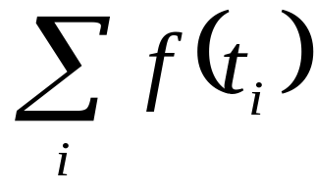
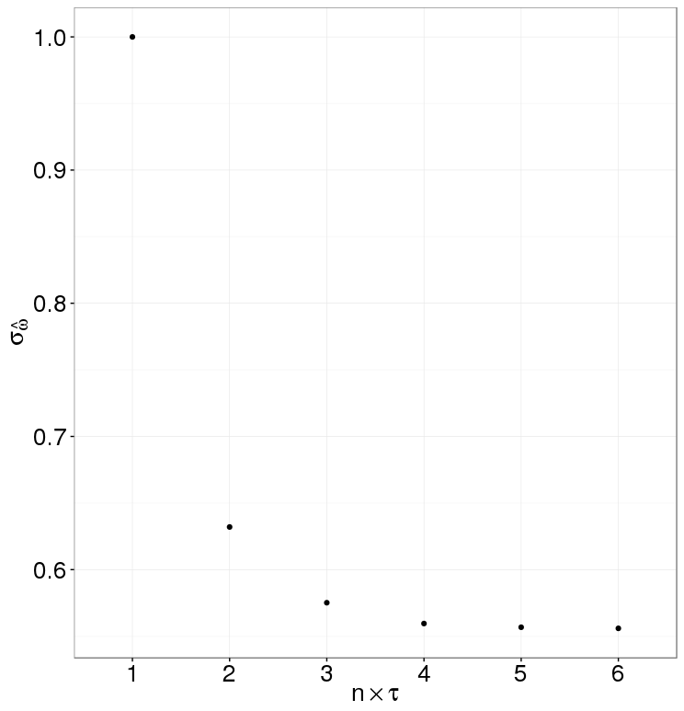
Time spread
FI limit (%) | By (×τ_{d}) | SNR@3% error
95 | 3.0 | 1.7
90 | 2.3 | 3.3
70 | 1.2 | 10.0

Slide 9
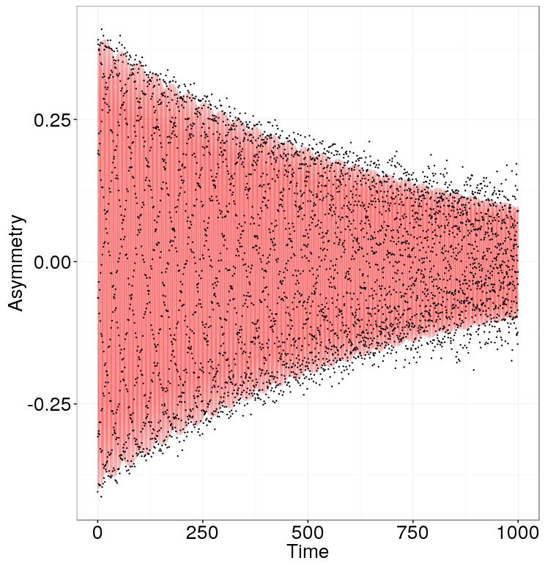
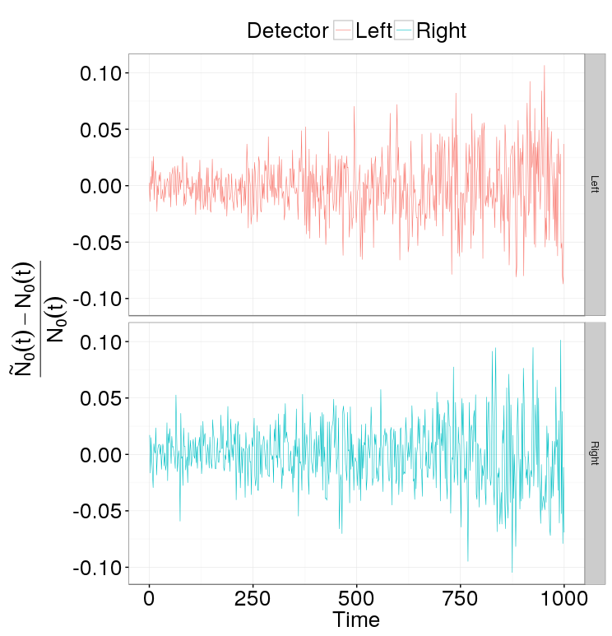
Simulation
Uniform sampling
Sample size equivalent to 2,000 events per 20 milliseconds for 1,000 seconds
Standard error 7.55⋅10⁻⁷ rad/sec
If ω is known down to 10⁻⁶, can improve the result by 30%

Slide 10
Conclusion
To measure the EDM on the order of 10⁻²⁹ e⋅cm we need a standard error of the frequency estimate at least as good as 10⁻⁹ rad/sec; 5⋅10⁻⁷ rad/sec in one fill is sufficient to produce 3⋅10⁻⁹ rad/sec in one year of measurement.

Slide 11
Thank You

