Slide 1

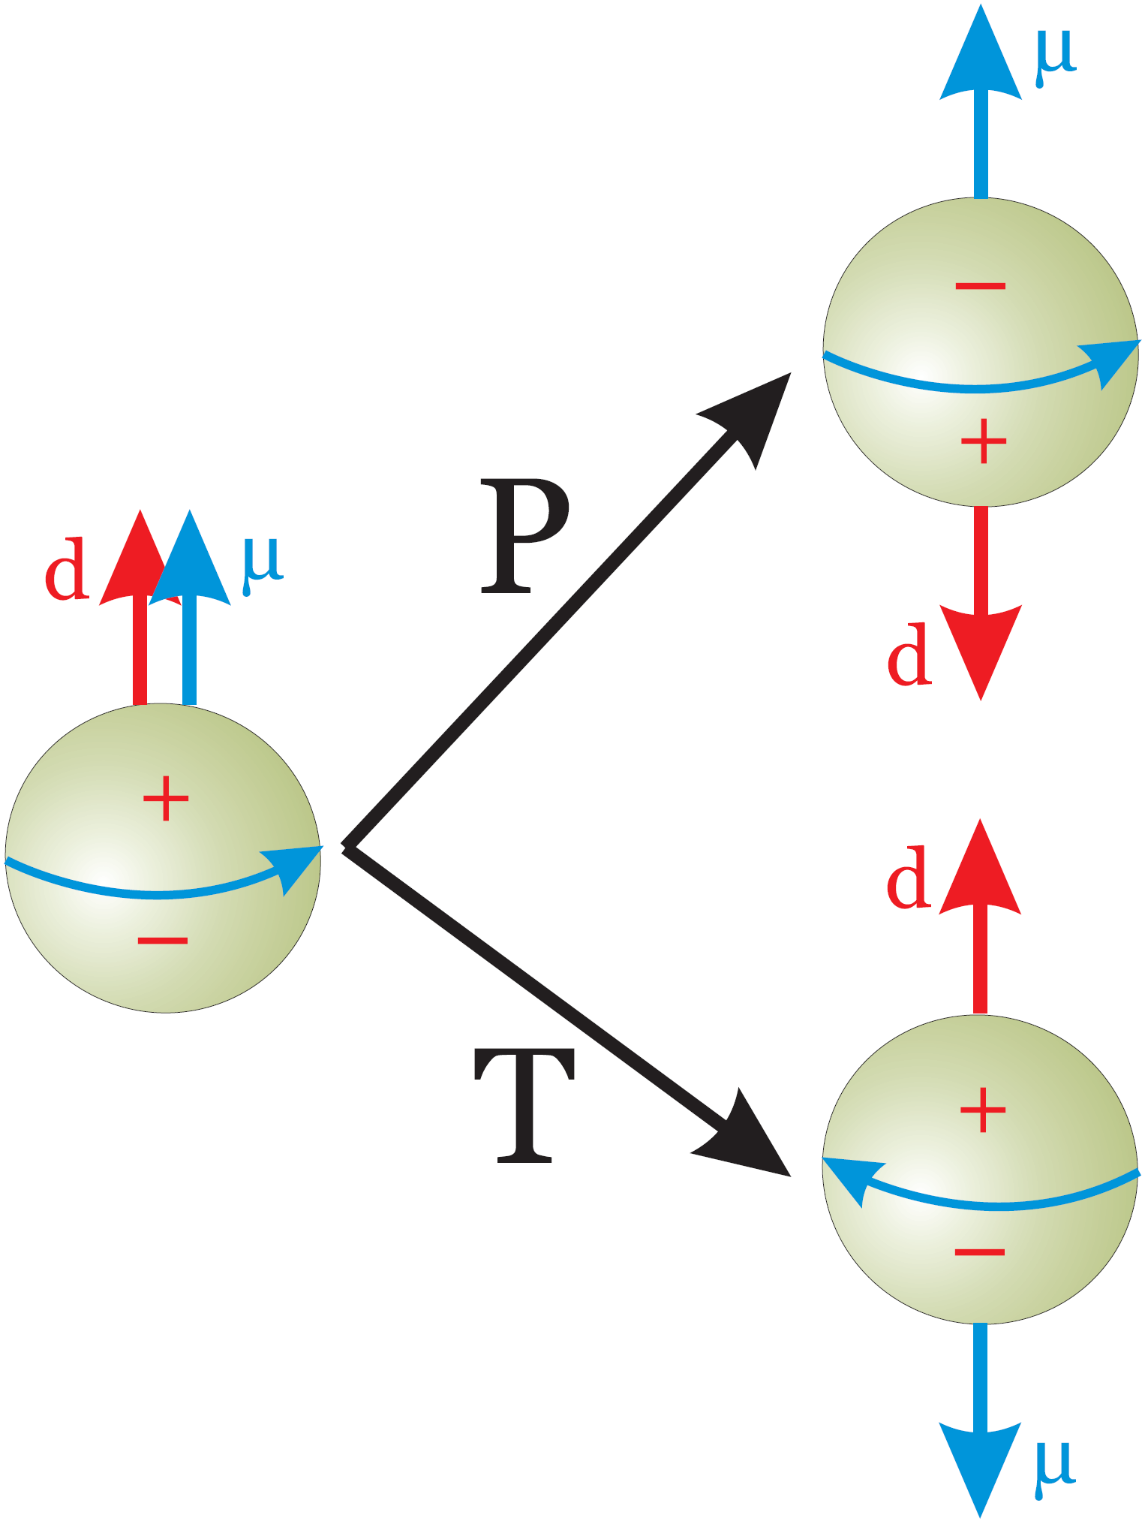
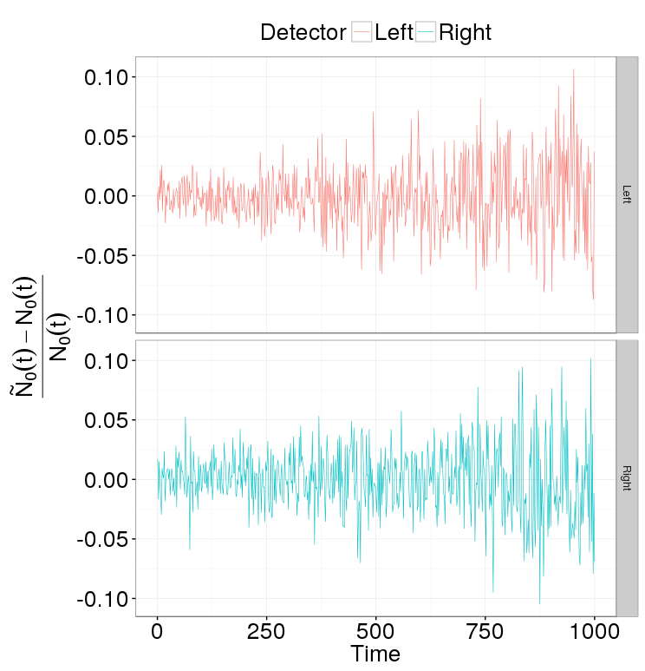
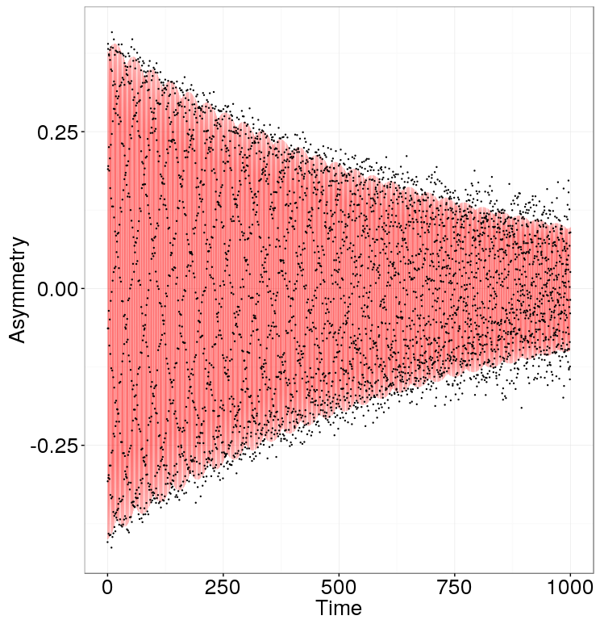
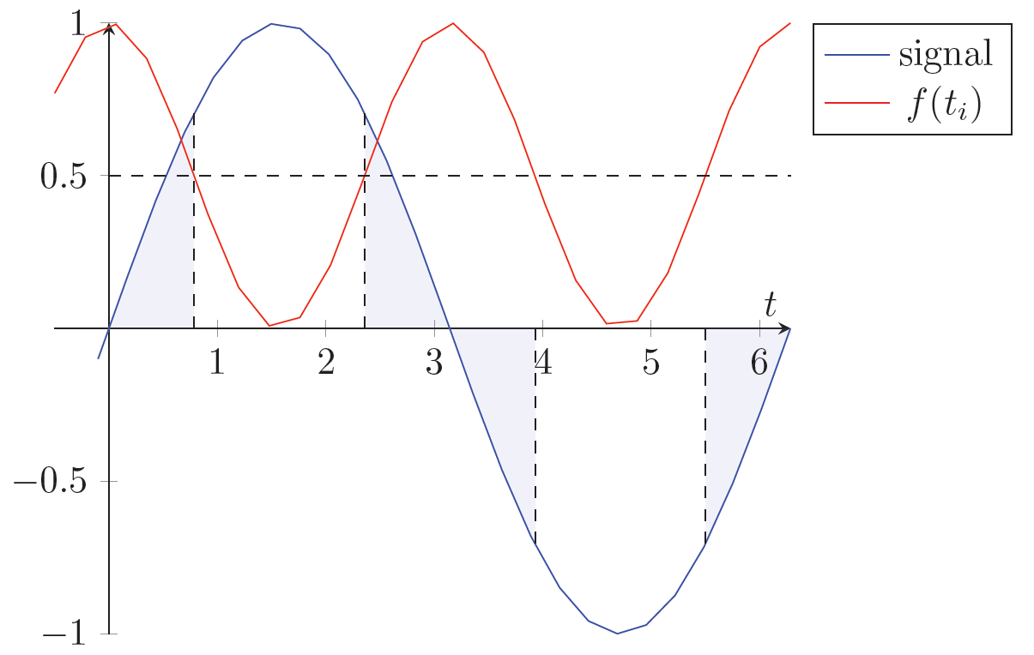
The amount of matter in the universe far exceeds that of antimatter
One of the Sakharov conditions for that is the violation of CP-symmetry
CP- and P-symmetry violations entail non-vanishing P- and T-violating Electric Dipole Moments
The SM can accommodate CP-violation, but the predicted baryogenesis rate is still far less than what one would expect; simultaneously, it predicts nucleon EDMs of magnitudes 5 orders less than the current upper bound for the neutron
Hence searches for particle EDMs promise to reveal physics beyond the SM
CW beam
CCW beam
MDM spin precession ≈ 3 rad/sec
EDM spin precession ≈ 10⁻⁹ rad/sec
Solution: CW/CCW procedure
Uniform sampling
Sample size equivalent to 2,000 events/20 millisec for 1000 sec
A measurement of the EDM on the order of 10⁻²⁹ e∙cm requires a standard error of the frequency estimate be better than 10⁻⁹ rad/sec
Modeling shows that such precision can be achieved in one year of measurement by the application of a modulated sampling strategy
Sampling | Fisher Info a.u.
uniform | 1.00
50% compaction | 1.64
80% compaction | 1.94
By modulating the sampling frequency we can potentially improve the precision of the frequency estimate by a factor of √2
An error on the order of 10⁻⁶ rad/sec is sufficient for a 30% improvement in precision

